Slide 1
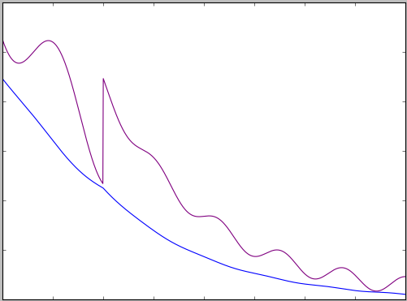
INCOMING
LIGHT
Local absorption
Poynting vector
n=1
n=3.3+0.3i
n=1
n=2.2+0.2i

Slide 2
Thin layers…
z>0
z=0
Interference here
z<0
Incoming
Reflected
|E(z)| ~ e^{+α|z|/2}
P (z) ~ e^{+α|z|}
|E(z)| ~ r e^{-α|z|/2}
P(z) ~ R e^{-α|z|}

Slide 3
Layer 3
v₃=t
w₃=0
Layer 2
“forwards”
“backwards”
v₂
w₂
Layer 1
v₁
w₁
+z direction
1
r
Layer 0

Slide 4
Layer 6 = Incoherent layer 3
W₃=0
V₃=T
Layer 5
= Stack 1
Layer 4 = Incoherent layer 2
W₂
V₂
Layers 2 and 3
= Stack 0
Layer 1 = Incoherent layer 1
W₁
V₁
1
R
Layer 0 = Incoherent layer 0

