Slide 1

Paper ID CHCS 1065
First International Conference on Advances in Electrical, Computing, Communications and Sustainable Technologies (IEEE ICAECT 2021)
Organized by
Shri Shankaracharya Technical Campus (SSTC), Bhilai, Chhattisgarh
A Presentation on
"Data Analysis of Betelnut’s selling Dataset Using Tableau“
Co-Authors:
Vikas Rahate

Slide 2
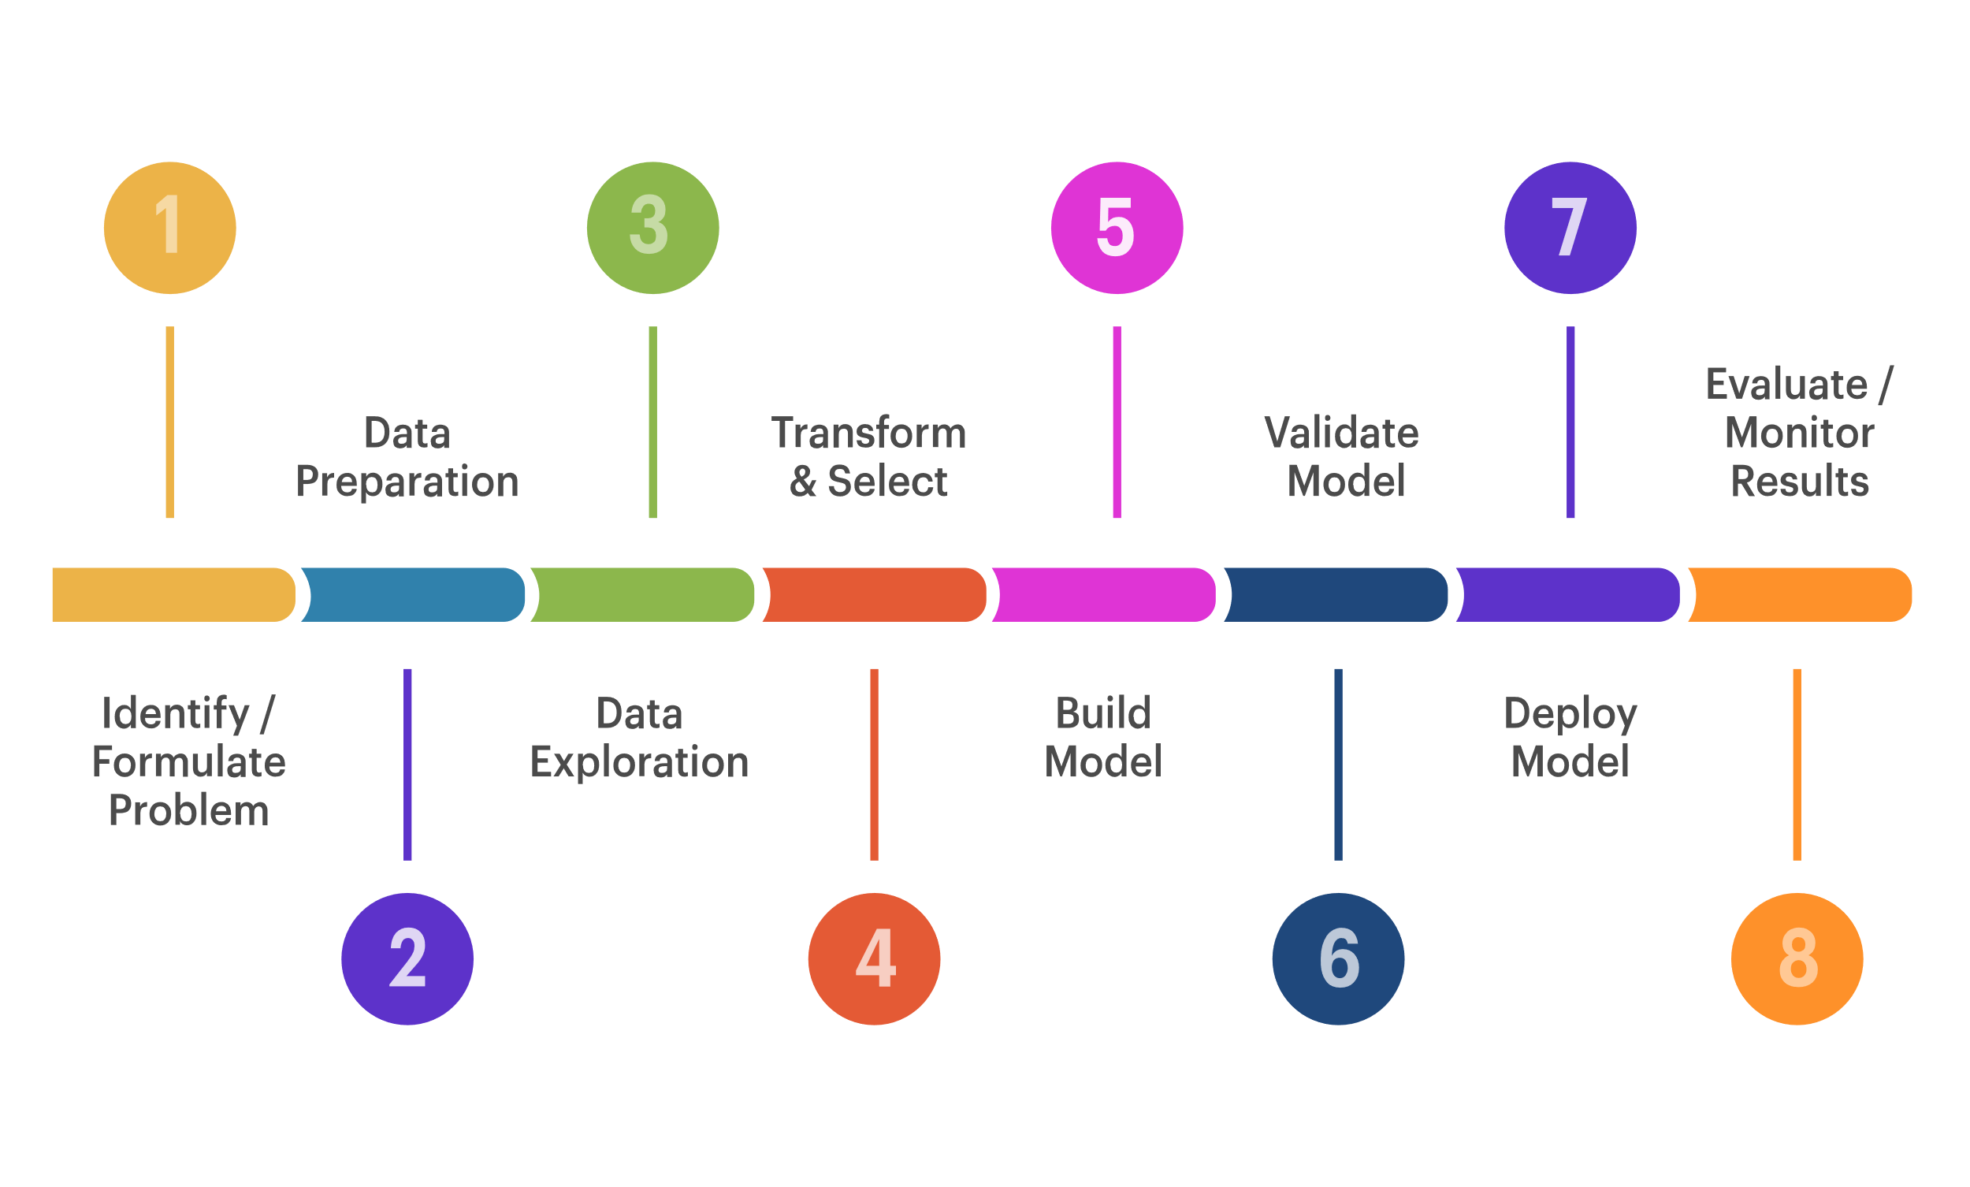
Data Analysis and Visualization, Interpretation using Tableau

Slide 3
Contant:
Introduction
Objective
Process of Data Analysis
Data Analysis Cycle
Introduction of Areca nut tree
Areca nut Varieties / Areca nut Cultivars
Requirements for Growing Areca nut
Some Factors for Growing Areca nuts
Irrigation in Growing Areca nut
Implementation and Results
References

Slide 4
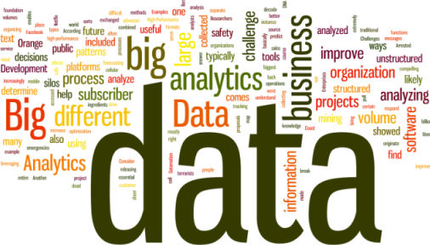
Introduction to Data Analysis Data analysis is a process used by researchers for reducing data to a story and interpreting it to derive insights. The data analysis process helps in reducing a large chunk of data into smaller fragments, which makes sense. It’s process of evaluating data using analytical and logical reasoning to examine each component of the data provided so as to get a perfect or semiperfect interpretation towards a trend.

Slide 5
Our Objective:
Our objective for the given paper is to analyse the data and answer some general questions like plotting graph and statistical data such that we could interpret some basic facts and views about our PRODUCTION. This paper was created with a motto to demonstrate a clear idea about data analytics on a simple complex and larger dataset of Betelnut’s selling across India in the current year 2020. The methodology explained here strictly focuses on Data Exploration, Model Development, and Data Visualization with basic knowledge of geography, culture, and tradition of our motherland India. Implementation has been done with the use of Tableau software. We have implemented this idea with a vision to give a clear idea of the use of data analytics at the local level in the country.

Slide 6
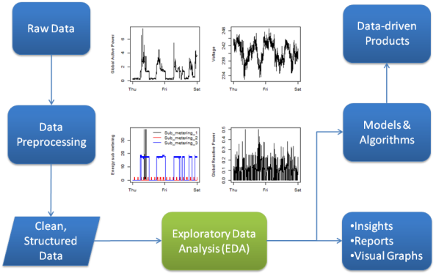
Process
Following are the objectives of our project:-
1. To analyse the raw data before cleaning.
2. To clean the raw data given using various norms and aspects provided.
Data Analysis Process

Slide 7
Data Analysis Cycle
Data Gathering
Quality Checking
Data Cleaning
Structure of Data
Modelling the Data
Getting Interpreted
Concluding towards Result of problem domain and our Analysis
Exploratory Data Analysis
Raw Data Collected
Data is Proceed
Clean Database
Model & Algorithm
Data Product
Communicate Visualize Report
Data Analysis Cycle

Slide 8

1. Data Gathering : Its process of collecting the raw data which is to be processed further.
We are already having Betelnut’s dataset for analysis in the form Excel sheet.

Slide 9
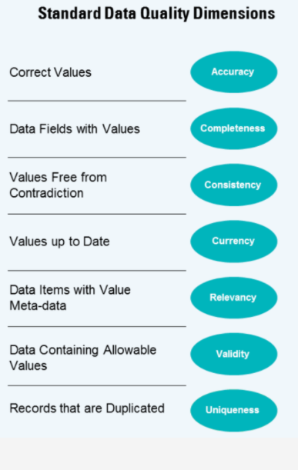
2. Quality Checking: Analysing what kind of data is given and whether all the attributes are admissible or not. Data Quality plays a vital role in development of analytical model such that the result obtained here is uniform and must have maximum variety with moderate variance towards the central values so that the fluctuations and errors must be minimised to reach much nearer to accuracy.

Slide 10
3. Data Cleaning: Data cleaning refers to removal of invalid and non usable data from the dataset. Data cleaning is most probably main factor responsible for the verge of accuracy.
Irrelevant Data
Incomplete Data
Incomplete Data
Incorrect Data
Incorrect Data
Data Cleaning

Slide 11
4. Structuring of Data: Arranging of data in format such that its easily modified and must provide fast access. The data in our model is already structured in form of Excel Sheet.
“Structured data is essential because it becomes easier to search and is easily accessible before modelling the dataset and whenever the error is meant we can easily reach the place to correct the errors.”

Slide 12
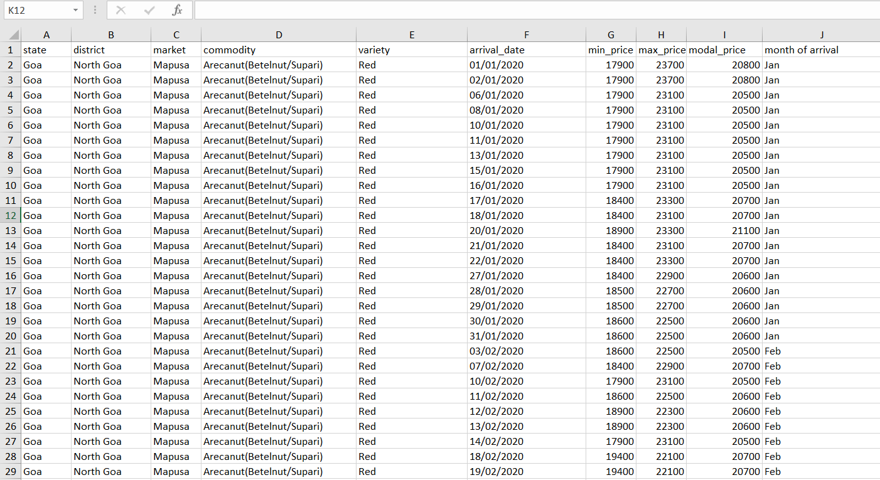
Structured and Arranged data

Slide 13
5. Modelling the Data using TABLEAU: Tableau is a Business Intelligence tool for visually analyzing the data. The analysis of data objects and their relationships to other data objects.
Data modeling is often the first step in database design and object-oriented programming as the designers first create a conceptual model of how data items relate to each other.

Slide 14
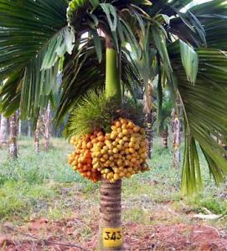
Introduction of Areca nut tree
Areca nut is also known by Betel nut (Chewing nut) or Supari. Areca nut is considered as a cash crop and Areca nut is considered as second most cash crop after Coconut. Areca nut is grown on a large scale in India since Areca nut crop has excellent commercial value in India. Areca nut palms can grow different heights depending on environmental conditions and variety. They can even reach up to 30 meters. Areca nut is said to be originated in India and South East countries. When it comes to world production and consumption of Arecanut, India occupies the first place. When it comes to Areca nut plant description, It is a tall stemmed tree can reach a height up to 90 feet. Apart from using in veterinary medicines and Ayurveda, its by-products are being used in commercial leather processing and paper manufacturing.
Family name of Areca nut: O. Palmacea.
Botanical/Scientific Name of Areca Nut: Areca catechu.
Common Names: Supari, Pinang, and Betal nut.
Dwarf Areca nut Tree

Slide 15
Areca nut Varieties / Areca nut Cultivars
VTLAH-1 (Vittal Areca Hybrid-1):
This varity is hybrid between Hirehalli Dwarf and Sumangala.
These tree are dwarf type with reduced canopy. They also have sturdy stem.
These cultivars have partially drooping crown. These crowns have well spread leaves.
When it comes to nut yield, it is considered as a moderate yielder. However, you can expect early stabilization in nut yield.
They produce medium sized oval, yellow to orange nuts.
These trees can yield abiout : 5200 kg/ha.
Expect the recovery over fresh nut: 27%.
In case of seed production, artificial crossing is advised between Hirehalli Dwarf and Sumangala.
VTL-12 (Swarnamangala):
These trees bear regularly and considerd as a consistent yielder.
This variety of Arecanut trees are semi-tall to tall with sturdy atem. They have shorter internodes.
You can expect an average number of bunches/palm/year : 4.
This variety nuts will be orange to deep yellow for riped ones.
The nuts shape is oblong to round and bold.
Usually, these trees start bearing by fourth year after planting.
You can obtain a potential yield of 6.5 kg chali/palm/year.
Expect an average yield of 4 kg chali/palm/year.
They have high recovery with 27% of chali from fresh nuts.

Slide 16
Requirements for Growing Areca nut
Climate:
Areca nut trees thrives best in a temperature range of 15ºC and 37ºC and temperatures below 10ºC and above 40ºC will hamper the growth of the palm trees. These trees require an minimum annual rainfall of 800 mm. In areas with low annual rainfall can use drip irrigation to meet the water requirement. Arecanut palms can be grown up to an altitude of more than 1000 meters of mean sea level.
Soil:
Though Areca nut is grown on wide range of soils, The gravelly laterite soils of red clay type is best suited for its cultivation. You can grow these treees in rich loamy soils as well. Avoid brackish , sticky clay, sandy, calcareous and alluvial soils as they are not ideal for growing areca nut.

Slide 17
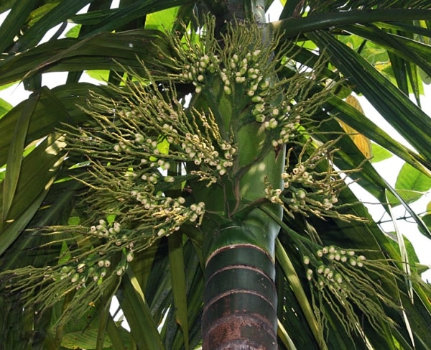
Some Factors for Growing Areca nuts
Site Selection and Layout Required for Growing Areca nut
Season, Spacing and Transplanting in Growing Areca nut
Shading and Drainage in Growing Areca nut
Manures and Fertilizers in Growing Areca nut
Areca Palm

Slide 18
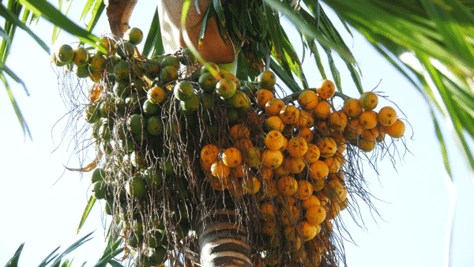
Irrigation in Growing Areca nut
Areca nut plams are not drought resistant. As, these palms can not withstand drough for long time, you should provide irrigation depending in moisture level of the soil. You must avoid water stress especillay during their growth period. The frequency of irrigation depends in soil type, and cliamte. The ideal frequency of irrigation is 5 to 9 days. Each palm require 200 to 250 liters of water. In water scarcity areas and hot summers, drip irigation and sprinkeler irrigation methods are preferred.
Irrigation for Areca nut tree

Slide 19
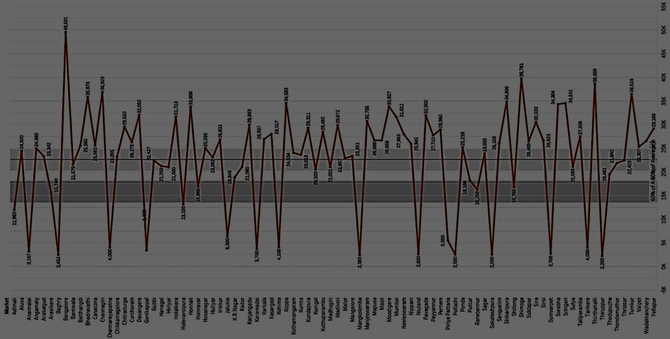
Use and Implementation: Tableau is a powerful and fastest growing data visualization tool used in the Business Intelligence Industry.
It helps in simplifying raw data into the very easily understandable format. Data analysis is very fast with.
Tableau and the visualizations created are in the form of dashboards and worksheets.
Line graph between markets versus average model price.

Slide 20
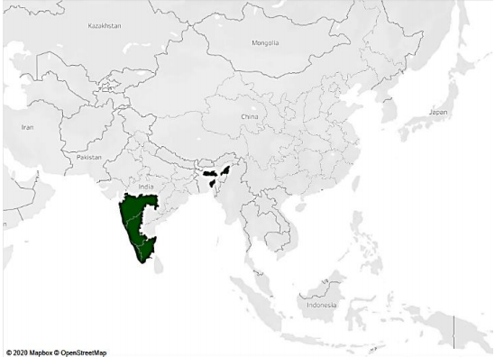
6. Analysis and Interpreted Results: After analyzing the data, we have got here are some interpretations which are clear indicator of what data is conveying on the basis of which we are going to make predictions and estimations for near future.
1. Betelnut mostly grows in tropical and subtropical regions. It is a profitable plantation crop that is commercialized for maximizing returns. The main reason for cultivation in the above-shaded regions is well-distributed rainfall and well-drained soil with a low water table. The above regions mostly southern India and northeastern part are having laterite, loamy (red), and alluvial soil, which is suitable for its plantation. The temperature range required is usually 15°C-37°C.
Indication of geographical regions covered by Betelnut cultivation in the country.

Slide 21
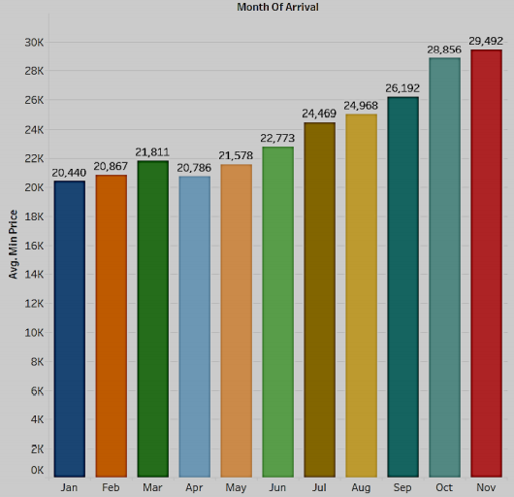
2. It could be concluded that the average maximum price is highest for the month of November with an average difference of Rs 9693 between the starting month of January and the end of November, which is a huge value for an average farmer in India.
Bar graph of Month of arrival versus average maximum price

Slide 22
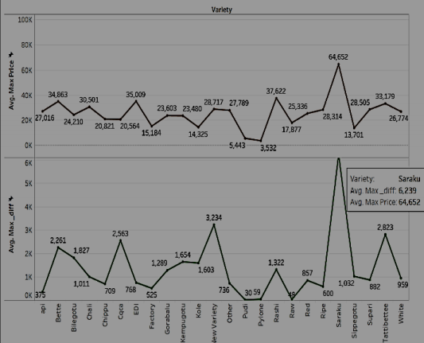
3. We can interpret that raw and pudi variety Betelnut is having least maximum price difference and highest profit is obtained from it as far as other varieties are concerned so this a profitable variety because of least deviation from the median value i.e. 985, with reference to modal price. So farming of raw and pudi must be emphasized for cultivation to maximize the profit whereas suruku must be avoided due to less profit and demand.
Line graph between average maximum price and average of maximum differences

Slide 23
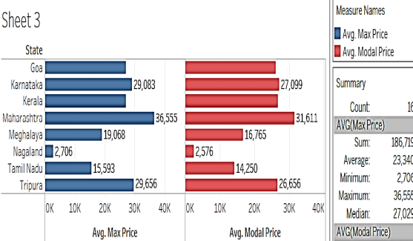
4. It could be estimated that Maharashtra is the state with the highest average market value for Betelnuts. So it’s advisable to farmers around Maharashtra that it is the state with the highest profit value. Also, it is having a higher crop rate than other states with an average difference of Rs 13,215.
Bar graph between average maximum price and average modal price
Month vs Profit plot

Slide 24
References
Baader F, Sattler U, an overview of Tableau Algorithm for Description Logic
Stolte C., Tang D., and Hanrahan, P. 2008. Polaris: a system for query, analysis, and visualization of multidimensional databases. Communication. ACM 51, 11 (Nov. 2008), 75--84.
Government of India, National Informatics Centre, DMI
Akhtar, Nikhat & Tabassum, Nazia & Perwej, Dr. Asif & Perwej, Dr. Yusuf. (2020). Data analytics and visualization using Tableau utilitarian for COVID-19 (Coronavirus). Global Journal of Engineering and Technology Advances. Volume 3. Page 28-50. 10.30574/gjeta.2020.3.2.0029.
Grolemund, G. and Wickham, H. (2014), A Cognitive Interpretation of Data Analysis. International Statistical Review, 82: 184-204.
Susan Spiggle, Analysis and Interpretation of Qualitative Data in Consumer Research, Journal of Consumer Research, Volume 21, Issue 3, December 1994, Pages 491–503,
Jamie Hoelscher, Amanda Mortimer, Using Tableau to visualize data and drive decision-making, Journal of Accounting Education, Volume 44,2018, Pages 49-59, ISSN 0748-5751,
Faten Hamad, Hussam Fakhuri, Sinaria Abdel Jabbar. (2020) Big Data Opportunities and Challenges for Analytics Strategies in Jordanian Academic Libraries. New Review of Academic Librarianship 0:0, pages 1-24.

Slide 25
References
Lengere, Monica, 2020/02/25, CHAPTER FOUR DATA ANALYSIS INTERPRETATION 4.1 Data analysis, Presentation and Interpretation Plan
Mons, Barend. (2018). Data cycle step 6: Data analysis, interpretation. 10.1201/9781315380711-7. Data Analysis and Visualization of Bicycle Dataset using Tableau Department of Computer Science and Engineering, LNCT Indore 45
Sarah Anne Murphy (2013) Data Visualization and Rapid Analytics: Applying Tableau Desktop to Support Library Decision-Making, Journal of Web Librarianship, 7:4, 465- 476, DOI: 10.1080/19322909.2013.825148
Mark Eaton. (2017) Seeing Library Data: A Prototype Data Visualization Application for Librarians. Journal of Web Librarianship 11:1, pages 69-78.
Suresh K. Peddoju, Himanshu Upadhyay. 2020. Evaluation of IoT Data Visualization Tools and Techniques. Data Visualization, pages 115-139.
Chapman, Joyce and Lown, Cory. 2010. Practical Ways to Promote and Support Collaborative Data Analysis Projects. code4lib,12: 1–10.
Tableau Software. 2020.3 Technical Specifications— Tableau Desktop. Accessed: November 2020.
Few, Stephen. 2009a. Now You See It: Simple Visualization Techniques for Quantitative Analysis, Oakland, CA: Analytics Press. [Google Scholar]

Slide 26
ANY QUESTIONS?

Slide 27
Thank You!

