Slide 1
CHCS 1065
IEEE International Conference on Advances in Electrical, Computing, Communications and Sustainable Technologies-2021.
Implementation & Analysis of Betelnut’s Marketing using Tableau
Guided By: Presented By:
Er. Khushboo Sawant Badal Chouhan(0820CS181018)
Er. Seema Narvare Manisha Yadav(0820CS181034)
Vikas Rahate(0820CS181053)

Slide 2
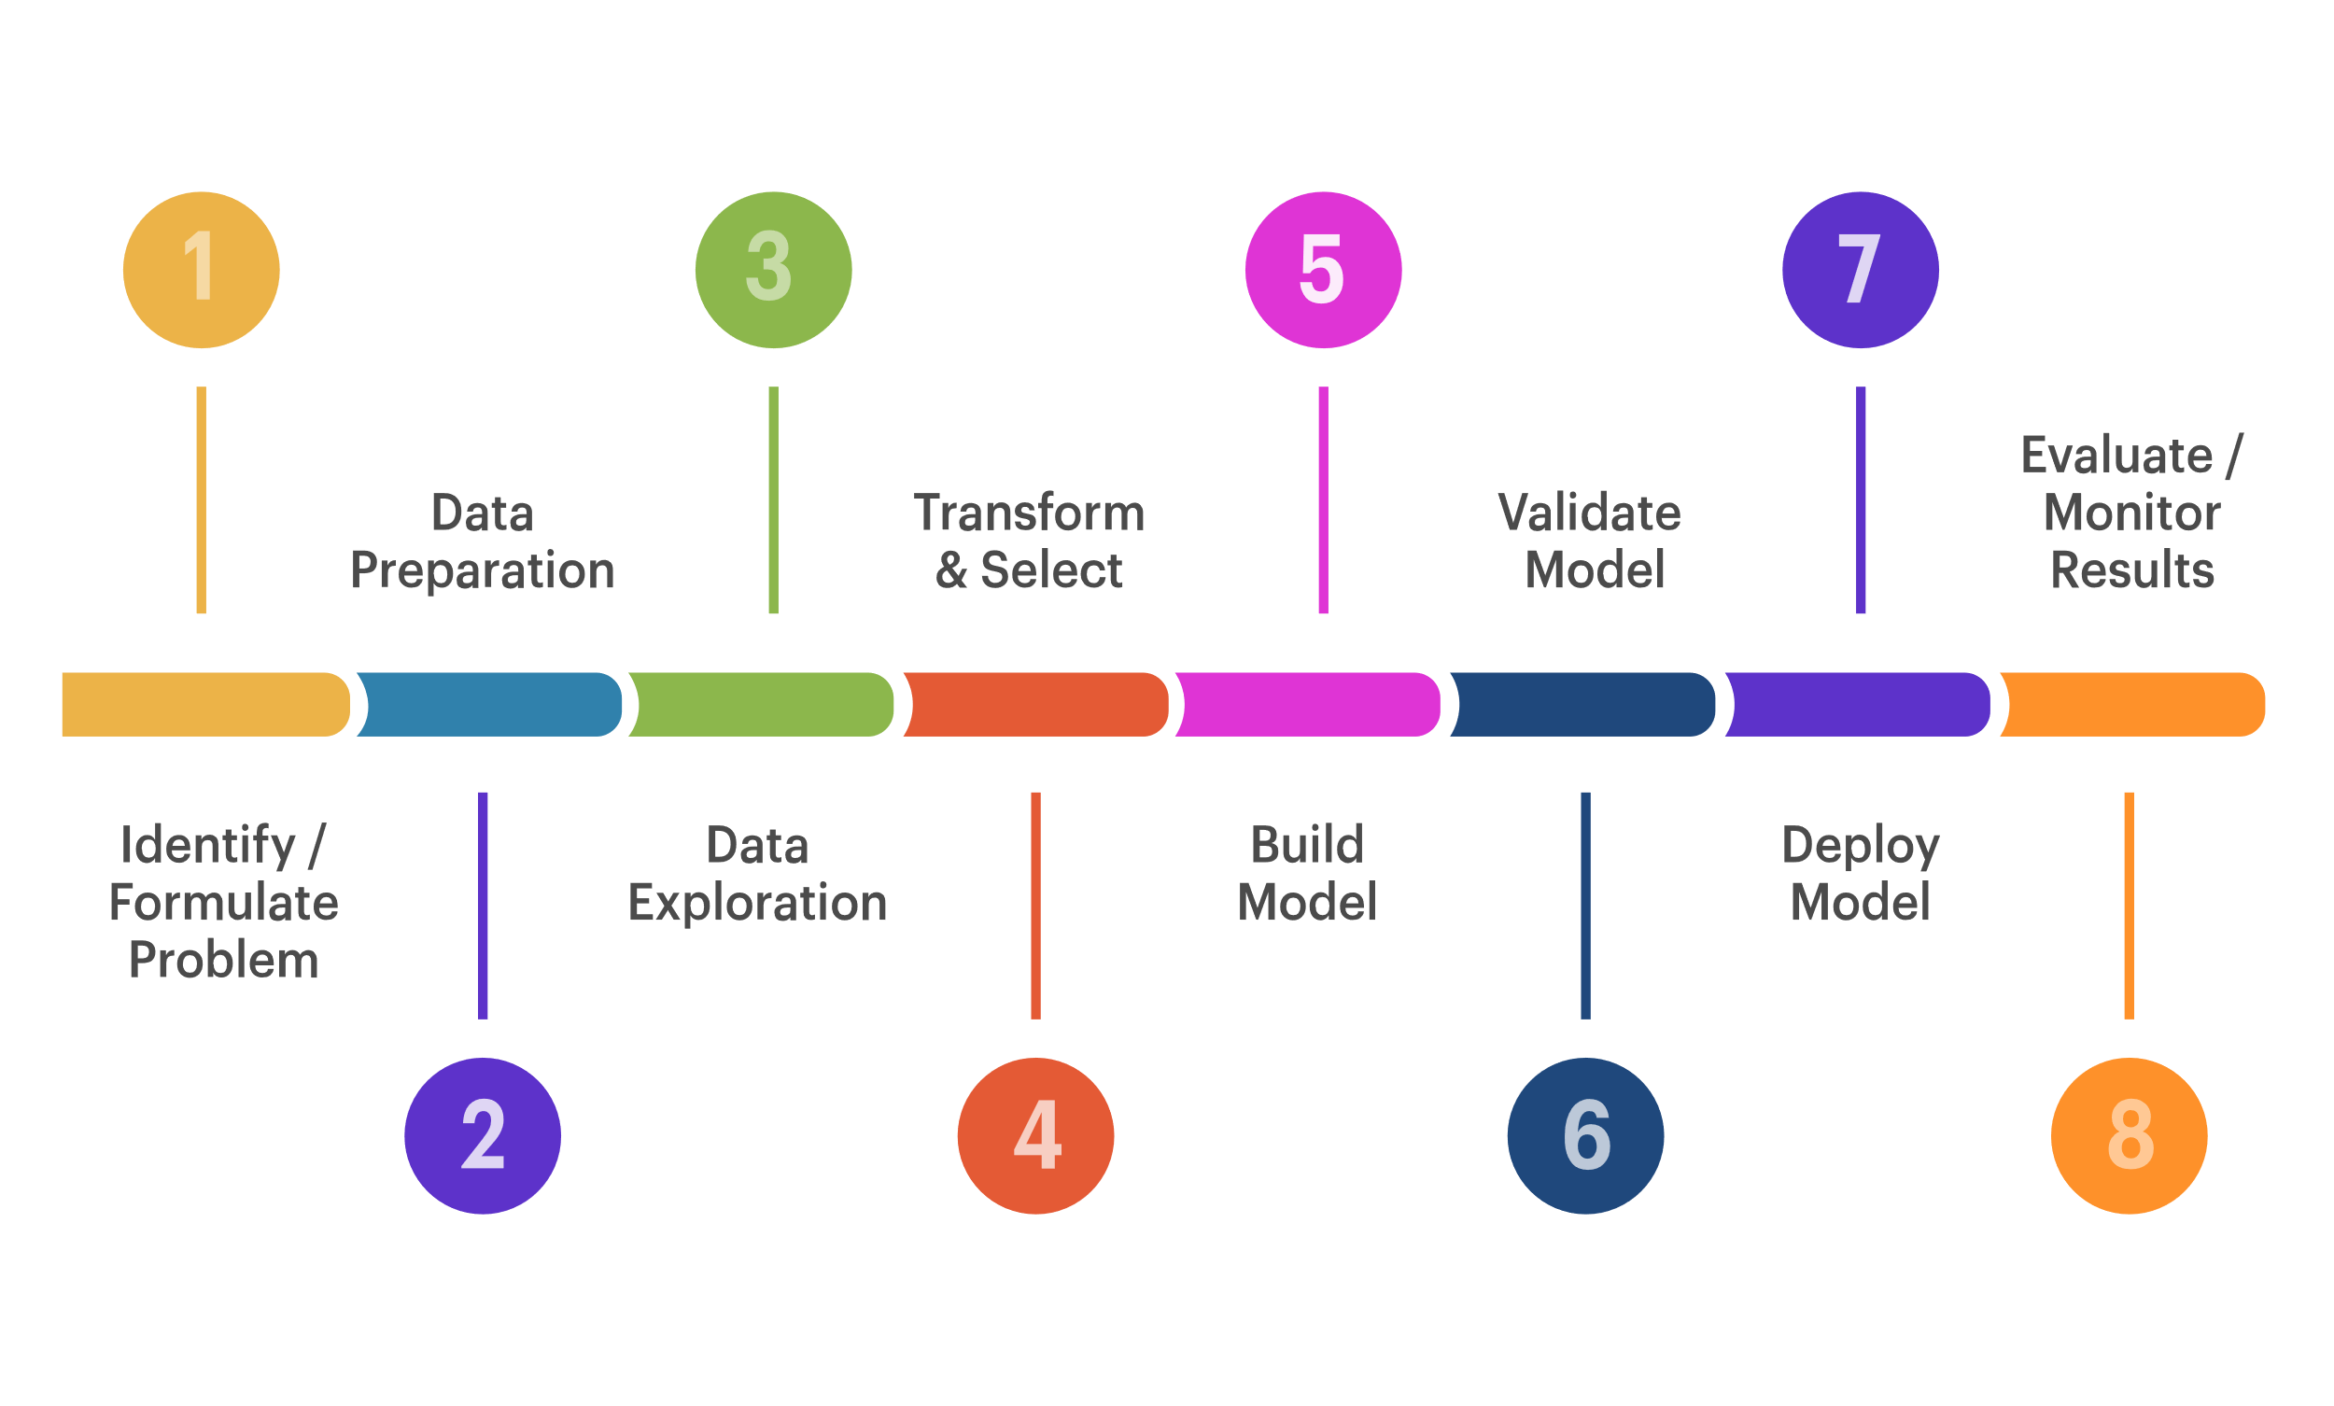
Data Analysis and Visualization, Interpretation using Tableau

Slide 3
Contents:
Abstract
Related Work
Introduction
Problem Domain
Introduction of Betelnuts
Factors responsible for growing Betelnuts
Process of Data Analysis
Dataset Attributes
Tableau Description
Implementation and Result Discussion
References

Slide 4
Abstract:
The key work done here is emphasised on selling of Betelnuts and identity the trends in the given dataset or record set .
The trends obtained mainly provides us interpretations which the data
wanted to convey or indicate.
The problem here is mainly applying Data Analysis at local level in various fields especially Agricultural field where more work has to be done .
The research work aims to compress the large real-time dataset into their insights with proper procedure.
It’s a clear demonstration of Data Analysis process with proper results and their interpretations which we have estimated based on the dataset.
This paper was created with a motto to demonstrate a clear idea about data analytics on a simple but larger dataset of Betelnuts selling across the country in current year 2020.

Slide 5
Related Work:
Baeder F. et al. [1] discussed Description logic is a family of knowledge representation formalism that goes down from semantic networks and frames via the system Kl-one. During the last decade, it has been shown that the important reasoning problems in a variety of description logic can be distinguished using tableau-like algorithms.
Akhtar et al [4] have investigated Data analytics and visualization using Tableau utilitarian for COVID-19 (Coronavirus). A huge opportunity provided to use this data and to turn these opportunities into reality. At this time spread of COVID-19, peoples must be made available with reliable, trustworthy information. At this time tableau played an important role.
In April 2014, Grolemund G. and Wickham H. [5] investigated “A Cognitive Interpretation in Data Analysis”, the current paper has explained the data analysis process in the form of a scientific model. In this, it has been argued that data analysis is primarily a procedure to develop understanding because it includes several processes.
In 1994, Susan Spiggle [6] has investigated on Analysis and Interpretation of Qualitative Data in Consumer Research and explained the work done by him in the field of qualitative data analysis.

Slide 6
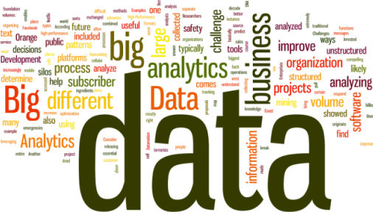
Introduction to Data Analysis Data analysis is a process used for reducing data to a story and interpreting and modelling it to derive insights. The data analysis process helps in reducing a large chunk of data into smaller fragments, which makes sense. It’s process of evaluation of data using analytical and logical reasoning to examine each component of the data provided , so as to get a perfect or semiperfect interpretation towards obtained trend.

Slide 7
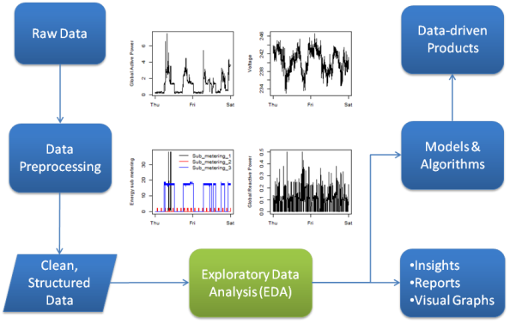
Process of Data Analysis
Following are the objectives of our project:-
1. To analyse the raw data before cleaning.
2. To clean the raw data given using various norms and aspects provided.
Data Analysis Process

Slide 8
Data Analysis Cycle
Data Gathering
Quality Checking
Data Cleaning
Structure of Data
Modelling the Data
Getting Interpreted
Concluding towards Result of problem domain and our Analysis
Exploratory Data Analysis
Raw Data Collected
Data is Proceed
Clean Database
Model & Algorithm
Data Product
Communicate Visualize Report
Data Analysis Cycle

Slide 9
Data Cleaning: Data cleaning refers to removal of invalid and non usable data from the dataset. Data cleaning is most probably main factor responsible for the verge of accuracy.
Irrelevant Data
Incomplete Data
Incomplete Data
Incorrect Data
Incorrect Data
Data Cleaning

Slide 10
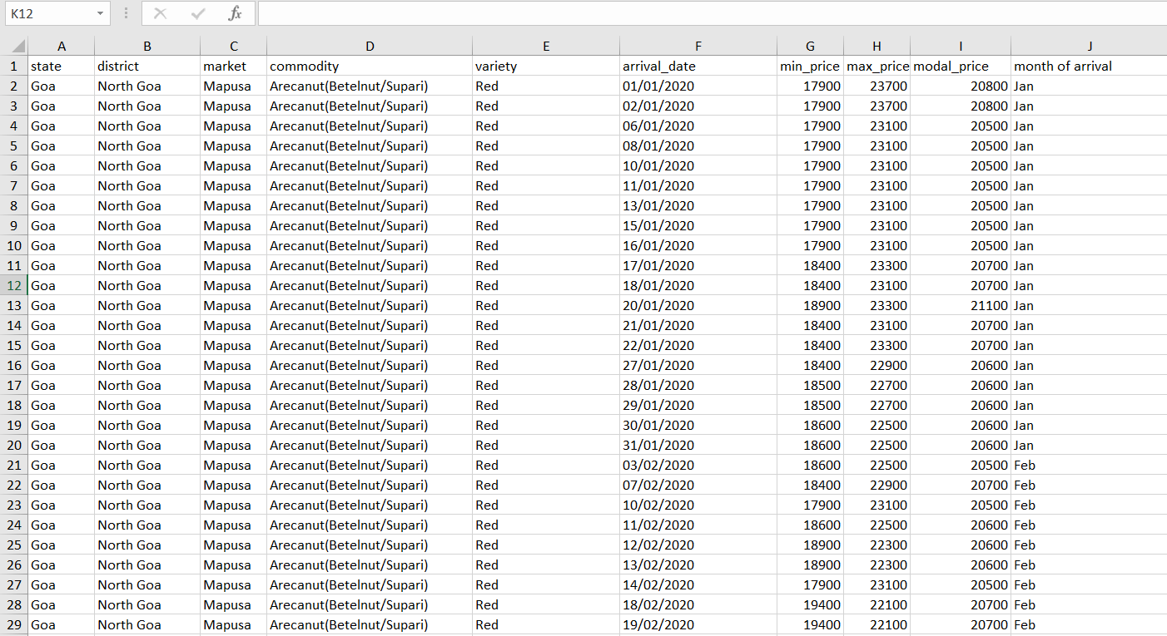
Structured and Arranged data

Slide 11
5. Modelling the Data using TABLEAU:
Tableau is a Business Intelligence tool for visually analyzing the data. The analysis of data objects and their relationships to other data objects.
Data modeling is often the first step in database design and object-oriented programming as the designers first create a conceptual model of how data items relate to each other.

Slide 12
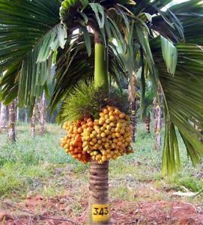
Introduction of Areca nut tree
Areca nut is also known by Betel nut (Chewing nut) or Supari. Areca nut is considered as a cash crop and Areca nut is considered as second most cash crop after Coconut. Areca nut is grown on a large scale in India since Areca nut crop has excellent commercial value in India. Areca nut palms can grow different heights depending on environmental conditions and variety. They can even reach up to 30 meters. Areca nut is said to be originated in India and South East countries. When it comes to world production and consumption of Arecanut, India occupies the first place. When it comes to Areca nut plant description, It is a tall stemmed tree can reach a height up to 90 feet. Apart from using in veterinary medicines and Ayurveda, its by-products are being used in commercial leather processing and paper manufacturing.
Family name of Areca nut: O. Palmacea.
Botanical/Scientific Name of Areca Nut: Areca catechu.
Common Names: Supari, Pinang, and Betel nut.
Dwarf Areca nut Tree

Slide 13
Requirements for Growing Areca nut
Climate:
Areca nut trees thrives best in a temperature range of 15ºC and 37ºC and temperatures below 10ºC and above 40ºC will hamper the growth of the palm trees. These trees require an minimum annual rainfall of 800 mm. In areas with low annual rainfall can use drip irrigation to meet the water requirement. Areca nut palms can be grown up to an altitude of more than 1000 meters of mean sea level.
Soil:
Though Areca nut is grown on wide range of soils, The gravelly laterite soils of red clay type is best suited for its cultivation. You can grow these trees in rich loamy soils as well. Avoid brackish , sticky clay, sandy, calcareous and alluvial soils as they are not ideal for growing areca nut.

Slide 14
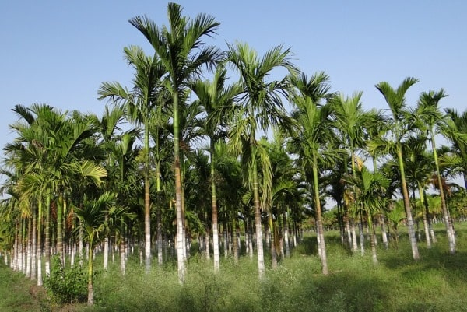
Raising Areca nut Seedlings
Mother palm Selection for growing Areca nut
Seed nut Selection for growing Areca nut
Raising of Areca nut Seedlings in Nursery Beds for growing Areca nut
Selection of Areca nut Seedlings for Transplanting
Areca nut Orchard

Slide 15
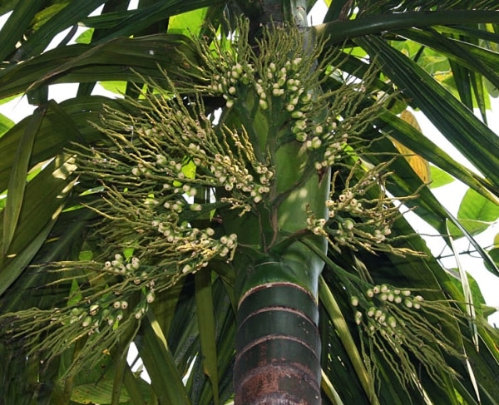
Some Factors for Growing Areca nuts
Site Selection and Layout Required for Growing Areca nut
Season, Spacing and Transplanting in Growing Areca nut
Shading and Drainage in Growing Areca nut
Manures and Fertilizers in Growing Areca nut
Areca Palm

Slide 16
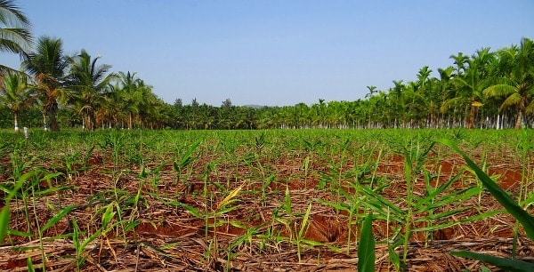
Intercultural operations in Growing Areca nut
Weed Management in growing Areca nut.
Inter/Mixed Cropping in growing Areca nut.
Cultural Operations in growing Areca nut.
Organic Matter Recycling in growing Areca nut.
Areca nut Plantation

Slide 17
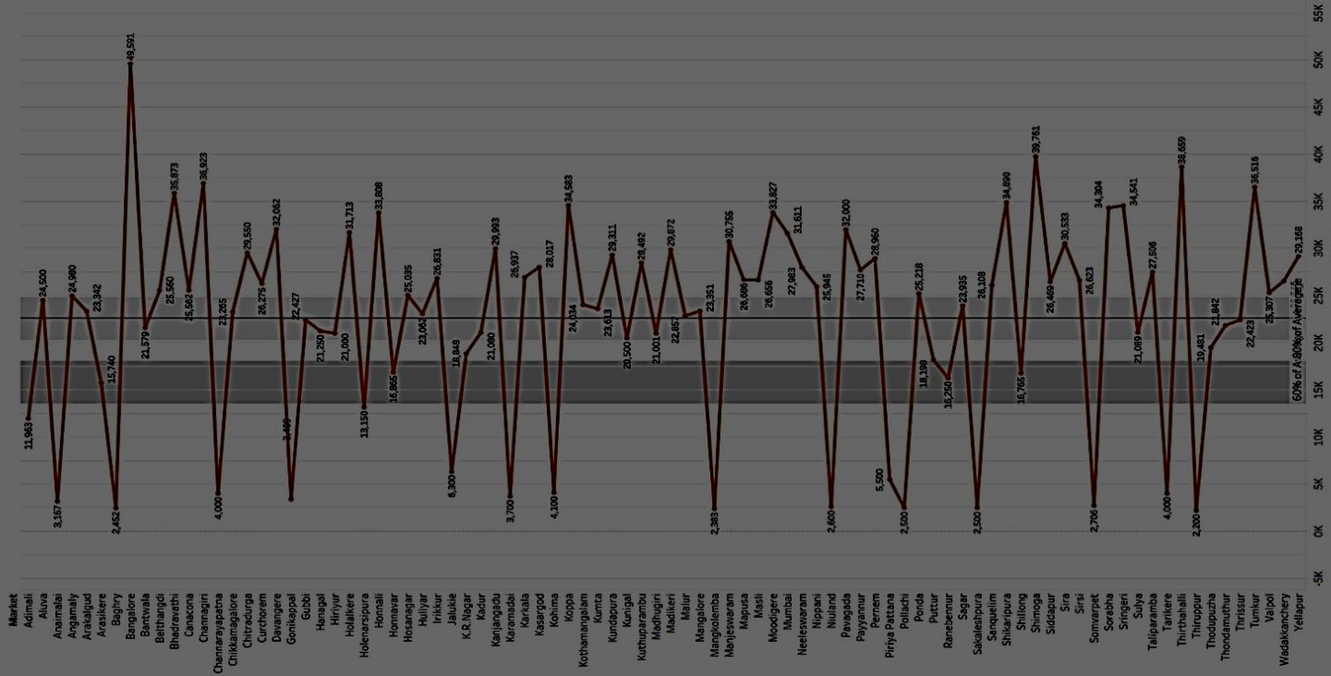
Use and Implementation: Tableau is a powerful and fastest growing data visualization tool used in the Business Intelligence Industry.
It helps in simplifying raw data into the very easily understandable format. Data analysis is very fast with.
Tableau and the visualizations created are in the form of dashboards and worksheets.
Line graph between markets versus average model price.

Slide 18
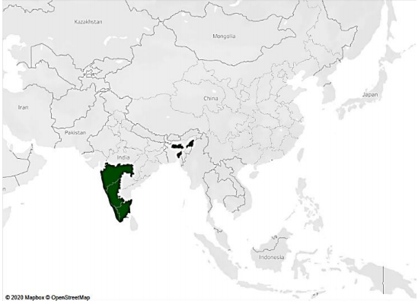
6. Analysis and Interpreted Results: After analyzing the data, we have got here are some interpretations which are clear indicator of what data is conveying on the basis of which we are going to make predictions and estimations for near future.
1. Betelnut mostly grows in tropical and subtropical regions. It is a profitable plantation crop that is commercialized for maximizing returns. The main reason for cultivation in the above-shaded regions is well-distributed rainfall and well-drained soil with a low water table. The above regions mostly southern India and northeastern part are having laterite, loamy (red), and alluvial soil, which is suitable for its plantation. The temperature range required is usually 15°C-37°C.
Indication of geographical regions covered by Betelnut cultivation in the country.

Slide 19
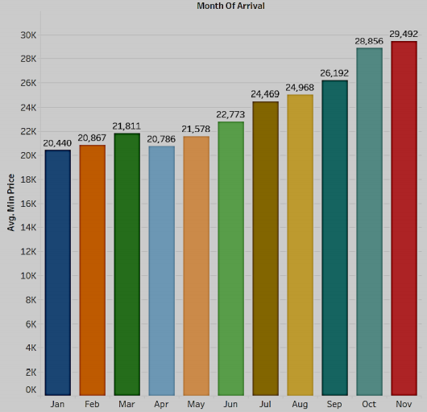
2. It can be concluded that the average maximum price is highest (constantly increasing except march) for the month of November with a difference of Rs 9693 between the starting month of January and the end of November, which is a huge value for an average farmer in India and average price difference of Rs 5652.
Bar graph of Month of arrival versus average maximum price

Slide 20
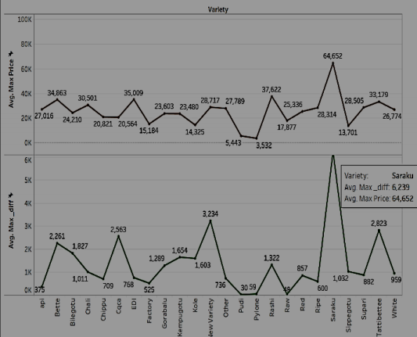
3. We can interpret that raw and pudi variety Betelnut is having least maximum price difference and highest profit is obtained from it as far as other varieties are concerned so this a profitable variety because of least deviation from the median value i.e. 985, with reference to modal price. So farming of raw and pudi must be emphasized for cultivation to maximize the profit whereas suruku must be avoided due to less profit and demand.
Line graph between average maximum price and average of maximum differences

Slide 21
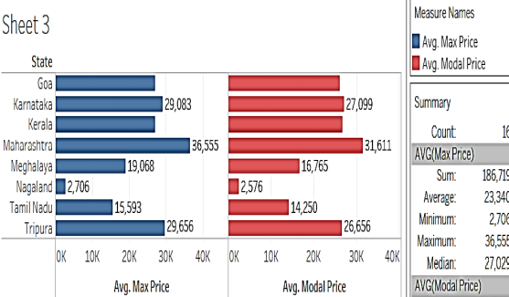
4. It could be estimated that Maharashtra is the state with the highest average market value for Betelnut. So we can advise to farmers around Maharashtra that it is the state with the highest profit value. Also, it is having a higher crop price than other states with an average maximum price difference of Rs 13,215.
Bar graph between average maximum price and average modal price
Month vs Profit plot

Slide 22
References
Baader F, Sattler U, an overview of Tableau Algorithm for Description Logic
Stolte C., Tang D., and Hanrahan, P. 2008. Polaris: a system for query, analysis, and visualization of multidimensional databases. Communication. ACM 51, 11 (Nov. 2008), 75--84.
Government of India, National Informatics Centre, DMI
Akhtar, Nikhat & Tabassum, Nazia & Perwej, Dr. Asif & Perwej, Dr. Yusuf. (2020). Data analytics and visualization using Tableau utilitarian for COVID-19 (Coronavirus). Global Journal of Engineering and Technology Advances. Volume 3. Page 28-50. 10.30574/gjeta.2020.3.2.0029.
Grolemund G. and Wickham H. (2014), A Cognitive Interpretation of Data Analysis. International Statistical Review, 82: 184-204.
Susan Spiggle, Analysis and Interpretation of Qualitative Data in Consumer Research, Journal of Consumer Research, Volume 21, Issue 3, December 1994, Pages 491–503,
Jamie Hoelscher, Amanda Mortimer, Using Tableau to visualize data and drive decision-making, Journal of Accounting Education, Volume 44,2018, Pages 49-59, ISSN 0748-5751,
Faten Hamad, Hussam Fakhuri, Sinaria Abdel Jabbar. (2020) Big Data Opportunities and Challenges for Analytics Strategies in Jordanian Academic Libraries. New Review of Academic Librarianship 0:0, pages 1-24.
Lengere, Monica, 2020/02/25, CHAPTER FOUR DATA ANALYSIS INTERPRETATION 4.1 Data analysis, Presentation and Interpretation Plan

Slide 23
References
10. Mons, Barend. (2018). Data cycle step 6: Data analysis, interpretation. 10.1201/9781315380711-7.
11. Sarah Anne Murphy (2013) Data Visualization and Rapid Analytics: Applying Tableau Desktop to Support Library Decision-Making, Journal of Web Librarianship, 7:4, 465- 476, DOI: 10.1080/19322909.2013.825148
12. Mark Eaton. (2017) Seeing Library Data: A Prototype Data Visualization Application for Librarians. Journal of Web Librarianship 11:1, pages 69-78.
13. Suresh K. Peddoju, Himanshu Upadhyay. 2020. Evaluation of IoT Data Visualization Tools and Techniques. Data Visualization, pages 115-139.
14. Chapman, Joyce and Lown, Cory. 2010. Practical Ways to Promote and Support Collaborative Data Analysis Projects. code4lib,12: 1–10.
15. Tableau Software. 2020.3 Technical Specifications— Tableau Desktop. Accessed: November 2020.
16. Few, Stephen. 2009a. Now You See It: Simple Visualization Techniques for Quantitative Analysis, Oakland, CA: Analytics Press. [Google Scholar]
17. Images from www.google.com

Slide 24
ANY QUESTIONS?

Slide 25
Thank You!

