Slide 1
1M1B AI for Sustainability Virtual Internship · IBM SkillsBuild & AICTE
SDG 6
SDG 13
Groundwater Level
Depletion Forecasting
AI-powered prediction & risk classification for Western Uttar Pradesh
Badal Kumar
E.Mail id :- badalkumar88935@gmail.com
Quantum university
Roorkee, Uttrakhand
Notes:
Introduce yourself. Mention that this project is rooted in a real local problem — groundwater depletion across Saharanpur and 5 surrounding districts. Data is from the Central Ground Water Board (CGWB).

Slide 2
Problem Statement
How might we use AI to forecast groundwater depletion so that communities in Western UP can plan water use more sustainably?
Study Area
Saharanpur
Muzaffarnagar
Low Risk
Moderate Risk
~60%
3rd
UP
of India's agriculture depends on groundwater
largest groundwater user in the world
among states with critical depletion zones
Meerut
Bijnor
Moderate Risk
Low Risk
Root Causes:
Overextraction for agriculture & drinking water
Erratic monsoon & reduced natural recharge
No early-warning system at district level
Moradabad
Bareilly
Moderate Risk
Low Risk
Notes:
Explain the groundwater problem in India & UP specifically. Mention that Saharanpur is your home district — this gives the project a real local anchor.

Slide 3
SDG Alignment
SDG 6
Clean Water & Sanitation
SDG 13
Climate Action
How this project aligns:
How this project aligns:
Forecasts groundwater depth across 6 UP districts
Classifies depletion risk (Low / Moderate / High)
Supports sustainable extraction planning
Built on 20+ years of real CGWB monitoring data
Groundwater decline is a direct climate impact indicator
AI trend analysis reveals long-run climate stress
Enables data-driven climate adaptation strategies
Demonstrates AI as a tool for environmental monitoring
Notes:
Explain that SDG 6 is the primary SDG and SDG 13 is secondary. Both are directly relevant — groundwater depletion is both a water resource issue AND a climate change indicator.

Slide 4
AI Solution Overview
01
02
03
04
05
Data Collection
Data Cleaning
Feature Engineering
Random Forest
Model
Risk Classification
CGWB quarterly well depth data
1996–2017, 180+ wells,
6 UP districts
Aggregate well readings
to district-level means,
interpolate small gaps
Lag features (prev 4 quarters)
+ seasonal quarter index
for each district
300 trees, trained on
lag features; recursive
3-year forecast
Linear trend slope:
≥0.30 m/yr = High
0.10–0.30 = Moderate
Model Results (Actual)
Saharanpur
Low
Muzaffarnagar
Moderate
Meerut
Moderate
Trend: +0.002 m/yr
MAE: 0.544 m
Trend: +0.216 m/yr
MAE: 1.887 m
Trend: +0.125 m/yr
MAE: 0.590 m
Notes:
Walk through the 5-step pipeline. Emphasize that this is real data and real model outputs — not simulated. Mention the holdout MAE values to show model accuracy was evaluated properly.

Slide 5
Target Users
Farmers
District Authorities
& Jal Boards
Plan irrigation cycles based on forecast water table depth and seasonal risk alerts for their district.
Allocate water extraction permits, monitor depletion trends, and plan recharge interventions.
Environmental
Planners
Researchers
& NGOs
Use risk maps to prioritise groundwater conservation zones and design sustainable land-use policies.
Validate and extend the model with newer field data; use the dashboard for public awareness campaigns.
Notes:
Explain that the primary beneficiary is farmers in Western UP who depend on groundwater for irrigation. The dashboard is designed to be simple enough that district-level officials can use it without technical training.

Slide 6
Prototype — Groundwater Watch Dashboard
Prototype — Groundwater Watch Dashboard
District Selector
Borehole Visual
Risk Badge
Switch between Saharanpur, Muzaffarnagar, Meerut, Bijnor, Moradabad, Bareilly in one click.
Cross-section graphic showing current water table depth in metres — intuitive even for non-technical users.
Colour-coded Low / Moderate / High label derived from the linear trend slope.
Historical Trend Chart
3-Year Forecast
Self-Contained HTML
20-year quarterly depth time series (1996–2017) rendered with Chart.js.
Random Forest recursive forecast shown as a dashed line extending beyond observed data.
No server, no install — open the single .html file in any browser, works offline.
Notes:
Demo the actual dashboard HTML file here. Open it in a browser, click between districts, show the borehole dropping and the forecast line. Show Muzaffarnagar vs Saharanpur to contrast risk levels.

Slide 7
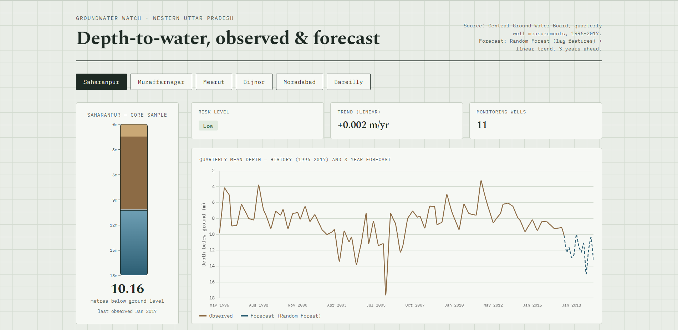
Prototype — Groundwater Watch Dashboard
Prototype — Groundwater Watch Dashboard
Notes:
Demo the actual dashboard HTML file here. Open it in a browser, click between districts, show the borehole dropping and the forecast line. Show Muzaffarnagar vs Saharanpur to contrast risk levels.

Slide 8
Responsible AI Considerations (Mandatory)
Fairness
Transparency
Data covers 6 districts equally — no geographic bias in model training
Risk labels use objective, explainable thresholds (slope in m/yr)
No demographic data involved — no risk of social discrimination
Both models (Random Forest + Linear Trend) are fully explained in the report
Holdout MAE values published per district — no hidden accuracy claims
Dashboard footer explicitly states data limitations & model scope
Ethics & Privacy
Limitations (Honest Disclosure)
No personal or sensitive data used — all data is public CGWB records
Forecast framed as 'indicative trend', not a precise operational prediction
No commercial bias — this is a public-good academic tool
Data cuts off at 2017 — post-2017 trends not validated
Sparse well coverage in some quarters may affect district averages
Random Forest may underestimate extreme depletion events
Notes:
Responsible AI is MANDATORY in the guideline — spend enough time on this slide. Emphasise the honest limitations section — internship evaluators appreciate intellectual honesty.

Slide 9
Expected Impact
If Deployed, This Tool Would:
Farmers:
Receive seasonal depletion alerts before irrigation season to plan water use
Jal Board UP:
Identify high-risk districts for targeted recharge schemes & extraction limits
Policymakers:
Use 3-year forecast to allocate groundwater conservation budgets
Researchers:
Baseline model to build upon with newer post-2017 CGWB data
Notes:
Point out that Muzaffarnagar has the steepest decline at 0.216 m/year and Saharanpur is essentially stable at 0.002 m/year. These are real, model-derived findings — not assumptions.

Slide 10
Key Takeaways
Real data, real model — CGWB 1996–2017, 180+ wells, 6 districts
Interpretable AI — Random Forest + linear trend, both explainable
Locally grounded — Saharanpur & surrounding UP districts
Responsible AI — Transparent, limitations disclosed, public-good use
Groundwater Watch · Western UP
A student project for the 1M1B AI for Sustainability Virtual Internship
Badal Kumar · Quantum University · Roorkee, UK
Thank you
Notes:
Close with confidence — you have real data, a working prototype, and an honest responsible-AI section. Offer to demo the dashboard live.

