Slide 1
Siliguri Institute of Technology
Face Detection Attendance Project
Team:
Kunal Ranjan
Nishant sharma,Priyanshu kumar choubey, Badal singh, Abhishek raj

Slide 2
Introduction
Problem: In Traditional method of taking attendance we waste lots of paper and time and at the same time there is some malpractices are there like proxy, which is actually a big problem for teachers.
Solution: Here comes a machine learning based Face Detection Attendance Program which uses Intel optimized python to eliminate all these problems and making this process more efficient and less time consuming.

Slide 3
LIBRARIES USED
Intel-Numpy
Cmake
Dlib
Face_recognition
Pickle
Datetime
Opencv

Slide 4
OpenCV
OpenCV is the huge open-source library for the computer vision, machine learning, and image processing and now it plays a major role in real-time operation which is very important in today’s systems. By using it, one can process images and videos to identify objects, faces, or even handwriting of a human. When it integrated with various libraries, such as NumPy, python is capable of processing the OpenCV array structure for analysis. To Identify image pattern and its various features we use vector space and perform mathematical operations on these features.

Slide 5
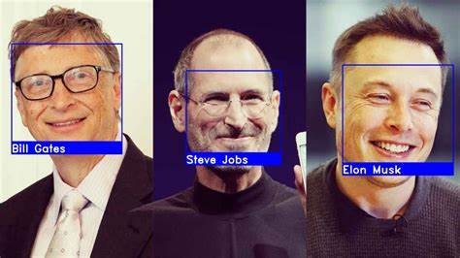
Face_Recognition
Face recognition in Python refers to detecting a face and then identifying the person to whom the face belongs. There are many stimulating applications for face recognition in Python like sentiment analysis, age analysis, gender analysis, and ethnicity analysis– among others.

Slide 6
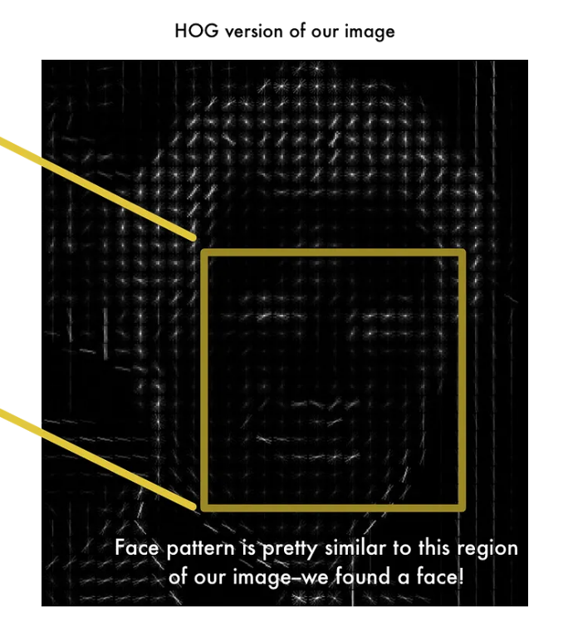
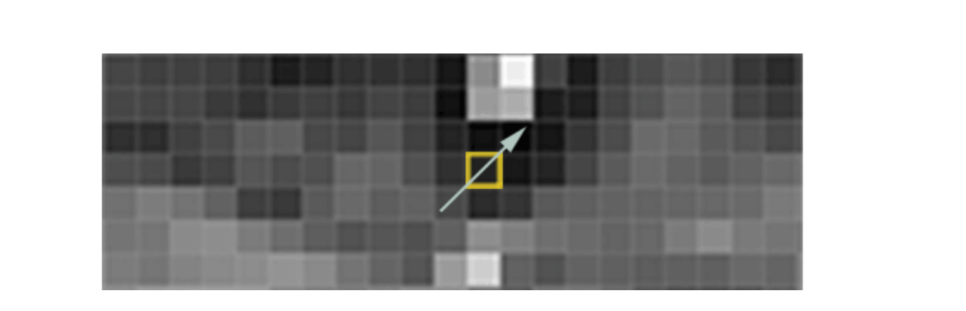
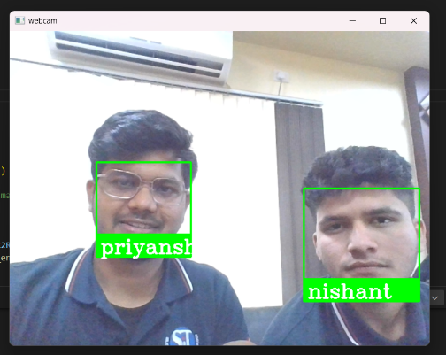

STEP:1
Finding all the faces:
Converting the image from BGR to RGB
Converting the images into gradients and getting HOG oriented gradient images
(This method help us to find faces in the image)

Slide 7
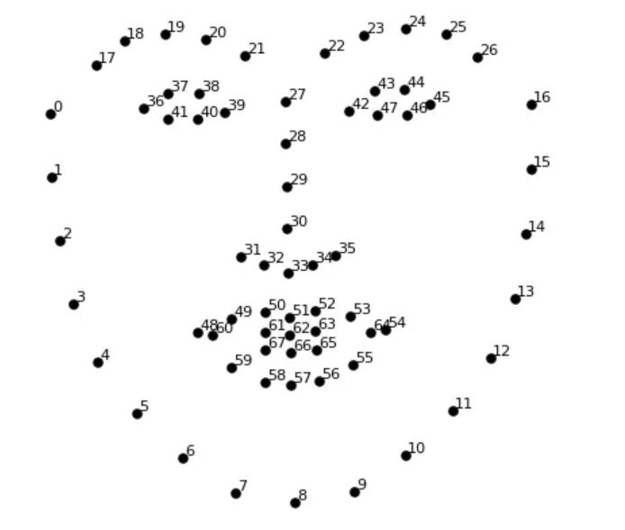
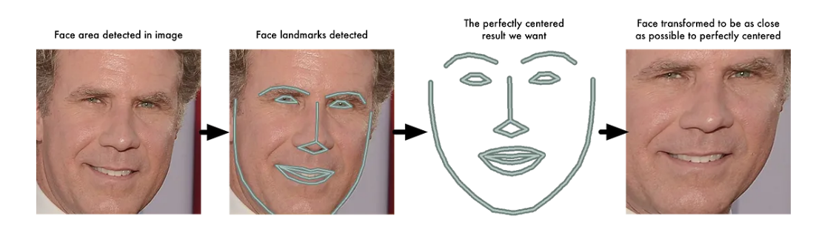
STEP:2
Centring face
68 face landmarks
Posing and Projecting image:
Here we centre the face of a person, looking at different direction
We use 68 face landmarks to achieve this

Slide 8
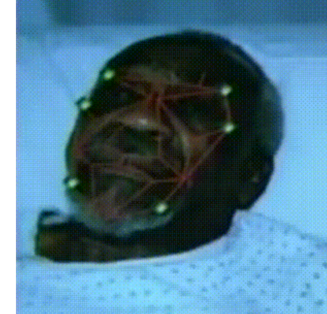
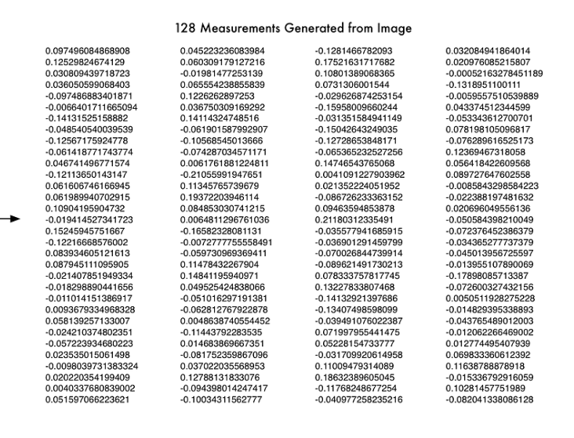
STEP:3
Encoding faces:
We extract few basic measurements like spacing between eyes, length of nose etc
Then using deep convolution neural networks we train the model to generate 128 measurements of each face
Basically we upload to images of same person and one image of different person and then let the model figure out and classify the test image itself.

Slide 9
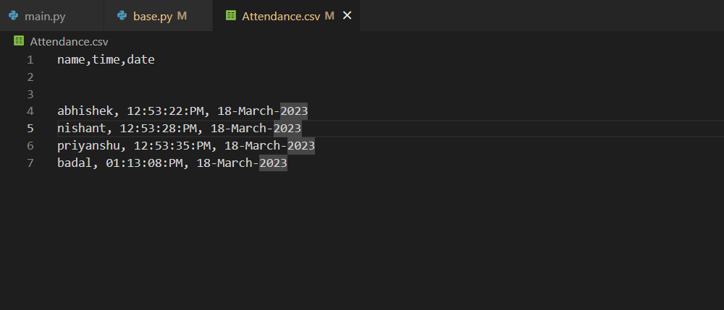
STEP:4
Finding the persons name from encoding:
Then marking the persons name with date and time in attendance.csv file

Slide 10
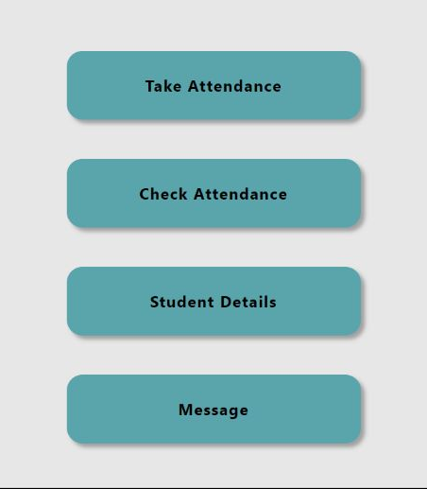
SCOPE
Attendance application.
With notification feature
Student details based on face Id.
And a user friendly UI.
Registration in different events using Face Id.

Slide 11
CONCLUSION
The overall aim of this project is to replace the traditional attendance method with new Face detection Attendance project which uses ML and intel optimized python.
It will make the process more convenient and with more training data the machine will become more capable and with the time the accuracy also increases.
ENTER TITLE
Click here to add content of the text，and briefly explain your point of view.Click here to add content of the text，

Slide 12
“If we wish to predict the future of machine learning, all we need to do is identify ways in which people learn but computers don't, yet.”
ENTER TITLE
Click here to add content of the text，and briefly explain your point of view.Click here to add content of the text，
THANK YOU..

