Slide 1


Team Member’s Details
Name
Year
Typex
Badal Singh
3rd
Name
Year
Sandeep Kumar Behera
3rd
Name
Year
Mental-Health-AI-Chatbot
Srianga Kinkar Nayak
3rd
Name
Year
Jatin Behera
3rd

Slide 2

PROPOSED SOLUTION
Rising mental health challenges among students and professionals.
Lack of accessible, affordable, and private mental health support.
Stigma around visiting psychologists in person.

Slide 3
TECHNICAL APPROACH
Tech Stack:
Frontend: HTML, CSS, JavaScript
Backend: Python (Flask)
AI/ML: Emotion Detection, NLP for Chatbot
APIs: OpenAI(Gemini AI studio)

Slide 4


System Architecture
User Interface (Web) – Chat UI, timers, dashboard
Backend (Flask) – Handles requests & responses
AI Modules – NLP chatbot & emotion recognition

Slide 5
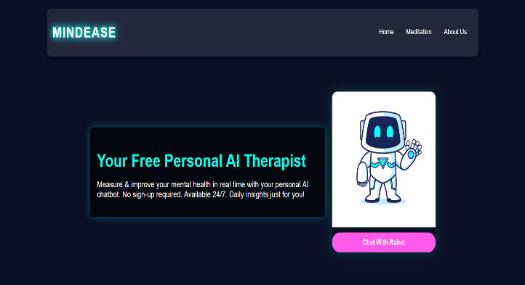
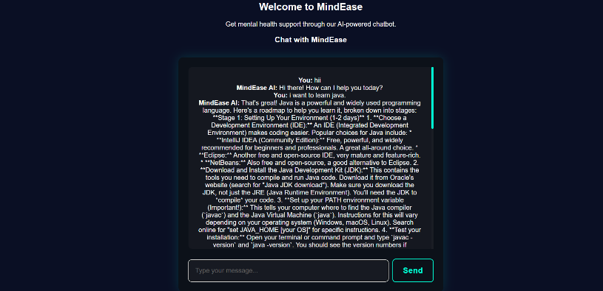
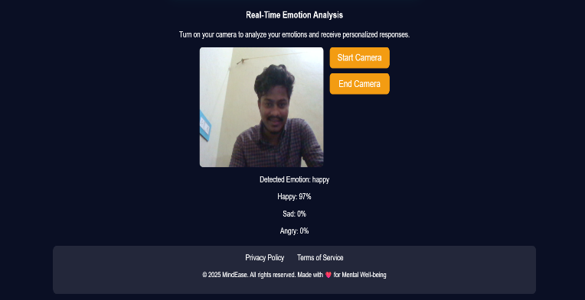
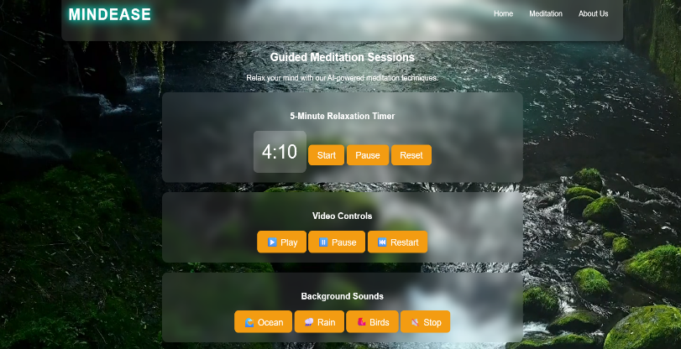
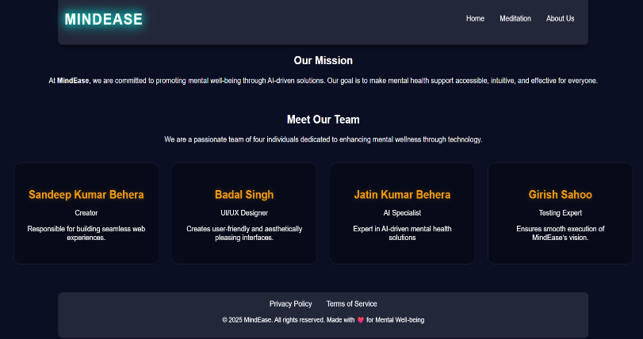
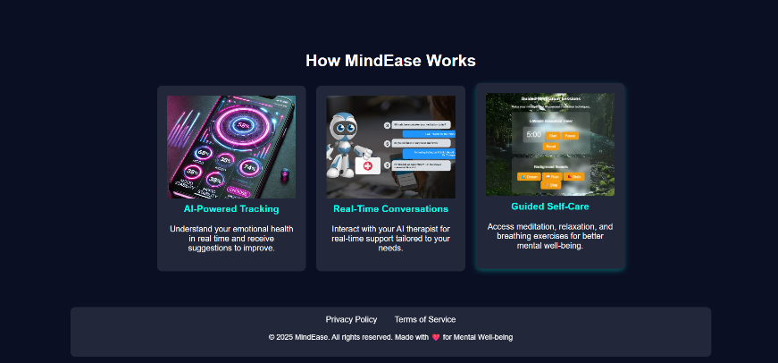
Screenshots
1️⃣ Home Dashboard
2️⃣ Chatbot Conversation Window 3️⃣ Emotion Detection
5️⃣ Our Missions 6️⃣ How MindEase works
4️⃣Meditation Timer

Slide 6
Future Enhancements
Multilingual support for chatbot.
Mobile App version.
Integration with wearable devices.
Professional consultation booking.

Slide 7
Thank You
Group Name: Typex.
GitHub: github.com/Badalsingh25.
LinkedIn: linkedin.com/in/badal-singh-767911333

