Slide 1
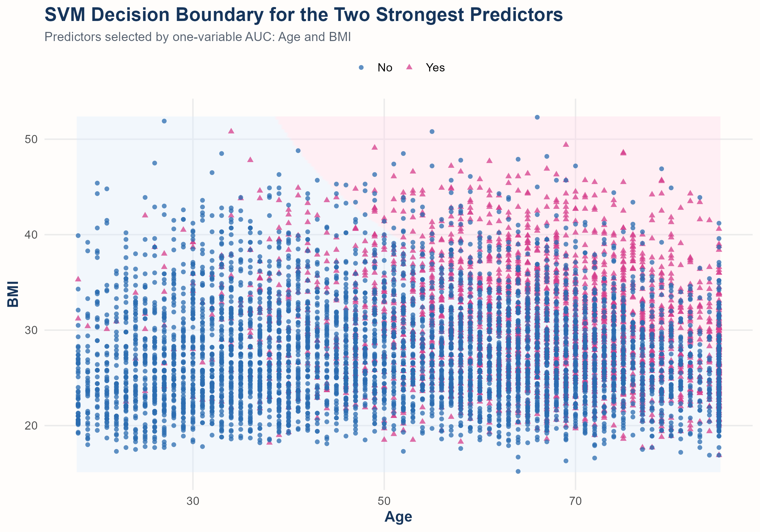
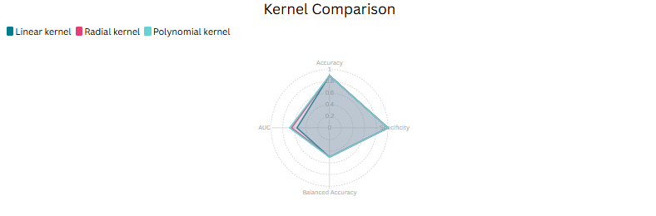
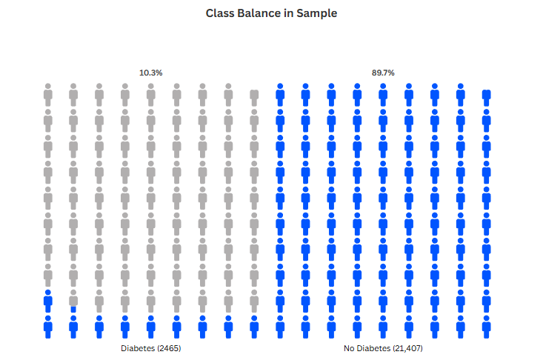
Predicting Diabetes from Health Behaviors with Linear, Radial, and Polynomial SVMs
DATA 5322 Statistical Machine Learning II | NHIS 2022 via IPUMS Health Surveys | Target: DIABETICEV | Badamgarav Battushig
IPUMS Health Surveys, Minnesota Population Center (2022) – NHIS (accessed via course GitHub), James et al. (2023), Meyer et al. (2023)
Introduction
Example Decision Boundary
This project studies whether demographic characteristics and daily health behaviors can be used to predict diabetes in the 2022 National Health Interview Survey, accessed through IPUMS Health Surveys.
The target variable is DIABETICEV, recoded to a binary diabetes outcome for adults only. Predictors include age, sex, education, work hours, BMI, cigarettes per day, moderate activity, vigorous activity, fruit intake, vegetable intake, and sleep hours. Three support vector machine models are compared: linear, radial (RBF), and polynomial kernels.
Theoretical Background
Results
A support vector machine finds a separating hyperplane that maximizes the margin between classes while allowing some misclassification through slack variables.
Linear SVM tunes cost. Radial SVM tunes cost and gamma. Polynomial SVM tunes cost, degree, and coef0. Performance is evaluated with accuracy, sensitivity, specificity, precision, F1, balanced accuracy, and AUC.
Descriptive differences by diabetes status
This SVM plot uses Age and BMI, the two strongest individual predictors. The overlap between classes shows that these variables are informative but do not fully separate diabetes and non-diabetes cases.
Adults with diabetes have higher average age and BMI, and lower average work hours and physical activity compared to non-diabetic individuals.
Evaluation metrics used
Accuracy, sensitivity, specificity, precision, F1, balanced accuracy, and AUC are reported for all three kernels on the same held-out test set.
Discussion
Methodology
Kernel Comparison Table
Age, BMI, and physical activity appear to be among the strongest predictors because they show clear differences between diabetes and non-diabetes groups.
Model flexibility matters too. The polynomial kernel performed best, which shows nonlinear relationships in the data, although all models had very low sensitivity. These patterns are predictive rather than causal. Lower work hours or lower activity may partly reflect the consequences of diabetes rather than causes of diabetes.
1. Start with 35,115 NHIS responses and restrict to adults using ASTATFLG = 1.
2. Recode special survey values such as 7, 9, 96, 98, 99, 996, 997, 998, and 999 to missing when they represent non-substantive responses.
3. Convert coded categories such as Sex and Education to factors so the SVM does not treat category labels as measured distances.
4. Use a 70/30 train-test split with set.seed(123). Tune on a smaller stratified tuning sample with 5-fold cross-validation, then refit the chosen model on the full training data.
Final held-out test-set metrics for the three SVM kernels are shown below. The polynomial kernel performed best by balanced accuracy and AUC, although all three models had very weak sensitivity.
Conclusions
This analysis illustrates that SVMs provide a useful framework for comparing linear and nonlinear boundaries in a large health-survey dataset.
In practical terms, older age, higher BMI, and lower activity are likely to be important signals for diabetes risk. Prevention and screening efforts should focus on obesity, physical activity, and older adults.
Ethical note: demographic variables may improve prediction, but they can also reflect structural inequalities. Predictive use should be transparent and should not reinforce unfair treatment.
Results: Sample Structure
Model | Accuracy | Sensitivity | Specificity | F1 | Balanced Accuracy | AUC
Linear kernel | 0.895 | 0.000 | 1.000 | NaN | 0.500 | 0.556
Radial kernel | 0.895 | 0.001 | 0.999 | 0.003 | 0.500 | 0.648
Polynomial kernel | 0.894 | 0.007 | 0.998 | 0.013 | 0.502 | 0.681
Complete-case sample: 23,872 adults
Class counts: 21,407 No and 2,465 Yes (10.3% prevalence), indicating a strongly imbalanced dataset. As a result, accuracy is misleading, so balanced accuracy, sensitivity, and AUC are emphasized.
Best model: Polynomial kernel, but all three models missed most true diabetes cases.

