Slide 1


FILTERING AND ENHANCEMENT OF MEDICAL SIGNALS USING TRADITIONAL TECHNIQUES
National Institute of Technology Puducherry, Karaikal (2024)
SAMBHAIAHPALEM CHENCHU NIRANJAN(EC22B1044)
BADAVATH KRANTHI(EC22B1005)
NIT Puducherry, Karaikal-609609

Slide 2
Contents
Introduction
Techniques
Work
Results and Discussions
Conclusions
1
2
National Institute of Technology Puducherry, Karaikal (2024)
3
4
5

Slide 3
Introduction
Electrocardiogram signals represent electrical activity of heart. They are very necessary in monitoring the heart conditions of both mother and foetus to predict various abnormalities related to heart.
They can be obtained in two ways:
1.Invasive method
2.Non –Invasive method
National Institute of Technology Puducherry, Karaikal (2024)

Slide 4
Techniques:
1.Traditional techniques: Wavelet-based methods, singular value decomposition, blind source seperation, Discrete Cosine Transform(DCT) adaptive filtering, Butterworth filtering, Principal Component Analysis(PCA).
2.Non-traditional techniques: Deep learning techniques.
National Institute of Technology Puducherry, Karaikal (2024)

Slide 5
WORK
CA-1:
Filtering of 6th electrode reading from Daisy database using butterworth filter.
CA-2:
Filtering of 7th and 8th electrode readings from Daisy database using butterworth filter and analysing ADFECG database.
National Institute of Technology Puducherry, Karaikal (2024)

Slide 6
AFTER CA-2:
1.Taking abdominal readings from Daisy database.
2.Converting signals into matrices.
3.Obtaining regenerated signals after applying Principal Component Analysis.
4.PCA considers principal eigen values.
5.Reconstruct matrices using these principal eigen values.
6.Comparing these with remaining thoracic readings.
7.Obtaining MSE values.
8.Coming to conclusion.
National Institute of Technology Puducherry, Karaikal (2024)

Slide 7
Importance of eigen values
1.They represent energy content of signals
2.Eigen values and eigen vectors are very central concepts to PCA.
3.

Slide 8
Advantages:
1.Simple and easy to understand.
2.Coplex algorithms are not required.
3.Easy to implement.
Applications:
1.Medical field.

Slide 9
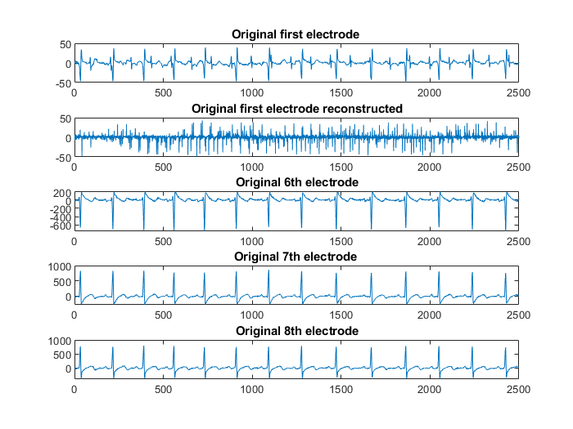
RESULTS AND DISCUSSIONS

Slide 10
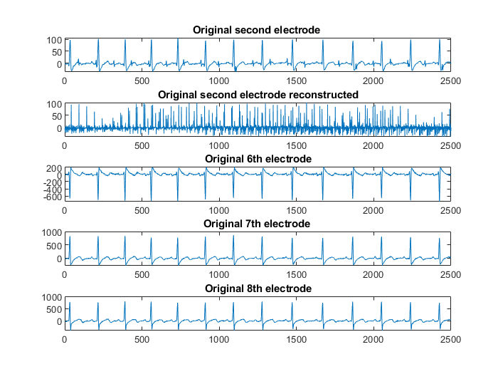

Slide 11
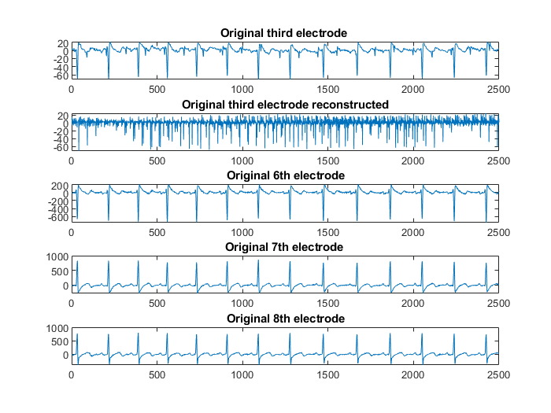

Slide 12
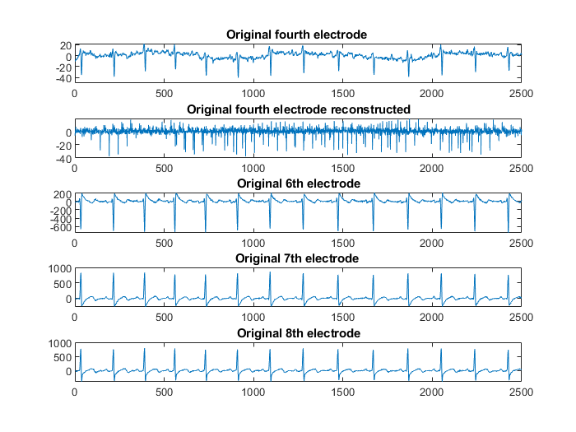

Slide 13
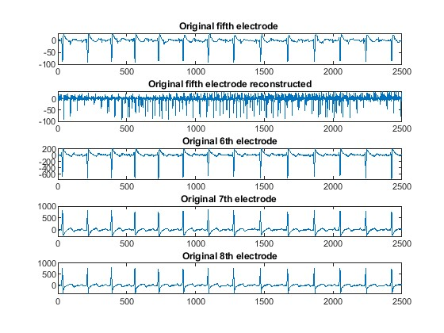

Slide 14
MSE VALUES OBTAINED AFTER COMPARING REGENERATED ABDOMINAL ELECTRODE READINGS AND MATERNAL READINGS
ABDOMINAL READINGS | 6TH ELECTRODE | 7TH ELECTRODE | 8TH ELECTRODE
1ST ELECTRODE | 1.2407 | 1.8965 | 1.2444
2ND ELECTRODE | 1.2509 | 1.9348 | 1.7072
3RD ELECTRODE | 1.2444 | 1.9032 | 1.6750
4TH ELECTRODE | 1.2317 | 1.8974 | 1.6683
5TH ELECTRODE | 1.2561 | 1.9109 | 1.6823

Slide 15
CONCLUSION
1.Importance of ECG .
2.Role in medical field.

Slide 16
References
https://ieeexplore.ieee.org/abstract/document/9815469/
S. E. S. Gan, S. K. Debnath, Y. S. Ashely, H. Nugroho, S. Bagchi, and M. Nafea, “Foetal ECG Extraction from Abdominal ECG Using Chebyshev and Butterworth Filters,” in 2021 IEEE Symp. Comput. Informatics, Oct. 2021, pp. 25–30.
Cano GG, Briller SA, Coast DA (1990) Enhancement of low-level ECG components in noise with time-sequenced adaptive filtering. J Electrocardiol 23:176–18
National Institute of Technology Puducherry, Karaikal (2024)

Slide 17
THANK YOU
National Institute of Technology Puducherry, Karaikal (2024)

