Slide 1
Day-2
Maven
Chintan Dwivedi

Slide 2
GOALS
Understand Maven usage and implementation.

Slide 3
What is Maven?
Maven is a project management and comprehension tool. Maven provides developers a complete build lifecycle framework. Development team can automate the project's build infrastructure in almost no time as Maven uses a standard directory layout and a default build lifecycle.

Slide 4
Maven Objective
Maven primary goal is to provide developer
A comprehensive model for projects which is reusable, maintainable, and easier to comprehend.
Plugins or tools that interact with this declarative model.
Maven project structure and contents are declared in an xml file, pom.xml referred as Project Object Model (POM), which is the fundamental unit of the entire Maven system.

Slide 5
Maven Feature
Maven provides developers ways to manage following:
Builds
Documentation
Reporting
Dependencies
SCMs
Releases
Distribution
Mailing list

Slide 6
Convention over Configuration
Maven uses Convention over Configuration which means developers are not required to create build process themselves.
Maven creates default project structure. Developer is only required to place files accordingly and he/she need not to define any configuration in pom.xml.
Item | Default
source code | ${basedir}/src/main/java
resources | ${basedir}/src/main/resources
Tests | ${basedir}/src/test
Complied byte code | ${basedir}/target
distributable JAR | ${basedir}/target/classes

Slide 7
Maven Pom File
It’s a fundamental unit of work. The POM contains information about the project and various configuration detail used by Maven to build the project(s).
POM contains the goals and plugins.
Some of the configuration that can be specified in the POM are following:
project dependencies
plugins
goals
build profiles
project version
developers
mailing list

Slide 8
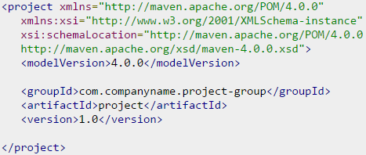
Pom Example
There should be a single POM file for each project.
All POM files require the project element and three mandatory fields: groupId, artifactId,version.
Projects notation in repository is groupId:artifactId:version.

Slide 9
Pom Nodes
Node | Description
groupId | This is an Id of project's group. This is generally unique among a project. For example, com.staples.presentation has all the projects related to presentation.
artifactId | This is an Id of the project. This is generally name of the project. For example, staples-core. Along with the groupId, the artifactId defines the artifact's location within the repository.
version | This is the version of the project. com.staples.presentation:staples-core:1.0

Slide 10
Maven Plugins
Maven is a plugin execution framework where every task is actually done by plugins.
Maven Plugins are generally used to
create jar file
create war file
compile code files
unit testing of code
create project documentation
create project reports

Slide 11
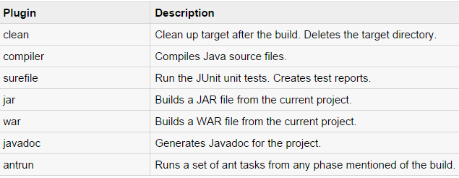
Maven Plugins
List of few common plugins

Slide 12
Maven Repository
A repository is a place i.e. directory where all the project jars, library jar, plugins or any other project specific artifacts are stored and can be used by Maven easily.
Maven repository are of three types
Local
<localRepository>C:/MyLocalRepository</localRepository>
Central
When Maven does not find any dependency in local repository, it starts searching in central repository using following URL: http://repo1.maven.org/maven2/
Remote
<repositories>
<repository> <id>companyname.lib1</id> <url>http://download.companyname.org/maven2/lib1</url> </repository>
</repositories>

Slide 13
Maven Features to Try
Maven Profile creation in POM files.
Deployment automation.
Help link
http://www.tutorialspoint.com/maven/index.htm

