Slide 1
MARKETING DEPARTMENT
Annual Budget 2026
How the department's budget is planned and shared across its four units:
Advertising • Marketing • Public Relations • e-Business
Amounts in US$ · Source: Marketing_Department_Budget.xlsx
Notes:
Good day. This presentation covers the 2026 budget of the Marketing Department. The department has four units: Advertising (Ads), Marketing, Public Relations (PR) and e-Business. The figures were prepared in Microsoft Excel, where SUM and AVERAGE formulas calculate the totals and averages.

Slide 2
Budget at a Glance
How the $890,000 department budget is shared across the four units
$890,000
Advertising
$320,000 · 36.0%
Total department budget
Marketing
$260,000 · 29.2%
Excel: =SUM(B13:E13)
Public Relations
$130,000 · 14.6%
$222,500
Average budget per unit
e-Business
$180,000 · 20.2%
Excel: =AVERAGE(B13:E13)
Notes:
In total the department plans to spend $890,000. In Excel this is the SUM of the four unit budgets. The average budget per unit is $222,500, calculated with the AVERAGE formula. Advertising takes the largest share (36.0%), followed by Marketing (29.2%), e-Business (20.2%) and Public Relations (14.6%).

Slide 3
Advertising (Ads)
Paid media campaigns on TV, radio, print, outdoor and online channels
Key Figures
Where the Money Goes (US$)
Total budget: $320,000
Excel formula: =SUM(B5:B12)
Share of the department: 36.0% (rank 1 of 4)
Average per budget item: $40,000
Largest item: Media & Advertising Space, $150,000
Notes:
Advertising (Ads): this unit covers paid media campaigns on TV, radio, print, outdoor and online channels. Its total budget is $320,000, the SUM of its 8 budget items. That is 36.0% of the department budget, making it the largest of the 4 units. The largest item is Media & Advertising Space at $150,000 (46.9% of the unit's budget), followed by Staff Salaries & Benefits at $66,000. On average the unit spends $40,000 per budget item (AVERAGE formula).

Slide 4
Marketing
Market research, sales promotions, product launches and trade shows
Key Figures
Where the Money Goes (US$)
Total budget: $260,000
Excel formula: =SUM(C5:C12)
Share of the department: 29.2% (rank 2 of 4)
Average per budget item: $32,500
Largest item: Events, Sponsorships & Promotions, $70,000
Notes:
Marketing: this unit covers market research, sales promotions, product launches and trade shows. Its total budget is $260,000, the SUM of its 8 budget items. That is 29.2% of the department budget, making it the second largest of the 4 units. The largest item is Events, Sponsorships & Promotions at $70,000 (26.9% of the unit's budget), followed by Staff Salaries & Benefits at $68,000. On average the unit spends $32,500 per budget item (AVERAGE formula).

Slide 5
Public Relations (PR)
Media relations, corporate events, sponsorships and community relations
Key Figures
Where the Money Goes (US$)
Total budget: $130,000
Excel formula: =SUM(D5:D12)
Share of the department: 14.6% (rank 4 of 4)
Average per budget item: $16,250
Largest item: Staff Salaries & Benefits, $44,000
Notes:
Public Relations (PR): this unit covers media relations, corporate events, sponsorships and community relations. Its total budget is $130,000, the SUM of its 8 budget items. That is 14.6% of the department budget, making it the smallest of the 4 units. The largest item is Staff Salaries & Benefits at $44,000 (33.8% of the unit's budget), followed by Events, Sponsorships & Promotions at $38,000. On average the unit spends $16,250 per budget item (AVERAGE formula).

Slide 6
e-Business
Company website, e-commerce platform, search and social media marketing
Key Figures
Where the Money Goes (US$)
Total budget: $180,000
Excel formula: =SUM(E5:E12)
Share of the department: 20.2% (rank 3 of 4)
Average per budget item: $22,500
Largest item: Digital Platforms & Technology, $60,000
Notes:
e-Business: this unit covers company website, e-commerce platform, search and social media marketing. Its total budget is $180,000, the SUM of its 8 budget items. That is 20.2% of the department budget, making it the third largest of the 4 units. The largest item is Digital Platforms & Technology at $60,000 (33.3% of the unit's budget), followed by Staff Salaries & Benefits at $56,000. On average the unit spends $22,500 per budget item (AVERAGE formula).

Slide 7
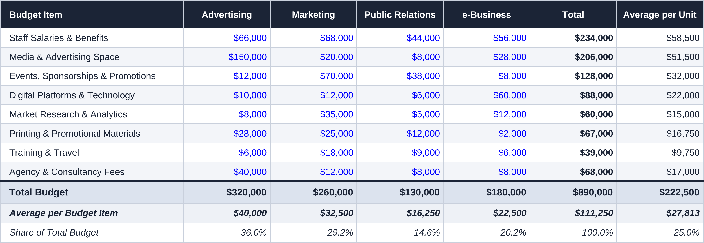
Budget Table from Excel
Imported from Marketing_Department_Budget.xlsx, sheet “Marketing Budget”, cells A4:G15
Double-click the table to open it in Excel. Blue figures are the budget inputs; black figures are SUM and AVERAGE formulas.
Notes:
This is the budget table imported directly from the Excel workbook as an embedded Excel worksheet object, so double-clicking it opens the live spreadsheet. Each row is a budget item and each column is a unit. The Total column and the Total Budget row use SUM; the Average per Unit column and the Average per Budget Item row use AVERAGE. The department total is $890,000 and the average per unit is $222,500.

Slide 8
Unit Budgets vs. the Average
Each unit's total (SUM) compared with the average of $222,500 per unit (AVERAGE)
Average per unit: $222,500
Advertising: $97,500 above the average
Marketing: $37,500 above the average
Public Relations: $92,500 below the average
e-Business: $42,500 below the average
Notes:
The dashed line marks the average budget per unit, $222,500. Advertising and Marketing are above the average; Public Relations and e-Business are below it. Advertising is $97,500 above the average, while Public Relations is $92,500 below it.

Slide 9
Key Takeaways
$890,000 in Total
Advertising Is the
Largest Unit
Staff Costs Are the
Biggest Item
Technology Leads
e-Business
The SUM of the four unit budgets. The AVERAGE budget per unit is $222,500.
$320,000 (36.0% of the total). Media space alone costs $150,000.
Staff Salaries & Benefits come to $234,000 across all units, 26.3% of the budget.
$60,000 of its $180,000 (33.3%) goes to digital platforms and technology.
Thank You. Questions?
Notes:
To summarise: the department budget is $890,000 with an average of $222,500 per unit. Advertising is the largest unit at $320,000, staff salaries and benefits are the biggest single item at $234,000, and e-Business puts 33.3% of its budget into digital platforms. Thank you; I am happy to take questions.

