Slide 1

Hand Gesture Presentation
Presented by:
B. Pravallika
Batch No: 480

Slide 2
About me
I have completed my B.Tech in Computer Science and Engineering
at Nalla Malla Reddy Engineering College.
Interested in leveraging data to drive insights and solutions in tech and healthcare,
solving real-world problems.
https://www.linkedin.com/in/baddam-pravallika
https://github.com/Baddampravallika

Slide 3
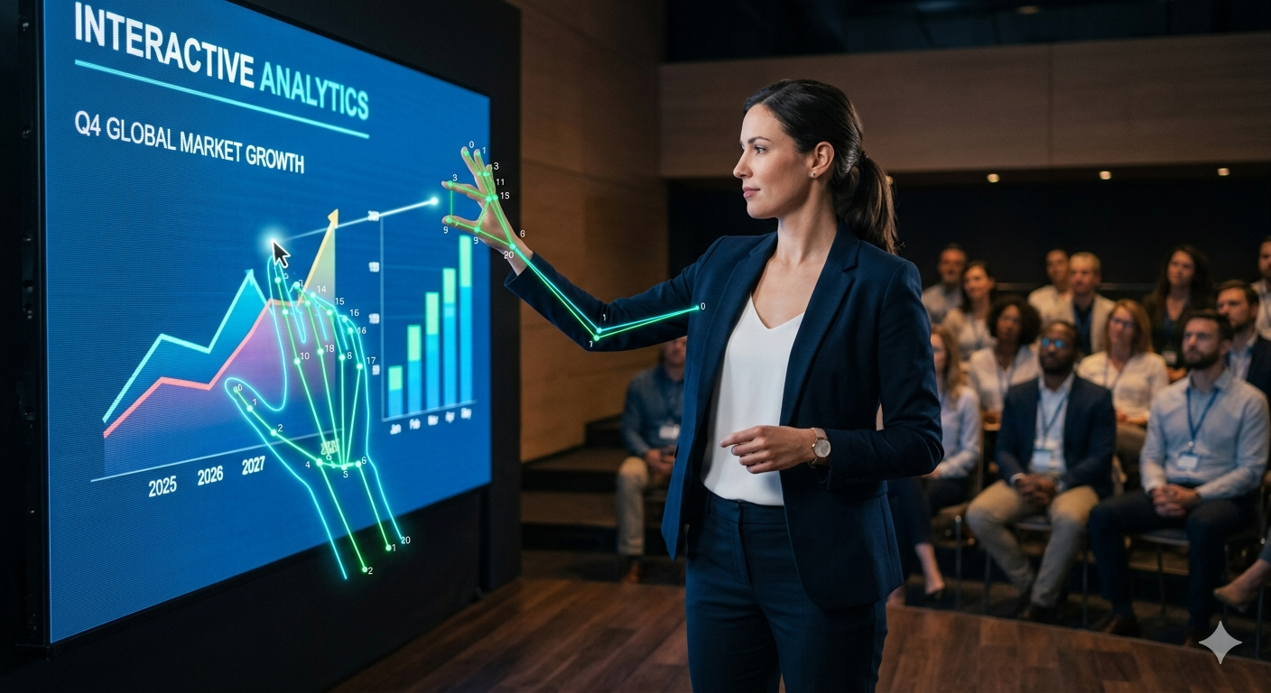
Agenda
Business Problem
Problem Statement
Data Understanding
Data Preprocessing
Model Building
Model Evaluation
Model Deployment
Monitoring & Maintainance
Conclusion

Slide 4
Business Problem
Traditional presentations are limited by a
Hardware Dependency: Presenters are restricted by physical clickers, mouse, or laptop "tethering", limiting natural movement and body language.
High Cost of Interaction: Digital whiteboards and high-end interactive systems are expensive, fragile, and not portable.
Engagement Friction: Moving back to a PC to draw, zoom, or switch slides breaks the flow of the presentation and audience connection.

Slide 5
Problem Statement
To develop a high-performance, computer vision-based Human-Computer Interface (HCI) that translates 21 spatial hand landmarks into actionable presentation commands. The goal is to provide a fluid, "air-touch" experience that replaces traditional input devices.functioning on any standard RGB webcam to ensure cost-effectiveness and portability without requiring specialized depth sensors or infrared hardware.

Slide 6
Data Understanding
Source: Real-time RGB video feed from a standard webcam.
Raw Input: Frames typically captured at a resolution of 640 × 480 pixels at 30 frames per second (FPS).The model specifically looks for 21 hand landmarks to interpret spatial coordinates as data points.
Data Type: Unstructured image data that is converted into structured coordinate data.
The model converts raw landmarks into a high-level Binary Vector [Thumb, Index, Middle, Ring, Pinky]
Example: A data vector of [0, 1, 0, 0, 0] tells the system that only the index finger is up, triggering the "Draw" state.

Slide 7
Data Pre-processing
Image Augmentation: uses cv2.flip(img, 1) to provide a mirrored view, making it intuitive for the user (move hand right, pointer moves right).
Normalization & Scaling: uses np.interp to map camera coordinates to screen coordinates.
Smoothing: implemented a linear interpolation logic (currX = prevX + (xval - prevX) / smoothening) to reduce "jitter" from the raw sensor data.

Slide 8
Model Building
Algorithm: utilizing a Mediapipe-based Hand Tracking Model (via cvzone).
Hand Landmarks: The model identifies specific joints (lmList).
Gesture Logic: This is the "Heuristic Model."
Index and middle Finger(Pointer): Moves the cursor
Index Finger Only-(Drawing Mode): Moves the cursor and draws lines if held.
Thumb Only-Above threshold(Previous Slide): Navigates to the left.
Pinky Only-Above threshold(Next Slide): Navigates to the right.
Thumb + Index(Color Change-Red): Changes ink to (0, 0, 255).
Middle, Ring, Pinky(Color Change-Green): Changes ink to (0, 255, 0).
Ring + Pinky(Color Change-Blue): Changes ink to (255, 0, 0).
All Fingers-No Thumb(Zoom Mode): Move hand up/down to scale the slide.
Index, Middle, Ring-Undo: Erases the last drawn line/annotation.
Full Open Palm(Clear All): Wipes all annotations from the current slide.
Thumb, Index, Middle(Save Slide): Captures current screen as a .png file.

Slide 9
Model Evaluation
Confidence Threshold: detectionCon=0.9 in the HandDetector. This ensures the system only reacts when it is 90% sure it sees a hand, reducing "ghost" triggers.
Latency Check: The use of buttonDelay and drawDelay ensures the model doesn't over-trigger gestures (debounce logic).
Visual Feedback: The red circle (cv2.circle) serves as real-time evaluation feedback for the user to see if the tracking is accurate.

Slide 10
Model Deployment
The Goal: Integration into the final environment.
UI/UX: used cv2.WND_PROP_FULLSCREEN to deploy the app as a professional presentation tool.
Feature Integration: (Zoom Engine) Dynamic scaling of the slide image.
Slide-Wise Storage: Using a dictionary (annotations = {i: []}) ensures that drawings are "pinned" to specific slides and don't disappear when moving between pages.
Feedback Loop: A PIP (Picture-in-Picture) camera overlay provides the user with real-time feedback of their hand position relative to the gestureThreshold.
Storage: The Save feature allows capturing annotated slides as .png files.

Slide 11
Monitoring and Maintainance
The Goal: Long-term stability.
Calibration: code includes minX, maxX variables, which allow for future calibration if the camera resolution or user distance changes.
Error Handling: The if not success- continue loop handles camera frame drops.
Resource Management: cap.release() and cv2.destroyAllWindows() ensure the system cleans up memory after the presentation ends.

Slide 12
Conclusion
By applying the CRISP-ML(Q) framework, successfully transformed a standard webcam into a high-precision Natural User Interface. this project eliminates the need for expensive hardware remotes.
The result is a portable, zero-cost solution that replaces the "hardware tether" with intuitive gestures, restoring speaker mobility and delivering a truly interactive presentation experience.Innovation: Successful mapping of 21 landmarks to fluid digital commands.

Slide 13


Slide 14

THANK
YOU

