Slide 1

Student Health Risk
Prediction
Presented by:
B. Pravallika
Batch No: 480

Slide 2
About me
I have completed my B.Tech in Computer Science and Engineering
at Nalla Malla Reddy Engineering College.
Interested in leveraging data to drive insights and solutions in tech and healthcare,
solving real-world problems.
https://www.linkedin.com/in/baddam-pravallika
https://github.com/Baddampravallika

Slide 3

Agenda
Introduction
CRISP-ML(Q)
Business Problem
Objective
Dataset Overview
Data Preprocessing
Architecture Building
Model Evaluation
Model Deployment
Challenges
Key Insights
Recommendations
Conclusion

Slide 4
Introduction
Student Health Risk Prediction is an Artificial Neural Network (ANN)-based project developed to predict students health risk levels using health, lifestyle, and academic factors such as sleep quality, physical activity, stress level, Body Mass Index (BMI), and academic pressure. Early identification of health risks enables timely interventions and promotes healthier lifestyles, leading to improved well-being and academic performance.
The project follows the CRISP-ML(Q) methodology, which includes data understanding, preprocessing, ANN architecture design, model evaluation, and deployment. The trained ANN model is integrated into a Streamlit web application, allowing users to enter student information and receive instant, accurate health risk predictions.

Slide 5
CRISP-ML(Q)
1. Business and Data Understanding
Defined the objective, explored the dataset, and identified features, target, and data
types.
2. Data Preparation
Cleaned and transformed the data.
3. Model Building
Developed an ANN with optimized architecture, hyperparameter tuning, and early
stopping.
4. Model Evaluation
Evaluated the ANN using Accuracy, Precision, Recall, F1-Score.
Model Deployment
Built a Streamlit application for real-time student health risk prediction.
Monitoring & Maintenance
Continuous monitoring and improving the model.

Slide 6
Business Problem
Educational institutions often face challenges in identifying students who are at risk of developing health problems due to factors such as poor sleep habits, unhealthy eating patterns, lack of physical activity, excessive screen time, high stress levels, and academic pressure. Delayed identification of health risks can negatively affect students academic performance, attendance, and overall well-being. Manual monitoring is time-consuming and often identifies problems only after they become severe.

Slide 7
Objective
The primary objective of this project is to support early health risk prediction, encourage preventive healthcare, and contribute to improved student well-being.
By providing timely and accurate predictions, reducing future health complications, and creating a healthier academic environment.
Predict student health risk accurately.
Identify at-risk students early.
Support healthcare and counseling decisions.
Improve student well-being and academic outcomes.

Slide 8
Dataset Overview
Student health dataset containing health, lifestyle, and behavioral parameters. It includes both numerical and categorical features.
Features: Sleep Duration, Heart Rate, BMI, Calorie Expenditure, Step Count, Exercise Duration, Water Intake, Diet Type, Stress Level, Sleep Quality, Physical Activity Level, Smoking & Alcohol, Gender, etc.
Target Feature: Health Condition
Data Type: Mixed (Categorical + Numerical)
Problem Type: Multi-Class Classification
Target Classes: Fit, At-Risk, Unhealthy
Total Records: 690,088
Total Columns: 15 (14 features + 1 target)

Slide 9
Data Pre-processing
Removed unnecessary column: Student_ID
Separated features into Input (X) and Target Variable (Health_Condition).
Encoded categorical variables:
One-Hot Encoding for nominal features: Gender, Diet_Type, Physical_Activity_Level, Smoking_Status, Alcohol_Consumption
Ordinal Encoding for ordered features: Stress_Level (Low, Medium, High) and Sleep_Quality (Poor, Average, Good)
Applied Label Encoding to the target feature: Health_Condition (Fit, At-Risk, Unhealthy).
Scaled numerical features using StandardScaler.
Created separate preprocessing pipelines for:
Numerical features, Nominal features, Ordinal features
Combined all preprocessing steps using ColumnTransformer and Pipeline for efficient data transformation.
Performed Train-Test Split:
80% Training Data, 20% Testing Data
Applied Class Weights to handle class imbalance during ANN training.

Slide 10
Numerical Features:-age,ratings,vehicle_condition,multiple_deliveries,order_day,order_month
is_weekend,pickup_time_minutes,order_time_hour,distance
Ordinal Features:-
traffic,city_type
Nominal Features:-
weather,type_of_order,type_of_vehicle,festival,city_name,order_day_of_week,
order_time_of_day
Created separate pipelines for:
Numerical features
Nominal features
Ordinal features
Applied all transformations using ColumnTransformer and Pipeline for efficient
preprocessing.
Train-Test Split:- 80% Training Data ,20% Testing Data

Slide 11
Architecture Building
Built an Artificial Neural Network (ANN) for multi-class health risk classification.
Input Layer: Receives preprocessed student features.
Hidden Layers: 5 Dense layers with 41, 38, 50, 58, and 37 neurons using ReLU activation.
Applied He Normal Initialization for efficient weight initialization.
Used L1-L2 Regularization to reduce overfitting.
Added Dropout (0.1–0.3) and Batch Normalization (Momentum = 0.3) after each hidden layer.
Output Layer: 3 neurons with Softmax activation to classify students into Fit, At-Risk, and Unhealthy.
Optimized the model using Optuna Hyperparameter Tuning.
Trained the model with Early Stopping to achieve the best validation performance.

Slide 12
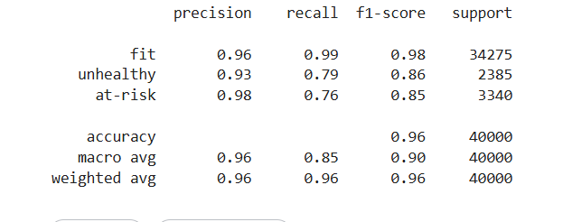
Model Evaluation
Evaluated the ANN model using Accuracy, Precision, Recall, and F1-Score.
Compared Training and Validation Accuracy/Loss to monitor model performance.
Used Early Stopping to prevent overfitting and improve generalization.
Evaluated the model on the test dataset to assess prediction performance

Slide 13
Hyperparameter Tuning
Method: Optuna
Optimized Parameters: Hidden layers, neurons, learning rate, optimizer, batch size, epochs, dropout rate, and batch normalization momentum.
Regularization Techniques: Early Stopping, Dropout, L1-L2 Regularization, and Batch Normalization.
Evaluation Metrics: Accuracy, Precision, Recall, F1-Score.
Final Model Performance: 96% Test Accuracy with improved generalization.

Slide 14
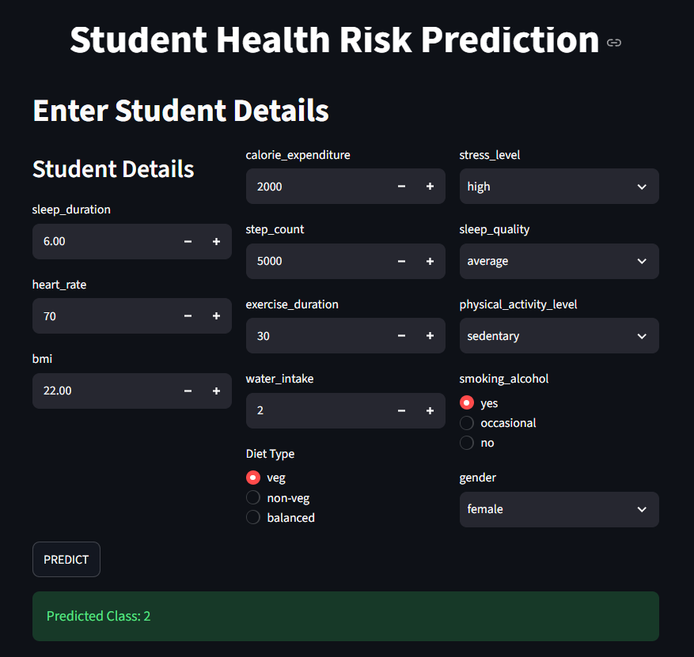
Model Deployment
Developed a Streamlit web application for real-time Student Health Risk Prediction using the trained ANN model.
Provides an easy-to-use interface for entering student details and instantly predicting the health risk category (Fit, At-Risk, or Unhealthy).

Slide 15
Challenges
1. Challenge: The dataset was highly imbalanced, leading to biased predictions toward the majority class.
Solution: Applied Class Weights during ANN training to improve minority class prediction.
2. Challenge: Selecting the optimal ANN architecture (hidden layers, neurons, dropout, etc.) was difficult.
Solution: Used Optuna Hyperparameter Tuning to identify the best model configuration.

Slide 16
Key Insights
Early prediction of student health risk enables timely intervention and better well-being.
Sleep quality, stress level, BMI, and physical activity are key factors influencing health risk.
Data preprocessing and feature engineering significantly improved prediction performance.
Class weights effectively addressed the imbalanced dataset problem.
Optuna hyperparameter tuning optimized the ANN architecture and improved model accuracy.
The Streamlit application provides fast, user-friendly, and real-time health risk assessment.

Slide 17
Recommendations
Encourage students to maintain a balanced diet, regular exercise, and adequate sleep.
Conduct regular health screenings to identify at-risk students early.
Promote stress management and mental health awareness programs.
Continuously update the model with new student data to improve prediction accuracy.
Integrate the system with school or college health monitoring platforms for real-time risk assessment.
Use the prediction results to provide personalized health recommendations and preventive interventions.

Slide 18
Conclusion
The Student Health Risk Prediction system successfully demonstrates the application of Artificial Neural Networks (ANN) in predicting students' health risk based on health, lifestyle, and academic factors. By following the CRISP-ML(Q) methodology, the project achieved 96% prediction accuracy through effective data preprocessing, feature engineering, hyperparameter optimization, and model evaluation. The Streamlit-based application provides real-time health risk assessment, enabling early identification of at-risk students. This project highlights the potential of AI in supporting preventive healthcare and promoting healthier lifestyles through timely, data-driven decision-making.

Slide 19


Slide 20

THANK
YOU

