Slide 1

Swiggy Delivery Time Prediction
Presented by:
B. Pravallika
Batch No: 480

Slide 2
About me
I have completed my B.Tech in Computer Science and Engineering
at Nalla Malla Reddy Engineering College.
Interested in leveraging data to drive insights and solutions in tech and healthcare,
solving real-world problems.
https://www.linkedin.com/in/baddam-pravallika
https://github.com/Baddampravallika

Slide 3

Agenda
Introduction
CRISP-ML(Q)
Business Problem
Objective
Dataset Overview
Data Preprocessing
Model Building
Model Evaluation and Selection
Model Deployment
Challenges
Key Insights
Recommendations
Conclusion

Slide 4
Introduction
In high-volume food delivery, unpredictable factors like traffic, weather, and restaurant delays make estimating accurate delivery times (ETA-Estimated Time of Arrival) extremely difficult. Inaccurate ETAs lead to customer dissatisfaction, order cancellations, and higher operational costs.
A Machine Learning regression model is developed to process historical delivery data including rider, location, and environmental variables—to predict delivery time with high precision. By moving from static estimates to data-driven predictions, the model helps optimize logistics, minimize delays, and improve the overall customer experience.

Slide 5
CRISP-ML(Q)
CRISP-ML(Q) is a framework used for machine learning project development.
Business and Data Understanding Identify the problem and understand the dataset.
Data Preparation
Clean and transform the data.
Modeling Building
Train the machine learning model.
Model Evaluation
Test the model performance.
Model Deployment
Implement the model in a real system.
Monitoring & Maintenance
Continuous monitoring and improving the model.

Slide 6
Business Problem
Swiggy processes millions of food delivery orders daily and must provide accurate delivery time estimates (ETA) to ensure customer satisfaction. However, factors such as traffic congestion, weather conditions, restaurant preparation delays, delivery distance, rider availability, and peak-hour demand make delivery times difficult to predict. Inaccurate ETAs can lead to customer dissatisfaction, order cancellations, and operational inefficiencies.
Key Challenges
Traffic congestion and route delays
Restaurant preparation time variations
Weather conditions
Delivery partner availability
City-wise operational differences

Slide 7
Objective
Swiggy’s objective is to predict the delivery time (in minutes) for each order at the time of order placement.The goal is to build a scalable Machine Learning model that predicts per-order delivery time using factors such as order details, rider information, restaurant location, delivery distance, traffic conditions, weather, and time-related features.
Objectives:
Analyze delivery time factors.
Predict food delivery time accurately.
Improve ETA reliability.
Enhance customer satisfaction.
Optimize delivery operations.

Slide 8
Dataset Overview
Dataset Size - Total Records: 45,502 Total Features: 26
Target Variable:- (time_taken) Actual delivery time (in minutes)
Feature Categories
Rider Information:- rider_id,age,ratings
Restaurant & Delivery Location:- restaurant_latitude,restaurant_longitude,delivery_latitude,delivery_longitude,distance
Order Information:- order_date,type_of_order,multiple_deliveries
Environmental Factors:- weather,traffic,festival
Vehicle Information:- vehicle_condition,type_of_vehicle
Location Information:- city_type,city_name
Time-Based Features:- order_day,order_month,order_day_of_week,is_weekend,
pickup_time_minutes,order_time_hour,order_time_of_day

Slide 9
Data Pre-processing
Removed unnecessary columns:
rider_id,order_date,restaurant_latitude,restaurant_longitude,delivery_latitude,
delivery_longitude
Separated features (X) and target variable (time_taken).
Handled missing values:
Numerical features → Median Imputation
Categorical features → Most Frequent (Mode) Imputation
Encoded categorical variables:
One-Hot Encoding for nominal features
Ordinal Encoding for ordered features (traffic, city_type)
Standardized numerical features using StandardScaler.

Slide 10
Numerical Features:-age,ratings,vehicle_condition,multiple_deliveries,order_day,order_month
is_weekend,pickup_time_minutes,order_time_hour,distance
Ordinal Features:-
traffic,city_type
Nominal Features:-
weather,type_of_order,type_of_vehicle,festival,city_name,order_day_of_week,
order_time_of_day
Created separate pipelines for:
Numerical features
Nominal features
Ordinal features
Applied all transformations using ColumnTransformer and Pipeline for efficient
preprocessing.
Train-Test Split:- 80% Training Data ,20% Testing Data

Slide 11
Model Building
The problem is treated as a Regression task since the target variable is delivery time (in minutes), which is continuous.
Multiple Machine Learning models were trained and compared to identify the best-performing algorithm:
Linear Regression
K-Nearest Neighbors (KNN) Regressor
Support Vector Regressor (SVR)
Decision Tree Regressor
Random Forest Regressor
XG Boost Regressor
Each model was trained using a pipeline (preprocessing + algorithm).

Slide 12
Model Evaluation and Model Selection
from the above models XG Boost Regressor is best model having the best R2 score with low error.
Model | MSE | RMSE | R2 Score | Training & Testing R2 score
Linear Regression | 36.94 | 6.07 | 0.58 | 0.57,0.58
KNN | 34.29 | 5.85 | 0.61 | 0.73,0.61
Decision Tree Regressor | 31.80 | 5.63 | 0.64 | 1.00,0.64
SVR | 25.88 | 5.08 | 0.70 | 0.71,0.70
Random Forest | 16.95 | 4.11 | 0.80 | 0.97,0.80
XG Boost Regressor | 16.64 | 4.07 | 0.81 | 0.86,0.81

Slide 13
Cross validation
Method Used: K-Fold Cross Validation
Model : XG Boost
Dataset split into 5 equal folds
Evaluation Metric: R2 Score(0.80)
Hyperparameters Tuning
Method Used: Grid SearchCV
Tested multiple combinations of:
n_estimators → [100, 200,300]
learning_rate → [0.01, 0.05, 0.1]
max_depth → [4, 6,7, 8]

Slide 14
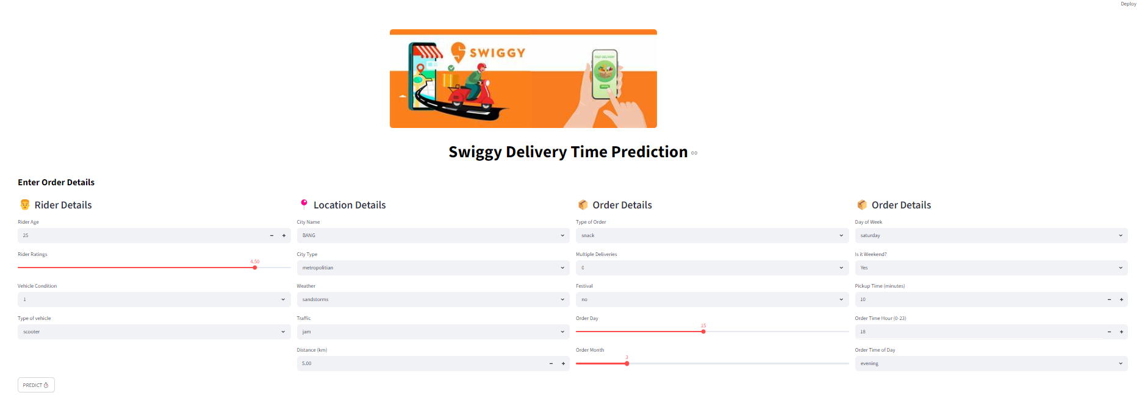
Model Deployment
Developed using Streamlit.
Built a user-friendly interface for entering delivery details and generating delivery time predictions.Deployed the application on Hugging Face Spaces for free cloud hosting
and public access.
https://huggingface.co/spaces/baddampravallika/Swiggy_Delivery_Time_Prediction

Slide 15
Challenges
The Problem: Two algorithms produced similar r2 scores, making it unclear which model would perform best in real-world conditions i.e (Random Forest & XGBoost).
The Solution: I compared the r2 scores of both training and validation sets to identify and resolve overfitting (where the model memorizes data) and underfitting (where it learns too little), ensuring the final model is both accurate and robust.

Slide 16
Key Insights
Distance is one of the most influential factors affecting delivery time.
Traffic conditions significantly increase delivery duration.
Orders during peak hours and weekends tend to have longer delivery times.
Weather conditions impact delivery efficiency and ETA accuracy.
XGBoost outperformed traditional models such as Linear Regression, KNN, Decision Tree, and Random Forest.

Slide 17
Recommendations
Improve ETA accuracy using traffic and distance data.
Optimize rider allocation during peak hours.
Incorporate real-time traffic and weather updates.
Continuously retrain the model with new delivery data.
Use predictive ETAs to enhance customer satisfaction.

Slide 18
Conclusion
Developed a machine learning model to predict Swiggy delivery times using rider, order, traffic, weather, and distance-related features.
XGBoost achieved the best performance with an R² score of 81.28%, demonstrating strong predictive capability.
deployed Streamlit application enables real-time delivery time estimation for end users.

Slide 19


Slide 20

THANK
YOU

