Slide 1

Unified Complaint
Intelligence Using NLP
Presented by: B. Pravallika
Batch No: 480

Slide 2
About Me
B. Pravallika
B.Tech – Computer Science and Engineering
Nalla Malla Reddy Engineering College
Interested in using data, machine learning and NLP to solve real-world problems.
2

Slide 3
Agenda
• Introduction
• CRISP-ML(Q)
• Business Problem
• Objective
• Dataset Overview
• Data Preprocessing
• Text Representation
• Model Building
• Model Evaluation
• Hyperparameter Tuning
• Prediction / Inference
• Challenges
• Key Insights
• Recommendations
• Conclusion
3

Slide 4
Introduction
Customer complaints contain valuable information about product problems, customer issues and specific sub-issues. However, complaint narratives are unstructured text and are difficult to categorize manually at scale.
This project develops a unified NLP system that reads a complaint narrative and predicts three related labels: Problem, Issue and Sub-Issue.
4

Slide 5
CRISP-ML(Q)
Business & Data Understanding
Understand complaint data, label hierarchy and business need
Data Preparation
Clean narratives, handle missing values and encode labels
Model Building
FastText embeddings + Bidirectional LSTM with 3 outputs
Evaluation
Classification report and validation monitoring
Optimization
Optuna Bayesian hyperparameter search
Inference
Preprocess new complaint and return 3 predicted labels
5

Slide 6
Business Problem
• Organizations receive large volumes of customer complaints through support and complaint channels.
• Manual reading and categorization is time-consuming and can lead to inconsistent classification.
• A complaint may contain multiple levels of information: the broad product/problem, the issue and the detailed sub-issue.
• An automated classifier can support faster routing, categorization and downstream complaint analysis.
6

Slide 7
Objective
• Build an NLP-based multi-task classification model for customer complaint narratives.
• Predict Problem, Issue and Sub-Issue from the same complaint text.
• Use FastText word embeddings to represent complaint vocabulary.
• Use a Bidirectional LSTM to learn contextual information from complaint narratives.
• Support inference on new complaint text through a reusable prediction function.
7

Slide 8
Dataset Overview
Original data
2,023,066 rows
11 columns
Modeling sample
First 100,000 records
Input
Complaint narrative
Problem
5 classes
Issue
98 classes
Sub-Issue
213 classes
Key fields include: product_5, narrative, Product, Date received, Sub-product, Issue, Sub-issue, Company, State and Timely response?.
The target hierarchy is: Complaint narrative → Problem → Issue → Sub-Issue.
8

Slide 9
Data Pre-processing
• Loaded complaints.csv and inspected shape, columns, duplicates and missing values.
• Reduced the dataset to the first 100,000 records for modeling.
• Removed the Unnamed: 0 index column.
• Filled missing values with the value 'unknown'.
• Selected narrative as the input and product_5, Issue and Sub-issue as the three targets.
• Applied LabelEncoder separately to Problem, Issue and Sub-Issue labels.
• Used an 80% training / 20% testing split.
9

Slide 10
Text Pre-processing & Tokenization
1. Normalize
Convert complaint text to lowercase
2. Clean
Remove unwanted symbols and standalone x tokens
3. Normalize money
Replace currency amounts with the token 'money'
4. Tokenize
Split cleaned text into words
5. Stopwords
Remove English stopwords
6. Integer sequences
Keras Tokenizer with num_words=40,000
Padding: maximum sequence length = 200; padding='pre'; truncating='post'.
10

Slide 11
Vectorization & Embedding
FastText
vector_size = 100
window = 10
min_count = 2
Training
workers = 5
epochs = 5
Embedding matrix
40,000 × 100
FastText vectors
The FastText model is trained on the tokenized training sentences. Its word vectors are copied into an embedding matrix and supplied to the Keras Embedding layer.
11

Slide 12
Model Building
Input
200-token sequence
Embedding
40,000 vocab
100-d vectors
BiLSTM
128 units
Dense
96 → 32
ReLU
3 Outputs
Problem: 5
Issue: 98
Sub-Issue: 213
Shared representation with three classification heads makes this a multi-task / multi-output classifier.
12

Slide 13
Training Configuration
• Loss: sparse_categorical_crossentropy for all three outputs.
• Metric: accuracy for Problem, Issue and Sub-Issue.
• Optimizer in the base model: Adam.
• Training epochs: 20; batch size: 256.
• Class balancing: compute_sample_weight(class_weight='balanced') separately for each output.
• Early stopping monitors validation loss with patience=5 and restores the best weights.
• Training uses the same held-out test split as validation_data in the notebook.
13

Slide 14
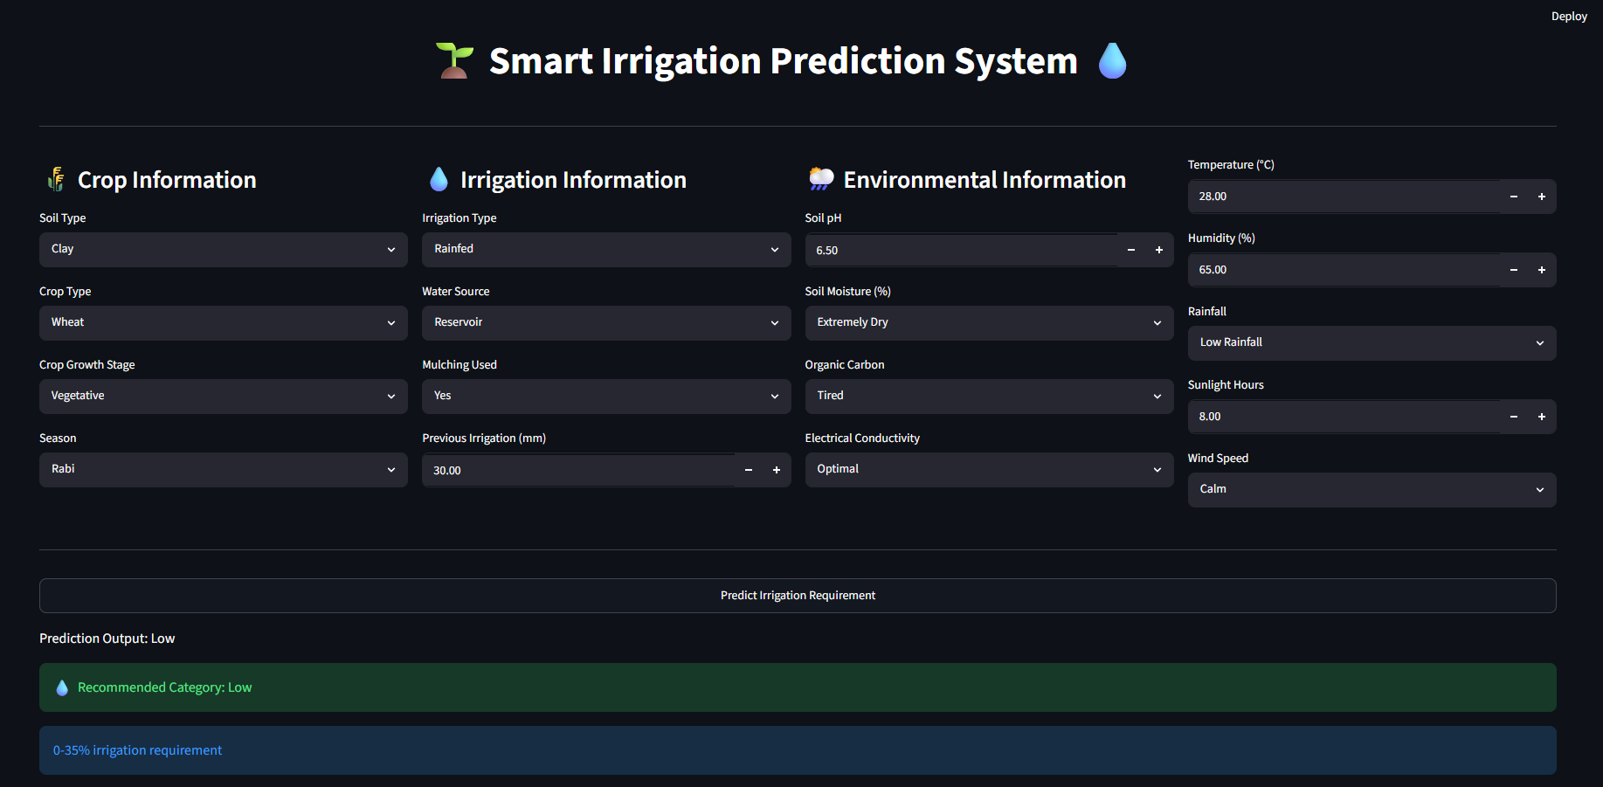
Model Evaluation
Evaluation method
classification_report
Reported output
Problem classification
Predictions
argmax on softmax outputs
The notebook contains evaluation code that predicts on x_test_pad and generates a classification report for the Problem output.
No final accuracy / precision / recall values are recorded in the notebook output, so this presentation does not invent or report unobserved scores.
14

Slide 15
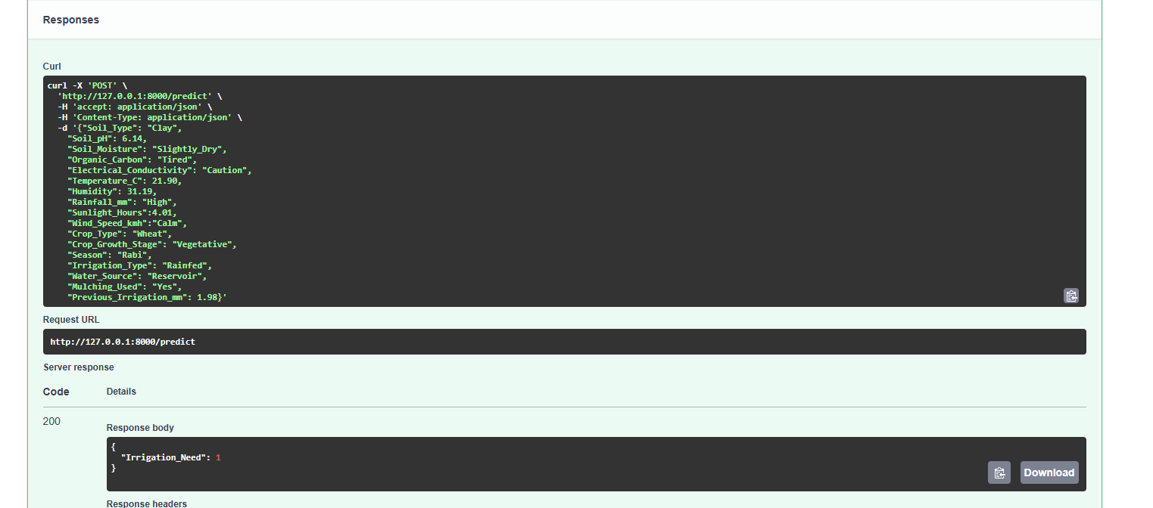
Hyperparameter Tuning – Optuna
• Optimization method: Optuna Bayesian-style search using an objective function.
• Number of trials configured: 20.
• LSTM units: 64–256.
• Number of Dense layers: 1–10; each layer can use 32–128 units.
• Epochs: 1–100; batch size: 6–128.
• Learning rate: 1e-4 to 1e-2.
• Activation: sigmoid, tanh or relu.
• Optimizer: SGD, Adagrad, RMSprop or Adam.
• First dropout rate: 0.1–0.5.
• Objective: average of the best validation accuracies for Problem, Issue and Sub-Issue.
15

Slide 16
Prediction / Inference Workflow
New complaint
Raw text
Preprocess
Clean text
Tokenize
Integer sequence
Pad
Length = 200
Model
3 outputs
The function predict_problem_n_issue() performs preprocessing, tokenization, padding and model prediction. Each softmax output is converted to a class index with argmax and decoded back to the original label using its LabelEncoder.
16

Slide 17
Challenges
• Highly imbalanced complaint categories, especially across many Issue and Sub-Issue labels.
• Large label space: 5 Problem classes, 98 Issue classes and 213 Sub-Issue classes.
• Complaint narratives are noisy and contain spelling variation, placeholders and monetary references.
• Maintaining consistent preprocessing between training and prediction is essential.
• Multi-output training requires aligned inputs and three target arrays with identical sample counts.
17

Slide 18
Key Insights
• The project converts unstructured complaint narratives into structured hierarchical labels.
• Problem classification is comparatively compact with 5 classes, while Sub-Issue classification is much more fine-grained with 213 classes.
• FastText provides a 100-dimensional word representation for the complaint vocabulary.
• Bidirectional LSTM captures information from both directions of the token sequence.
• One shared neural representation supports three related prediction tasks.
• Class-balanced sample weights and early stopping are used to address training challenges.
18

Slide 19
Recommendations
• Track separate performance metrics for Problem, Issue and Sub-Issue rather than relying only on one overall score.
• Investigate class-level precision, recall and F1 for rare Issue and Sub-Issue categories.
• Consider hierarchical prediction so Issue/Sub-Issue decisions can be constrained by the predicted parent category.
• Keep the preprocessing pipeline identical during training and production inference.
• Evaluate the tuned Optuna configuration against the base model on a fixed held-out test set.
• Consider modern transformer-based encoders for comparison with the BiLSTM baseline.
19

Slide 20

Conclusion
The notebook demonstrates a complete NLP workflow for customer complaint intelligence: data inspection, cleaning, text preprocessing, tokenization, FastText vectorization, multi-output BiLSTM modeling, class balancing, early stopping, evaluation and Optuna-based tuning.
The final system is designed to transform a complaint narrative into three structured predictions—Problem, Issue and Sub-Issue—supporting scalable complaint categorization.
20

Slide 21

THANK YOU
Unified Complaint Intelligence Using NLP

