Slide 1
LOGISIM

Slide 2
IMPORTANT POINTS
Logisim is a logic simulator which permits circuits to be designed and simulated using a graphical user interface.
Its code is Java using the Swing graphical user interface library.
The software is used most often by students in computer science classes to design and experiment with digital circuits in simulation.

Slide 3
WHAT LOGISIM CAN DO
Circuits are designed in Logisim using a graphical user interface similar to traditional drawing programs, an interface also found in many other simulator.
Unlike most other simulators of Logisim's sophistication, Logisim allows the user to edit the circuit during simulation.
It saves lot of time and effort. It helps the creative minds explore more and discover more.

Slide 4
Basic Interface

Slide 5
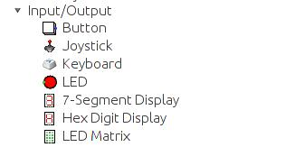
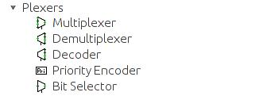

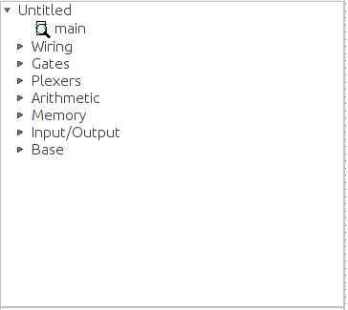
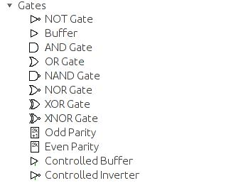
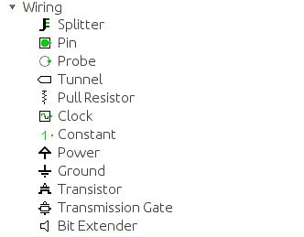
DIFFERENT COMPONENTS OF EXPLORAR PLANE

Slide 6
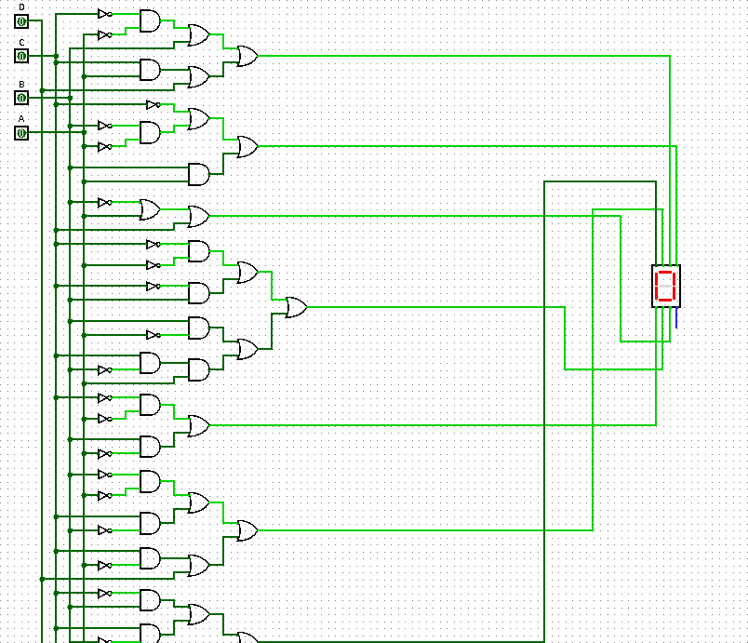
Digital display

Slide 7
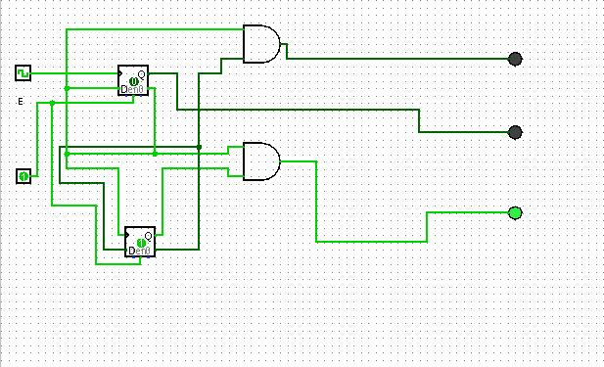
Traffic light

Slide 8
THANK YOU

