Slide 1
Autobahn
Traffic sign classification
Paul, Georg, 이장호, 이주현, 이지은

Slide 2
todo
finish making ppt
write script
~11/29
find video

Slide 3
Content
Project introduction : 30s~1m /지은
What is YOLO? : 1~2m / paul
Reference Paper : 2m /장호
Data labeling : 1m /georg -> upload labeling please
Implementation : 2~3m /주현
Result : 1~2m /지은

Slide 4
Project introduction
traffic classification~~~

Slide 5
2. What is YOLO?
explain yolo~~
compare with other models

Slide 6
3. Reference Paper
https://ieeexplore.ieee.org/document/8649887

Slide 7
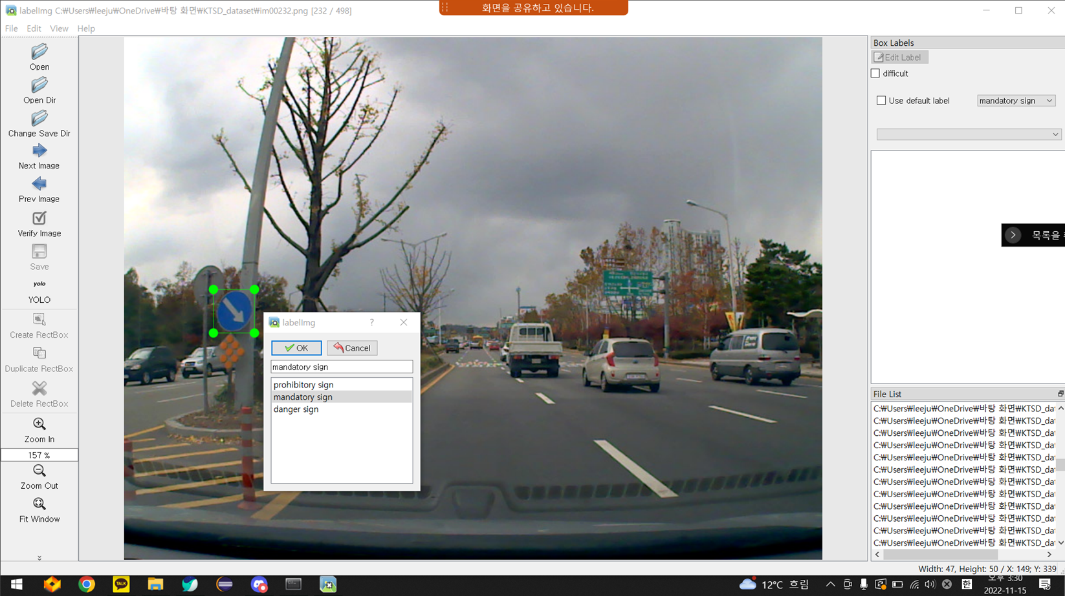
4. Data labeling
https://hc.hanyang.ac.kr/web/dslab/dataset?p_p_id=20&p_p_lifecycle=0&p_p_state=normal&p_p_mode=view&p_p_col_id=column-1&p_p_col_count=1&_20_struts_action=%2Fdocument_library%2Fview&_20_folderId=365651

Slide 8
5. Implementation
core code

Slide 9
6. Result
accuracy

Slide 10
약 500장의 데이터

