Slide 1
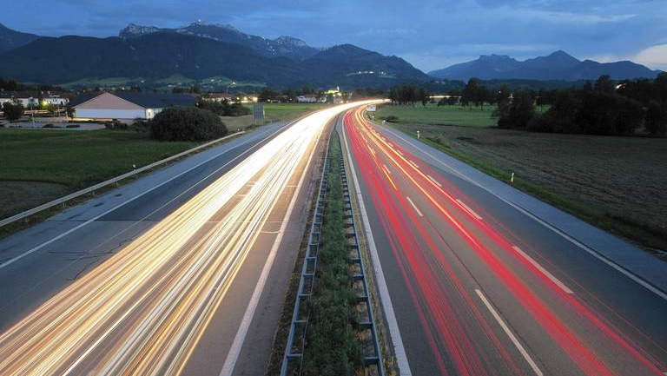

Autobahn
Traffic sign classification
Paul, Georg, 이장호, 이주현, 이지은

Slide 2
todo
finish making ppt
write script
~11/29
find video

Slide 3
Content
Project introduction : 30s~1m /지은
What is YOLO? : 1~2m / paul
Reference Paper : 2m /장호
Data labeling : 1m /georg -> upload labeling please
Implementation : 2~3m /주현
Result : 1~2m /지은

Slide 4
Project introduction
traffic classification~~~

Slide 5
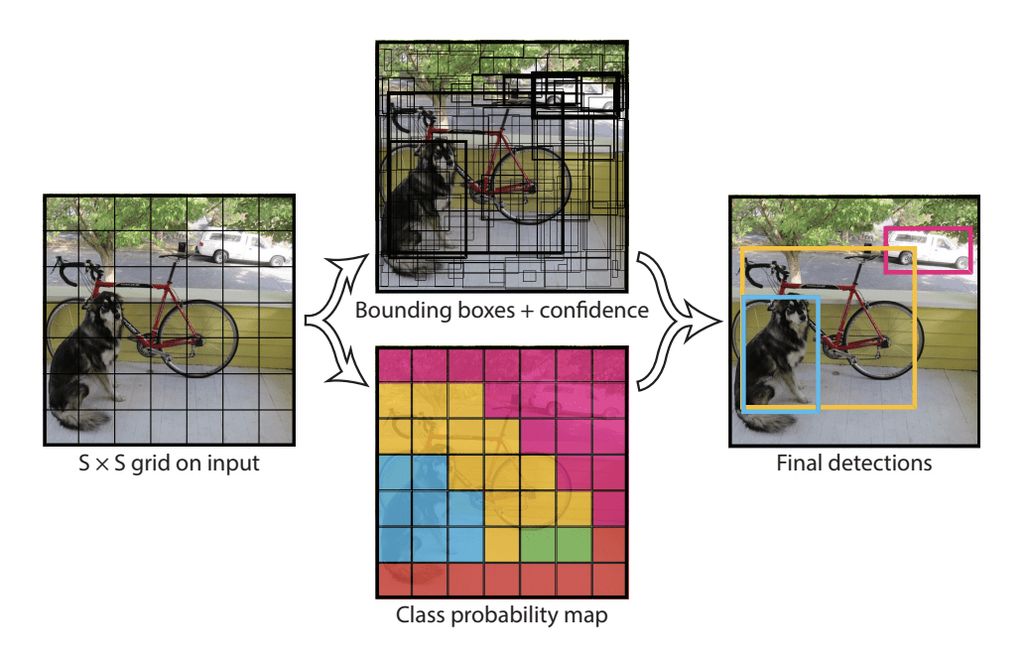
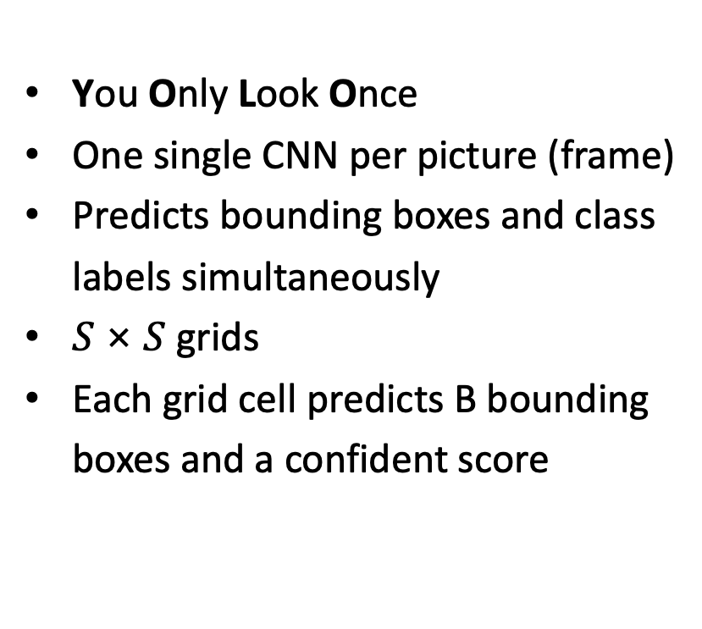
2. What is YOLO?
You Only Look Once
One single CNN per picture (frame)
Predicts bounding boxes and class
labels simultaneously
$S \text{×} S$ grids
Each grid cell predicts B bounding
boxes and a confident score
YOLO Architecture [1]

Slide 6
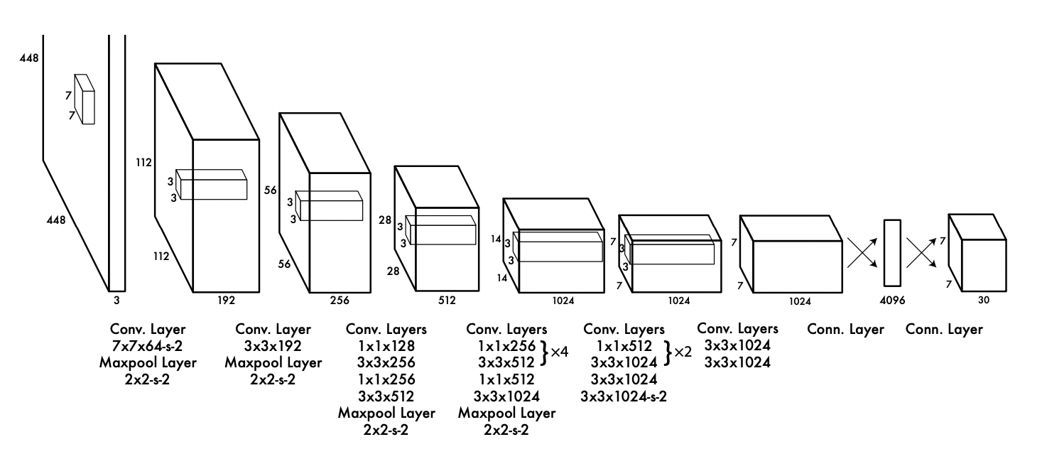
2. What is YOLO?
YOLO Architecture [1]

Slide 7

2. What is YOLO?
$S \text{×} S \text{×} (B∗5+C)$
Example: $S=7,$ $B=2,$ $C=20$
YOLO Architecture [1]

Slide 8

2. What is YOLO?
$S \text{×} S \text{×} (B∗5+C)$
Example: $S=7,$ $B=2,$ $C=20$
→ Output:$7 \text{×} 7 \text{×} 30$
YOLO Architecture [1]

Slide 9
2. What is YOLO?
$S \text{×} S \text{×} (B∗5+C)$
Example: $S=7,$ $B=2,$ $C=20$
→ Output:$7 \text{×} 7 \text{×} 30$
YOLO Architecture [1]
$${pred}_{cell}=\left[C_{1},C_{2},…,C_{20},p_{c1},x,y,w,h,p_{c2},x,y,w,h\right]$$
20 different classes
Box1
Box2

Slide 10
3. Reference Paper
https://ieeexplore.ieee.org/document/8649887

Slide 11
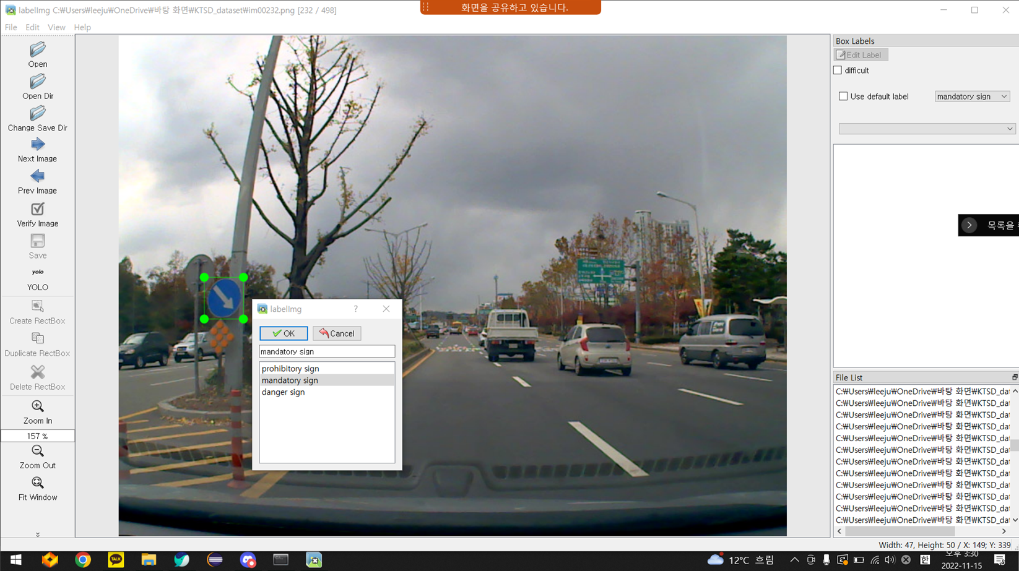
4. Data labeling
https://hc.hanyang.ac.kr/web/dslab/dataset?p_p_id=20&p_p_lifecycle=0&p_p_state=normal&p_p_mode=view&p_p_col_id=column-1&p_p_col_count=1&_20_struts_action=%2Fdocument_library%2Fview&_20_folderId=365651

Slide 12
5. Implementation
core code

Slide 13
6. Result
accuracy

Slide 14
약 500장의 데이터

Slide 15
Sources
[1] J. Redmon, S. Divvala, R. Girshick, and A. Farhadi. You only look once: Unified, real-time object
detecotion. arXiv preprint arXiv:1506.02640, 2015.

