Slide 1







Stack Overflow Survey Analysis
BADER ALMUTLAQ
21/07/2024

Slide 2



OUTLINE
Executive Summary
Introduction
Methodology
Results
Visualization – Charts
Dashboard
Discussion
Findings & Implications
Conclusion
Appendix

Slide 3

EXECUTIVE SUMMARY
This project is part of IBM data analysis capstone course
The aim is to analyze the survey data collected from software professional.
The data was collected from Stack Overflow under ODbL: Open Database License.
After collecting the data, we conducted the following
Exploring the data set and understanding the data set.
Cleaning the data and processing it to make it ready for analysis
Preforming exploratory data analysis on the data set
Creating visualization to analyze the data
Crating a dashboard to catch key findings
Findings: The focus of the analysis was on the respondents demographics, currently used technologies, and the future trending technologies and platforms

Slide 4

INTRODUCTION
Stack Overflow conducted an online survey of software professional across the world.
The survey included questions about their personal information, their experience, programming languages and platform they use, and programming languages and platform the want to learn
Using this survey, we can understand the currently used technology and the trending ones that professionals want to learn in the future.

Slide 5

METHODOLOGY
Data set was collected from Stack Overflow under ODbL: Open Database License.
The data set was stored in a pandas data frame to preform some analysis and explore the data.
The data set was cleaned and processed to make it ready for the analysis using pandas.
Visualization and statistics were created to analyze the data set.
Key findings were captured in a dashboard

Slide 6
RESULTS
From the survey we can see that a lot of the software professionals are males this could indicate that this field interest the males more than females.
Web development is very big field affecting the technologies used.
SQL databases are the most used databases given their features.
JavaScript HTML/CSS are the top languages since they are heavy used in web development.
New languages and databases are immerging to the top 10 since the needs and requirements are rapidly changing the the IT field.

Slide 7
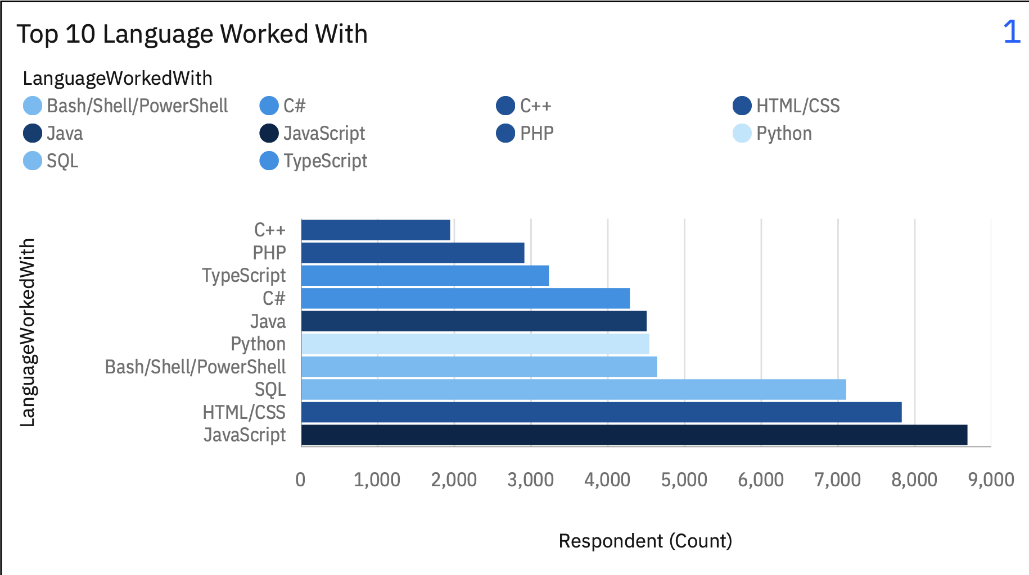
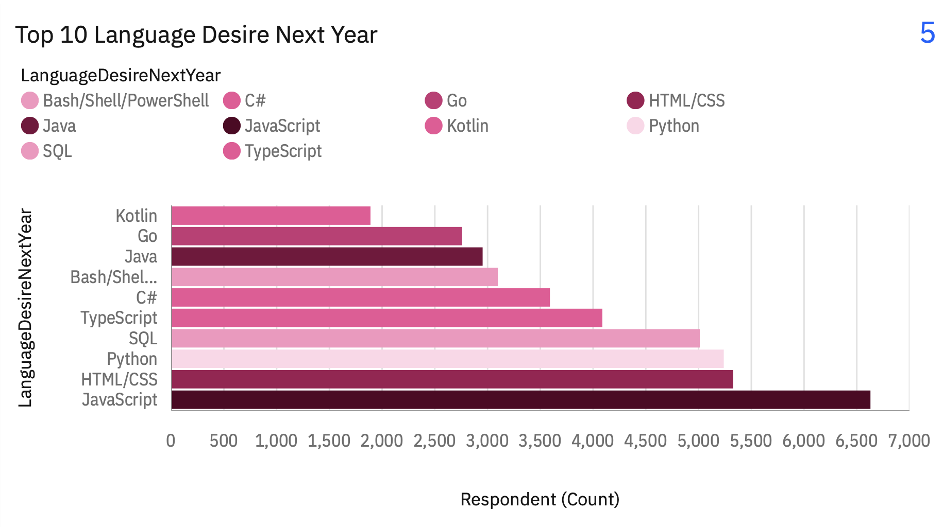
PROGRAMMING LANGUAGE TRENDS
Current Year
Next Year
<Bar chart of top 10 programming languages for the current year goes here.>

Slide 8
PROGRAMMING LANGUAGE TRENDS - FINDINGS & IMPLICATIONS
Findings
JavaScript is the most used language
We can see HTML/CSS and SQL coming second and third since they are used widely in web development with JavaScript
Finding 3
Implications
JavaScript is still number one language which indicated its importance
HTML/CSS and SQL are still second and third since web development is still an important skill
PHP is no longer in the top 10 since it is older, and we can see new languages in the top 10 such as GO and Kotlin

Slide 9
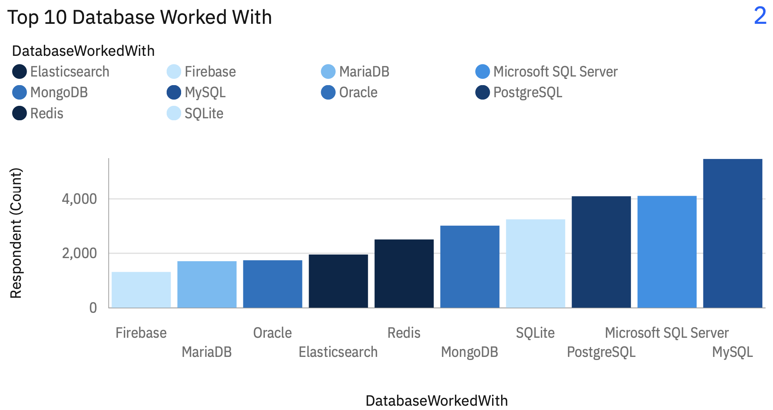
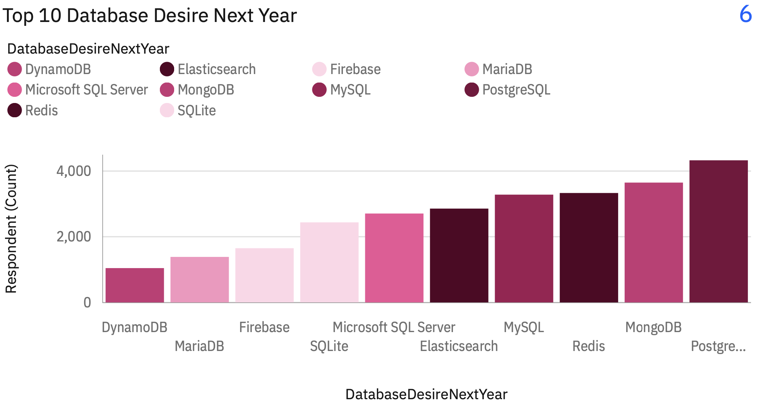
DATABASE TRENDS
Current Year
Next Year

Slide 10
DATABASE TRENDS - FINDINGS & IMPLICATIONS
Findings
MySQL Server is the most used database
SQL databases are mostly used compared to NoSQL
SQL lite is the fourth most used database since its very light.
Implications
PostgreSQL is the most wanted database to learn while it was the third most used one.
MongoDB is the second wanted database coming from fifth
We can see many NoSQL databases ranking higher since it’s a new technology and it's wanted in the future.

Slide 11

DASHBOARD
< https://github.com/Bader-Almutlaq/FinalDashboard.>

Slide 12
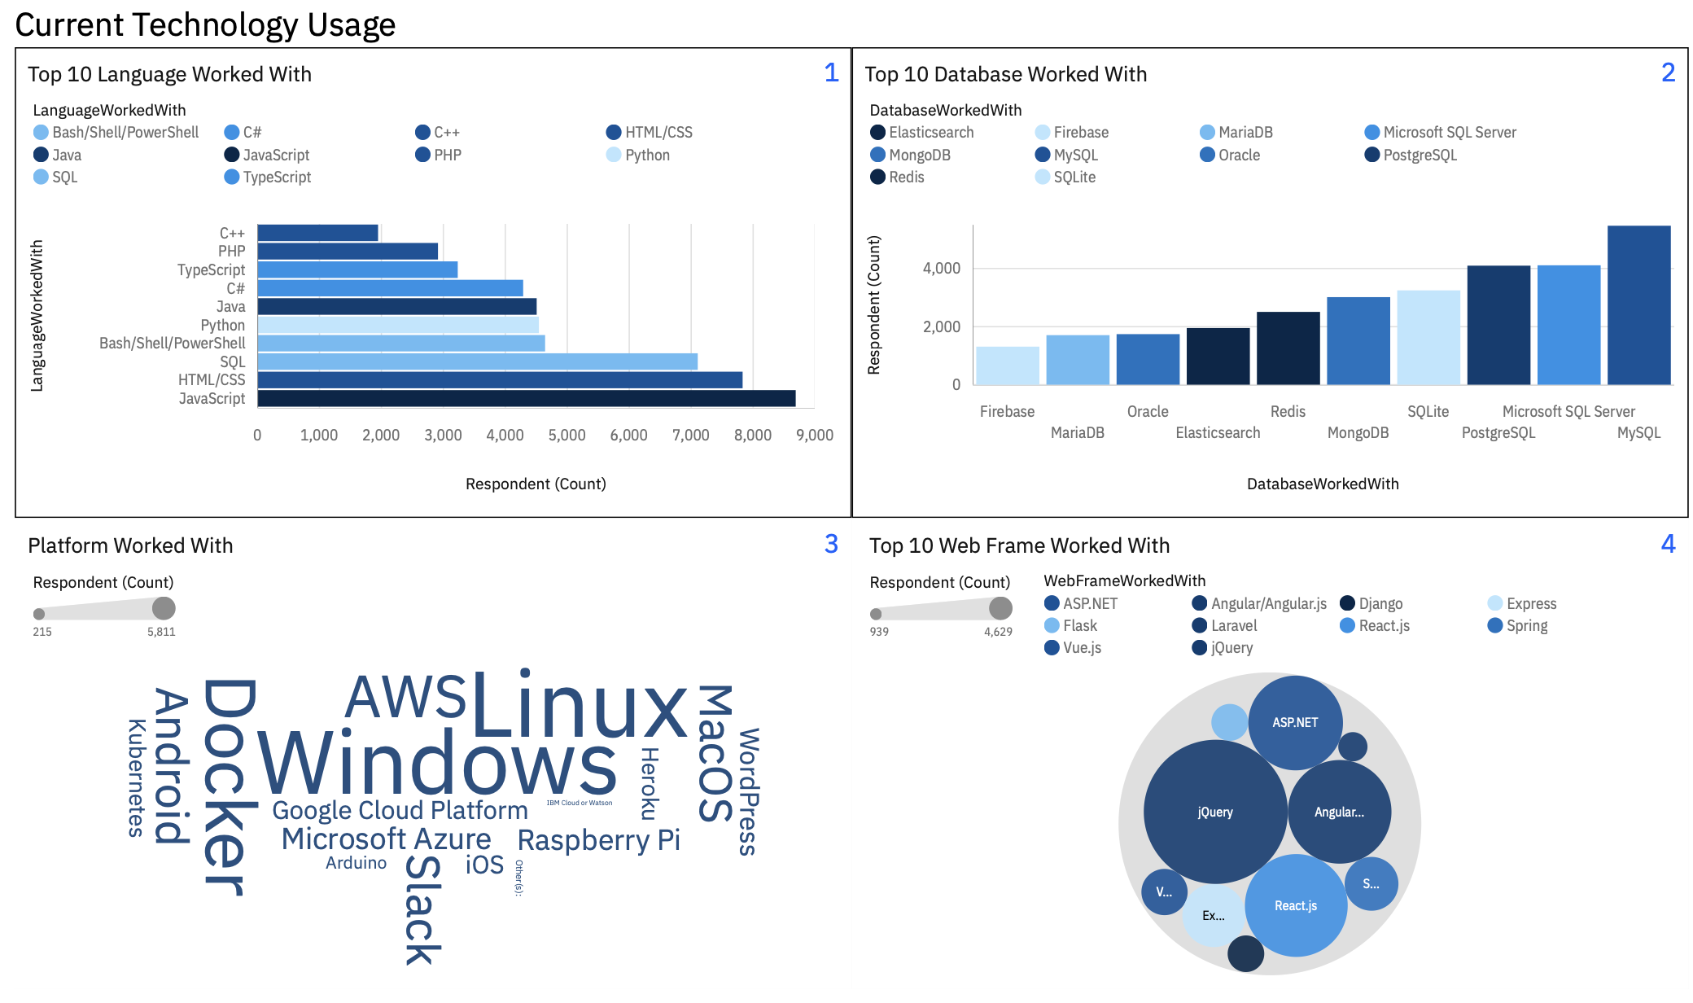
DASHBOARD TAB 1

Slide 13
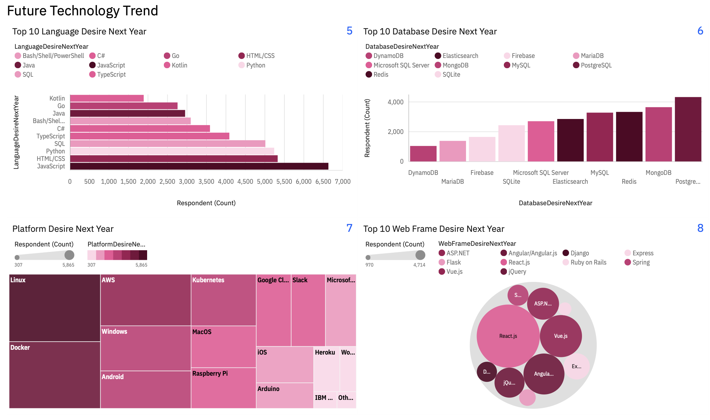
DASHBOARD TAB 2

Slide 14
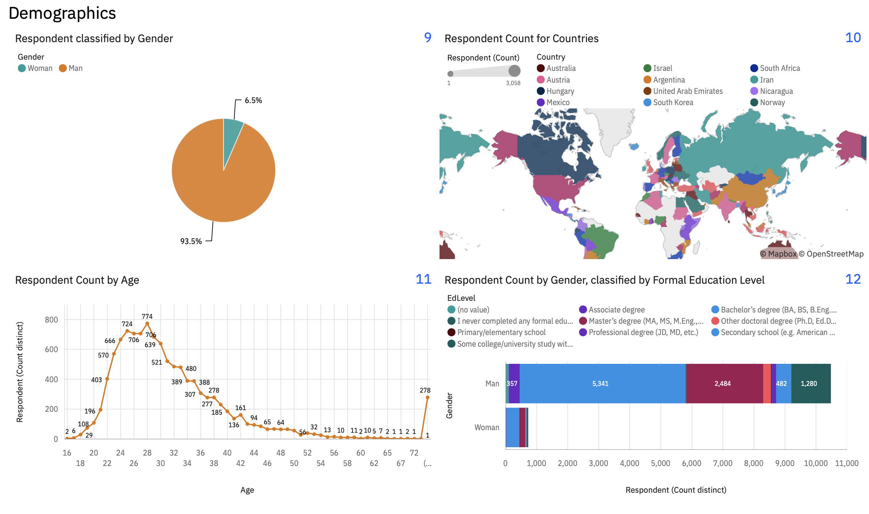
DASHBOARD TAB 3

Slide 15
DISCUSSION
From the previous results we can see that software professionals are currently using technologies that are still wanted in the future sine many of them want to learn it.
Also, the immerging of new languages and databases as requirements changes for example NoSQL to handle big data that SQL can’t handle very will.

Slide 16
OVERALL FINDINGS & IMPLICATIONS
Findings
MySQL Server is the most used database
JavaScript is the most used language
Web based tools are widely used
Implications
PostgreSQL is the most wanted database to learn.
JavaScript is still number one language which indicated its importance
New technologies are wanted such as NoSQL

Slide 17

CONCLUSION
SQL databases are the most used currently
NoSQL database is immerging, and professionals are trying to learn it
JavaScript is the most used and desired language
We can see that web base development languages and databases are at the top because the highly use of websites.

Slide 18
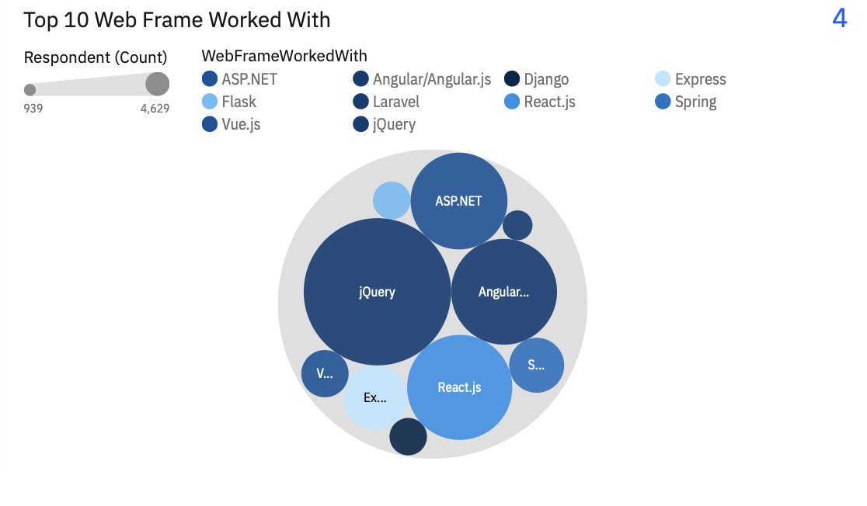
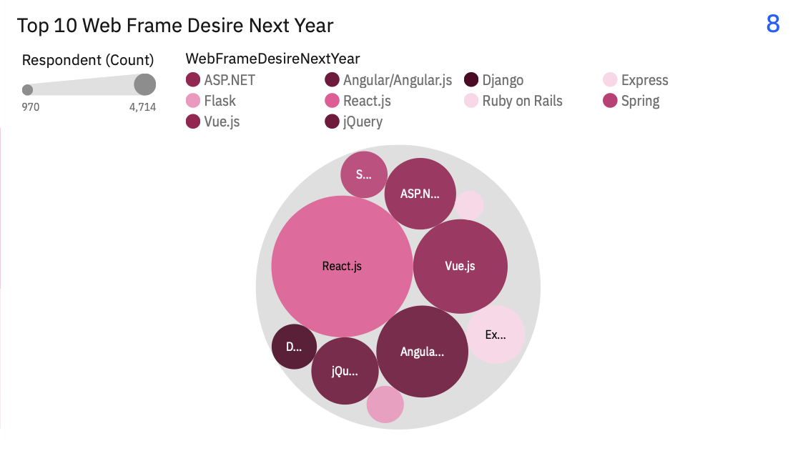
APPENDIX

Slide 19
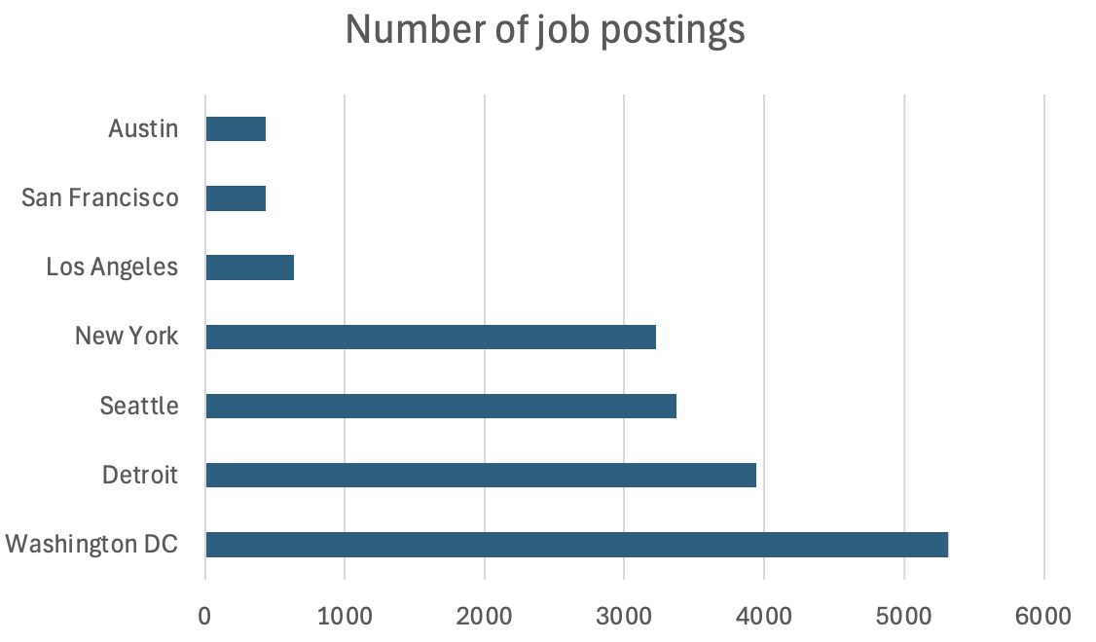
JOB POSTINGS

Slide 20
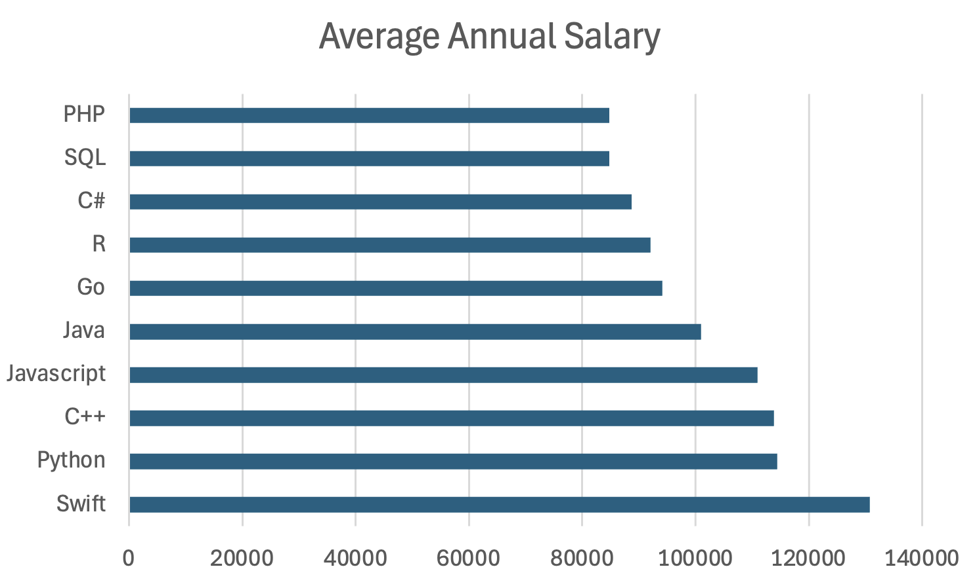
POPULAR LANGUAGES

