Slide 1





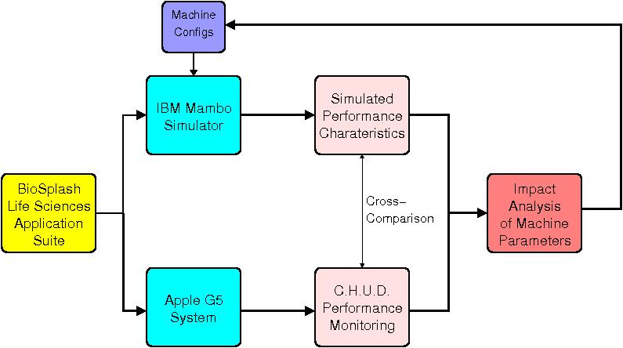

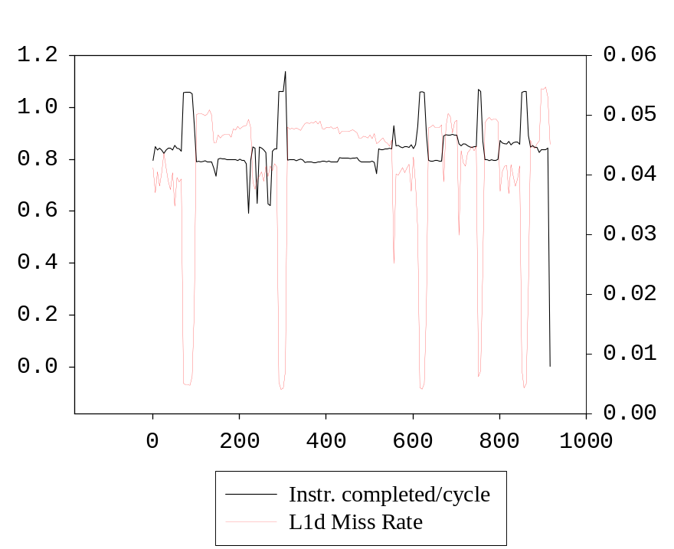
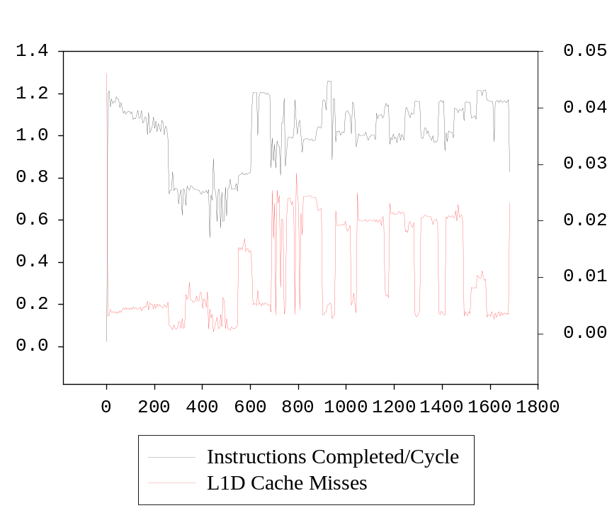
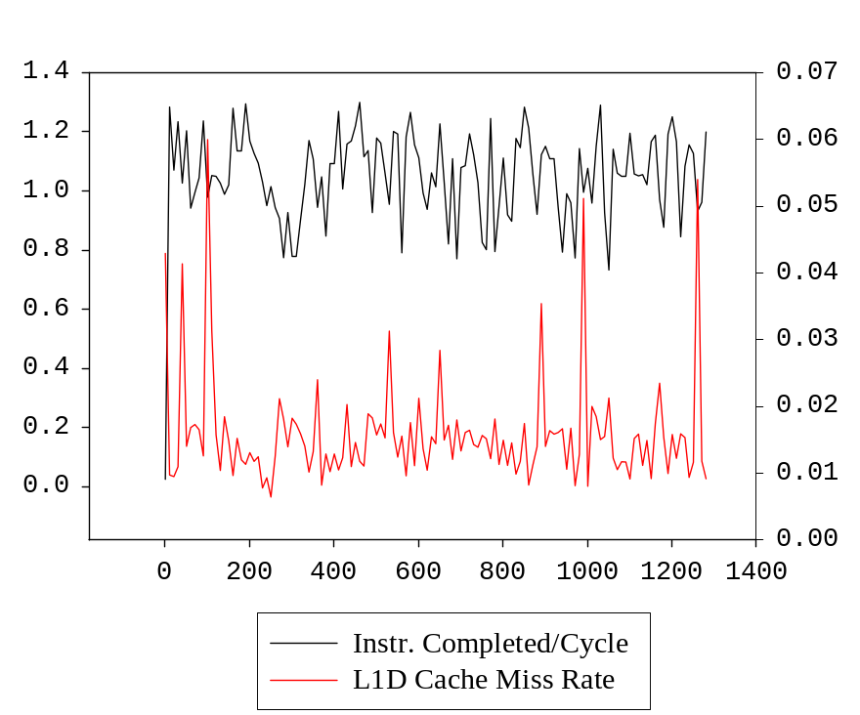

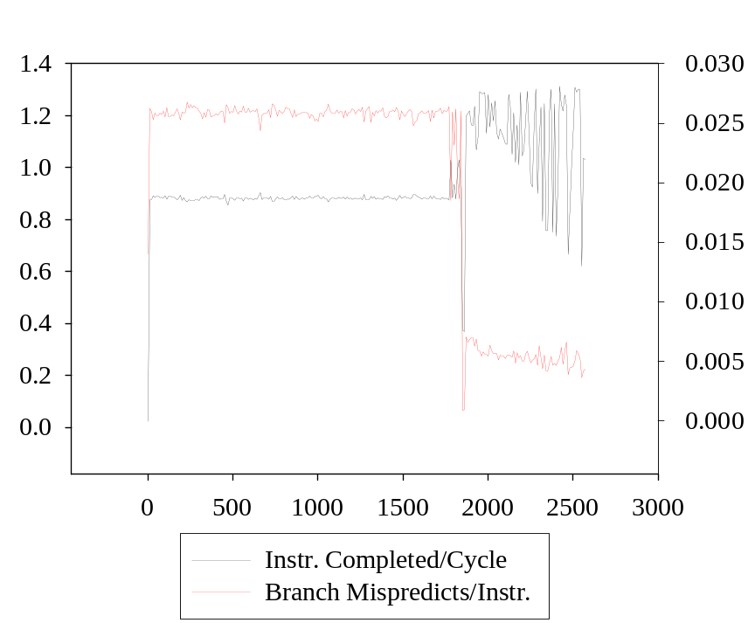
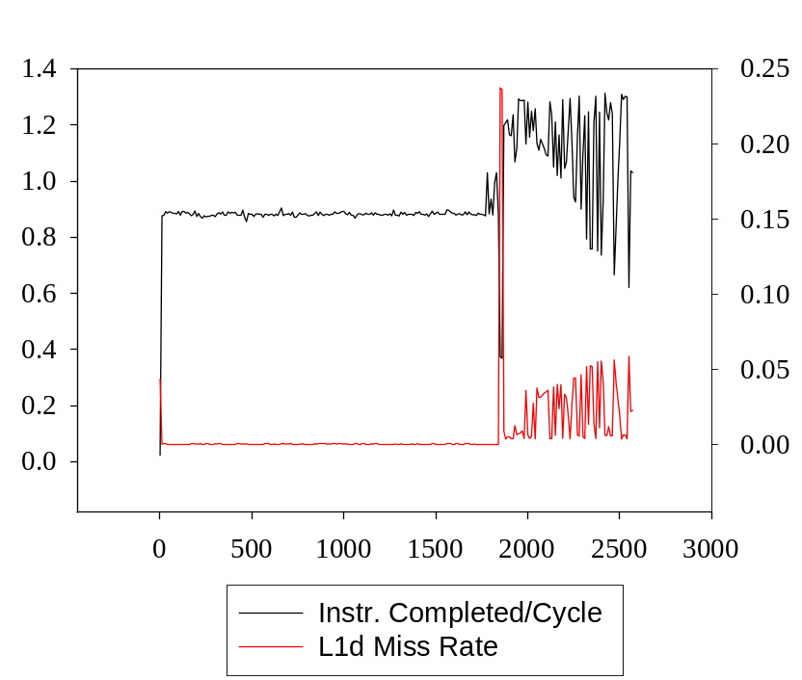
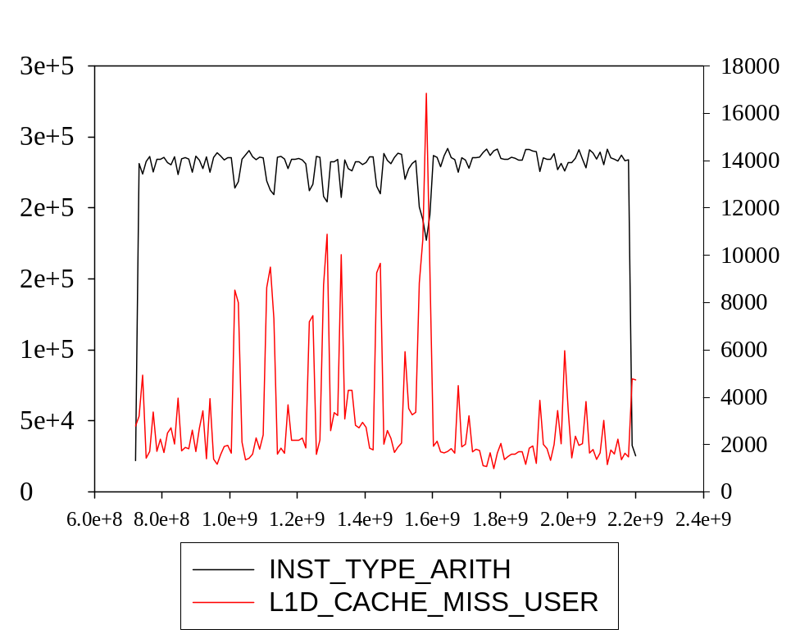
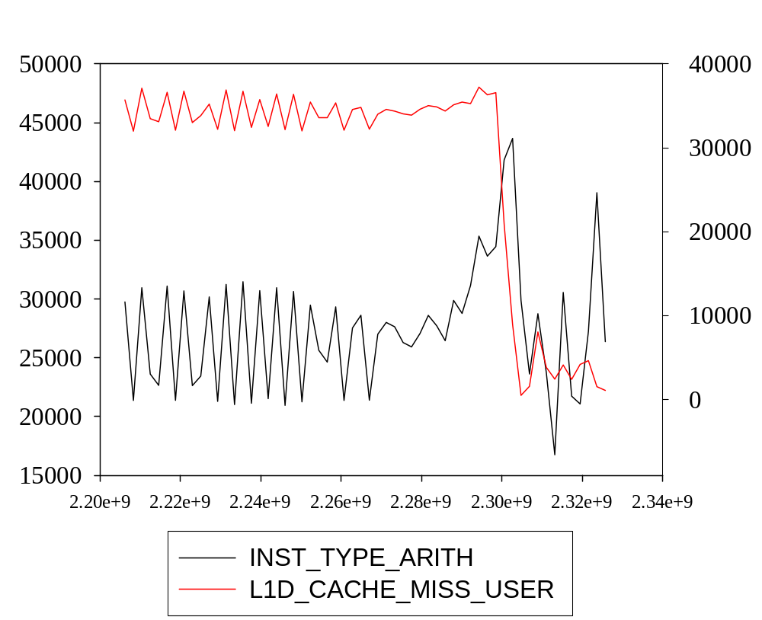
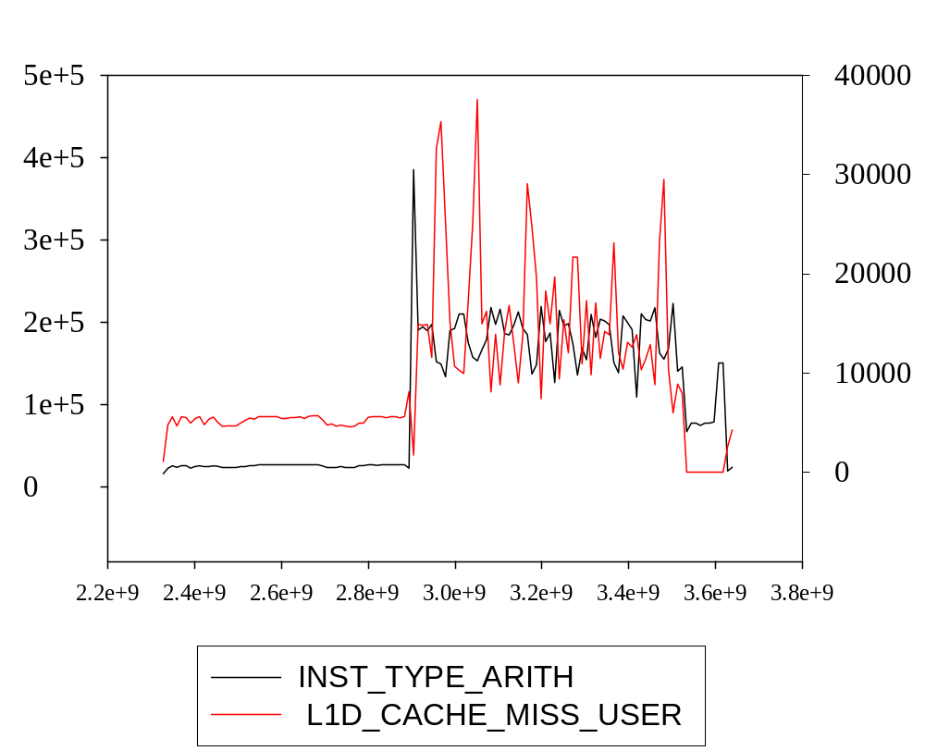
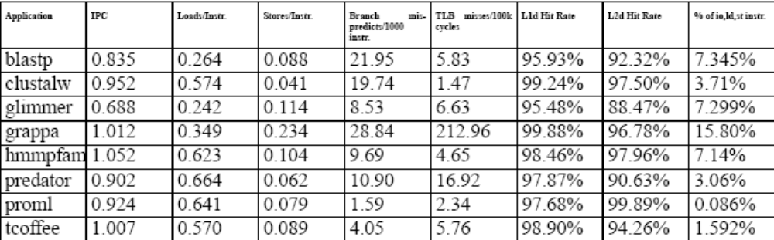

Incorporating Life Science Applications into the Architectural Optimizations of Next-Generation Petaflops Systems
David A. Bader
Georgia Institute of Technology
Vipin Sachdeva
University of New Mexico
Introduction
Performance Analysis
. BioPerf is a suite of representative applications that we have assembled from the computational biology community, where the codes are carefully selected to span a breadth of algorithms and performance characteristics. We have analyzed the complexity of these codes, at the instruction and memory level, using “live” and aggregate data on contemporary high-performance architectures (Apple G5 with the IBM PowerPC 970), and on the IBM cycle-accurate simulator Mambo, previously used to design supercomputers such as IBM p-Series and BlueGene, and currently being used to model future systems.
Hence, our work is novel in that it is one of the first efforts to incorporate life science application performance for optimizing high-end computer system architectures. Through dual-platform performance analysis, we offer system design parameters for machine configurations that may improve the performance of these codes. We target this suite for impact to both biologists and computer scientists for the evaluation of systems running bioinformatics applications.
Performance Analysis through live data
Methodology
Performance Analysis through live data
Blast, hmmpfam, and tcoffee performance graphs (from left to right)
Instructions per cycle increases in the same cycle that the L1 data miss rate decreases.
We can thus correlate the performance of the application as it varies, with the system metrics impacting it.
Instruction Profiling
BioPerf
Separated Regions of Performance
The following codes are included in BioPerf
Package Executable
BLAST blastn, blastp
FASTA fasta34_t, ssearch34_t
CLUSTALW clustalw, clustalw_smp
HMMER hmmsearch, hmmpfam
T-COFFEE tcoffee
GLIMMER glimmer, glimmer-package
PHYLIP dnapenny, promlk
GRAPPA grappa
CE ce
PREDATOR predator
Clustalw’s livegraphs with L1d miss rate and branch mispredicts (top left and right).
Performance of the last phase of clustalw is more closely related to branch mispredicts than L1 data miss rate.
Cumulative Metrics
ClustalW region I (top), II (bottom left) and III (bottom right) showing differences in algorithmic complexity and memory access pattern.
Clustalw’s performance is roughly categorized into three regions.
• Every sequence is compared against every other sequence by Smith Waterman, a quadratic time complexity dynamic programming algorithm,
• The neighbor joining method in which comparison score of sequences is used to make a guide tree with the sequences at the leaves of the tree
• The sequences are combined into a multiple sequence alignment according to the guide tree.
www.bioperf.org

