Slide 1

Accounting System
Ccapstone 3
Java Spring boot Bootcamp

Slide 2
Introduction
Welcome to Our System, a robust and efficient solution designed to streamline and enhance your financial management and accounting processes. Our system is crafted to meet the diverse needs of businesses, providing comprehensive tools to manage company finances, customer relations, employee , expenses, inventory, products, reports, and supplier interactions.

Slide 3
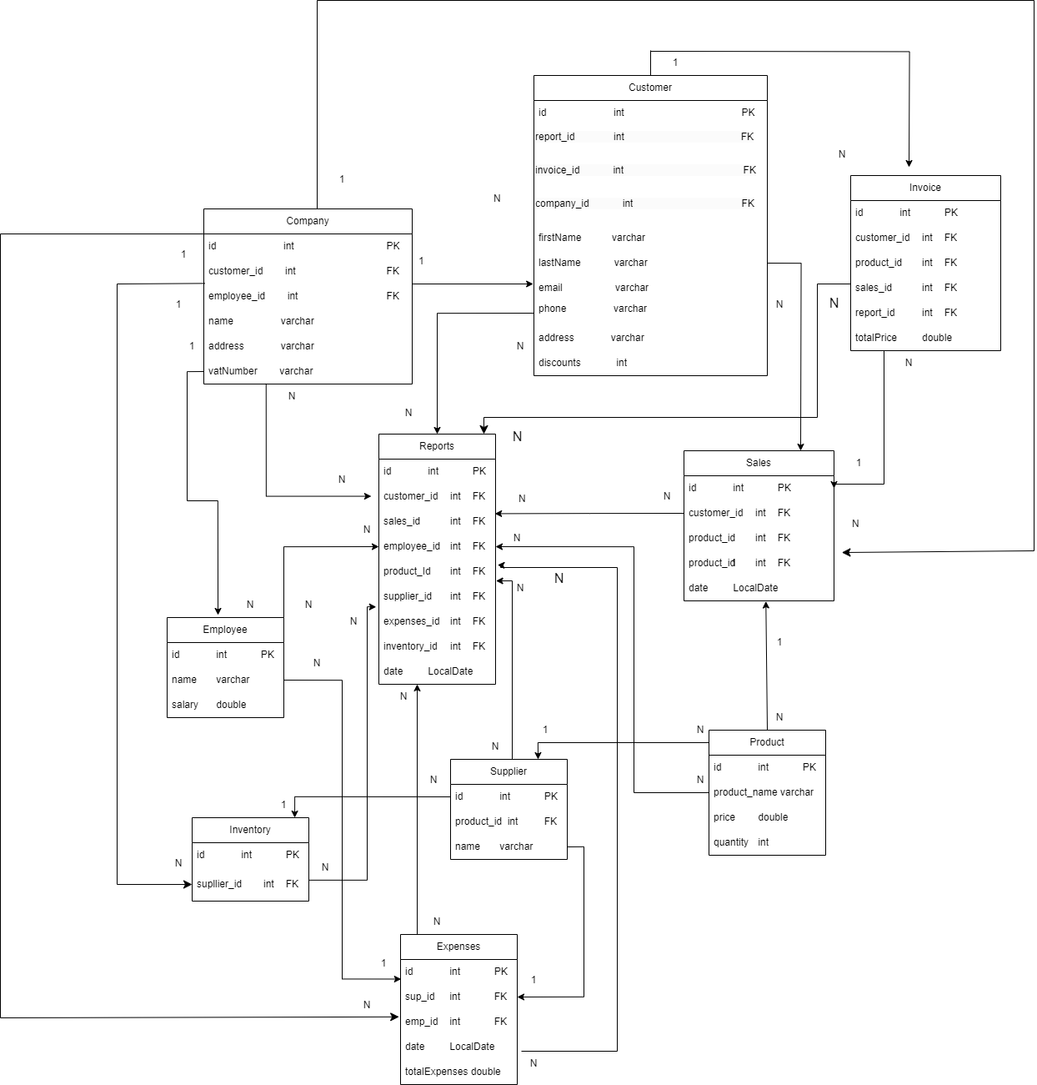

Slide 4
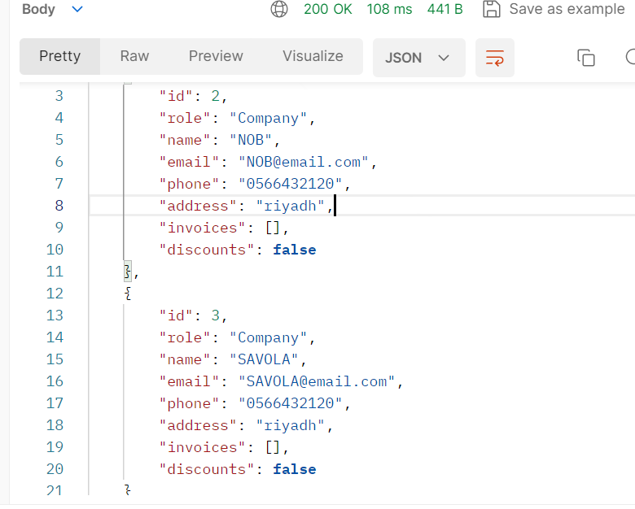
Get Customer By Company

Slide 5
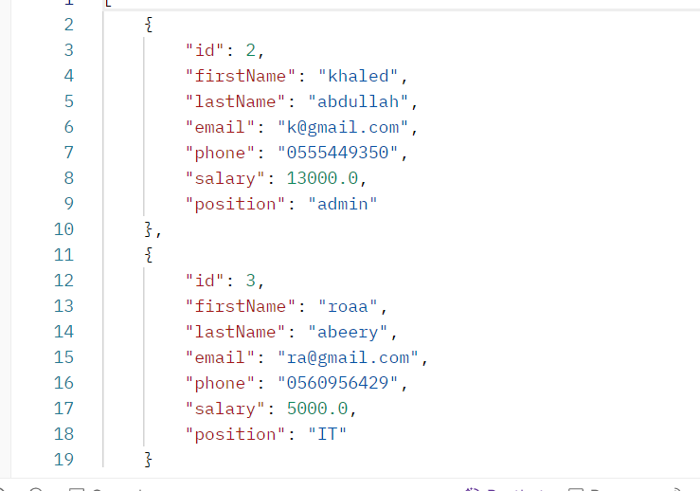
2. Get Employee By Company

Slide 6
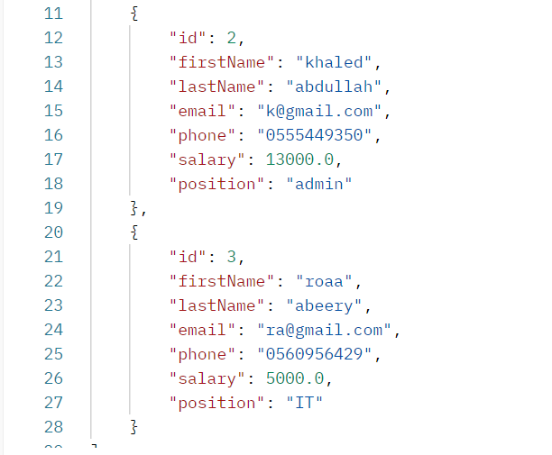
3. Get Employee By Range Of Salary

Slide 7
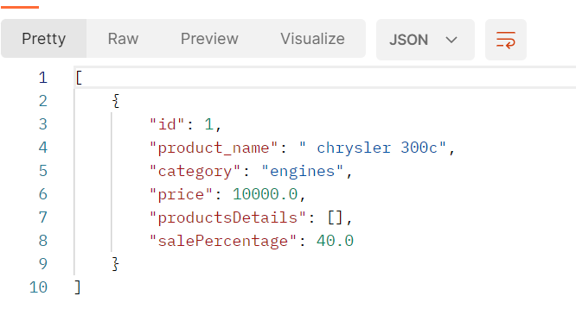
4. Get Product By Category

Slide 8
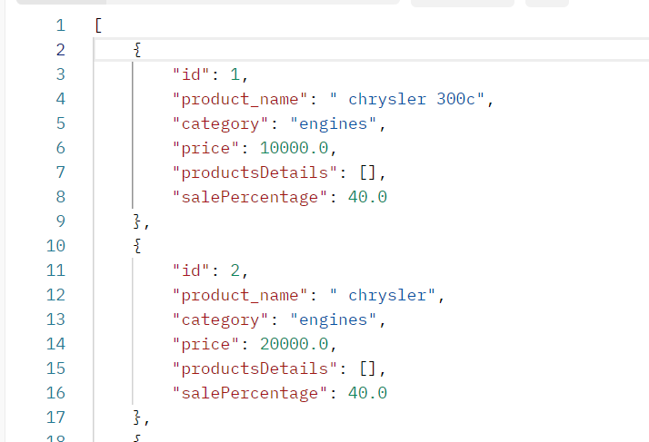
5. Get Product By Range Of Price

Slide 9
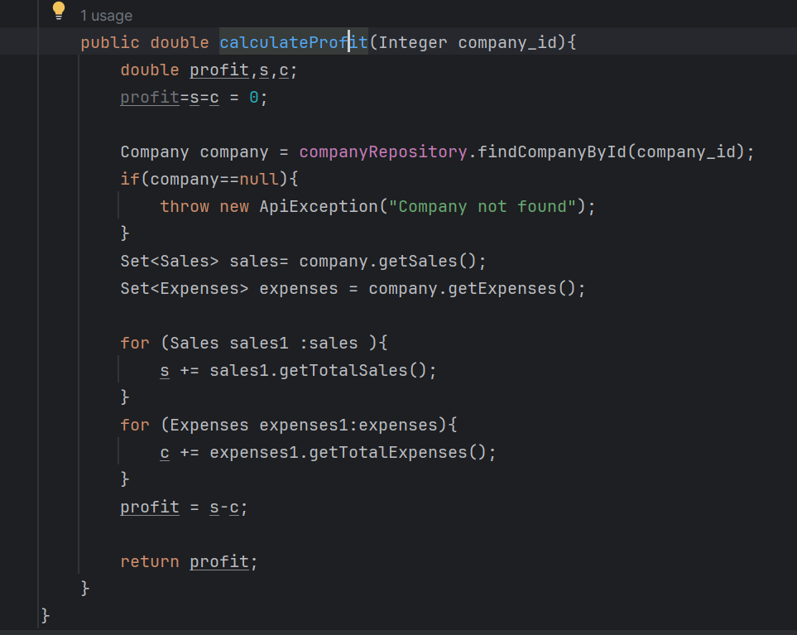
6. Get Company profits

Slide 10
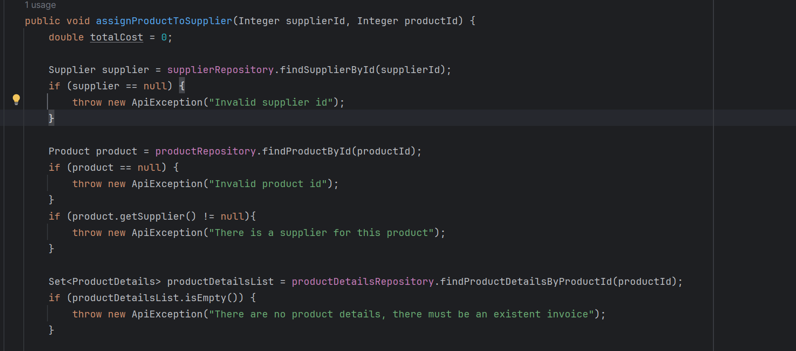
7. Check if product assign to supplier

Slide 11
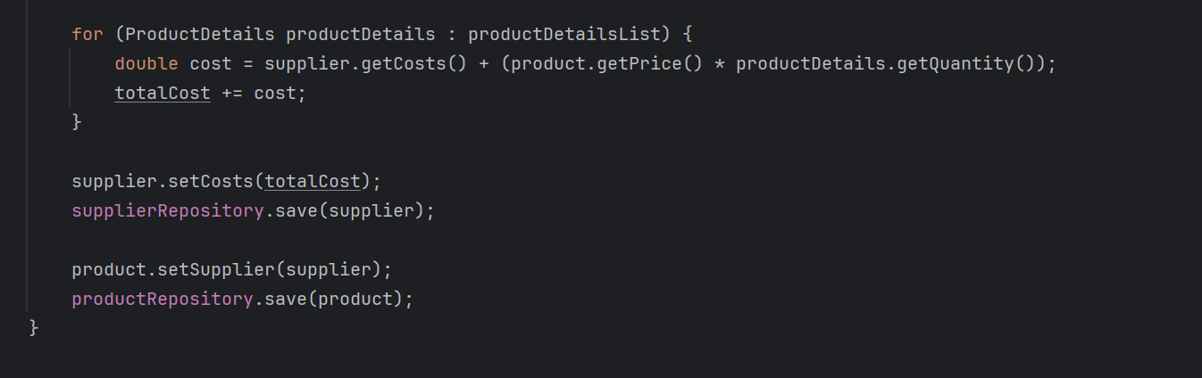
7. Check if product assign to supplier

Slide 12
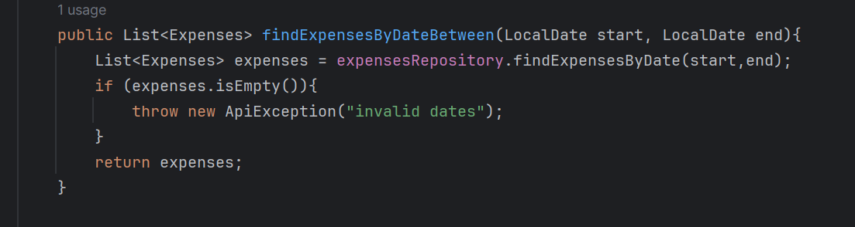
8. Find expenses By Date Range

Slide 13
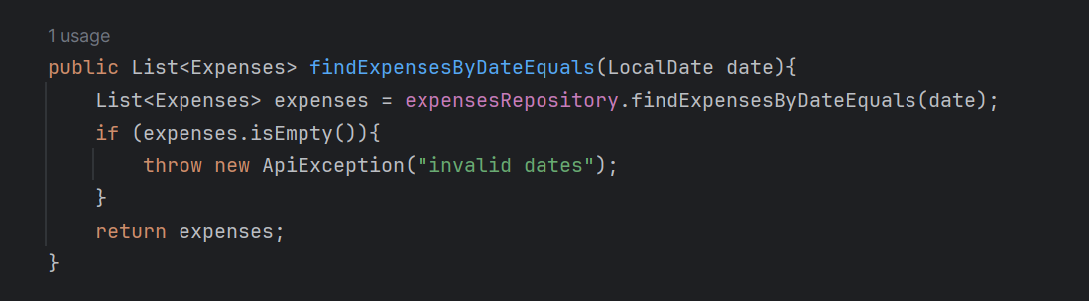
9. Find expenses By Date

Slide 14
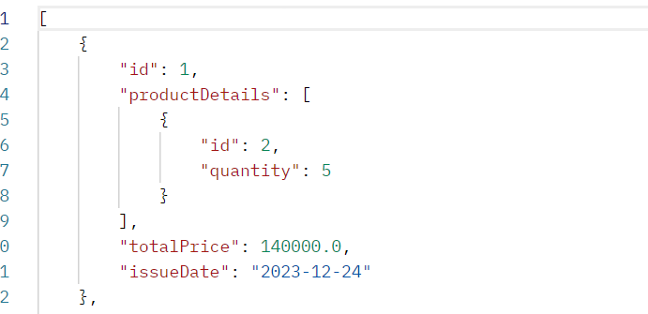
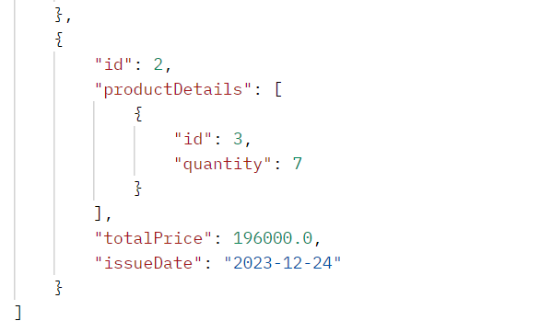
10. Find Invoices By Customer Id

Slide 15
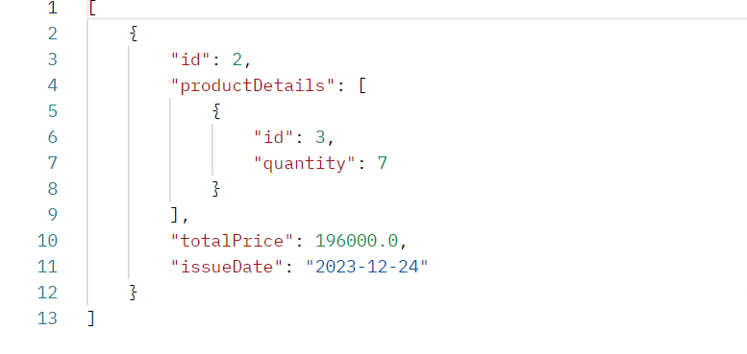
11. Find Invoices By Total Price

Slide 16
12. Find Invoices By less than Total Price

Slide 17
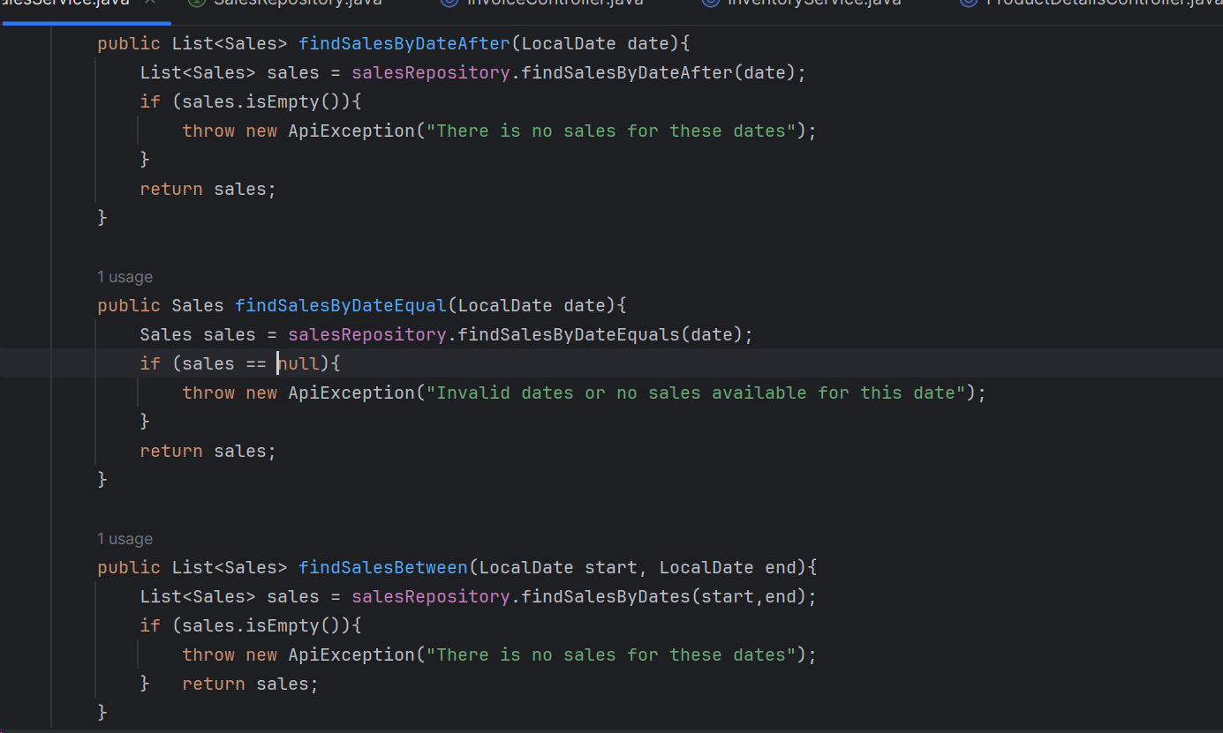
13. Find Sales By Date After

Slide 18
14. Find Sales By Date Equal

Slide 19
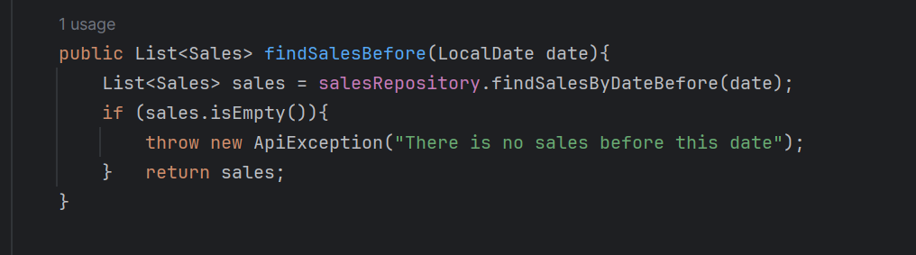
15. Find Sales By Before Date

Slide 20
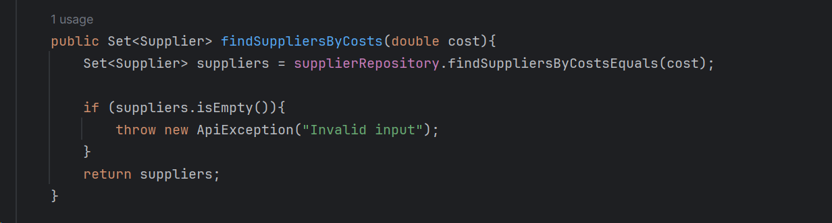
16. Find supplier By cost

Slide 21
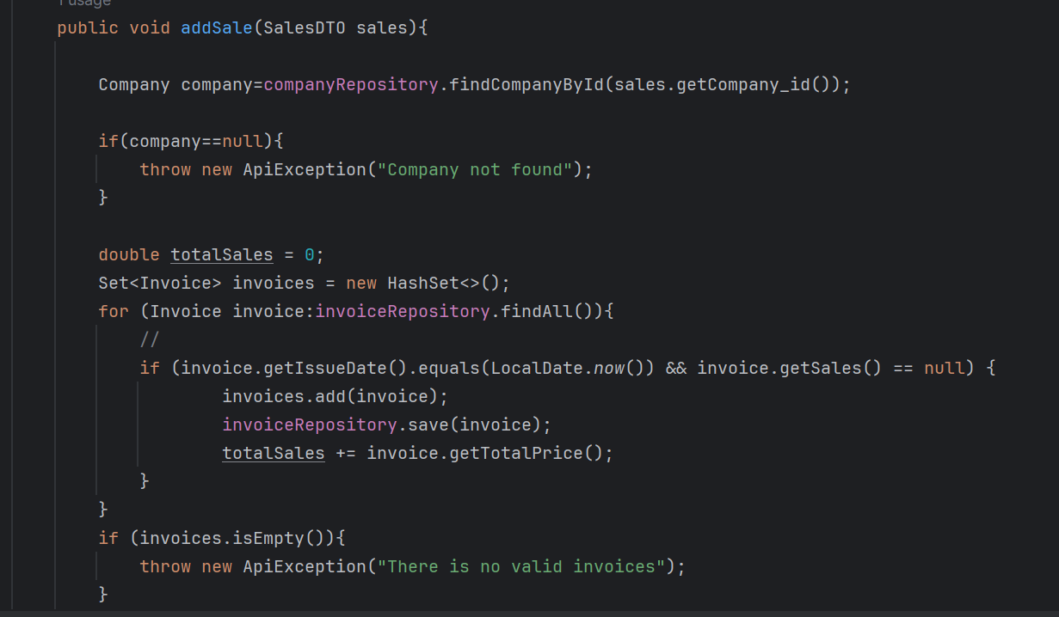
17. Add Sales

Slide 22
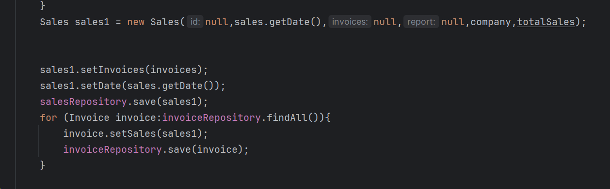
17. Add Sales

Slide 23
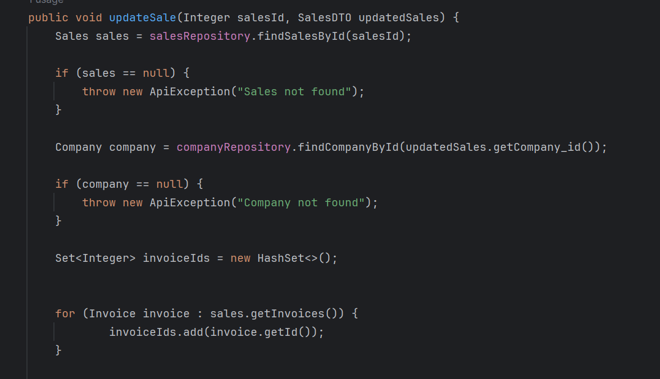
18. Update Sales

Slide 24
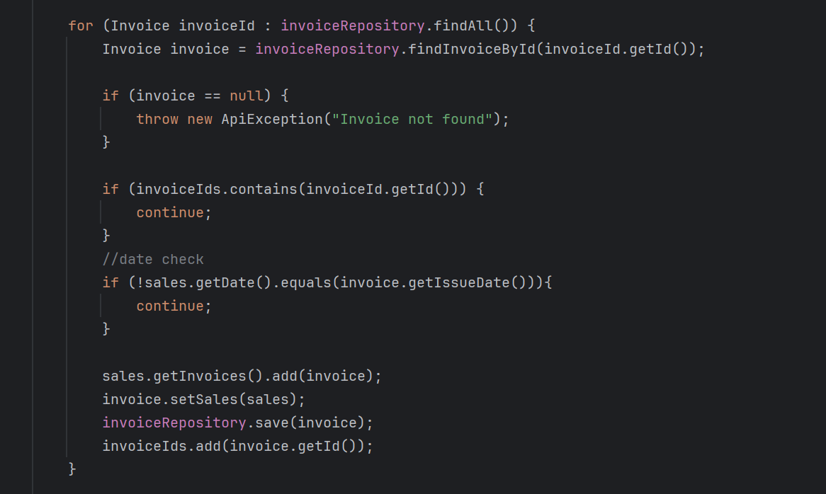
18. Update Sales

Slide 25
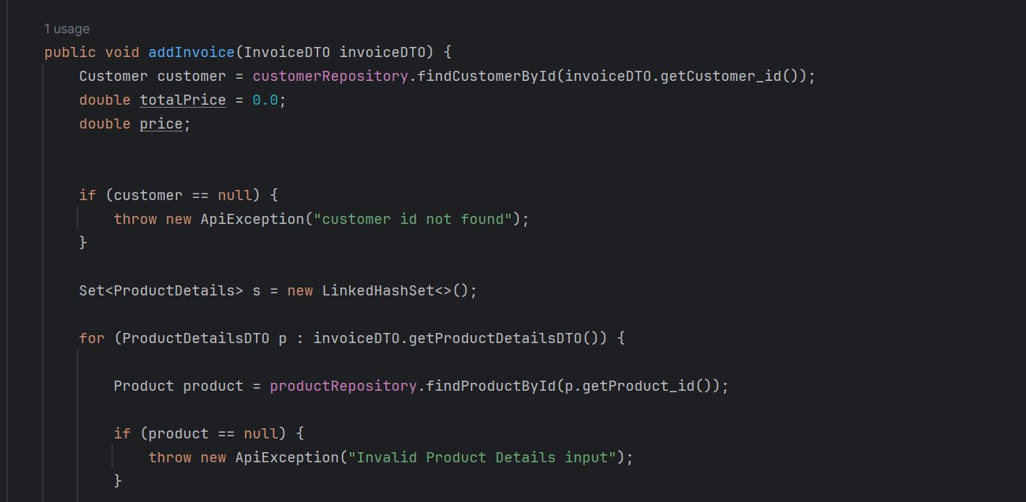
19. Add invoice

Slide 26
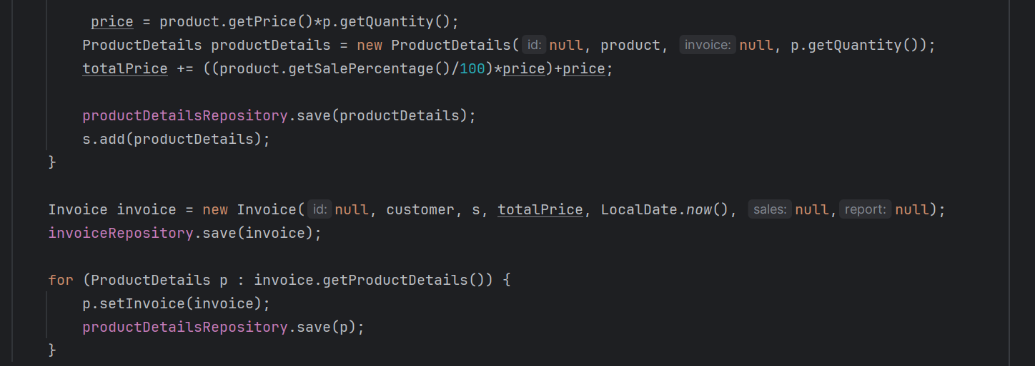
19. Add invoice

Slide 27
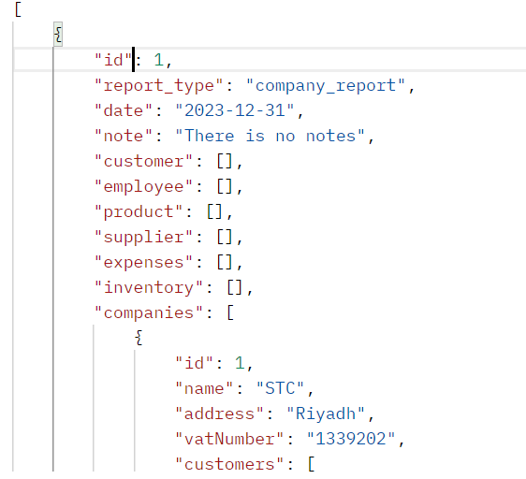
Report By Company id

Slide 28
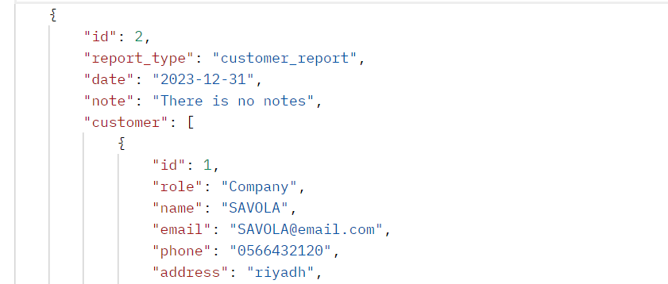
Get Report By Customer Id

Slide 29
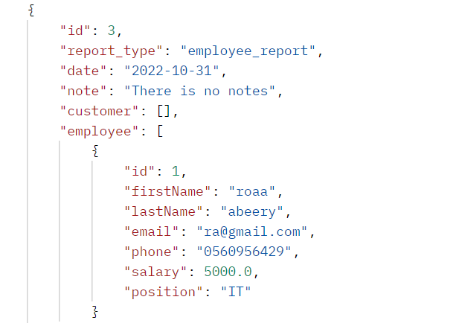
22. Get Report By Employee Id

Slide 30
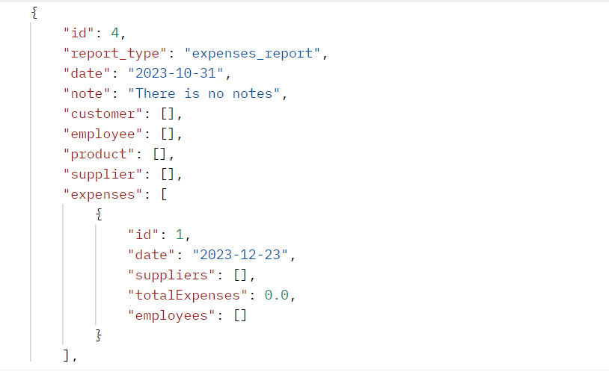
23. Get Report By Expenses Id

Slide 31
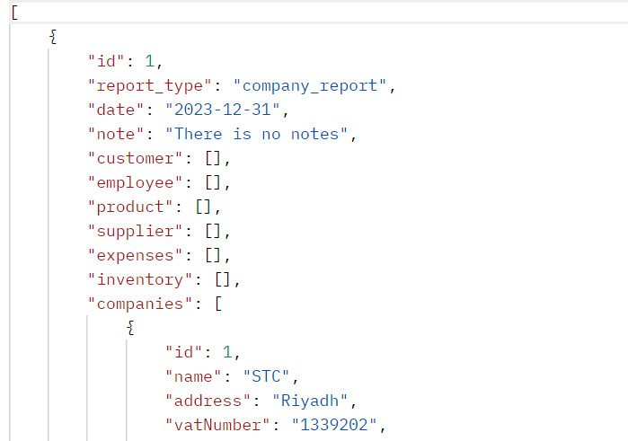
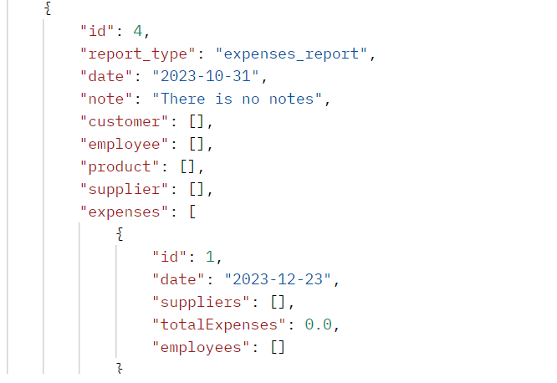
24. Get Report By Range Of Date

Slide 32
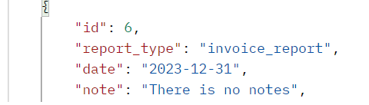
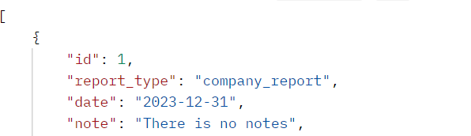
25. Get Report By Date

Slide 33
Thank you

