Slide 1
ICS 108 • Object-Oriented Programming in Java
Bader's Event
Management System
A Java console application for planning and validating campus events
Badercodes
King Fahd University of Petroleum and Minerals
Final Project Presentation
4
Packages
14
Classes / Interfaces
4
Event Types
12
Catalogued Venues

Slide 2
01 • WHAT IT DOES
2 / 10
System at a Glance
An interactive system for creating, scheduling, and inspecting events held across the KFUPM campus. Every event is bound to four pieces of context — a type, a hosting department, a venue, and a precise date / time window.
The scheduler keeps events in chronological order automatically and refuses to book a venue twice in the same time slot.
4
14
Cooperating packages
Classes & interfaces
MAINS · DEPARTMENTS · EVENTS · VENUES
incl. 1 abstract base + 4 venue subclasses
C / SE / SI / Q
2
Menu commands
Input modes
create · show all · show one · quit
manual keyboard ⇄ scripted file (Test.txt)
Bader's Event Management System • ICS 108 • KFUPM

Slide 3
02 • ARCHITECTURE
3 / 10
Four Cooperating Packages
Each package owns a single concern. Main is the only orchestrator that talks to all four.
«package»
«package»
«package»
«package»
MAINS
DEPARTMENTS
EVENTS
VENUES
Entry point + I/O
Department catalogue
Date model + scheduler
Venue hierarchy
Drives the menu loop, parses dates, and wraps Scanner with retry logic.
Loads departments from disk and looks them up by name.
Builds events, sorts them by start time, and detects clashes.
Abstract Venue base + 4 concrete subclasses + a catalogue manager.
CLASSES
CLASSES
CLASSES
CLASSES
▸ Main
▸ Input
▸ Type
▸ ValidationException
▸ Department
▸ DepartmentsManager
▸ DateAndTime
▸ Event
▸ EventManager
▸ Venue
▸ ConferenceHall
▸ LectureHall
▸ SportArea
▸ PublicArea
▸ VenueManager
Bader's Event Management System • ICS 108 • KFUPM

Slide 4
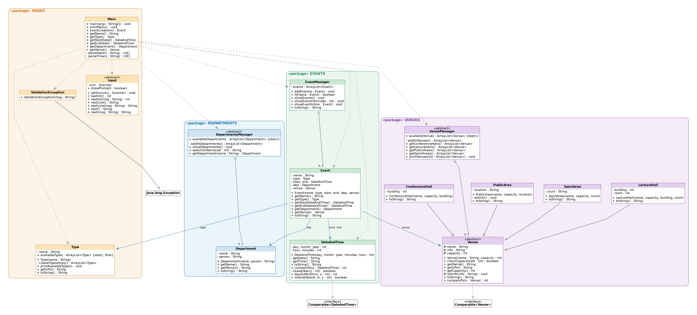
03 • STATIC STRUCTURE
4 / 10
UML Class Diagram
Figure 1. Solid ▷ = inheritance · Dashed ▷ = implements · Open ◇ = aggregation · → = association · ⇢ = dependency.
MAINS
DEPARTMENTS
EVENTS
VENUES
Bader's Event Management System • ICS 108 • KFUPM

Slide 5
04 • OOP MASTERY
5 / 10
Every ICS 108 Concept, Mapped to Code
Encapsulation
Inheritance
All fields private/protected; access via getters such as Event.getName().
ConferenceHall · LectureHall · SportArea · PublicArea extend Venue.
Abstract Classes
Polymorphism
Venue, DepartmentsManager, and VenueManager are all abstract.
EventManager.showEvents iterates over Venue references; each subclass's toString is dispatched at runtime.
Interfaces
Method Overloading & Overriding
Venue implements Comparable<Venue>; DateAndTime implements Comparable<DateAndTime>.
Input.nextInt() / nextInt(String); EventManager.showEventInfo(int) / showEventInfo(Event); every Venue subclass overrides toString.
Custom Exceptions
File I/O + Generics
ValidationException extends Exception — thrown by Venue.checkCapacity, DepartmentsManager.getDepartment.
Both managers parse text files via Scanner + try-with-resources; ArrayList<Venue>, ArrayList<Event> used throughout.
Bader's Event Management System • ICS 108 • KFUPM

Slide 6
05 • CORE LOGIC
6 / 10
Two Algorithms That Power the Scheduler
01
Chronological Insertion
02
Venue-Clash Detection
EventManager.addEvent — always-sorted insertion
EventManager.isFree — classic interval-overlap test
for (int i = 0; i < events.size(); i++) {
if (event.getStartDateAndTime()
.compareTo(events.get(i)
.getStartDateAndTime()) < 0) {
events.add(i, event); return;
}
}
events.add(event);
for (Event ev : events) {
if (ev.end > other.start &&
ev.start < other.end &&
ev.venue == other.venue) {
return false;
}
}
return true;
Walks the list once, finds the first event that starts later than the new one, and inserts before it. No Collections.sort needed.
A clash exists iff the two events overlap in time and they share a venue.
Complexity O(n) insert · O(1) per comparison
Result Conflicting events are dropped, not overwritten
Bader's Event Management System • ICS 108 • KFUPM

Slide 7
06 • RESILIENCE
7 / 10
Layered Defensive Programming
Each kind of failure is caught at the most useful place — no stack traces ever reach the user.
LAYER
CATCHES
RECOVERY
Input.next* methods
InputMismatchException
Re-prompts; never bounces the menu
DateAndTime constructor
Invalid date or time
Throws IllegalArgumentException → Main retries
Event constructor
start ≥ end
Throws IllegalArgumentException → Main retries
Venue.checkCapacity
attendees > capacity
Throws ValidationException → ask for another venue
DepartmentsManager.getDepartment
Unknown department
Throws ValidationException → ask again
EventManager.addEvent
Venue/time clash
Drops the new event with a console message
File loading (managers)
FileNotFoundException
Prints a clean message instead of crashing
Bader's Event Management System • ICS 108 • KFUPM

Slide 8
07 • DUAL-MODE I/O
8 / 10
Manual or File-Driven — Same Binary
A single fileName in Main switches between live menus and a scripted run, making the project easy to grade.
MANUAL MODE
FILE MODE
Interactive keyboard input
Scripted, reproducible runs
Menu shown after every command
Every input is re-prompted on error
Available departments, types, venues are listed for the user
showPrompts = true
Reads input from Test.txt instead of System.in
Prompts are suppressed for clean output capture
Falls back automatically if the file is missing
Input.setSource(new Scanner(file))
Enter: "C" to create a new event!
Enter: "Q" to quit the program.
Enter "SE" to show the events.
> C
Enter the Name of the Event:
C
Aramco Football
3 ← Sport
1 1 2000 ← start date
...
Bader's Event Management System • ICS 108 • KFUPM

Slide 9
08 • WHAT'S NEXT
9 / 10
Possible Extensions
01
02
03
Persistence
Search & Delete
Faster Inserts
Write the in-memory event list back to disk on Q so events survive between runs.
Add D <index> to remove events and a name-substring search command.
Replace the linear-scan insertion with a TreeSet keyed on start time → O(log n).
04
05
06
Per-Department Venues
JUnit Test Suite
Arabic Localisation
Let each department load its own preferred-venues list from a config file.
Unit-test DateAndTime validation, EventManager.isFree, and Venue.checkCapacity.
Wrap menu strings in a Messages bundle so the program runs in EN or AR.
Bader's Event Management System • ICS 108 • KFUPM

Slide 10
Thank you.
Questions?
PROJECT Bader's Event Management System
COURSE ICS 108 • Object-Oriented Programming in Java
INSTITUTION King Fahd University of Petroleum and Minerals
Java · 4 packages · 14 classes · built and documented end-to-end

