Slide 1
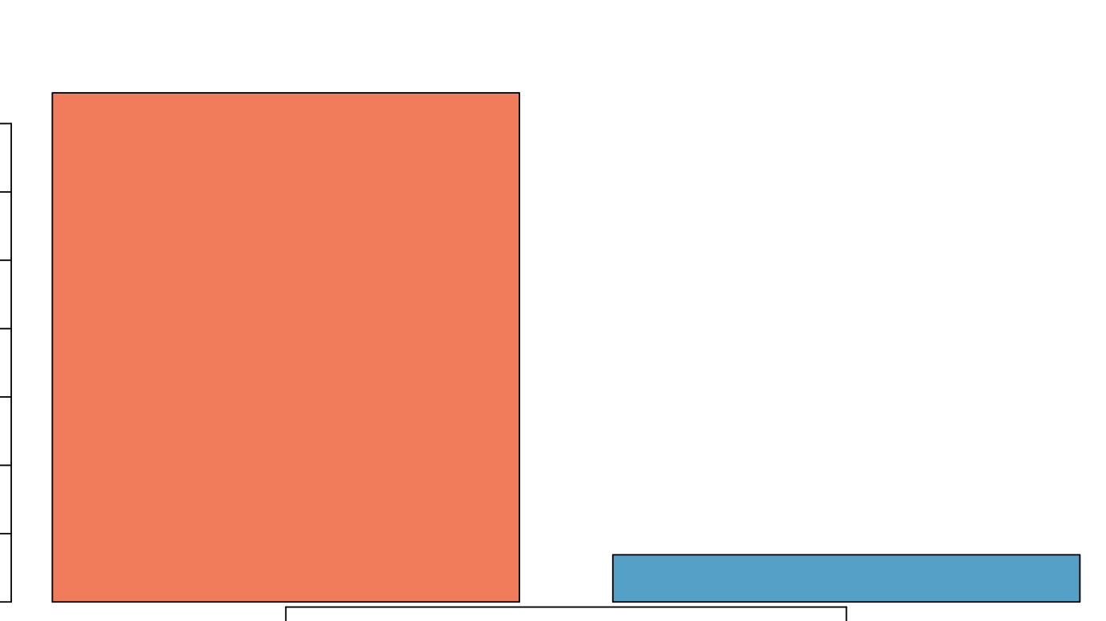
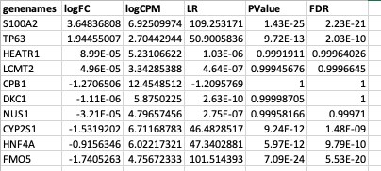
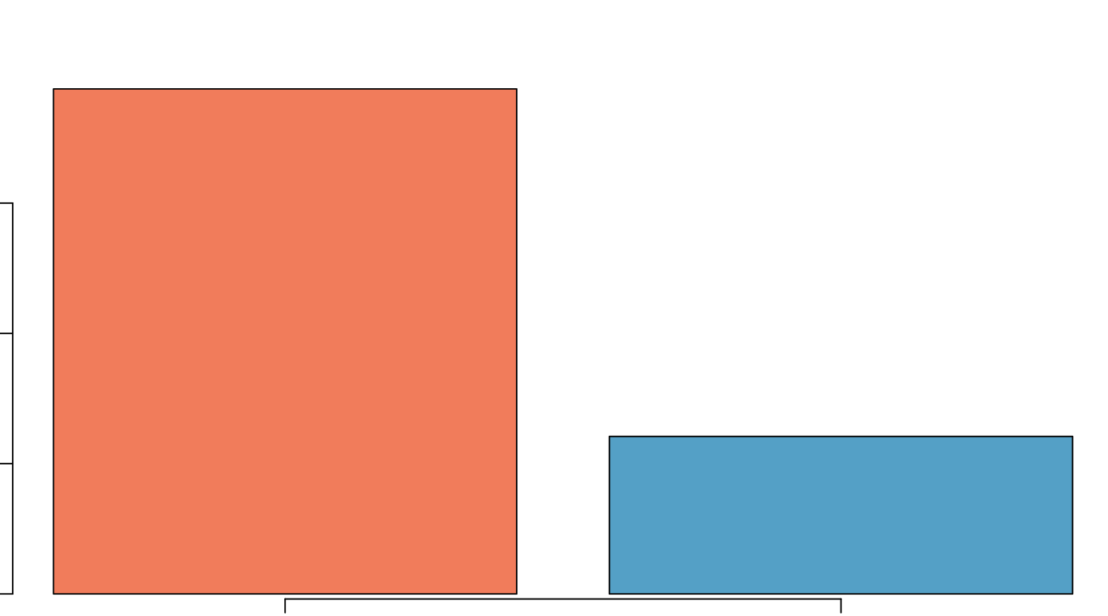
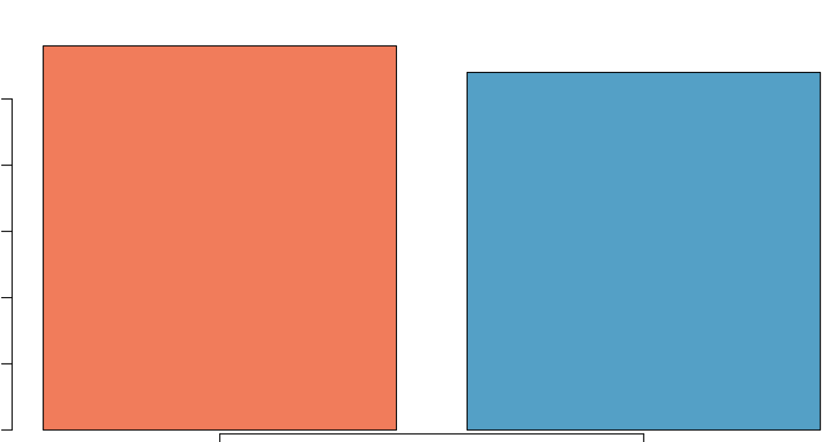
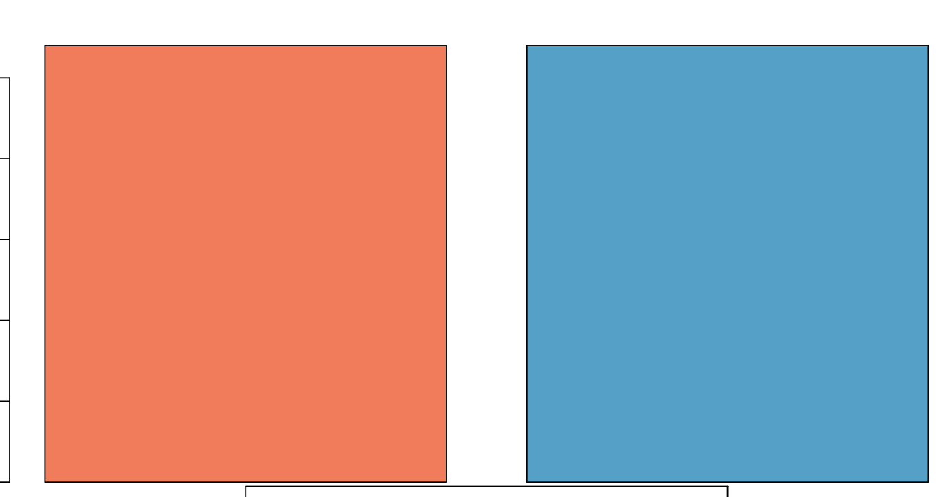
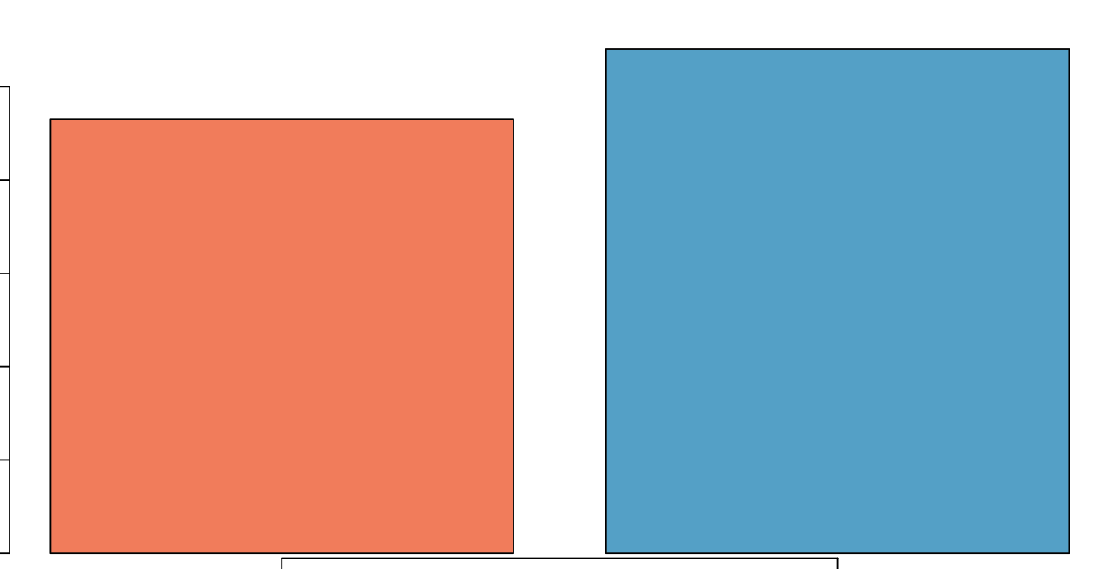
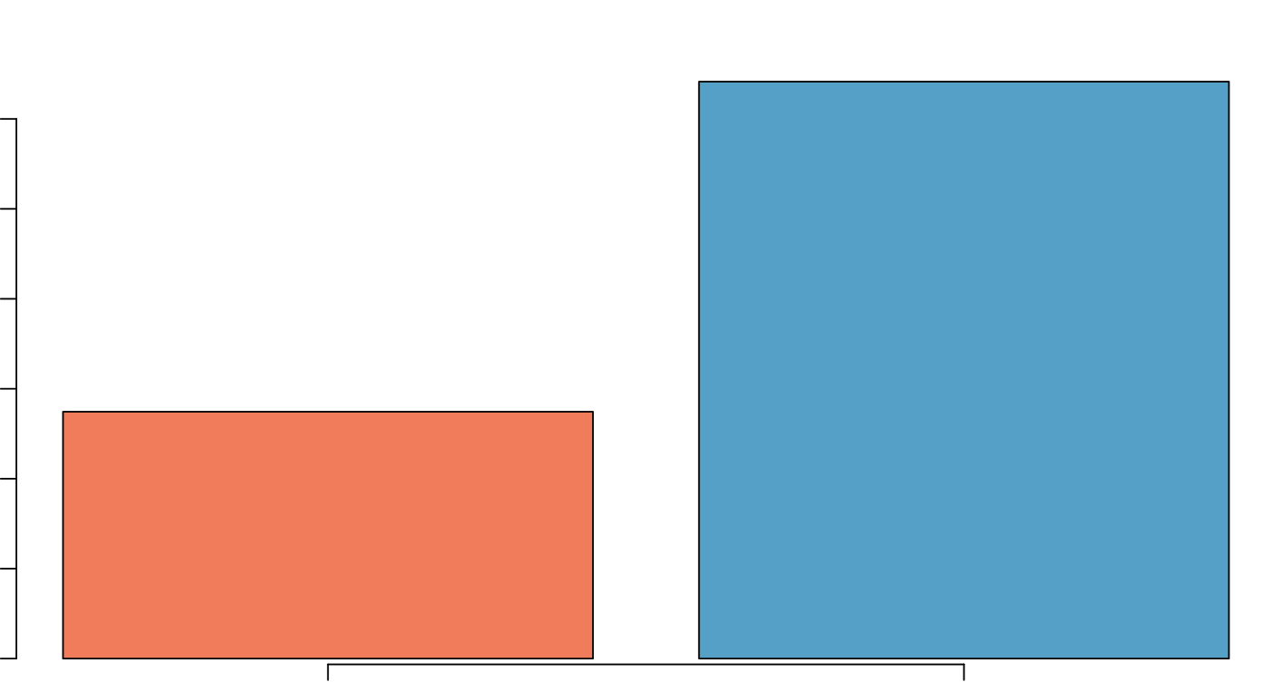
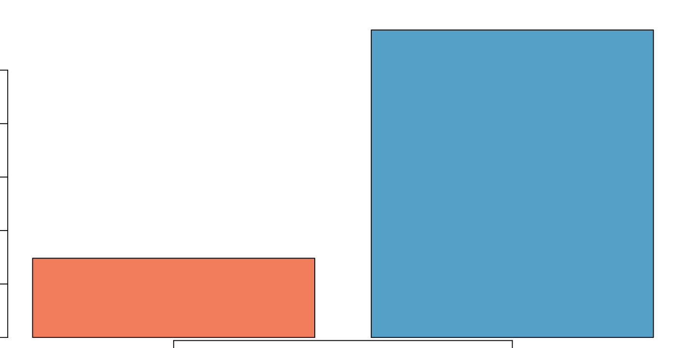
How to generate the rank file:
Scores/ranks
Basal
Classical
S100A2 24.85
TP63 12.01
Calculate the ranking score:
Using Excel:
=SIGN(logFC) * -LOG10(PValue)
Using R:
Sign(logFC) * -log10(PValue)
HEATR1 0.001
LCMT2 0
CPB1 -0.01
edgeR output
CYP2S1 -11.03
HNF4A -11.22
FMO5 -23.15

Slide 2
Pathway database
NES
2.7
Modified
Kolmogorov
Smirnov test
Scores/ranks
P73 TRANSCRIPTION
FACTOR NETWORK
Basal
Classical
S100A2
TP63
0
S100A2 24.85
TP63 12.01
Up
Down
HEATR1 0.001
LCMT2 0
CPB1 -0.01
0
XENOBIOTIC METABOLIC PROCESS
CYP2S1
HNF4A
FMO5
-2.7
Up
Down
CYP2S1 -11.03
HNF4A -11.22
FMO5 -23.15

Slide 3
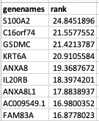
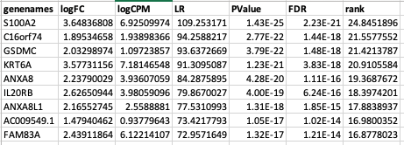
Save the files as a tab delimited text and with the extension .rnk

Slide 4
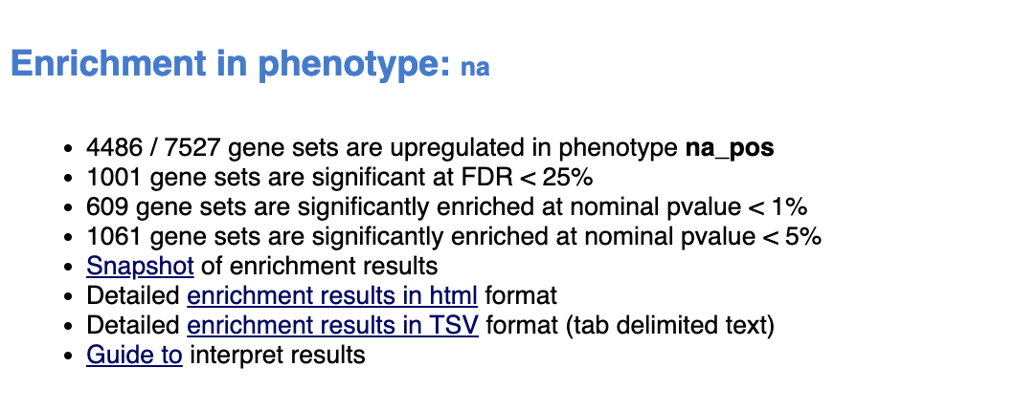
Number of gene sets when restricted to dataset, contains between 10 and 200 genes
Number of gene sets that are enriched with up-regulated (positive rank) genes
Enriched with genes with positive ranks i.e. up-regulated in phenotype
Number of gene sets that have
FDR<0.25
pval<0.01
qval<0.05

Slide 5
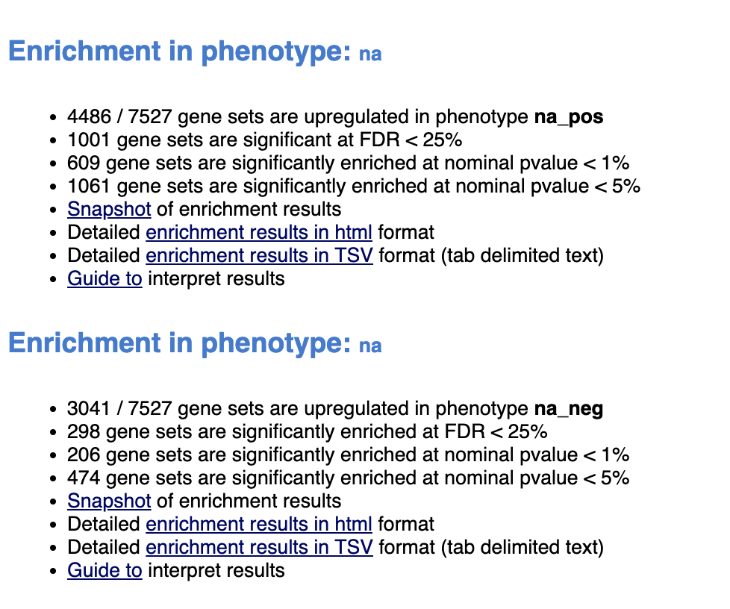
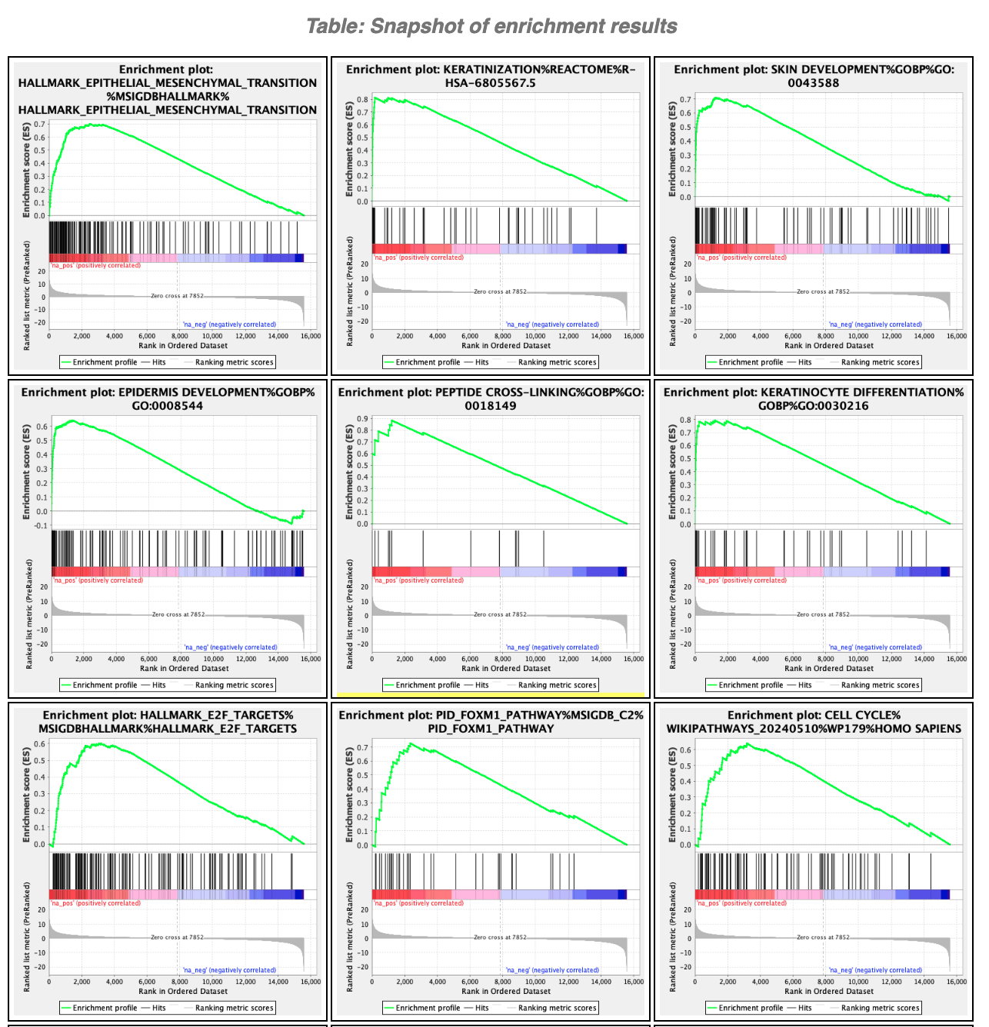
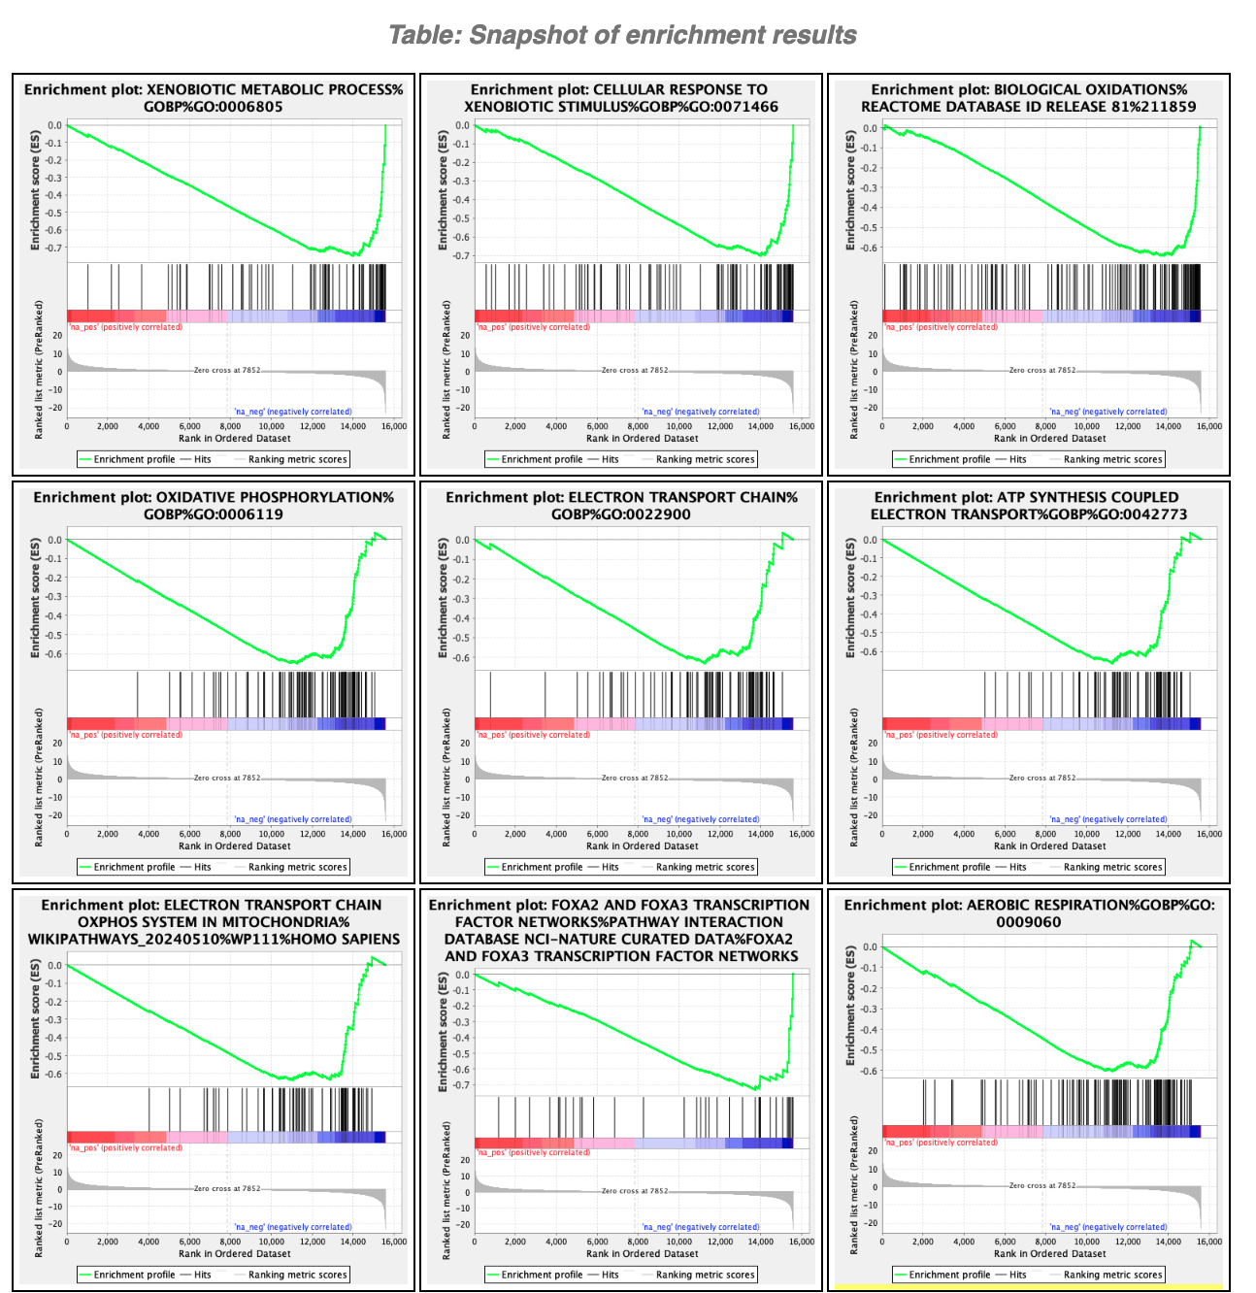
Basal
Classical

Slide 6
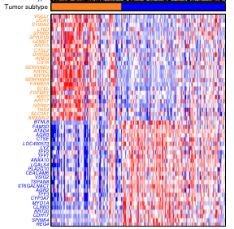






Data used for practical lab: RNAseq workflow
Dataset
Pancreatic
Ductal
Adenocarcinoma
(TCGA)
Basal
Classical
vs
Differential
Expression
(edgeR)
Rank file
Gene list
extracted using
FDR cut-off
Moffitt, R., Marayati, R., Flate, E. et al. Virtual microdissection identifies distinct tumor- and
stroma-specific subtypes of pancreatic ductal adenocarcinoma. Nat Genet 47, 1168–1178 (2015)

