Slide 1

Wavecon Telecom Analysis
Presented by Bader Nader

Slide 2
CONTENTS
Problem Statement
Dashboard Overview
Questions & Insights
Conclusion

Slide 3
PROBLEM STATEMENT

Slide 4
Wavecon Telecom has launched its 5G network and tasked the data analytics team with evaluating its impact on the business.
Specifically, the company seeks clear insights into how the business has been affected before and after the introduction of 5G.

Slide 5
DASHBOARD OVERVIEW

Slide 6


Slide 7
QUESTIONS & INSIGHTS

Slide 8
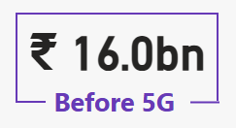
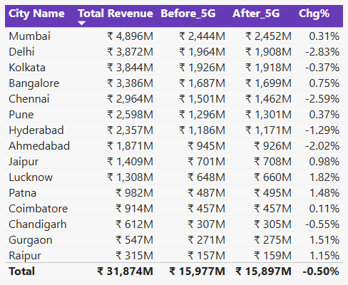
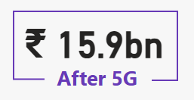
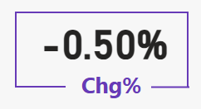
Q1. What is the impact of the 5G launch on our revenue?

Slide 9
Insights & Recommendations
Overall revenue dipped slightly from ₹16.0 bn before 5G to ₹15.9 bn after 5G, reflecting a modest 0.50% decline.
The top five revenue generators are Mumbai, Kolkata, Delhi, Bangalore, and Chennai—with four of these showing revenue declines post-5G (notably Delhi at –2.83%)—while the bottom five are Patna, Coimbatore, Chandigarh, Gurgaon, and Raipur, all of which saw modest upticks in revenue after the 5G launch.
Although a handful of large markets like Mumbai and Bengaluru saw small gains, steeper drops in major cities such as Delhi and Chennai drove the aggregate revenue just below its pre-5G level.
Larger metros appear to be adjusting more slowly to 5G adoption—perhaps due to market saturation—whereas smaller cities are registering small but consistent gains as customers there upgrade to new plans.

Slide 10
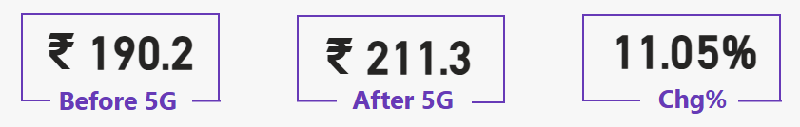
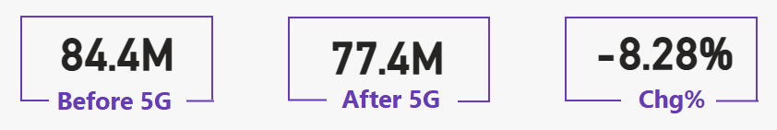
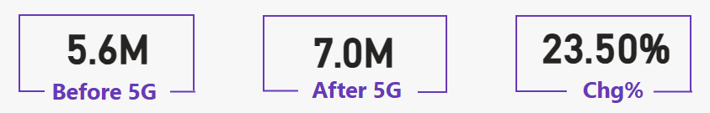
Q2. Which KPI is underperforming after the 5G launch?
ARPU
TAU
TUsU

Slide 11
Insights & Recommendations
Among ARPU, TAU, and TUsU, the only metric that fell post-5G is TAU, dropping from 84.4 million to 77.4 million users—a decline of 8.28%.
While average revenue per user and total users surged as customers upgraded to higher-value plans, the active-user count slipped noticeably, suggesting that fewer subscribers are engaging with the network regularly, even as they spend more and the overall base grows.

Slide 12
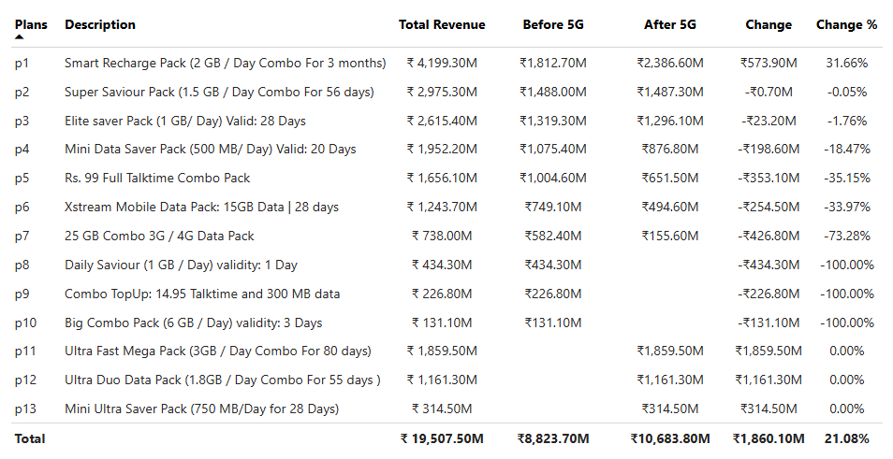
Q3. After the 5G launch, which plans are performing well in terms of revenue? Which plans are not performing well?

Slide 13
Insights & Recommendations
The Smart Recharge Pack (p1) stands out with a 31.7% revenue increase, and the Super Saviour Pack (p2) holds steady with almost no change, while all other active plans show declines ranging from 1.8% to 73.3%.
Customers clearly prefer longer-duration, higher-data bundles under 5G, whereas mid-range and smaller data/talk combos no longer meet their evolving needs and are losing traction.

Slide 14
Q4. Is there any plan affected largely by the 5G launch? Should we continue or discontinue that plan?

Slide 15
Insights & Recommendations
The 25 GB Combo (p7) and Xstream Mobile Data (p6) packs are most at risk with drops of 73% and 34% respectively and should be discontinued, while the 1 GB/day Elite Saver (p3) and low-value talk/data packs (p4, p5) warrant redesign rather than outright removal.
Steep revenue losses indicate that mid-tier plans no longer appeal to 5G users, but modestly affected offerings can recover with small data boosts or repackaging into clearer, value-focused bundles.

Slide 16
Q5. Is there any plan that is discontinued after the 5G launch? What is the reason for it?

Slide 17
Insights & Recommendations
The Daily Saviour (p8), Combo Top-Up (p9), and Big Combo (p10) plans have been fully discontinued, reflecting a complete withdrawal from ultra-short-term, low-data bundles.
Micro-duration products fail to satisfy continuous 5G streaming and gaming expectations, so customers have stopped buying one- or three-day packs in favor of longer-lasting, higher-throughput options.

Slide 18
CONCLUSION

Slide 19
The rollout of Wavecon’s 5G network has driven mixed outcomes across our product portfolio and markets. On the revenue front, total receipts dipped marginally by 0.5%, as major metros like Delhi and Chennai saw sharper declines that outweighed modest gains in smaller cities. At the product level, premium, long-duration bundles (notably the 2 GB/day Smart Recharge Pack) have thrived—with ARPU up 11% and total users rising 23.5%—while mid-tier and micro-packs have underperformed, and ultra-short-term offerings have been fully withdrawn. Most concerning is the 8.3% drop in active users (TAU), signalling that although customers are upgrading to higher-value plans, fewer are engaging regularly.
Key Takeaways & Next Steps
Double Down on Winning Bundles: Scale the high-value, long-tenure plans that delivered strong revenue growth under 5G.
Rationalize the Portfolio: Discontinue underperforming mid-range packs, redesign low-value offers into clear “starter” bundles, and eliminate obsolete micro-duration products.
Reignite User Engagement: Launch targeted campaigns—such as loyalty incentives and usage-based perks—to reverse the TAU decline and ensure customers stay active on our network.
By focusing on our proven winners, pruning ineffective SKUs, and rekindling regular usage, Wavecon can convert initial 5G enthusiasm into sustained growth and a more engaged subscriber base

Slide 20
THANK YOU

