Slide 1

BsidesKC 2019 Badge
Challenge Overview

Slide 2
Couple of different “Challenges”
Beacon Search
Crypto

Slide 3
Beacon Search
Wanted to use WIFI with Badge – Simple Scavenger hunt

Slide 4

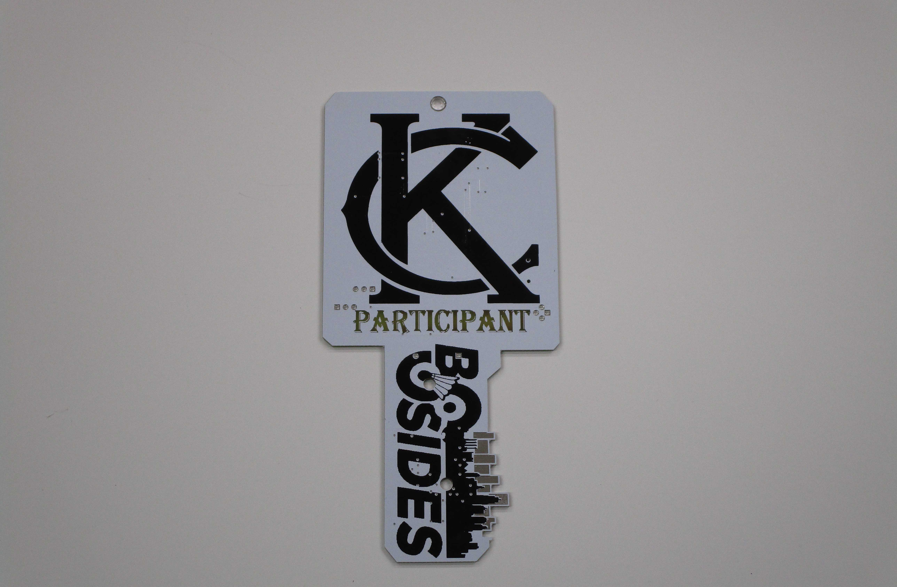
Beacon Search
Wanted to use WIFI with Badge – Simple Scavenger hunt
Wanted to Include LED

Slide 5
Beacon Search
Wanted to use WIFI with Badge – Simple Scavenger hunt
Wanted to Include LED
6 LED = 6 WIFI Beacons

Slide 6
Beacon Search
Wanted to use WIFI with Badge – Simple Scavenger hunt
Wanted to Include LED
6 LED = 6 WIFI Beacons
When Badge is turned on scan for AP’s, light LED for those found

Slide 7
Beacon Search
Wanted to use WIFI with Badge – Simple Scavenger hunt
Wanted to Include LED
6 LED = 6 WIFI Beacons
When Badge is turned on scan for AP’s, light LED for those found
Badge will save those found to EPROM (Memory)

Slide 8
Beacon Search (cont)
Initial State – Cylon

Slide 9
Beacon Search (cont)
Initial State – Cylon
Cycle – Cylon for 15 Sec then turn on WiFi, check

Slide 10
Beacon Search (cont)
Initial State – Cylon
Cycle – Cylon for 15 Sec then turn on WiFi, check
Show those found

Slide 11
Beacon Search (cont)
Initial State – Cylon
Cycle – Cylon for 15 Sec then turn on WIFI, check
Show those found
Turn off WIFI and Cylon again.

Slide 12
Beacon Search (CONT)
Initial State – Cylon
Cycle – Cylon for 15 Sec then turn on WIFI, check
Show those found
Turn off WIFI and Cylon again.
Random Blink if all found

Slide 13
Beacon Search (Settings)
Beacon AP names are BadgePirates01 – 06

Slide 14
Beacon Search (Settings)
Beacon AP names are BadgePirates01 – 06
To factory Reset – BadgePirates-Nuke

Slide 15
Beacon Search (Settings)
Beacon AP names are BadgePirates01 – 06
To factory Reset – BadgePirates-Nuke
To cheat and win AP - None

Slide 16
Crypto Challenge
2 Crypto Versions

Slide 17
Crypto Challenge
2 Crypto Versions
1 – Red Herring

Slide 18
Crypto Challenge
2 Crypto Versions
1 – Red Herring
1 – Gronsfeld Cipher

Slide 19
Crypto Challenge
2 Crypto Versions
1 – Red Herring
1 – Gronsfeld Cipher – On Non Electronic Badges

Slide 20
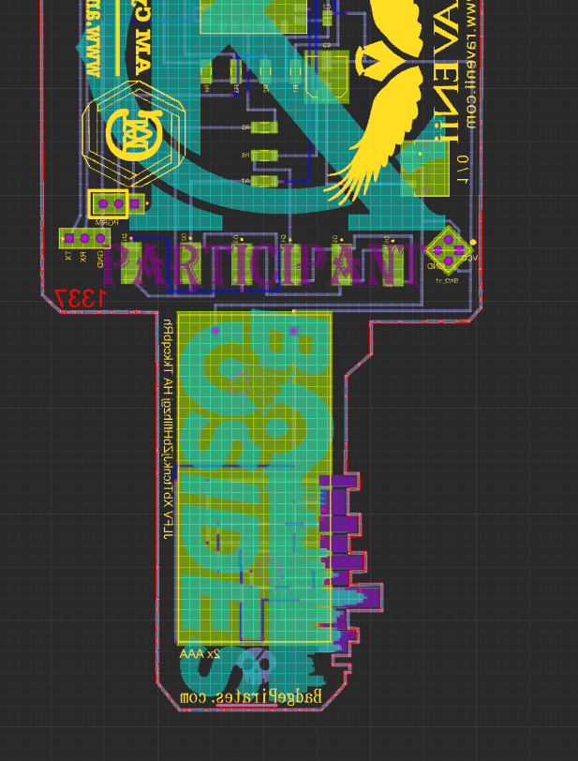
Crypto Challenge
2 Crypto Versions
1 – Red Herring
1 – Gronsfeld Cipher – On Non Electronic Badges

Slide 21
Crypto Challenge
Gronsfeld
Actual Crypto
JLFV XbTtcnkJjZbHfllhzgj HA TkkcqbRh

Slide 22
Crypto Challenge
Gronsfeld
Actual Crypto
2 Keys (Numeric & Alpha)

Slide 23
Crypto Challenge – Part 2
Crypto Gives you an SSID and PW
AP Hosted a Text Adventure game
Finishing the game directed you to BP with phrase that pays.

Slide 24

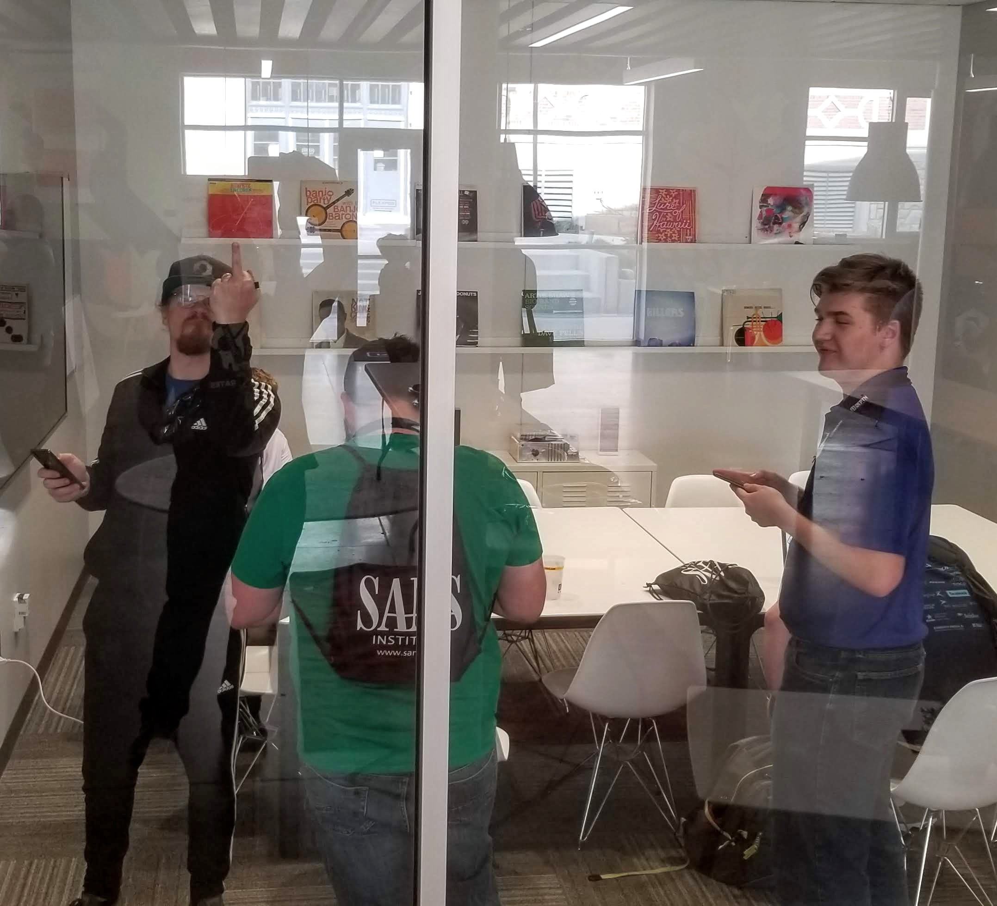
Winners
Winner - @ThatGuy
Honorable Mention
@Sysaaron
@archwisp
@Zilla
@smcmillian

Slide 25
Was there MORE?
Maybe LED Sequence?
Key Pads or traces?

Slide 26
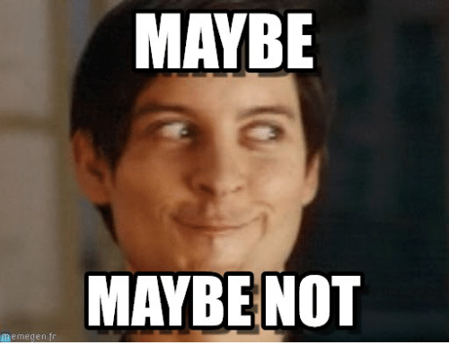
Was there MORE?
Maybe LED Sequence?
Key Pads or traces?

Slide 27
References:
Crypto Challenge example for Gronsfeld will be posted as a 101 Lesson on site: CryptoChallenges.com
This writeup will be posted on our Blog:
Blog.BadgePirates.com
BadgePirates.com

Slide 28
Badge Pirates Credits
@JiggleBilly and @Pecord – Software Development
@NetworkGeek – Awesome Kids Badge
@WhtHat – Game Design
@fg – Board Design

Slide 29
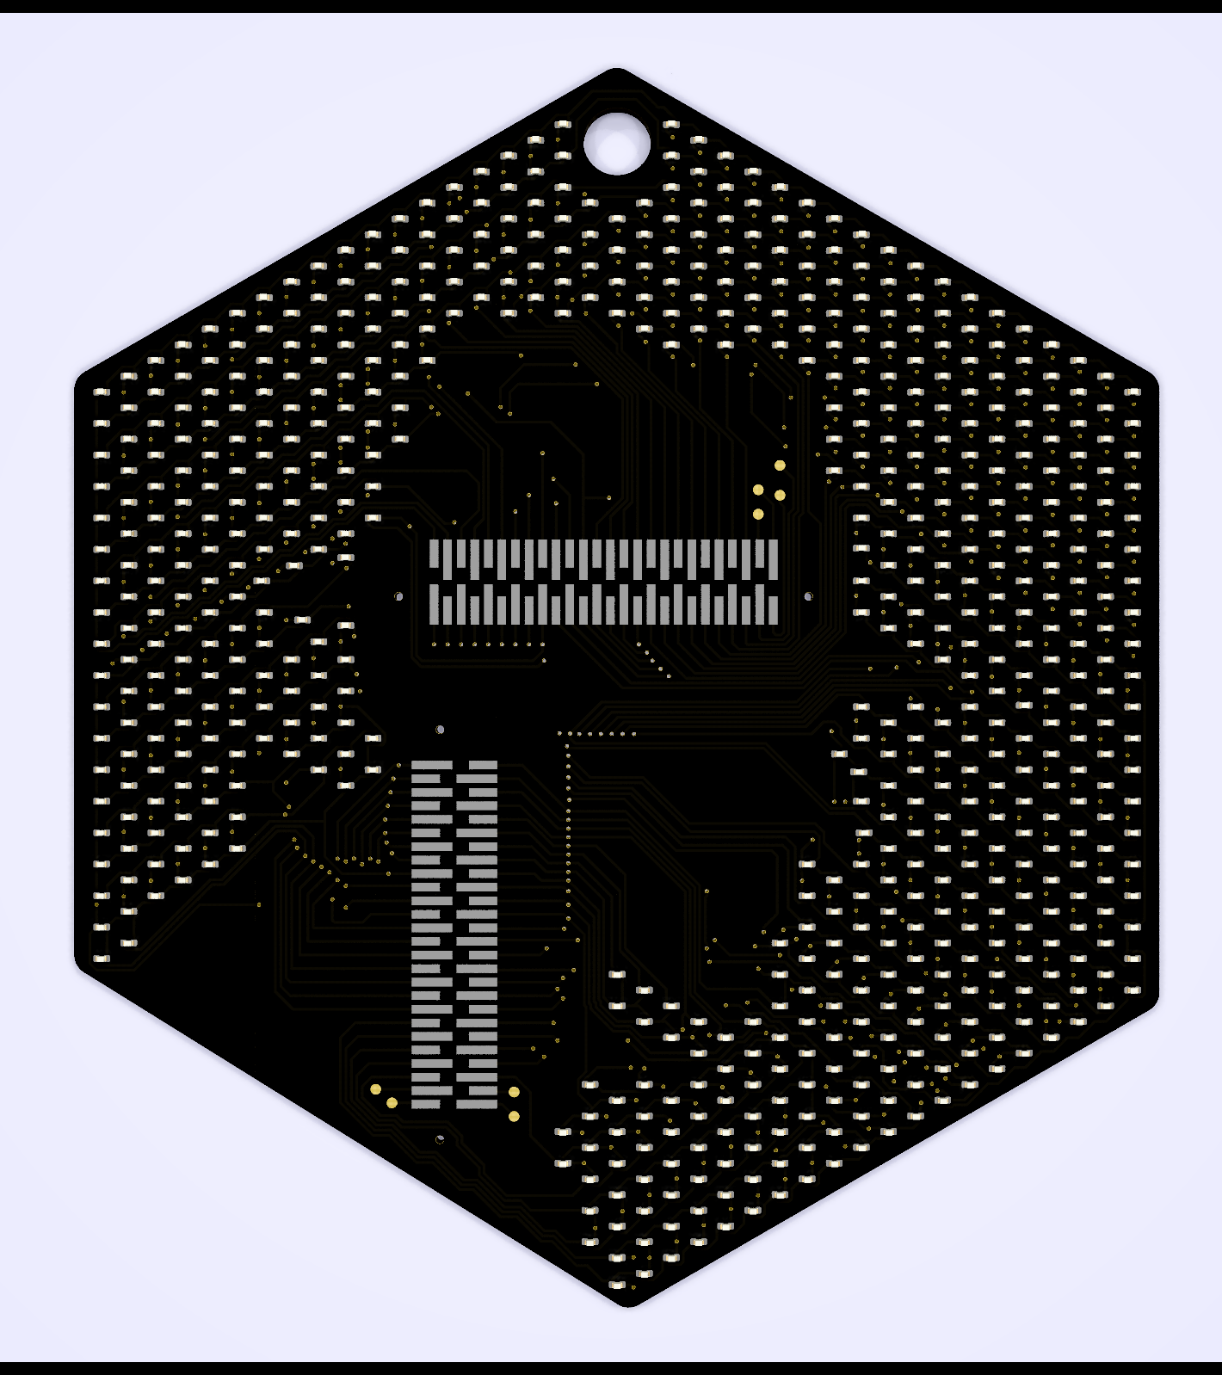
After Credits
We heard you liked LED!
650 enough?
Follow us on Twitter, and Slack for PreSale, by end of Month!

Slide 30

@NetworkGeek
Call for Volunteers

