Slide 1
Castor

Slide 2
Purpose
Decision support for quantifying the impacts of alternative forest management on timber supply
Caribou Recovery Program
Fisher Program
Research alternative methods/approaches
Spatial forest harvest simulator
With some ‘extras’
Indicator ‘trackers’
Other ‘agents’ that respond to forestry

Slide 3
dataCastor
Connects to a centralized postgres db
Harvest compartments (area of interest)
Polygon + raster
Forest inventory
Polygon + raster
age, height, basal area, crown closure, quadratic mean diameter
THLB
raster
Growth and yield curves
Raster of id’s linked to VDYP and TIPSY curves
Creates a relational database via SQLite engine (the object to pass between modules)

Slide 4
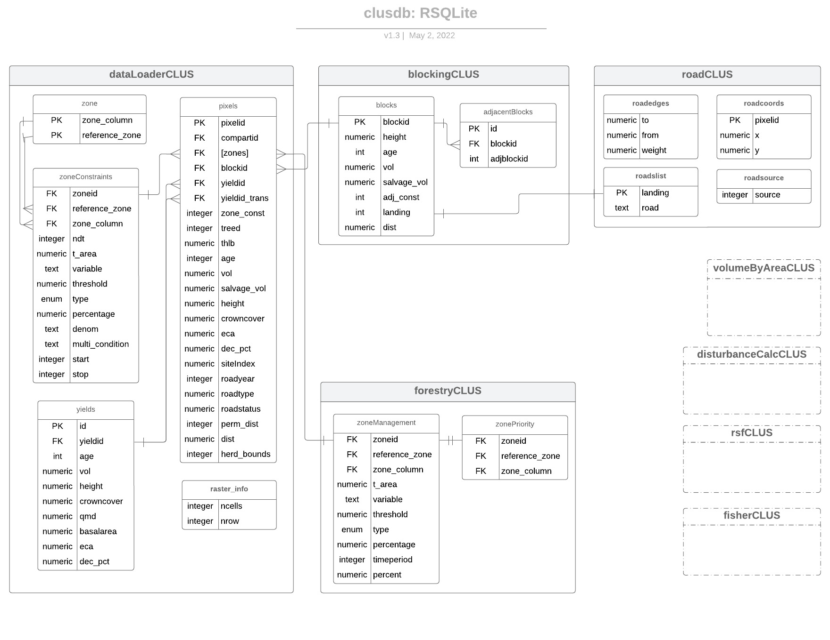
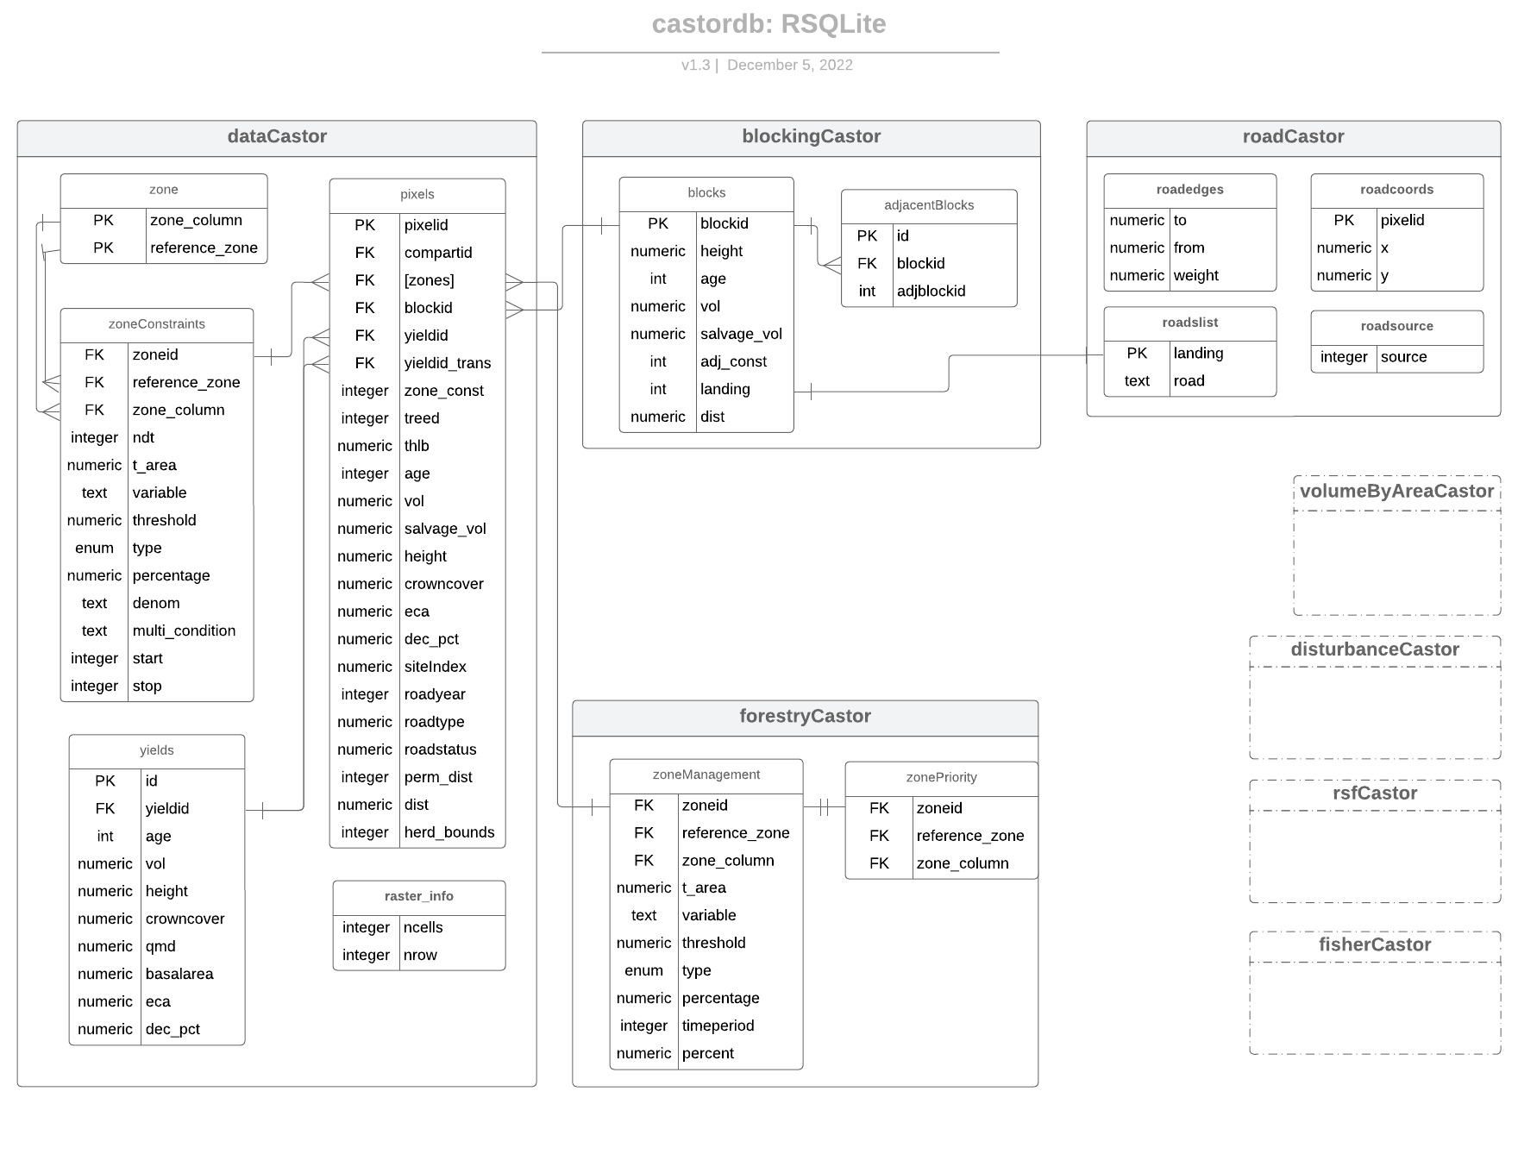

Slide 5
dataCastor -> data compilation
Example: “Zones” (constraints) that are legislated
VQO, WHA, UWR, BEO, etc
zoneid | Reference zone | zone_column | variable | threshold | type | percentage | denom
Integer | Raster name in db | In ‘pixels’ table | Forest attribute to constrain on (age) | Max/min value of the attribute | nh, ge, le | How much of the area | Area denominator (zone or forest)
multi_condition | t_area | start | stop
query | Total area of zone | Start time of constraint | End time of constraint

Slide 6
blockingCastor -> Designs the harvest unit
Graph based image segmentation
S.t. patch size targets, homogeneity of forest attribution
growingStockCastor -> Growth and yield for forest attribution
Linear interpolation of yield curves (ECA, QMD, height, merch volume, basal area, etc)
forestryCastor -> Forest harvest simulator
Sets the logic for recruiting and constraining harvest to meet numerous overlapping landcover constraints and characteristics of the harvest profile
Set the logic for the schedule/harvesting priority under spatial partitions, harvesting distances and adjacency considerations
roadCastor -> Road projection and backcasting
Multiple Target Access Problem
Snapping
Sequential least cost paths
Minimum spanning tree + least cost paths

Slide 7
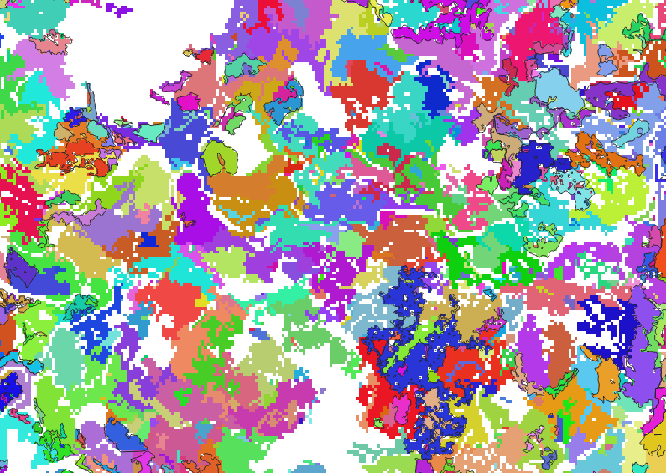
blockingCastor
Forms harvest units and updates their attributes
Requires
sqlite connection to the relational database from dataCastor
Existing blocks
Parameters
Type of blocking {pre, dynamic, none)
“pre” need patch size targets, existing, boundaries and maximum distance for homogeneity
Creates
Blocks table – attributes of a harvest unit

Slide 8

forestryCastor
Schedules harvesting
Omits areas required for landcover constraints and other non harvesting areas
Selects harvest units based on a priority
Requires
a sqlite connection
Populated blocks table
Harvest flow targets
Parameters
Available landcover constraints
Adjacency
Creates
Harvest schedule
Landings

Slide 9
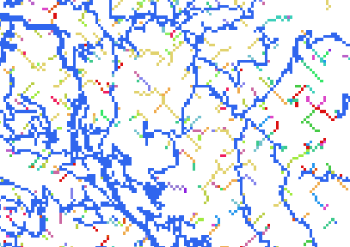
roadCastor
Projects and back-casts roads
Connects landings to existing road network
Solve Multiple Target Access Problem
Requires
Cost surface
“Landings” or points
Parameters
Roading type {snap, lcp, mst}
Recovery age
Creates
Roaded pixels
Age of roads

