Slide 1
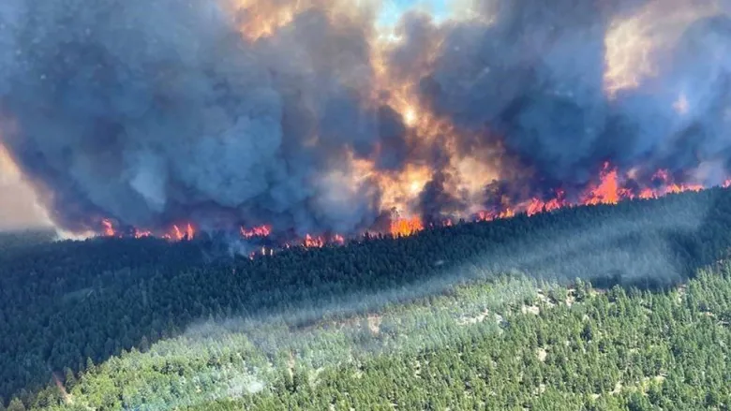
FireCastor
Elizabeth Kleynhans, Kyle Lochhead, Cora Skaien, Tyler Muhly

Slide 2
Goal
Simulate wildfire across the landscape (large scale) into the future (~2100)
Quantify the risk of fire to forest values or management plans e.g. timber harvest, wildlife etc.
Harvestable volume lost
Areas with highest risk of fire
Try different scenarios to see if we can mitigate the impacts of fire

Slide 3
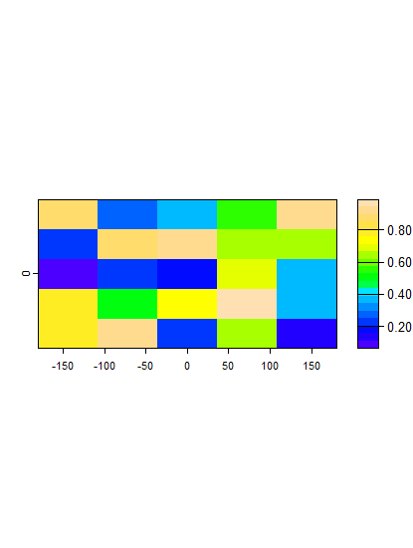
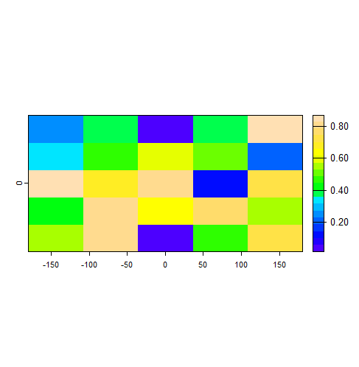
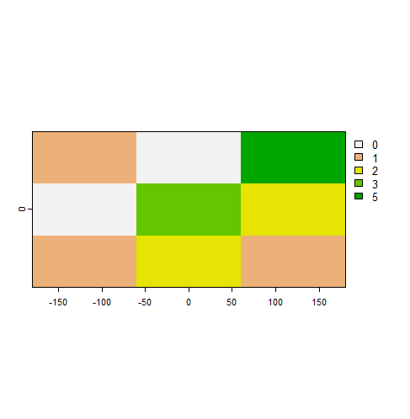

Four processes of wildfire
Number of Ignitions
Escape
Spread
Area burned
10km
1 ha
1 ha
10km
Develop statistical models for each process
Used data for lighting caused fires for years 2009 - 2022
Roughly based on Marchal et al. 2017, 2020

Slide 4
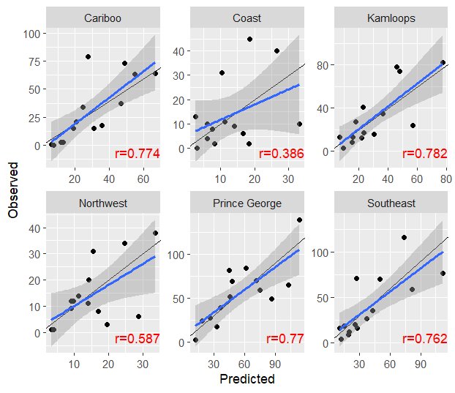
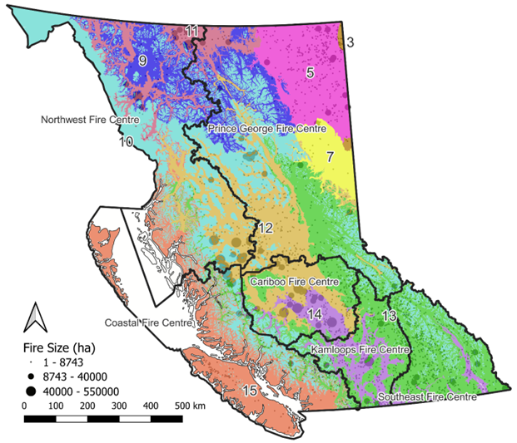
Number of ignitions
GLMM inhomogeneous Poisson process model
Province wide, 10 x 10km grid
Climate, landcover and a spatially varying parameter (u)
Number of ignitions ~ int + CMI_MIN + dCMI3yr + CMI_PROV + FRT + CON + YOUNG + DEC + u
Notes:
For lightning cause fires only at 10 km grid between 2009 and 2022 for the various fire centres.

Slide 5
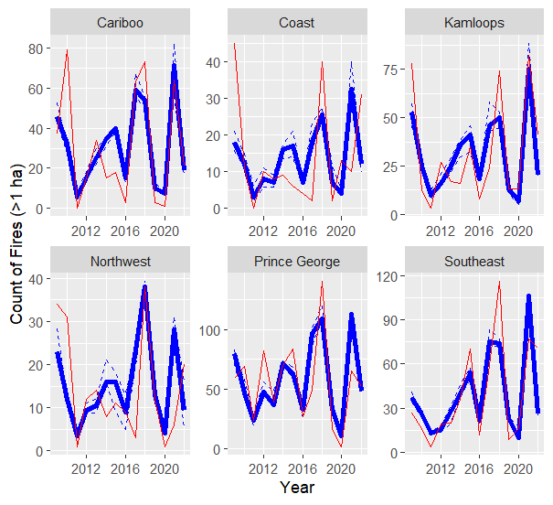
Number of ignitions
GLMM inhomogeneous Poisson process model
Province wide, 10 x 10km grid
Climate, landcover and a spatially varying parameter (u)
Number of ignitions ~ int + CMI_MIN + dCMI3yr + CMI_PROV + FRT + CON + YOUNG + DEC + u
Notes:
observed and predicted time series of fire occurrence using the fire occurrence and fire size model for the years 2009 to 2022. The blue line is the prediction with 95% range in the simulation as dashed lines and the red lines are observed.

Slide 6
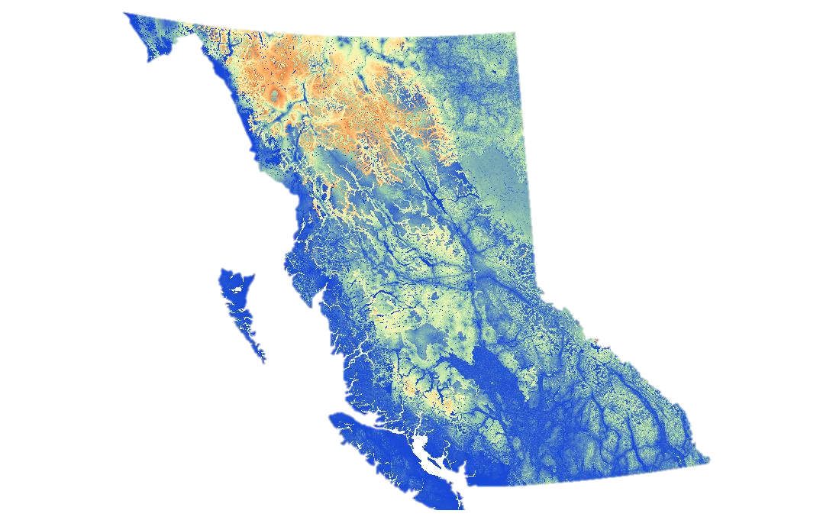
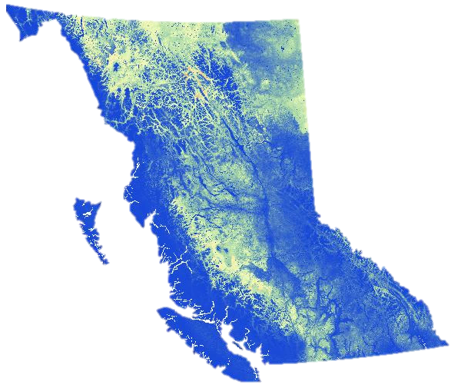
Probability of escape and spread
Escape ~ Tmax + PPT + veg_type + distance to road/infrastructure + slope + aspect + elevation
Spread ~ Tmax + PPT + veg_type + distance to road/infrastructure + slope + aspect + elevation + distance to point of ignition

Slide 7
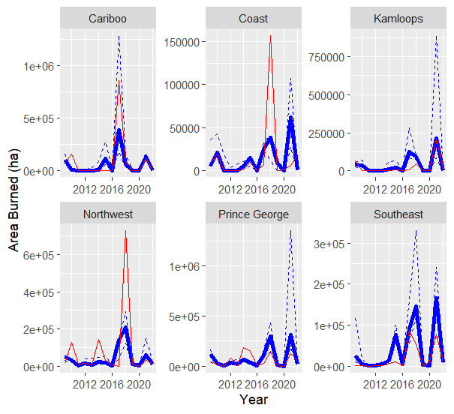
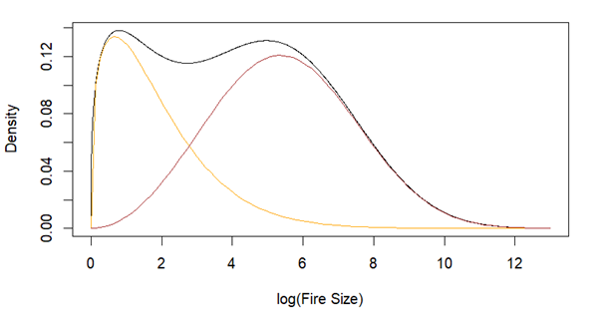
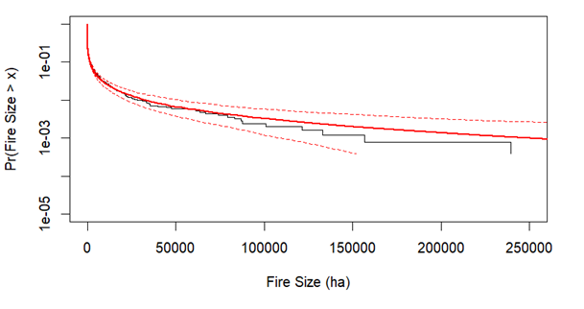
Area burned
Generalized additive model with a mixture of two Weibull distributions (finite mixture model)
Linear predictor 1st dist ~ int + PPT_SM + CMI + # ignitions + CON
Linear predictor 2st dist ~ int + PPT_SM + CMI + # ignitions + CON
Mixing probabilities pi~ int + FRT +CMI_PROV + TEMP_MAX
Correlation between predicted and observed =0.68
Notes:
PPT_sm is the total precipitation falling between May and September; CMI is the climate moisture index; # ignitions are the predicted ignition rate from the poisson process; CON is the log transformed area that conifer ( > 8 m2/ha basal area and leading species conifer > 75%); CMI_PROV is the provincial average CMI; TEMP_MAX is the maximum temperature between May and September. Figure to the left: in the top panel are the two Weibull fitted distributions with mixing probabilities for the year 2018; bottom panel is the observed fire size empirical cumulative distribution function and the red is the fitted two Weibull mixture with 95% confidence intervals in dashed lines. Figure to the right: observed and predicted time series of annual area burnt using the fire occurrence and fire size model for the years 2009 to 2022. The blue line is the prediction with 95% range in the simulation as dashed lines and the red lines are observed.

Slide 8
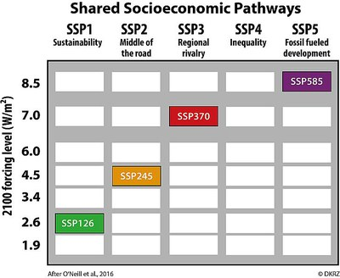
Feedbacks
Climate scenarios
Harvesting/management scenarios
- clear cutting
- partial harvest
- AAC, …
One-way effects
Possible effects
Scenarios
Pessimistic
Timber supply (AAC)
Damage to important values
Fire risk
Forest resilience
…
Optimistic
CASTOR
Forest management
Density & volume
Forest types (coniferous, mixed, broadleaf, young, open, non-flammable)
Fuel clearing
Retention of old forest, wildlife habitat areas, parks, etc.
Fire regime
Parameters/outputs:
Yearly # ignitions
Ignition probability map
Spread probability map
Total Area burned
STSM2023
Forest fuel changes
Fire regime parameters
Forest management
Density & volume
Species
Fuel clearing
Retention of old forest, wildlife habitat areas, parks, etc.
Forest fuel changes
Feedback with fire

Slide 10
FireCastor
Climate scenarios
Number of ignitions
GLMM inhomogeneous Poisson process model
Vegetation
Coniferous, mixed, deciduous, young, open, non-flammable, forest age, volume, % coniferous
Probability of ignition
(indicates locations with highest probability of fires starting)
Binomial logistic regression
Landscape attributes
Elevation, slope, aspect
Probability of spread
(locations with highest probability of burning)
Binomial GLMM
Infrastructure
Distance to roads
Distance to other infrastructure (e.g. urban, mines, railways, powerlines, etc)
Generalized additive model with a mixture of two Weibull distributions
Area burned
(by each fire or total)

