Slide 1

CodePulse
Intelligent Multi-Platform Coding Performance Analyzer
A unified dashboard that aggregates competitive-programming activity from Codeforces, LeetCode, AtCoder, and CodeChef — with AI-powered insights and recommendations.
Presented by
Abdus Salam Islam Badhon
BSSE ID: BSSE-1401 | Dept. of IIT, University of Dhaka
Supervised by
Mohd. Zulfiquar Hafiz
Professor, Dept. of IIT, University of Dhaka
1

Slide 2
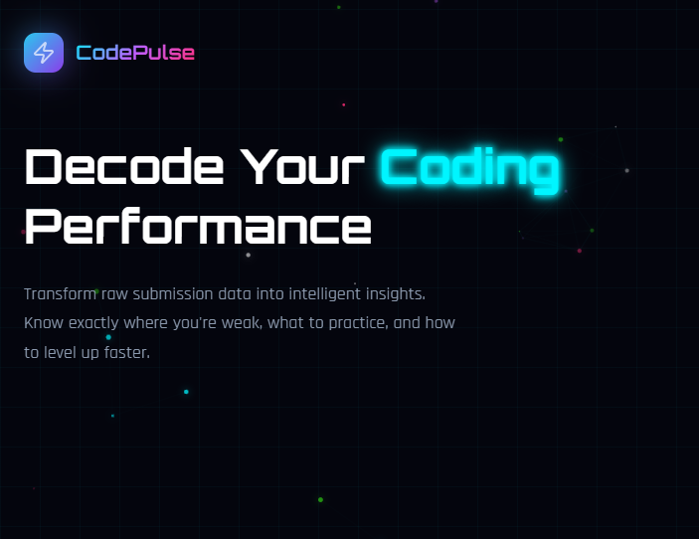
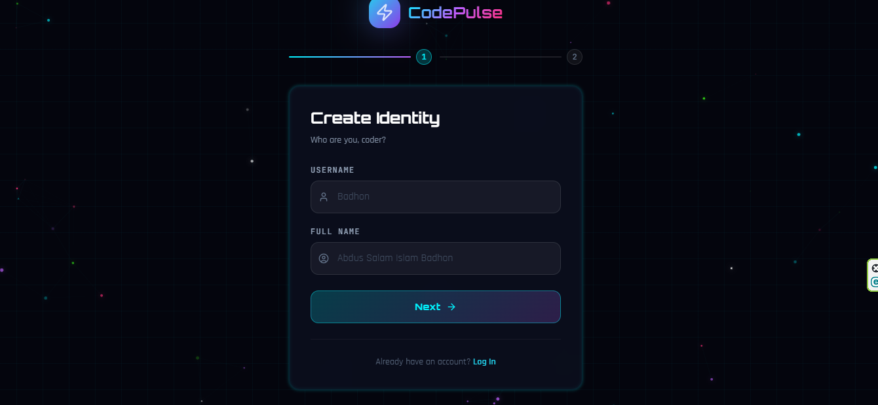
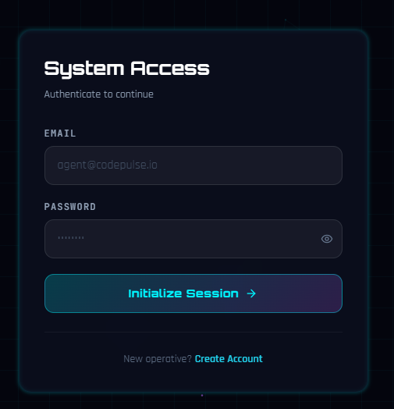
Overview
CP
CodePulse is a full-stack web application that aggregates and analyses competitive-programming activity across Codeforces, LeetCode, AtCoder, and CodeChef into a single intelligent dashboard.
Instead of checking four separate platforms, users get one unified view of their strengths, weaknesses, combined rating, and AI-generated problem recommendations.
Built on a Next.js 14 frontend and a Spring Boot 3.2 backend, with Mistral AI powering the recommendation and coaching layer.
CodePulse
2

Slide 3
Motivation
CP
1
Fragmented Data
2
No Cross-Platform Insight
3
Manual Problem Selection
Competitive programmers' stats are scattered across 4+ unrelated platforms with no shared view.
There is no easy way to see combined weaknesses, strengths, or a single unified rating.
Choosing what to practice next is largely manual, random, or based on gut feeling.
4
Limited Existing Tools
5
Untapped Behavioural Data
6
Opportunity for AI Coaching
Existing trackers are single-platform and rarely offer AI-driven, personalised guidance.
Submission history hides patterns (streaks, blind spots, comfort zones) that go unused.
Modern LLMs can turn raw submission history into a personal, context-aware coach.
CodePulse
3

Slide 4
Core Value Propositions
CP
Problem (status quo) | CodePulse solution
Stats scattered across 4 platforms | Single combined dashboard
No cross-platform weakness detection | Unified topic weakness radar
Rating comparison between platforms is hard | CodePulse Rating — one number from all 4
Problem selection is manual / random | Algorithmic + AI-powered recommendations
No insight into behavioural patterns | Hidden Findings Engine (8+ auto-generated insights)
AI can't understand your coding history | Mistral AI receives your full performance context
CodePulse
4

Slide 5
What is CodePulse?
CP
TARGET USERS
1
Developers
Track and improve competitive-programming performance across every platform they use.
2
Researchers
Study behavioural and performance patterns from aggregated multi-platform submission data.
3
Students / Teachers
Use unified analytics and AI recommendations for guided, structured practice.
CodePulse
5

Slide 6
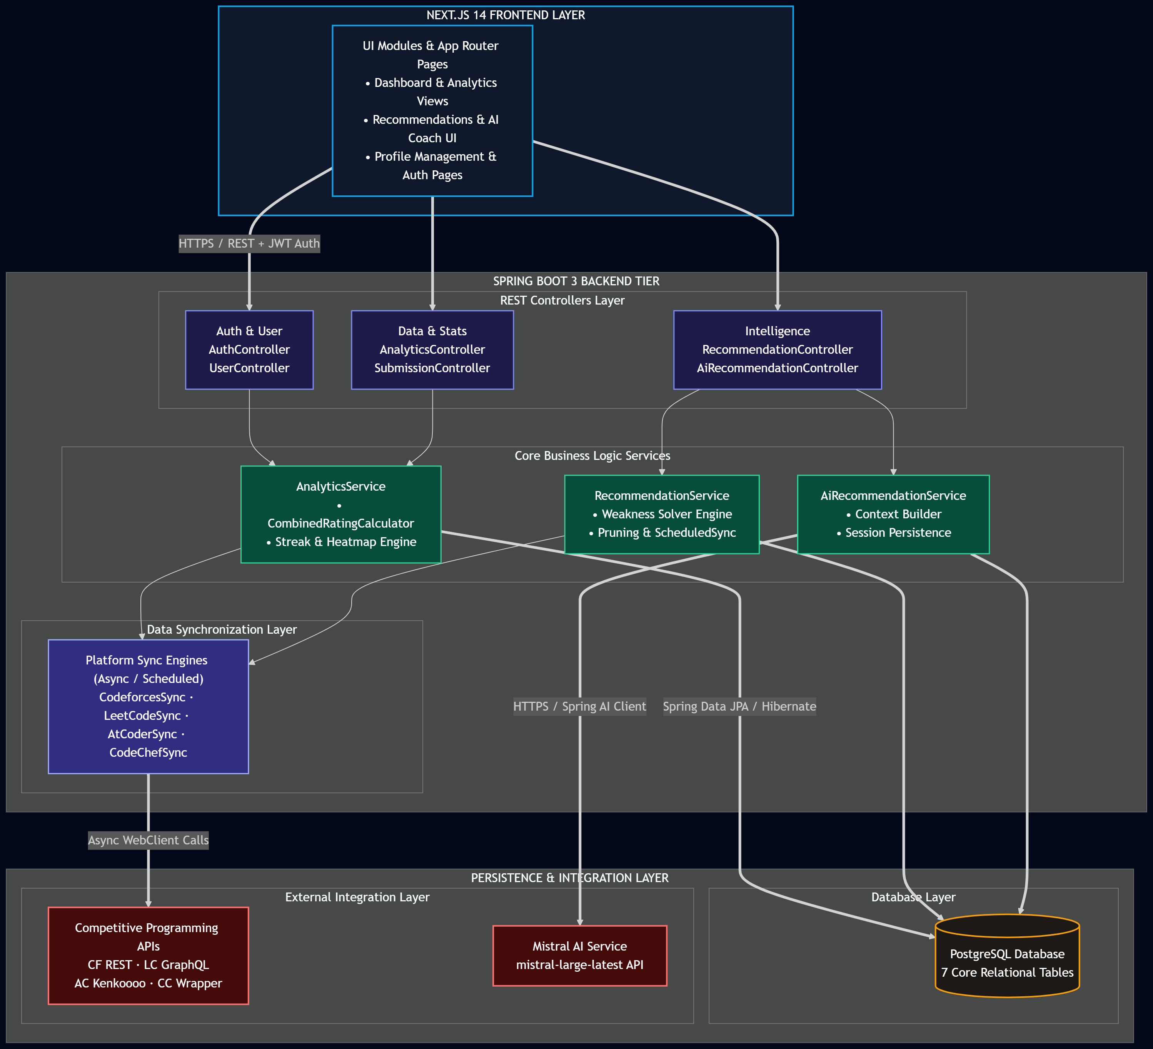
System Architecture
CP
Next.js frontend · Spring Boot backend · Data sync layer · PostgreSQL
CodePulse
6

Slide 7
Tech Stack
CP
BACKEND
FRONTEND
Layer | Technology
Language | Java 17
Framework | Spring Boot 3.2
Security | Spring Security + JWT + BCrypt
AI | Spring AI + Mistral (mistral-large-latest)
ORM | Spring Data JPA / Hibernate 6
Database | PostgreSQL 15+
Build | Maven 3.9
Layer | Technology
Framework | Next.js 14 (App Router)
Language | TypeScript
Styling | Tailwind CSS (cyberpunk theme)
Animation | Framer Motion
Charts | Recharts
State | Zustand + TanStack Query v5
HTTP | Axios
CodePulse
7

Slide 8
Supported Platforms
CP
Platform | API | Data collected
Codeforces | Official REST API | Submissions, verdict, rating history, tags, difficulty
LeetCode | GraphQL API | Submissions, Easy/Medium/Hard difficulty, topic tags
AtCoder | kenkoooo.com community API | Submissions, Elo-like difficulty model, contest info
CodeChef | Community wrapper API | Solved problems, division-based difficulty estimation
CodePulse
8

Slide 9
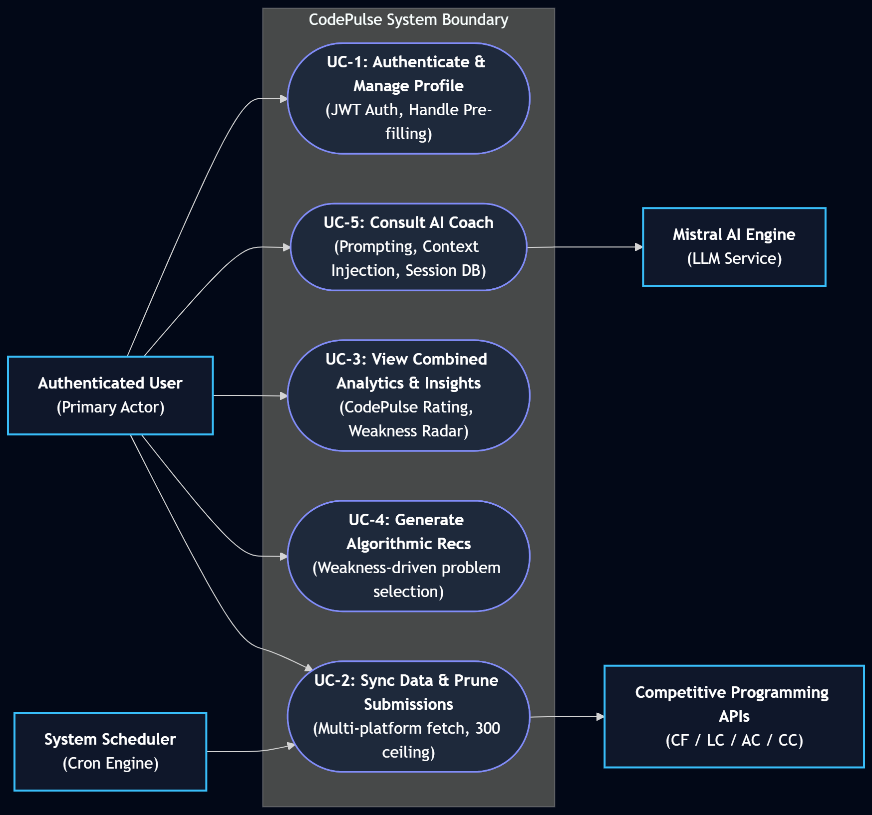
Use Case Diagram — System Overview
CP
Five core use-case clusters (UC-1 to UC-5)
CodePulse
9

Slide 10
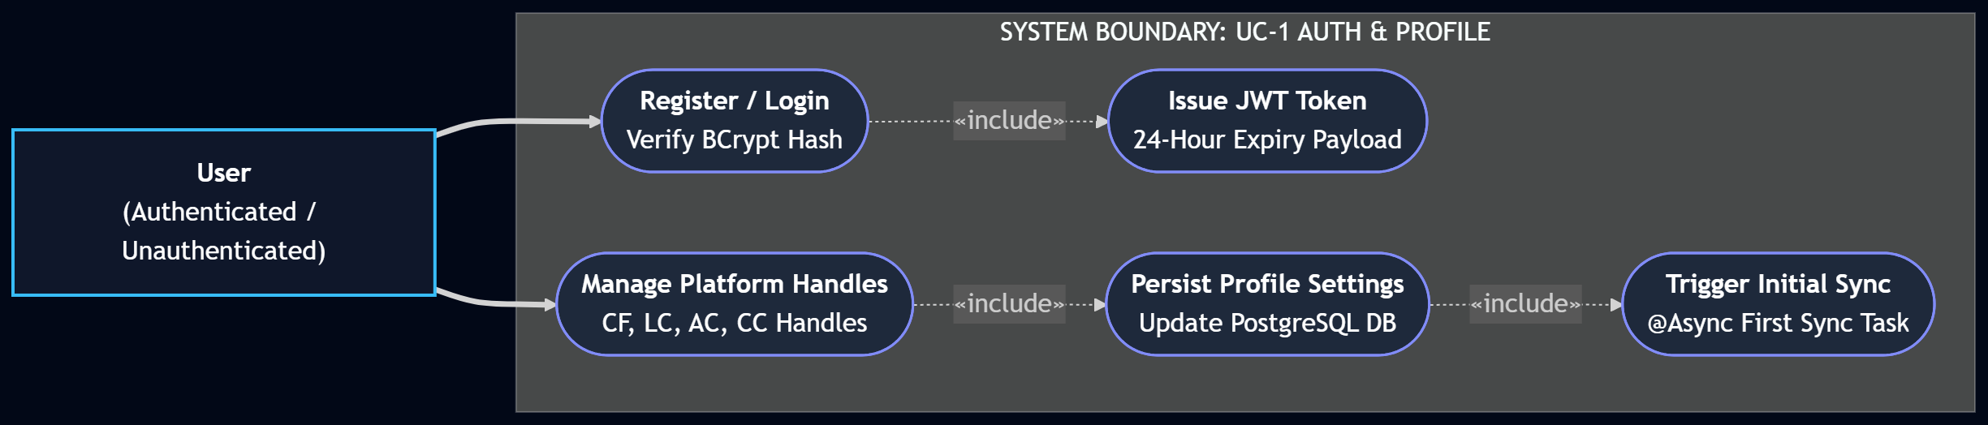
Use Case — Authentication & Profile
CP
UC-1: registration, login, and platform-handle management
CodePulse
10

Slide 11
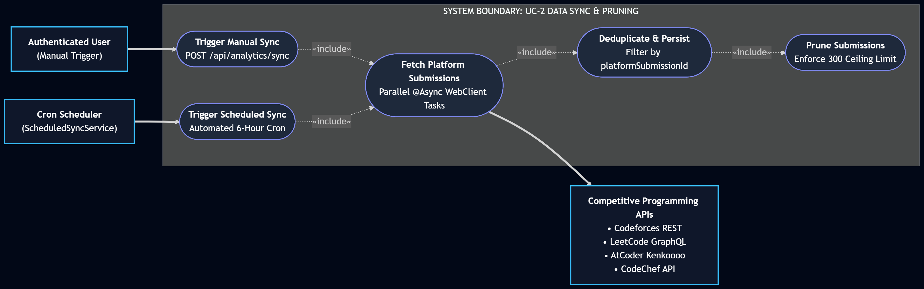
Use Case — Data Sync & Pruning
CP
UC-2: multi-platform submission sync and retention
CodePulse
11

Slide 12
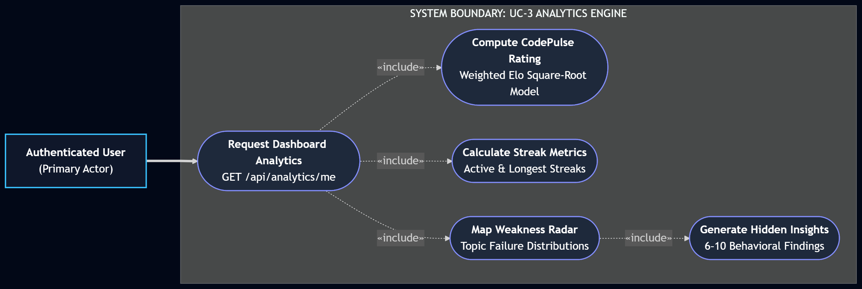
Use Case — Analytics Engine
CP
UC-3: CodePulse Rating, streaks, and weakness radar
CodePulse
12

Slide 13
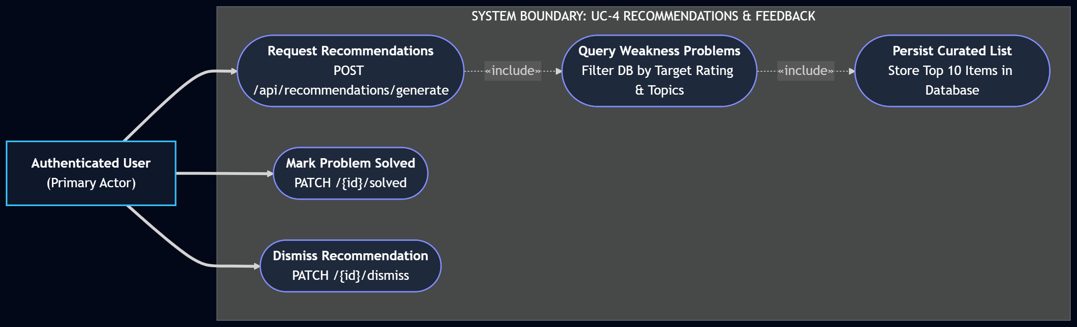
Use Case — Recommendations & Feedback
CP
UC-4: curated problem generation and solve tracking
CodePulse
13

Slide 14
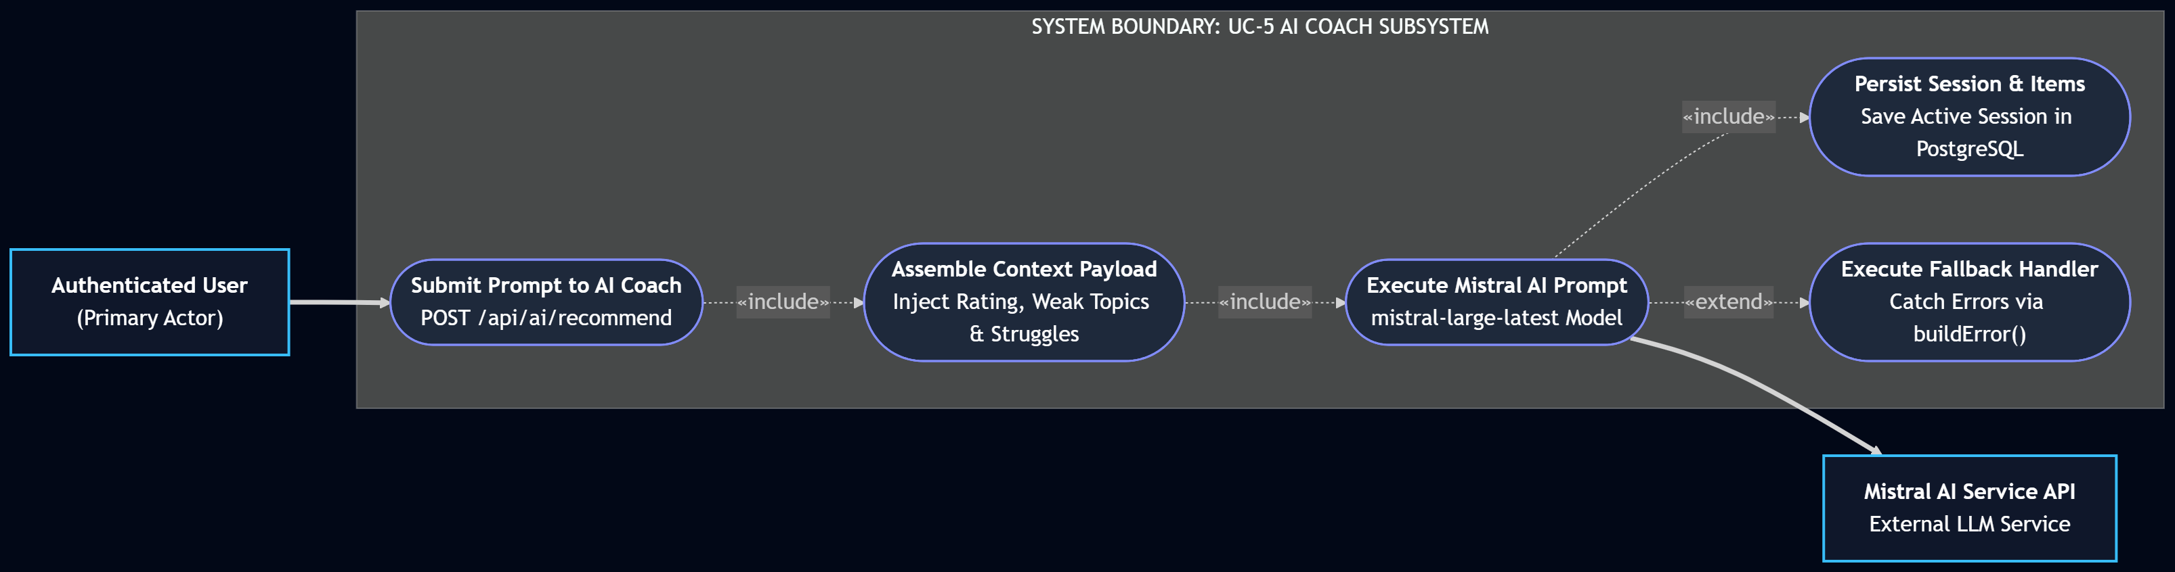
Use Case — AI Coach Subsystem
CP
UC-5: prompt-driven Mistral AI recommendation sessions
CodePulse
14

Slide 15
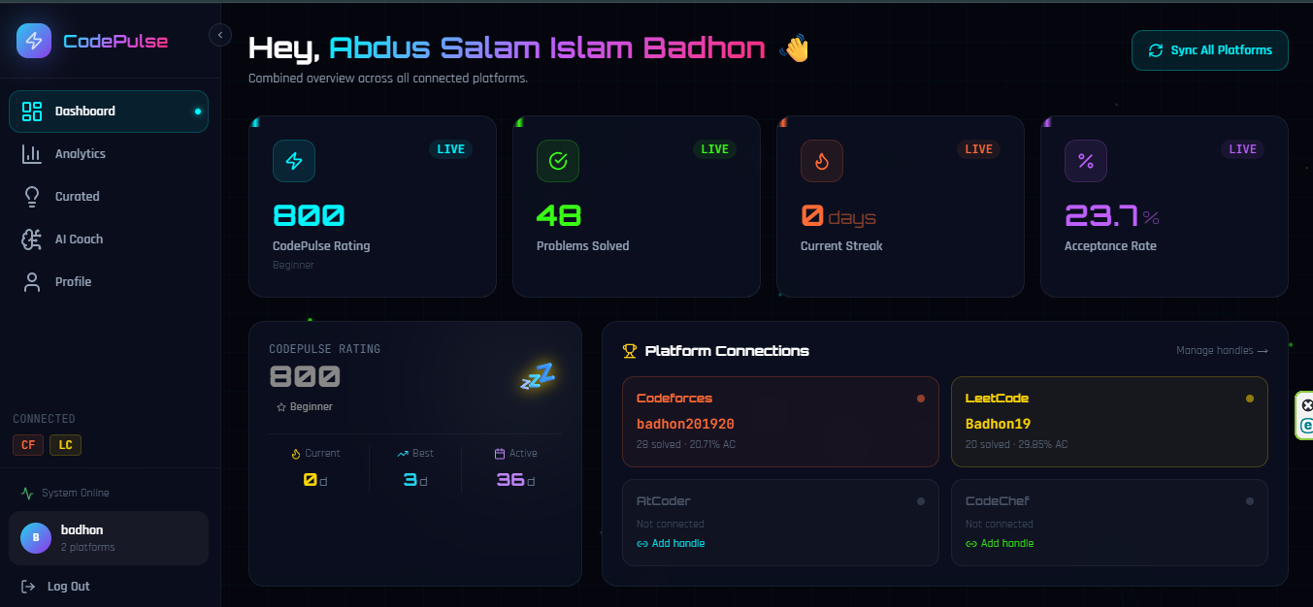
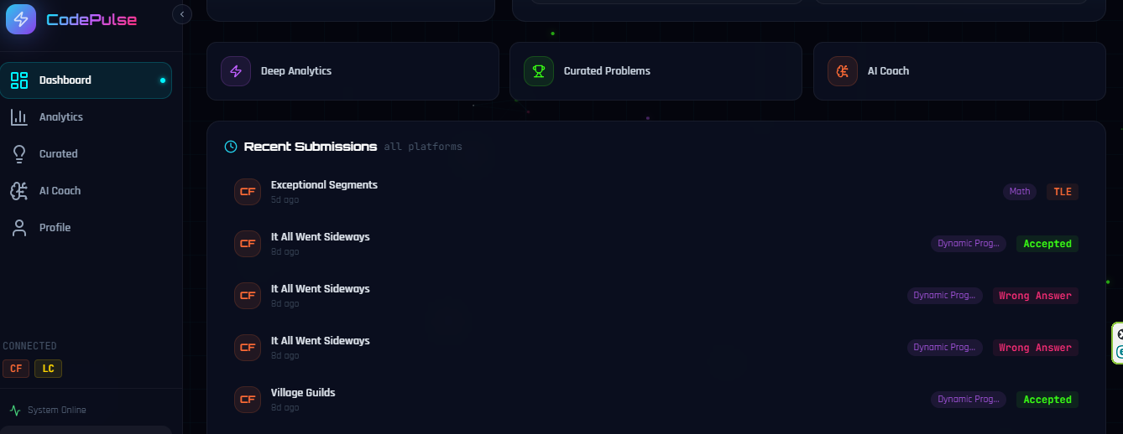
Feature — Combined Dashboard
CP
CodePulse Rating — unified rating computed from all 4 platforms
Current & longest streak across all connected platforms
Platform connection grid showing handle names and stats
Recent submissions timeline with clickable links to the actual problems
CodePulse
15

Slide 16
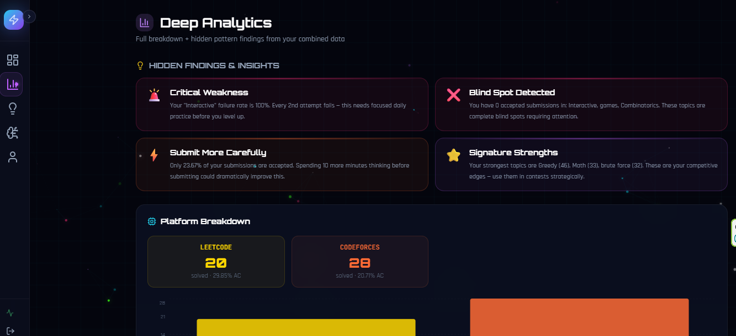
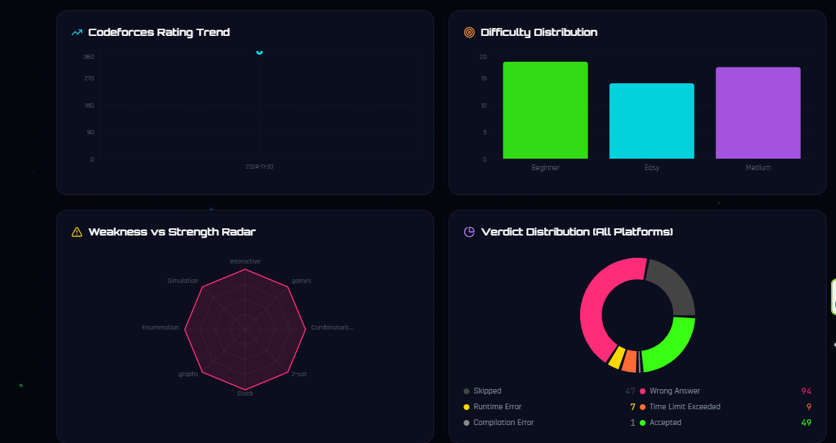
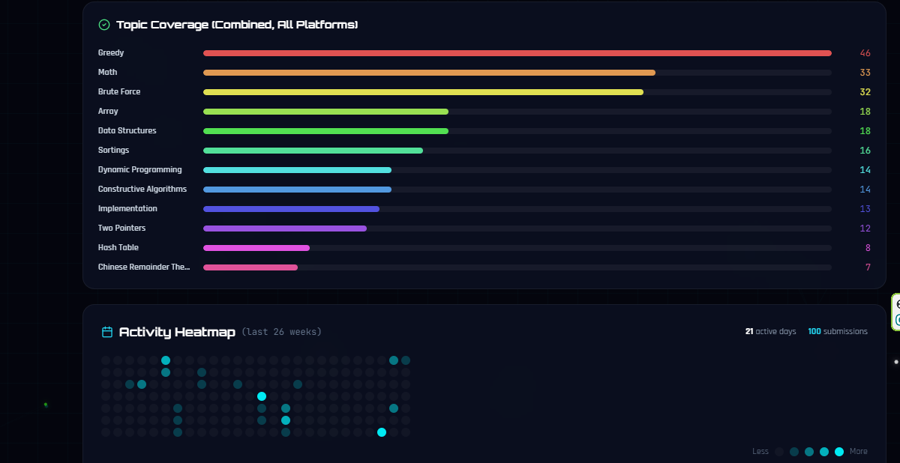
Feature — Deep Analytics
CP
Activity heatmap — 26 weeks, all platforms combined
Per-platform comparison chart & CF rating trend line
Difficulty distribution normalised across platforms
Topic coverage bar chart (top 12) & weakness vs strength radar
Combined verdict distribution donut chart
CodePulse
16

Slide 17
Hidden Insights Engine
CP
Auto-generates 6–10 findings from a user's combined data
1
Critical Weakness Detection
2
Zero-Accepted Topics
3
Acceptance Rate Analysis
Flags the topic dragging performance down the most.
Surfaces blind-spot topics with no accepted submissions.
Tracks accuracy trends across platforms.
4
Difficulty Comfort-Zone Alert
5
Streak Pattern Recognition
6
Topic Diversity Score
Warns when a user avoids harder problems.
Detects consistency and gaps in practice habits.
Measures breadth of topics practised.
7
Platform Imbalance Detection
8
Activity Trend
9
Strength Signature Recognition
Flags over-reliance on a single platform.
Compares last 30 vs previous 30 days of activity.
Highlights the user's strongest topic areas.
CodePulse
17

Slide 18
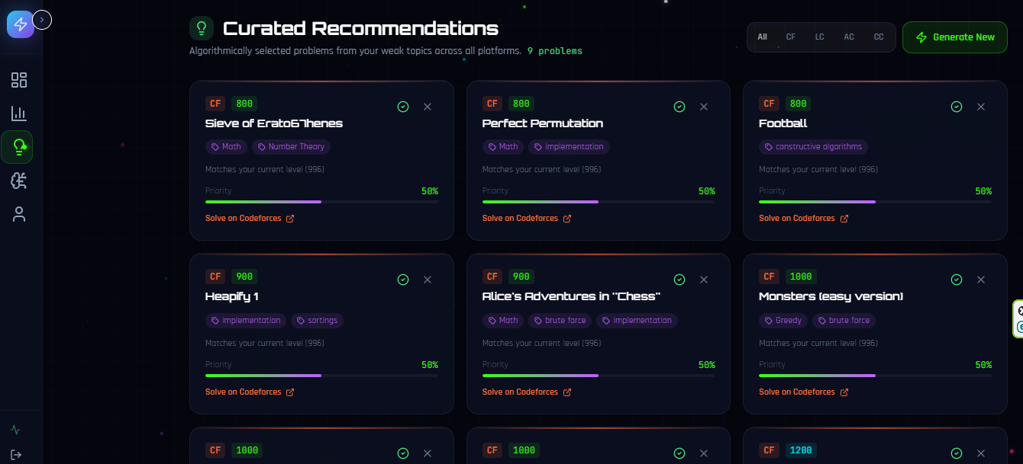
Feature — Curated Recommendations
CP
/recommendations
Algorithmic recommendations based on detected weakness topics
Estimated user rating determines the difficulty range
Recommendations sourced from any of the 4 connected platforms
Platform filter: All / CF / LC / AC / CC
Mark solved (feedback loop) · Dismiss · Generate new (replaces previous)
CodePulse
18

Slide 19
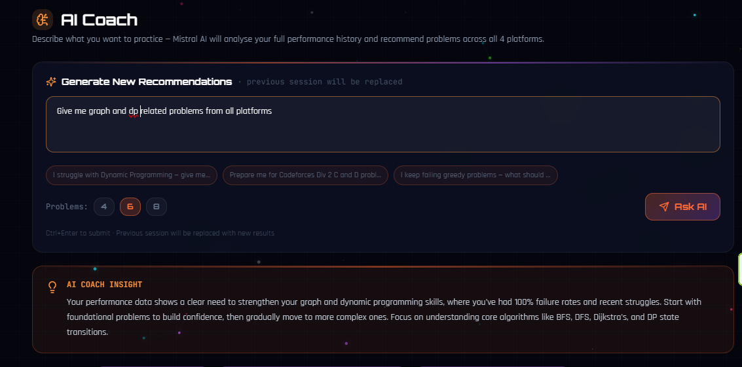
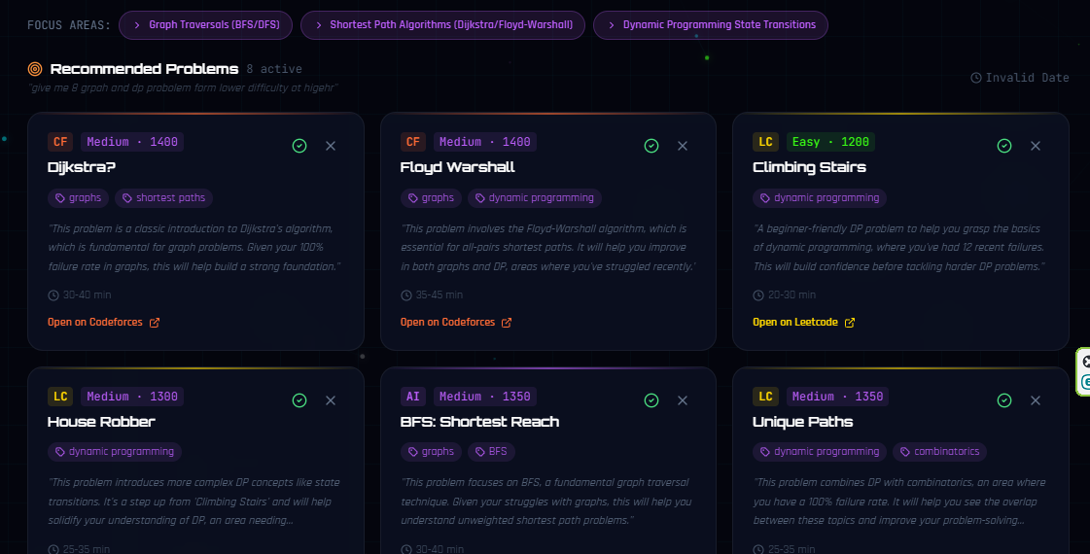
Feature — AI Coach
CP
/ai-recommend
Free-text prompt, e.g. "I want to practice DP on trees"
Mistral AI receives full user context: rating, weakness scores, per-platform stats, recently solved problems, recent WA/TLE topics
Returns 4–10 personalised problem recommendations with direct URLs
Coach Insight paragraph + Focus Areas
Session stored in DB and shown on page load · Regenerate replaces previous session
CodePulse
19

Slide 20
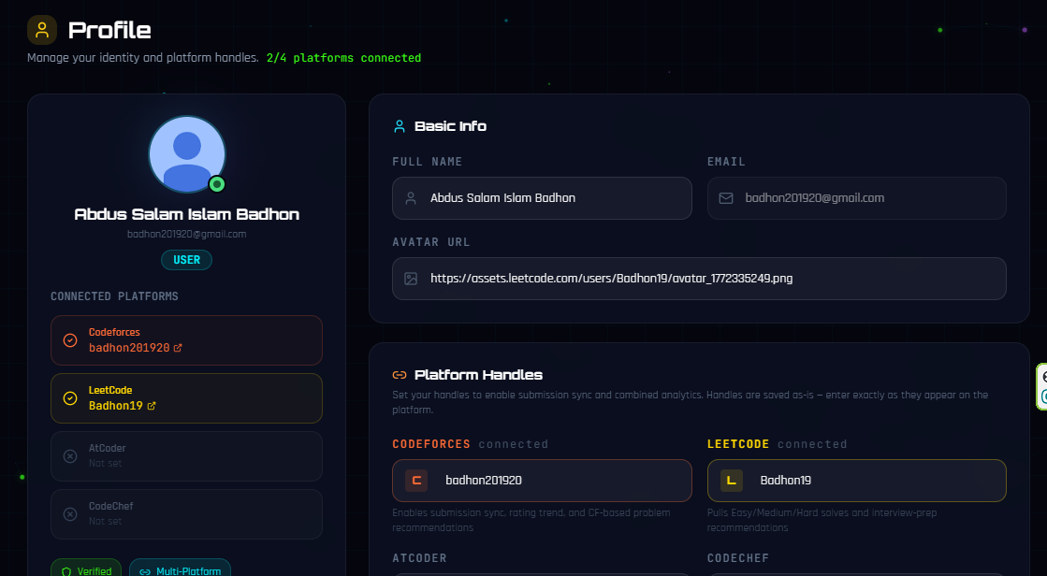
Feature — Profile & Auto-Sync
CP
PROFILE
All 4 platform handles always pre-filled from server
Connection status badge per platform
Clicking a handle opens the profile on that platform
Saving triggers re-sync eligibility
AUTO-SYNC
Runs every 6 hours for all active users (configurable cron)
Triggered manually by the user from any page
Submission pruning: keeps latest 300 per user (configurable)
CodePulse
20

Slide 21
CodePulse Rating Algorithm
CP
A single Elo-like number representing combined performance
For each connected platform:
CF_rating = actual CF rating from /user.rating API (or estimated)
LC_rating = 1200 + (easy × 2) + (medium × 9) + (hard × 22) + acceptance_rate_bonus
AC_rating = average difficulty of solved AtCoder problems × 1.05
CC_rating = 1000 + (easy × 3) + (medium × 10) + (hard × 20) + (expert × 35)
Weight per platform = √(submission_count_on_platform)
→ More activity on a platform gives it more influence, with diminishing returns
CodePulse_Rating = Σ(platform_rating × weight) / Σ(weight)
→ Clipped to the range [800, 3800]
CodePulse
21

Slide 22
Rating Tier Mapping
CP
Mirrors CF tier names for familiarity
Rating | Tier
< 1000 | Beginner
1000 – 1199 | Pupil
1200 – 1399 | Apprentice
1400 – 1599 | Specialist
1600 – 1899 | Expert
1900 – 2099 | Candidate Master
2100 – 2399 | Master
2400 – 2599 | International Master
2600 – 2999 | Grandmaster
3000+ | Legendary Grandmaster
CodePulse
22

Slide 23
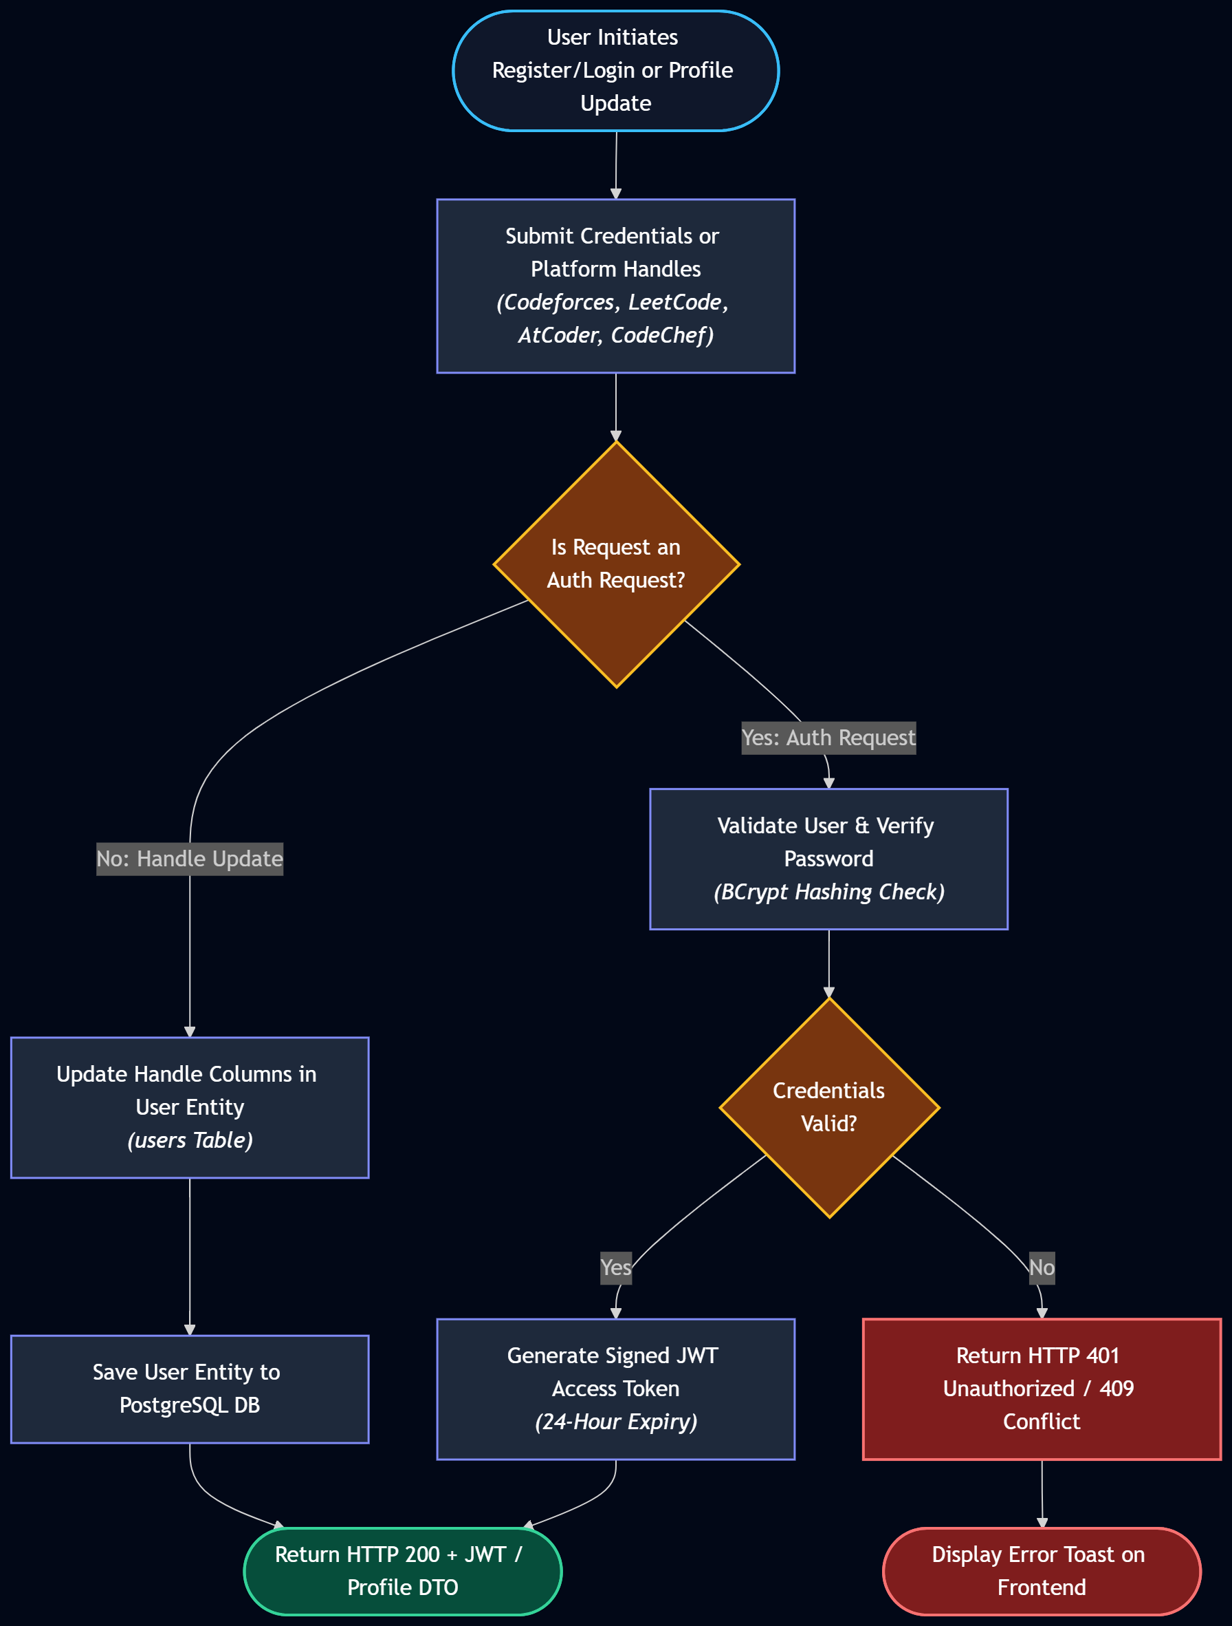
Activity Diagram — Authentication & Profile
CP
Register / login flow through JWT issuance and handle updates
CodePulse
23

Slide 24
Activity Diagram — Data Sync & Pruning
CP
Parallel multi-platform fetch → ingestion → pruning & finalisation
CodePulse
24

Slide 25
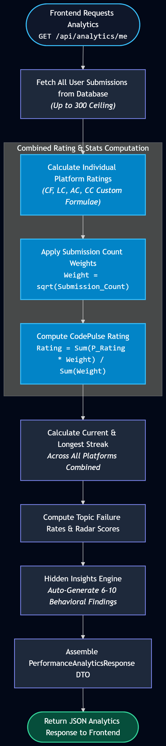
Activity Diagram — Analytics Computation
CP
From GET /api/analytics/me to CodePulse Rating & hidden insights
CodePulse
25

Slide 26
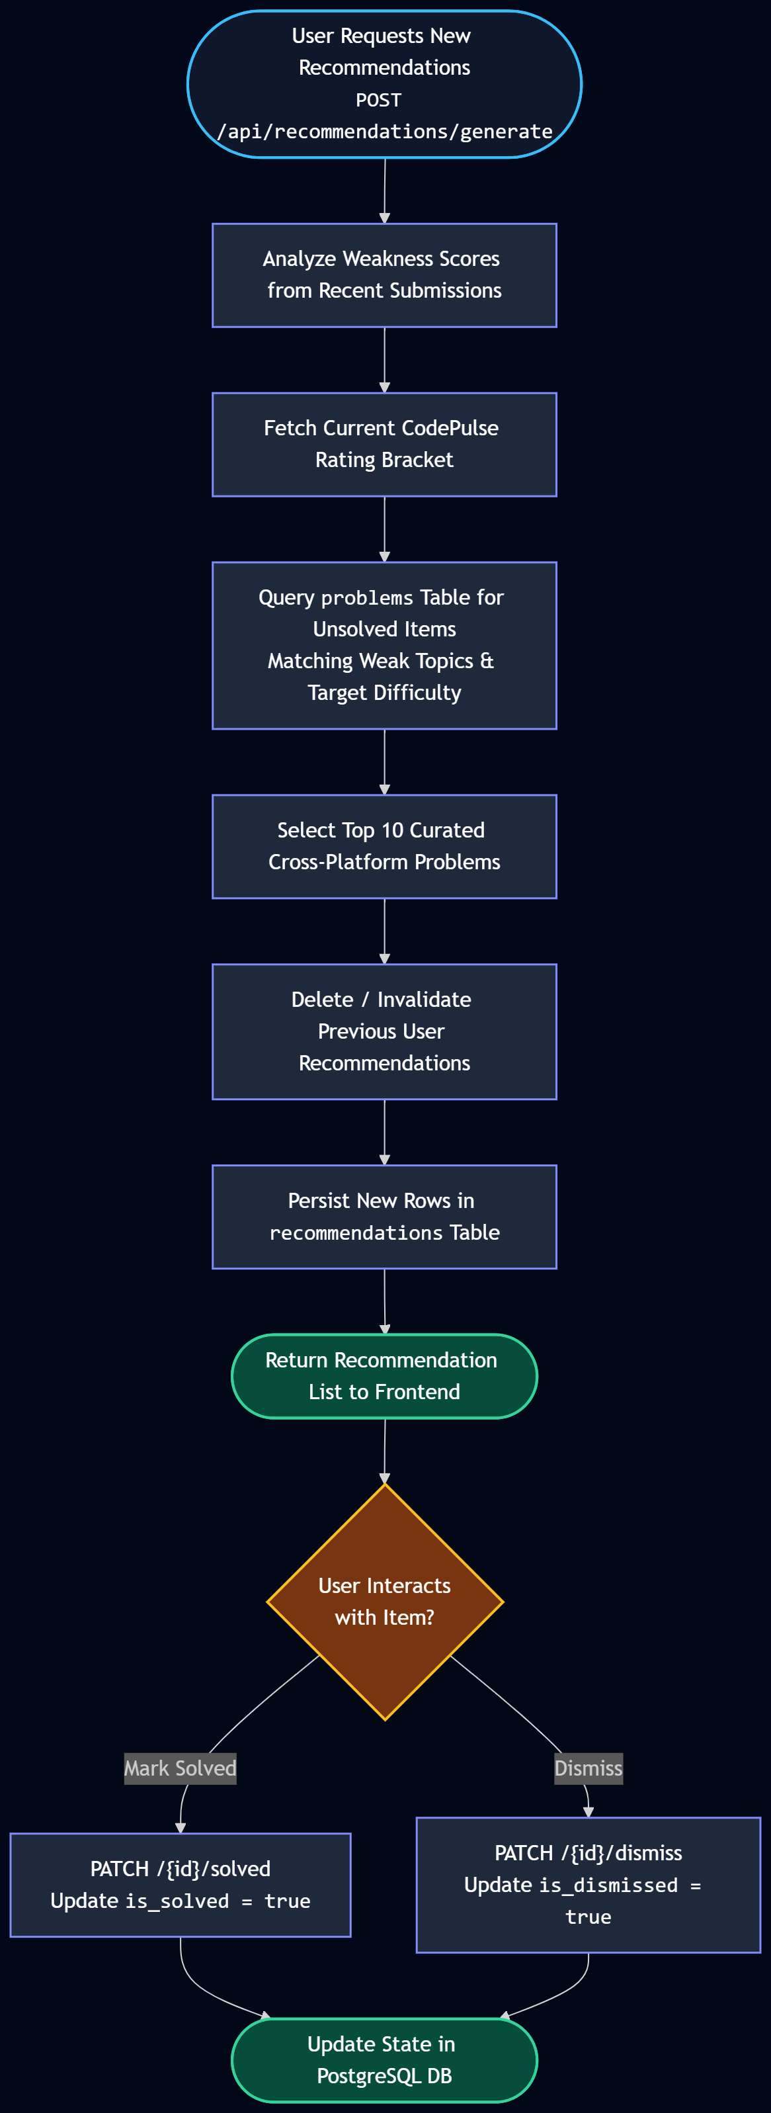
Activity Diagram — Recommendation Generation
CP
Weakness analysis → problem matching → curated list persistence
CodePulse
26

Slide 27
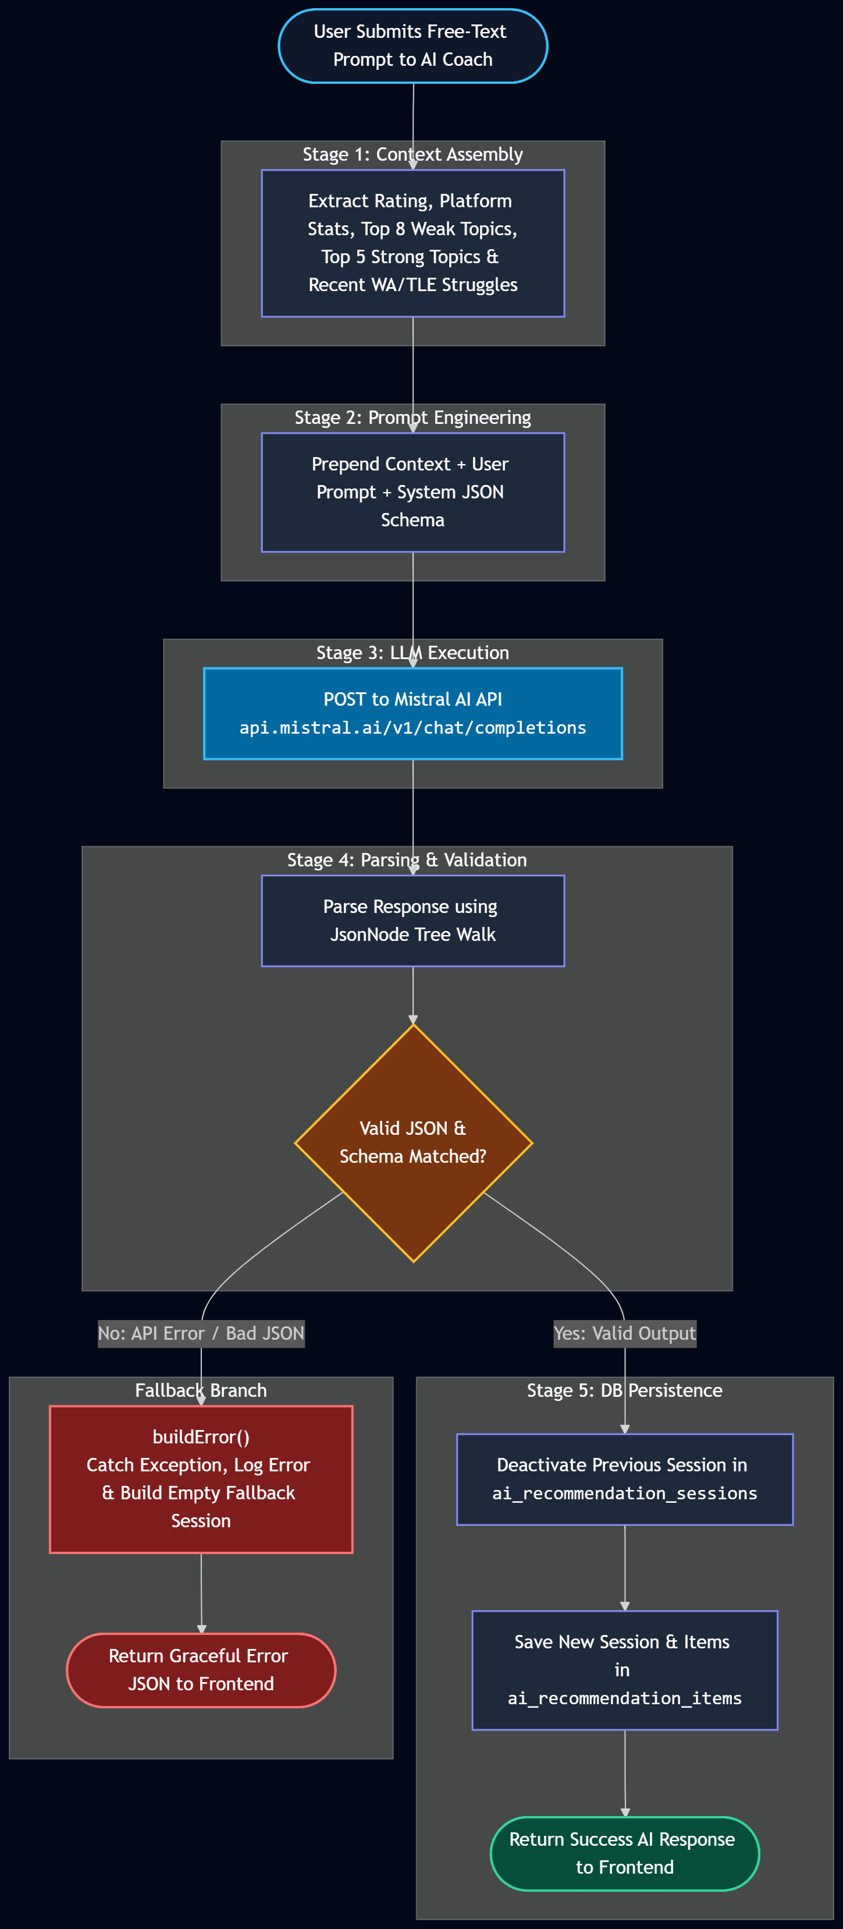
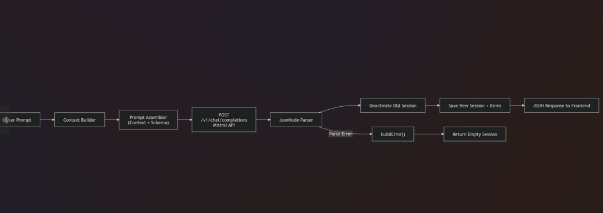
Activity Diagram — AI Coach Flow
CP
Prompt → context assembly → Mistral AI call → parsing & validation
CodePulse
27

Slide 28
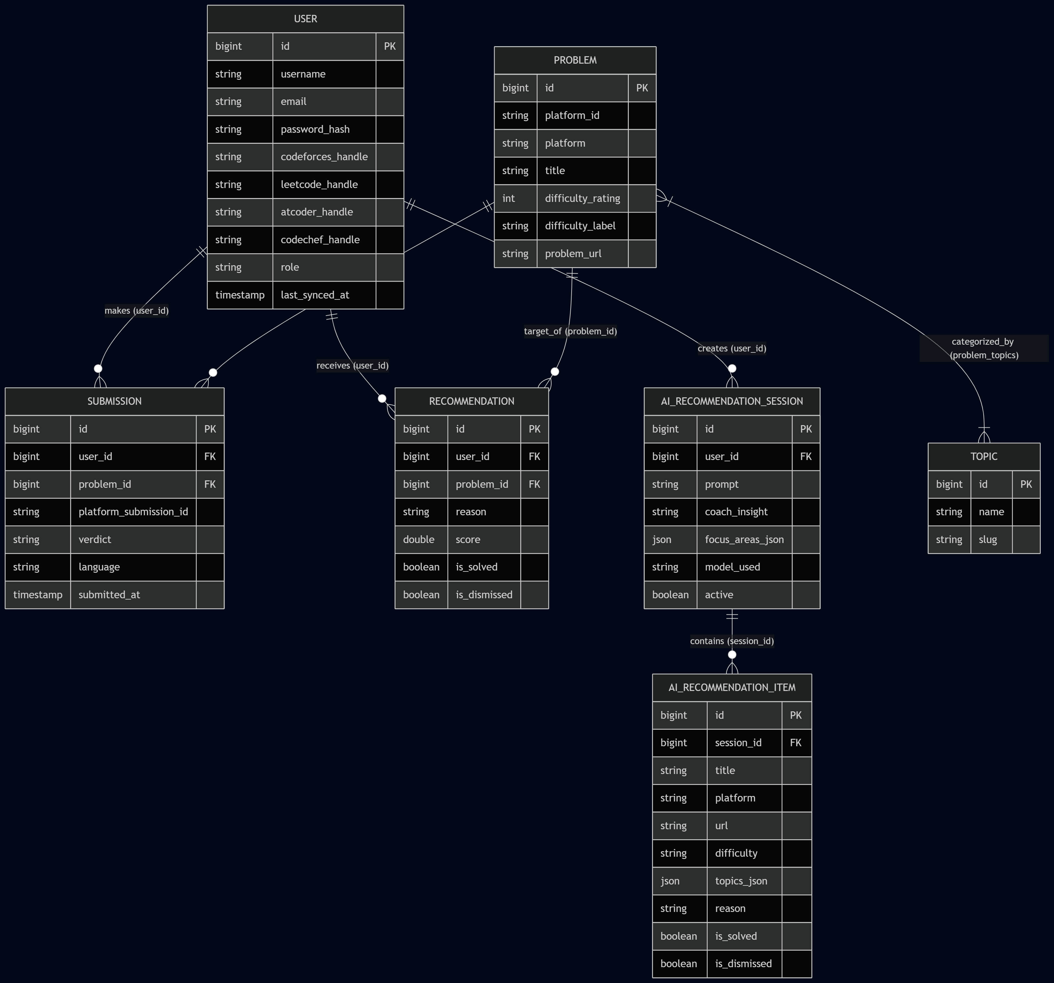
Entity–Relationship Diagram
CP
CodePulse
28

Slide 29
Progress So Far
CP
BACKEND
FRONTEND
Multi-platform data sync layer (CF, LC, AC, CC)
CodePulse Rating algorithm implementation
AI recommendation service integrated with Mistral
JWT authentication & role-based access
Dashboard, Analytics & Recommendations pages
AI Coach chat-style interface
Login / Register flow with 2-step wizard
Profile management with handle pre-fill
CodePulse
32

Slide 30
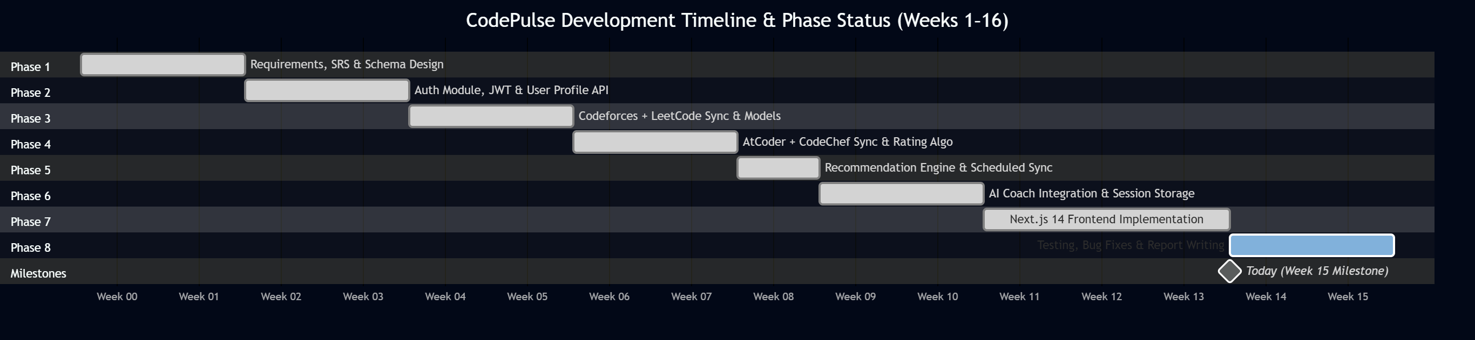
Timeline / Roadmap
CP
Development phases, Weeks 1–16
CodePulse
33

Slide 31
References
CP
[1] Add citations for any papers, APIs, or libraries your project builds on.
[2] Codeforces API documentation — https://codeforces.com/apiHelp
[3] LeetCode GraphQL (community-documented) endpoints.
[4] kenkoooo.com — AtCoder Problems community API.
[5] Mistral AI documentation — https://docs.mistral.ai
[6] Spring AI reference documentation.
CodePulse
35

Slide 32
Thank You!
Questions & Feedback are welcome — CodePulse
36

