Slide 1
SPL1 Store Management System
Submitted by:
Abdus Salam Islam Badhon
Roll : 1401
Supervised by:
Toukir Ahammed
Lecturer , IIT , University of Dhaka

Slide 2
Projects Motivation:
Automate the manual tasks
Better customer experience
Better inventory management

Slide 3
Tools used:
C++
GitHub
Vs Code

Slide 4
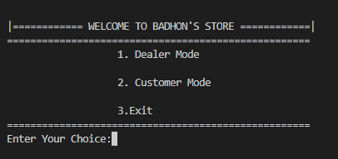
System’s Mode
Dealer Mode
Customer Mode

Slide 5
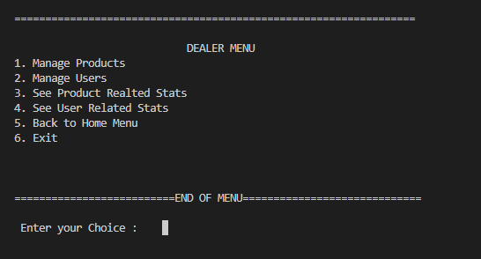
Dealer Mode Features:

Slide 6
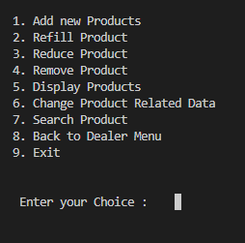
Manage Product menu features

Slide 7
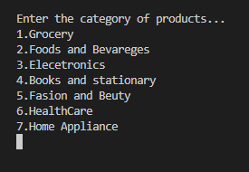
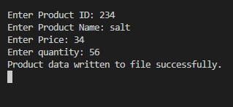
Choosing Category and adding products:

Slide 8
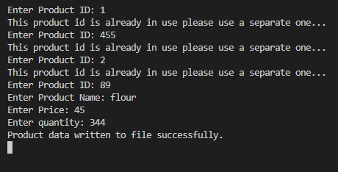
Maintaining unique IDs:

Slide 9
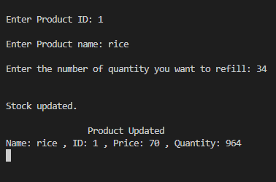

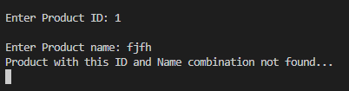
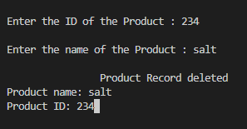
Refilling ,reducing, removing products and handling wrong id and name :

Slide 10
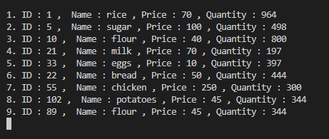
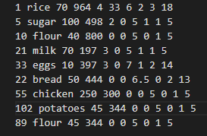
Displaying Stocks :

Slide 11
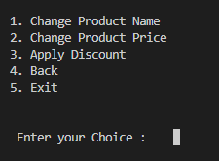
Changing Product Related Data:

Slide 12
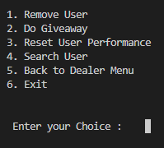
Manging User as a dealer:

Slide 13
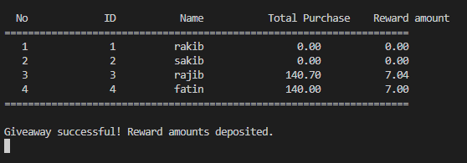
Giveaway:

Slide 14
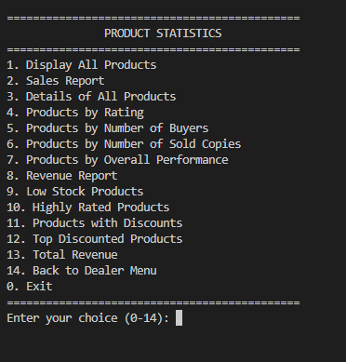
Product Stats:

Slide 15
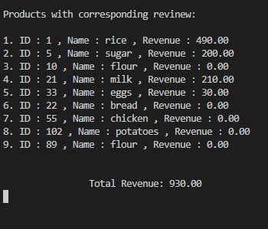
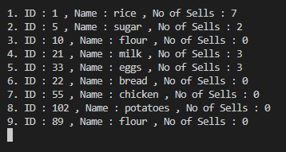
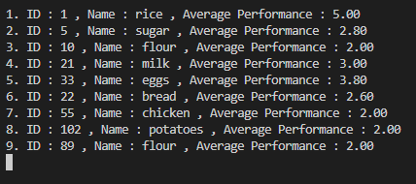
Sales Report ,Revenue Report, Product Based on overall performance:

Slide 16
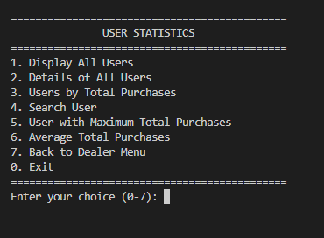
User Related Stats:

Slide 17
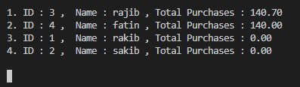
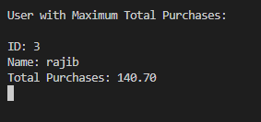

Sorting Users by total purchase, Maximum Purchases and seeing average users purchases:

Slide 18
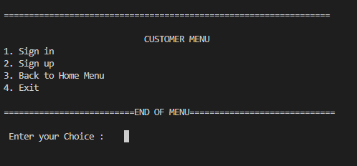
Customer mode:

Slide 19
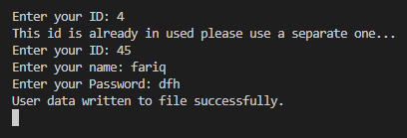
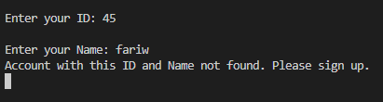
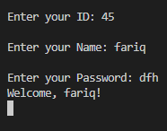
Sign Up and Sign In:

Slide 20

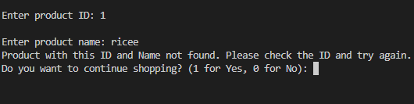
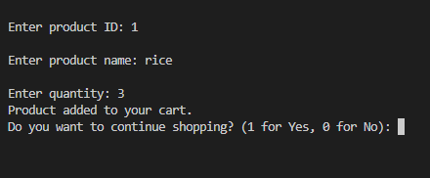
Shopping:

Slide 21
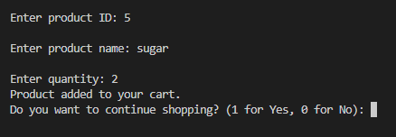
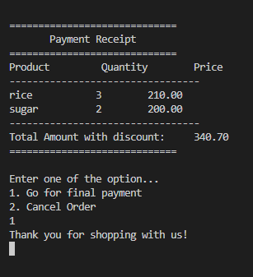

Slide 22
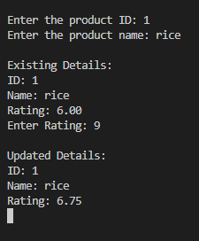
Rating Product:

Slide 23
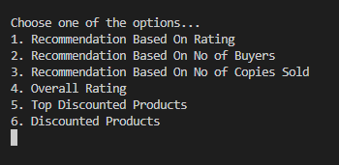
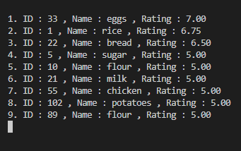
Seeing Recommended Product:

Slide 24
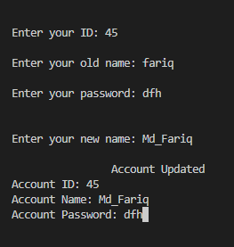
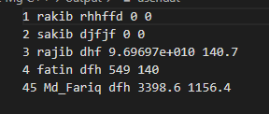
Changing Account Information:

Slide 25
Key features of implementing the project:
Trie data structure for better searching
Usage of a lot data points for applying relevant statistics
Categorization of products for better inventory management

Slide 26
Thank You

