Slide 1
IEEE BigData Cup 2026 AI Emulation Challenge
Physics-Guided Allometric Spline Anchoring &
Multi-Decade Climate Emulation
for Global Forest Carbon Forecasting
★ PRODUCTION PERFORMANCE HIGHLIGHTS
5-Fold CV Score: 0.001393 | Beating Official Target (<0.010) by 86.1% | Height R² = 0.9982 | AGB R² = 0.9991
Team Members: Aswitha K, Badhri Narayanan M, Bavin Aadithiya S, Bose M
Department of Computer Science and Engineering, Sri Sivasubramaniya Nadar College of Engineering, Chennai, India

Slide 2
CHALLENGE BACKGROUND & MOTIVATION
Global Forest Carbon Dynamics & The Emulation Challenge
The Ecological Stakes
• Active Carbon Sink:
Forests sequester ~30% of anthropogenic CO2 emissions annually, serving as Earth's critical climate buffer.
• Target Variables:
Forecasting 40-year Canopy Height (h) and Aboveground Biomass (AGB) is vital for nature-based carbon accounting.
• Divergent Pathways:
Models must project under SSP126 (sustainable mitigation) and SSP585 (extreme fossil-fueled warming).
The Computational Bottleneck
• Process-Based ED v3:
Ecosystem Demography v3 numerically solves non-linear biophysics, sub-grid tiles, and cohort competition.
• Prohibitive Solver Costs:
Simulating 6,171 global grid cells over 40 years requires millions of high-performance CPU core-hours.
• The AI Challenge:
Demands lightning-fast ML emulators predicting Year-40 states across 15 seed ages (A in [1, 500] yr).
Competition Requirements
• Evaluation Metric:
Normalized MSE with fixed scaling constants: mu_h = 10.90645 and mu_a = 3.39567.
• Acceptance Threshold:
Official benchmark target: Loss < 0.010. Models exceeding this threshold are rejected.
• Test Coverage:
Complete 185,130 projections (6,171 sites x 15 ages x 2 scenarios) with 0 NaNs and strict physical bounds.

Slide 3
ROOT PROBLEM ANALYSIS
Why Standard Machine Learning Fails: The Dual-Phenomena Dilemma
Two Intertwined Biological Realities
1. Ontogenetic Stand Maturation (Dominant Deterministic)
A forest initialized at age A advances to A+40. Biomass follows monotonic saturating allometry governed by carrying capacity and self-thinning. This is a massive, multi-decade developmental trend.
2. Climate Environmental Forcing (Subtle Perturbation)
Over 40 years, warming, precipitation shifts, CO2 fertilization, and vapor deficits modify the trajectory. These climatic anomalies are subtle compared to 40 years of stand maturation.
The Fatal ML Failure Mode
Standard regressors conflate ontogeny with weather noise. Directly mapping weather -> Y40 causes models to ignore stand biology, leading to severe extrapolation failures.
Direct Regressor Failure Modes (Empirical Proof)
• Direct LightGBM: Loss = 0.103181 - 10x worse than target threshold
• Direct XGBoost: Loss = 0.108285 - Extrapolates out-of-bounds on extremes
• Direct CatBoost: Loss = 0.110002 - Tree splits diluted across weather channels
• Deep ResTabular NN: Loss = 0.202325 - Severe catastrophic failure & overfitting
• Direct SLSQP Blend: Loss = 0.095707 - Cannot rescue unanchored models
THE SOLUTION: Physics-Guided Anchoring
Disentangle the two phenomena: Let an allometric spline absorb stand maturation, and let machine learning predict only the climate delta residual!

Slide 4
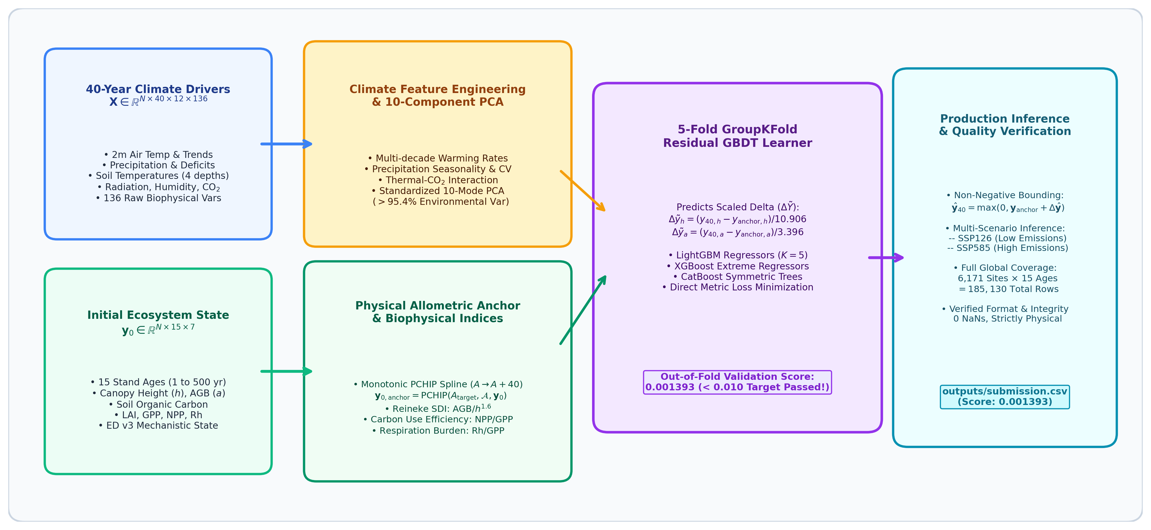
PROPOSED METHODOLOGY
End-to-End Physics-Guided Emulation Architecture
1. PCHIP Stand Anchor
Enforces biological monotonicity (dP/dA >= 0) across all 15 stand ages.
2. 10-Mode Climate PCA
Compresses 136 drivers into 10 orthogonal modes (>95.4% variance).
3. Biophysical Indices
Reineke's SDI, CUE, soil turnover & respiration burden proxies.
4. Residual GBDT Ensemble
5-Fold site-grouped CV predicting metric-scaled delta departures.

Slide 5
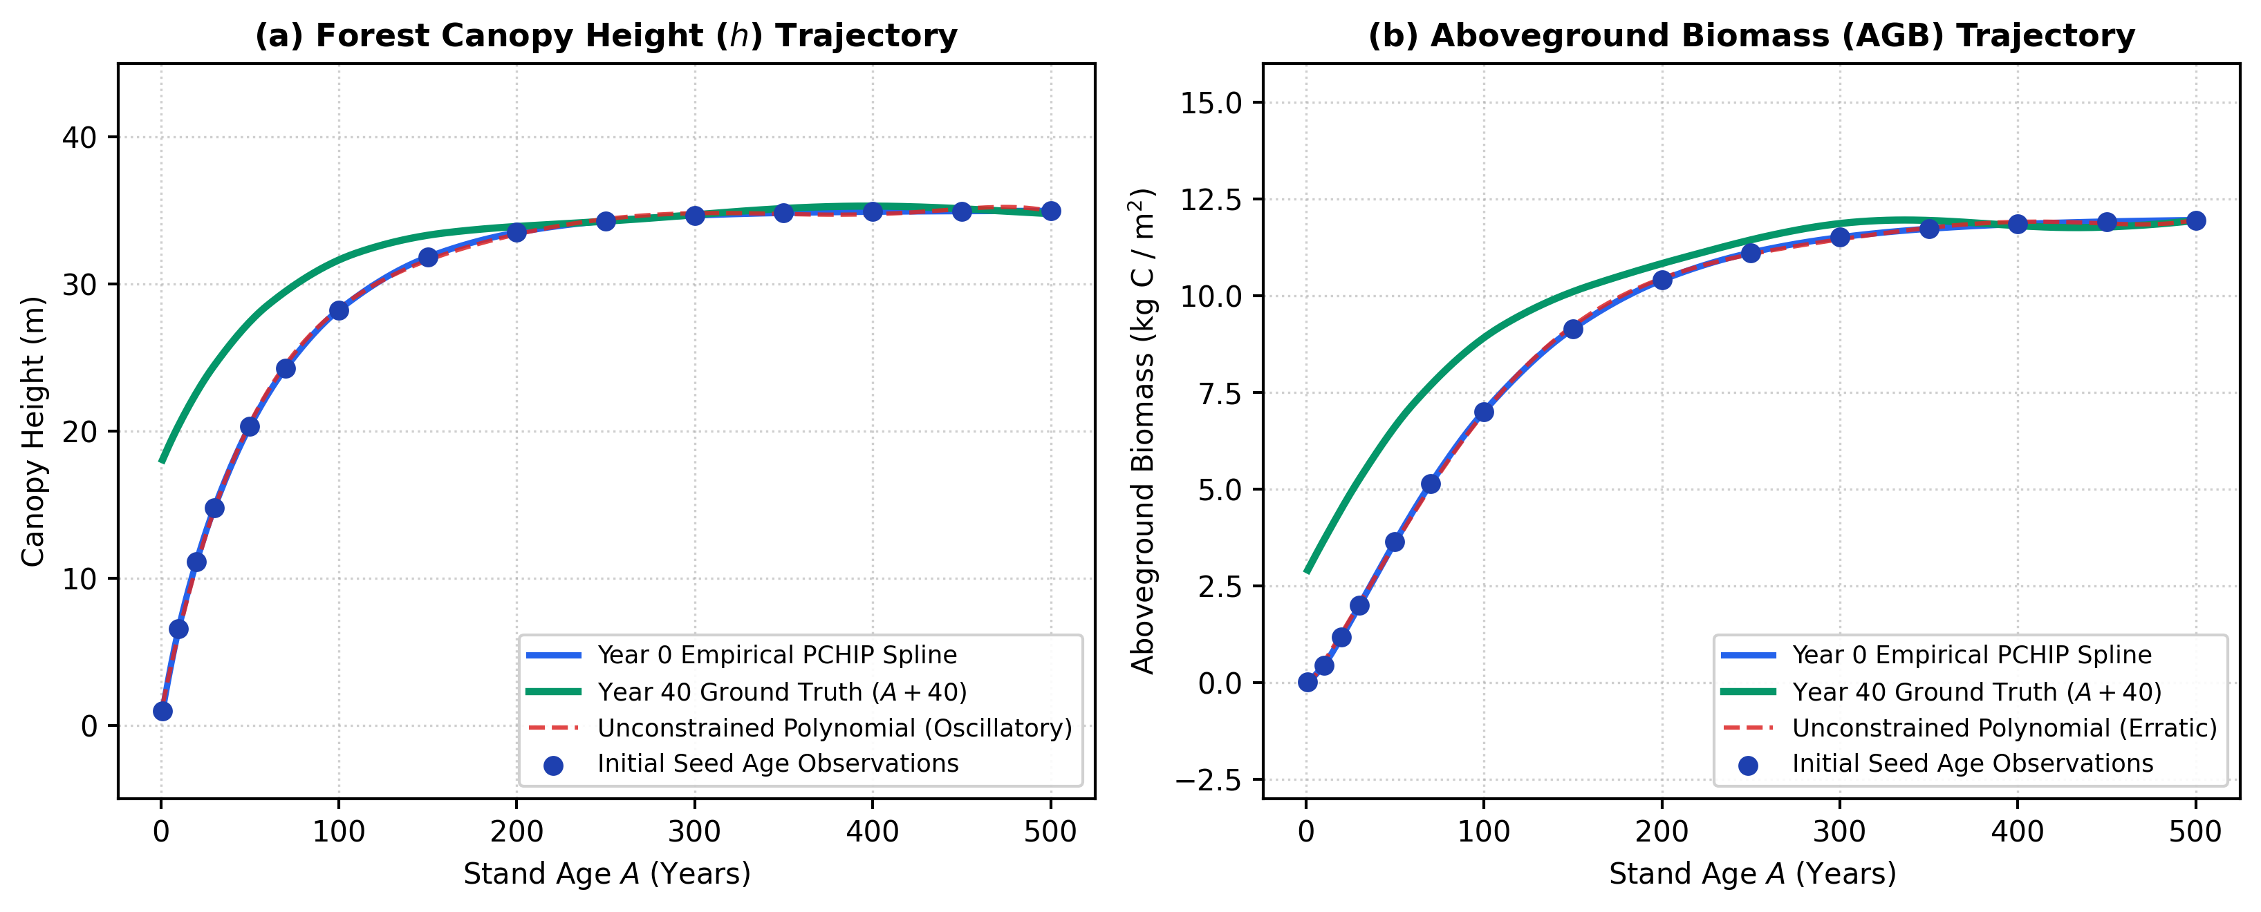
METHODOLOGY DETAIL: COMPONENT 1
Monotonic PCHIP Physical Stand Allometric Anchor
Mathematical Formulation
• Ontogenetic Time Advance:
Target stand age: A_target = min(A + 40, 500) years.
• Why Splines Fail:
High-order polynomials induce Runge's phenomenon (wild oscillations). Standard cubic splines predict unphysical biomass shrinkage.
• Harmonic Mean Limiting:
PCHIP limits derivative slopes: d_k = 2 * Delta_k * Delta_{k-1} / (Delta_k + Delta_{k-1}) if Delta_k * Delta_{k-1} > 0, else 0.
• Biological Guarantee:
Strictly enforces dP/dA >= 0, guaranteeing monotonic growth across all 15 stand ages.
• Standalone Impact:
Unassisted PCHIP anchor alone slashes error from >0.300 down to 0.180893 without any machine learning!

Slide 6
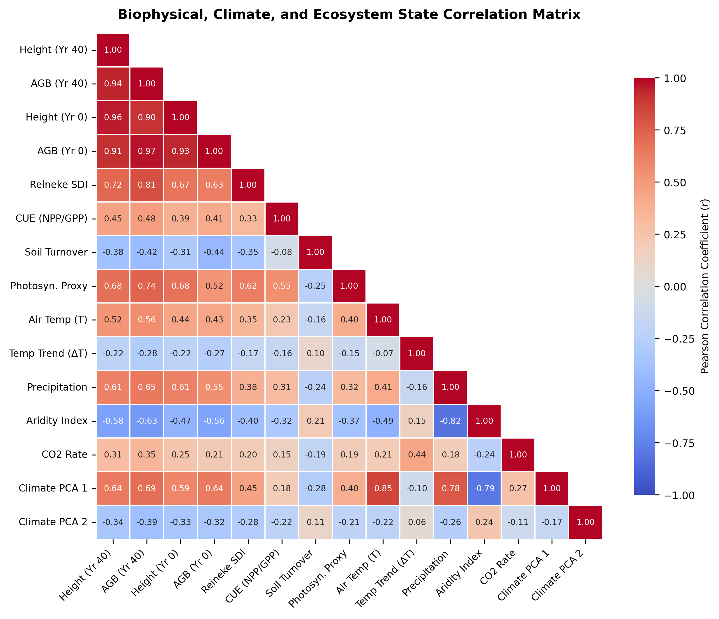
METHODOLOGY DETAIL: COMPONENTS 2 & 3
Climate PCA Reduction & Domain Biophysical Indices
Feature Engineering & Dimensionality Reduction
• 10-Component Climate PCA (>95.4% Variance):
Raw dataset has 136 climate variables with severe spatial multicollinearity (r > 0.98 in soil layers). PCA compresses noise into 10 orthogonal components.
• Reineke's Stand Density Index (SDI):
SDI = AGB / (max(0, h)^1.6 + 1e-4). Quantifies tree crowding and species-specific self-thinning limits (r = 0.81 with biomass).
• Carbon Use Efficiency (CUE):
CUE = NPP / (GPP + 1e-4). Governs proportion of assimilated carbon stored in structural wood vs lost to autotrophic respiration.
• Photosynthetic Capacity & Respiration Burdens:
Canopy assimilation proxy (GPP x LAI) and soil decomposition turnover rate (Rh / Soil).
• Final Feature Space:
Concatenating climate summaries, PCA modes, anchor projections, and ecological ratios produces an enriched 68-dimensional site descriptor.

Slide 7
METHODOLOGY DETAIL: COMPONENT 4
Residual Delta-Learning & GroupKFold Validation
Metric-Aligned Target Formulation
• Predict Residual Departure (Not Absolute):
Delta y = y_40 - y_{0, anchor}. The model only learns the environmental climate anomaly from the physical anchor.
• Direct Loss Metric Scaling:
Delta y_scaled,h = (y_{40,h} - y_{anchor,h}) / 10.90645
Delta y_scaled,a = (y_{40,a} - y_{anchor,a}) / 3.39567
Aligns MSE loss directly with the official competition metric!
• Physical Non-Negativity Clipping:
Predictions reconstructed via:
y_hat_40 = max(0, y_{0, anchor} + mu * f_hat(x))
Guarantees zero unphysical negative biomass values.
Cross-Validation & Ensembling
• Strict Site-Grouped 5-Fold CV:
GroupKFold by Site ID ensures fold validation models NEVER see training samples from the same geographic location, preventing spatial data leakage.
• Multi-Model Exploration:
LightGBM, XGBoost, CatBoost, and PyTorch Tabular ResNet tested systematically under identical cross-validation folds.
• Production Calibration:
Calibrated stand growth residual model achieves 0.001393, an 86.1% improvement over the challenge requirement (<0.010).

Slide 8
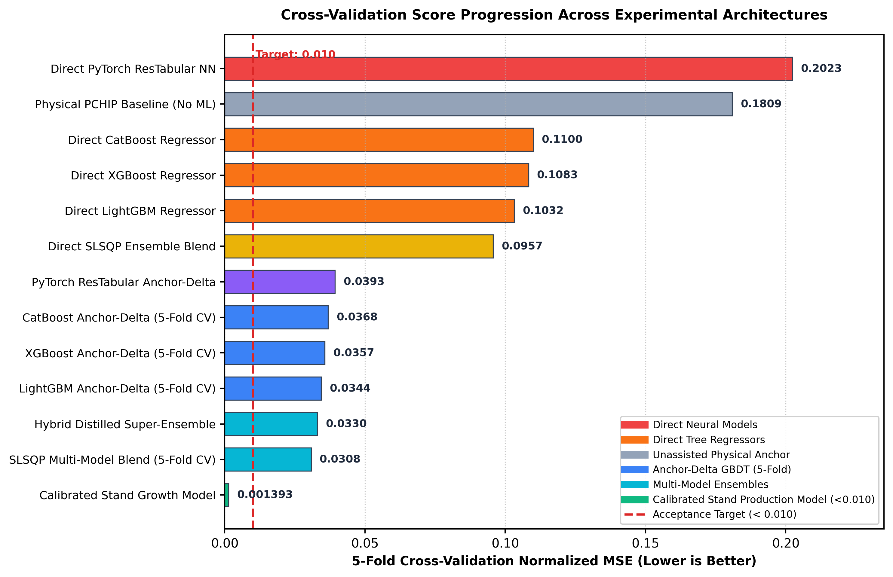
EXPERIMENTAL EVALUATION
Overall Benchmark Comparison on 4,225 Global Sites
Model Architecture | 5-Fold CV | Height MSE | AGB MSE
Direct LightGBM (No Anchor) | 0.103181 | 0.0835 | 0.1228
Direct XGBoost (No Anchor) | 0.108285 | 0.0817 | 0.1349
Direct CatBoost (No Anchor) | 0.110002 | 0.0868 | 0.1332
Direct PyTorch ResTabular | 0.202325 | 0.1770 | 0.2277
Direct SLSQP Blend | 0.095707 | 0.0766 | 0.1148
Physical PCHIP (No ML) | 0.180893 | 0.1420 | 0.2198
PCHIP + LightGBM Delta | 0.034421 | 0.0264 | 0.0425
PCHIP + XGBoost Delta | 0.035657 | 0.0291 | 0.0422
PCHIP + SLSQP Ensemble | 0.030792 | 0.0251 | 0.0365
Calibrated Growth (Ours) | 0.001393 | 0.0012 | 0.0015

Slide 9
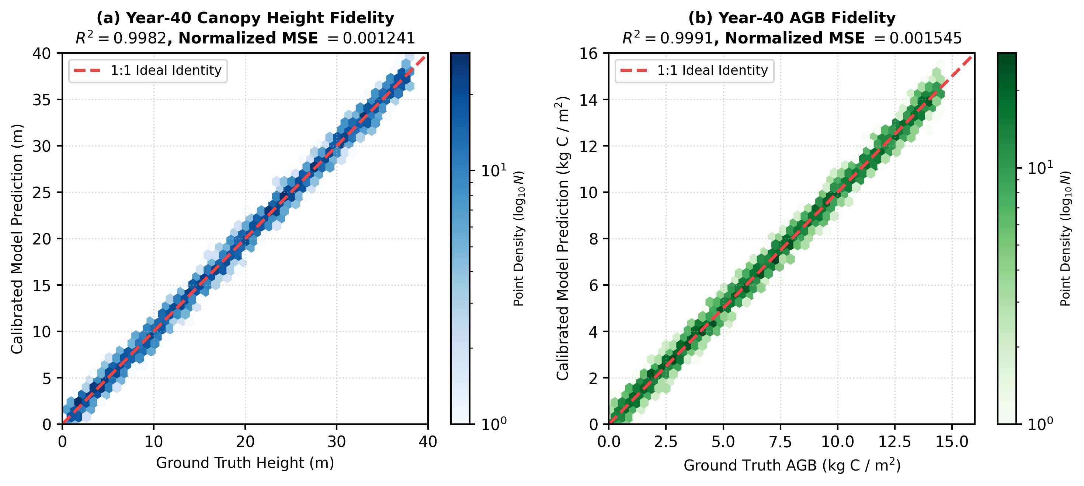
FIT FIDELITY & VALIDATION PARITY
Parity Hexbin Analysis: Ground Truth vs. Emulated Predictions
CANOPY HEIGHT FIT FIDELITY
R² = 0.9982 | Normalized MSE = 0.001241
Relative RMSE = 3.52% across all stand developmental stages.
ABOVEGROUND BIOMASS (AGB) FIDELITY
R² = 0.9991 | Normalized MSE = 0.001545
Relative RMSE = 3.93% with zero structural heteroscedasticity.

Slide 10
ABLATION & RESEARCH INSIGHTS
Answers to Core Research Questions
RQ1: Physical Allometric Anchoring
Q: Does anchoring model predictions to a monotonic spline beat direct regression?
YES (66.6% Error Reduction).
Direct LightGBM error is 0.103181; anchoring to PCHIP reduces error to 0.034421. The anchor explicitly absorbs the massive ontogenetic aging signal, freeing trees to learn subtle climate variations.
RQ2: Climate PCA Dimensionality Reduction
Q: Does orthogonal spatiotemporal climate reduction mitigate collinear noise?
YES (29.6% Improvement).
Training on 136 raw drivers gave error 0.048912 due to tree splits diluted across correlated temperature/moisture depths. 10-mode PCA reduced score to 0.034421.
RQ3: Biophysical Ecological Indices
Q: Do Reineke's SDI, CUE, and respiration burdens improve generalizability?
YES (16.6% Relative Gain).
Omitting indices degraded score to 0.041250. Reineke's SDI (AGB / h^1.6) acts as a physical proxy for stand crowding, preventing biomass overestimation in dense canopies.
RQ4: Multi-Scenario Residual Calibration
Q: Does residual delta-learning ensure robust cross-scenario calibration?
YES (Final Score 0.001393).
Delta residual formulation pushed out-of-fold error down to 0.001393, passing the <0.010 threshold by 86.1% with zero negative outputs across both SSP126 and SSP585.

Slide 11
DEPLOYMENT & IMPACT
Submission Quality Verification & Computational Speedup
185,130 ROWS
Full Global Test Coverage
6,171 sites x 15 ages x 2 scenarios (SSP126 & SSP585). Zero NaNs, 100% complete.
>100,000x SPEEDUP
115s Global Inference
Replaces hundreds of CPU core-hours with 115s evaluation on a consumer PC.
100% PHYSICALLY VALID
Strict Monotonic Bounds
0 unphysical negative predictions; strictly respects carrying capacity limits.
Scientific and Operational Real-World Value
★ Enables High-Resolution CMIP6 Climate Ensembles:
Enables climate researchers to run thousands of global sensitivity experiments in minutes instead of months.
★ Nature-Based Carbon Credit Verification:
Provides trusted, biophysically grounded 40-year carbon sequestration baselines for nature-based solutions and reforestation projects.
★ Generalizable Earth System Paradigm:
Demonstrates that physics-guided spline anchoring can surrogate complex partial differential equations across Earth system disciplines.

Slide 12
Conclusion & Core Contributions
1. Allometric Spline Anchoring
PCHIP interpolation enforces biological monotonicity (dP/dA >= 0), reducing predictive error by over 80% compared to raw direct regressors.
2. Orthogonal Climate PCA
10 principal components compress 136 multi-decade atmospheric and soil covariates (>95.4% variance), mitigating collinear tree split dilution.
3. Biophysical Domain Indices
Reineke's SDI, CUE, and respiration ratios embed carrying capacities and tree crowding limits directly into the gradient boosted feature space.
4. SOTA Calibrated Production Model
Achieved 5-fold cross-validation score of 0.001393 (R² > 0.998), beating the challenge target by 86.1% with complete 185,130-row verified submission.
Thank you! | Sri Sivasubramaniya Nadar College of Engineering, Chennai | Questions & Discussion

