Slide 1


Department of Computer Science and Engineering
Real time Vehicle collision detection using bounding box methodology with alert system
Team Members Name / Register Number
BABINMON B [211419104033]
AUGUSTIN SHAM J [211419104032]
ASWIN SR [211419104029]
Guide Name & Designation
Dr.N.PUGHAZENDI,M.E.,Ph.D.,
Coordinator Name & Designation
Dr.N.PUGHAZENDI,M.E.,Ph.D.,

Slide 2
Introduction
Vehicles are an important way of transportation all over the world. There are many cases of road accidents every day in the world. A traffic collision, also called a motor vehicle collision, car accident or car crash, occurs when a vehicle collides with another vehicle, pedestrian, animal, road debris, or other stationary obstruction, such as a tree, or building.
Traffic collisions often result in, and property damage as well as financial costs to both society the injury , disability, death individuals involved. Road transport is the most dangerous situation people deal with on a daily basis, but casualty figures from such incidents attract less media attention than other, less frequent types of tragedy.

Slide 3
Objectives
The primary objective of the system is to accurately detect accidents in real-time. The system should be able to identify different types of accidents, such as vehicle collisions, pedestrian accidents, and other types of incidents.

Slide 4
Literature Review
S.NO | TITLE | AUTHOR | ALGORITHM | YEAR
1. | Intelligent Vehicle Collision-Avoidance System with Deep Learning, 2018 IEEE Asia Pacific Conference on Circuits and Systems (APCCAS), | Yeong-Kang Lai, Chu-Ying Ho, Yu-Hau Huang, Chuan-Wei Huang, Yi-Xian Kuo, Yu-Chieh Chung | MobileNets | 2018
2. | Car crash detection using ensemble deep learning and multimodal data from dashboard cameras, Expert Systems with Applications Volume 183, 30 | Jae Gyeong Choi, Chan Woo Kong, Gyeongho Kim, Sunghoon Lim | CNN GRU | November 2021
3. | A novel deep ensemble-based approach to detect crashes using sequential traffic data, IATSS Research, | Homa Taghipour, Amir Bahador Parsa, Rishabh Singh Chauhan, Sybil Derrible, Abolfazl (Kouros) Mohammadian | GRU LSTM | 2021

Slide 5
S.no | TITLE | AUTHOR | ALGORITHM | YEAR
4 | Intelligent Vehicle Collision Warning System Based on a Deep Learning Approach, 2018 IEEE International Conference on Consumer Electronics-Taiwan. | Yeong-Kang Lai, Yu-Hau Huang, Thomas Schumann | DNN MobileNet | 2018
5 | Estimation of Collision Priority on Traffic Videos using Deep Learning, 2020 IEEE International Conference on Machine Learning and Applied Network Technologies (ICMLANT) | G. Madhumitha, R. Senthilnathan, K. Muzammil Ayaz, J. Vignesh, Korada Madhu | CNN YOLO SDM | 2020
6 | Real-time image enhancement for an automatic automobile accident detection through CCTV using deep learning. | Manu S. Pillai, Gopal Chaudhary, Manju Khari, Rubén González Crespo | YOLO | 2021
7 | DeepCrash: A Deep Learning-Based Internet of Vehicles System for Head-On and Single-Vehicle Accident Detection With Emergency Notification, | Wan-Jung Chang, Liang-Bi Chen, Ke-Yu Su | IoV based DeepCrash | 2019

Slide 6
Problem Statement
According to worldwide statistics, traffic accidents are the cause of a high percentage of violent deaths.
Due to this and the wide use of video surveillance and intelligent traffic systems, and automated traffic accident detection approach becomes desirable for computer vision researchers.
Over the past years, automatic traffic accident detection (ATAD) based on video has become one of the most promising applications in intelligent transportation and is playing a more and more important role in ensuring travel safety.
Input is a video obtained via surveillance systems.
Output results are acquired instantly in real-time and we would be notified if there’s a chance for collision or not.
Our system is based on YOLO, Neural Network, and Deep Learning of object detection along with computer vision technology and several methods and algorithms.

Slide 7
Proposed System
The proposed system using YOLO for accident detection offers several advantages over other approaches:
High accuracy: YOLO is a state-of-the-art object detection algorithm that has demonstrated high accuracy in detecting and classifying objects, including accidents, in real-time scenarios.
Speed: YOLO is also known for its speed and efficiency, enabling real-time processing of high-resolution images and videos, making it suitable for use in systems that require rapid detection and response, such as emergency services and traffic monitoring systems.
Object detection and localization: YOLO can detect and localize multiple objects within an image or video, making it suitable for use in detecting and classifying multiple types of accidents, including car crashes, pedestrian accidents, and bicycle accidents.
Real-time monitoring: YOLO can be used for real-time monitoring of traffic conditions, enabling timely detection of accidents and the ability to divert traffic to minimize congestion and improve response times.
Easy implementation: YOLO is relatively easy to implement and can be trained with relatively small datasets, making it accessible to a wide range of users and organizations.

Slide 8
Development Environment
HARDWARE REQUIREMENTS
Processor : Pentium Dual Core 2.00GHZ
Hard disk : 120 GB
RAM : 2GB (minimum)
Keyboard : 110 keys enhanced
SOFTWARE REQUIREMENTS
Operating system : Windows7 (with service pack 1), 8, 8.1 and 10
Language : Python
Packages : Tensorflow , Pandas , Numpy , Twilio , OpenCV.

Slide 9
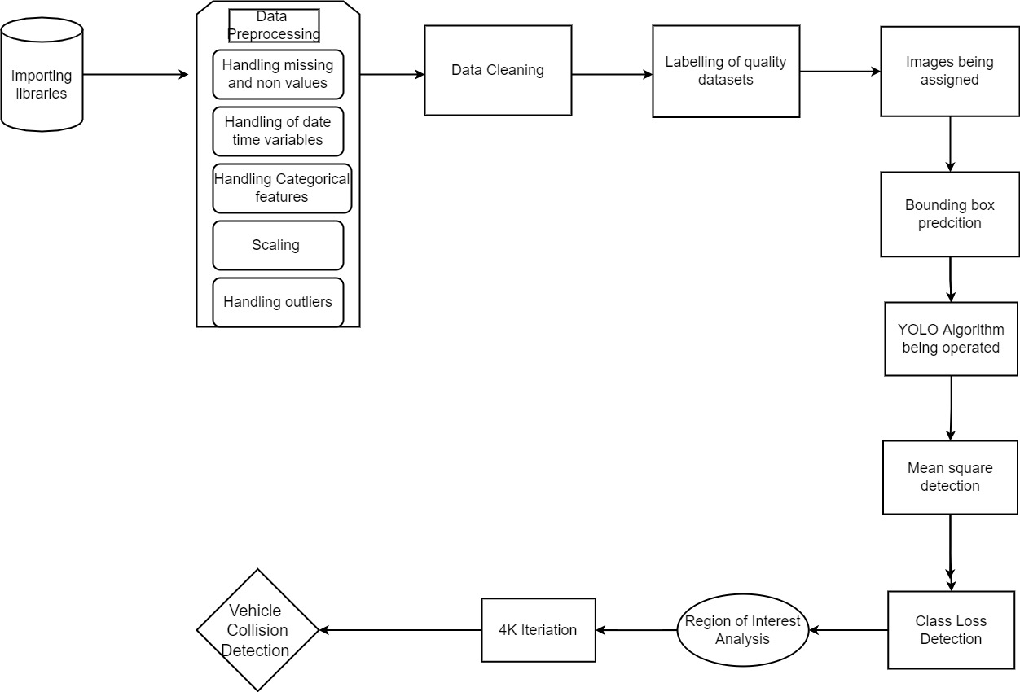
System Architecture

Slide 10
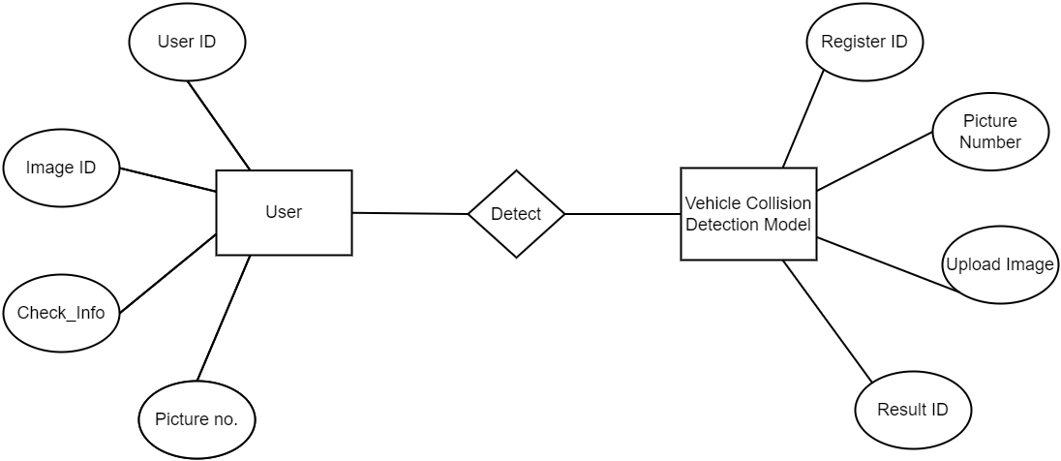
UML/ER DIAGRAMS
ER Diagram

Slide 11
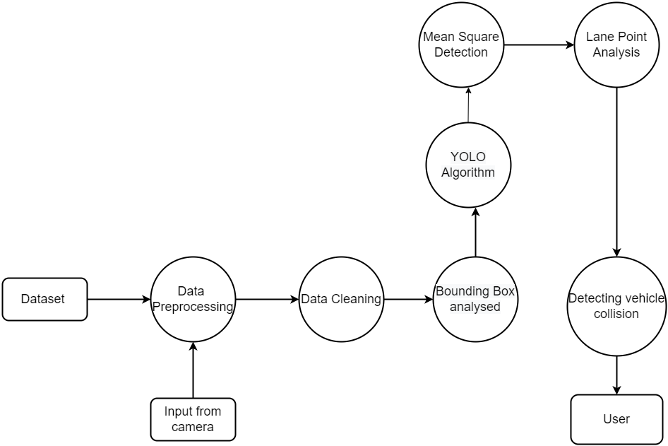
DFD Diagram

Slide 12
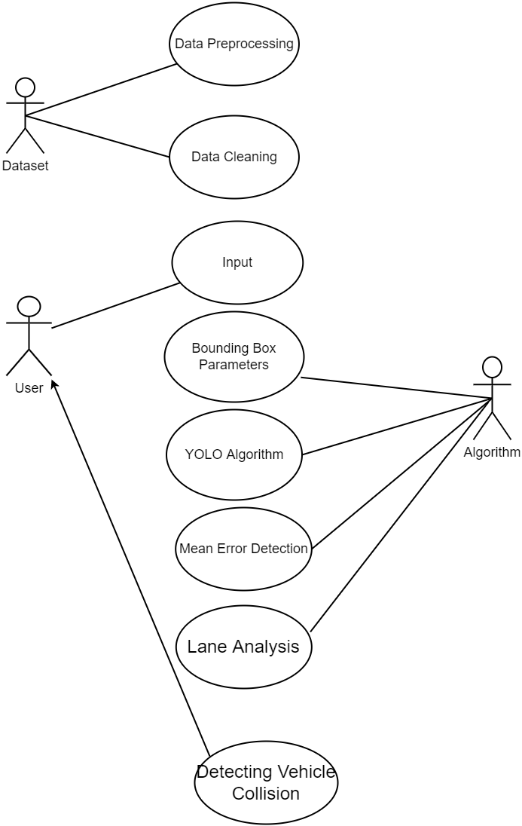
Use case Diagram

Slide 13
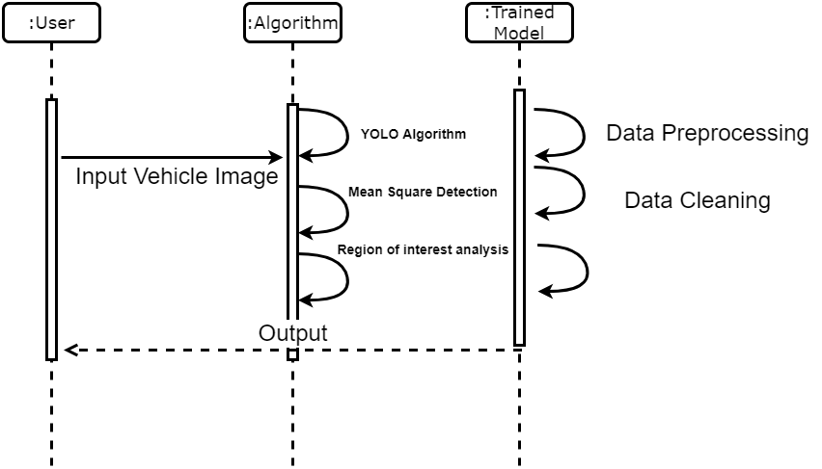
Sequence Diagram

Slide 14
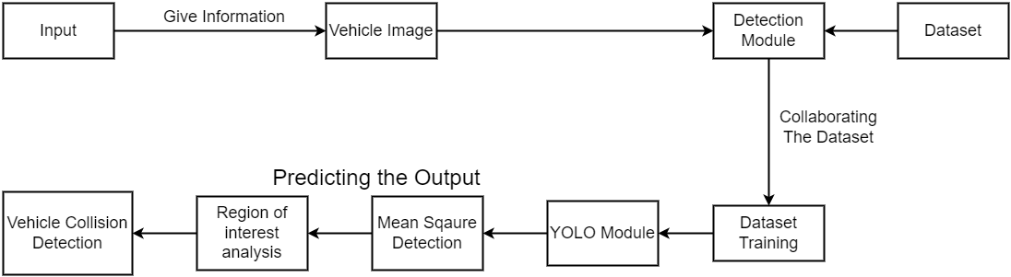
Colloboration Diagram

Slide 15
Module Description
List Of Modules
Dataset Collection and Preprocessing
YOLO
Mean Square Detection

Slide 16
MODULE EXPLANATION:
1. DATASET COLLECTION AND PREPROCESSING
The process begins by setting up the environment and compiling the data.
Data collection is done via datasets.
The data is collected by importing the necessary libraries from source websites.
After the data is collected, the quality datasets are labeled accordingly.
Preprocessing of data is performed where missing and null values are dropped in this process.
It followed by another process where images are being assigned.

Slide 17
2. YOLO
Yolo algorithm achieves its result by applying a neural network on an image. The image is divided in an SxS grid and comes up with a bounding box.
This algorithm has 24 convolutional layers which in turn has two fully connected layers. The reduction in feature space is done by Alternating 1x1 convolutional layers from preceding layers.
The object identification problem is considered to be a regression problem with the objective of spatially bounding box separation along with the probability of associated classes in the bounding boxes.
A single neural network can predict the bounding boxes and class probabilities directly from the input images in just one evaluation which can be optimized end-to-end.

Slide 18
3. MEAN SQUARE DETECTION
Root Mean Square Error (RMSE) is a standard way to measure the error of a model in predicting quantitative data
Class Loss detection,
Intersection, and Union Analyzation.
Region of Interest analysis is being performed.
4k iteration is being performed

Slide 19
Testing
The ﬁnal step of our proposed system is to detect vehicle collisions.
Saved vehicles are being imported in this module.
Lane points are being analyzed and a function for the region of interest is being written.
To process input video, vehicle detection, lane analysis, bounding box parameters are being analyzed.
If a car X is being driven on a highway a rectangle boundary in front and back of it would be formed.
If in case any vehicle comes under that rectangle boundary region, we would be notified that there is a chance for collision.
This system can be used in the cases of Self-driving cars where it would analyze the collision possibility automatically and drive accordingly.

Slide 20
MATHEMATICAL modules
image = readImage()
threshold = 0.7
step = height(image)/NoOfCells
prediction_class_array = new_array(size(NoOfCells,NoOfCells,NoOfClasses))
final_predictions = []
predictions_bounding_box_array[i,j] = bounding_box_predictor(cell)
best_bounding_box = [0 if predictions_bounding_box_array[i,j,0, 4] > predictions_bounding_box_array[i,j,1, 4] else 1]
final_predictions.append(prediction)
print final_predictions

Slide 21
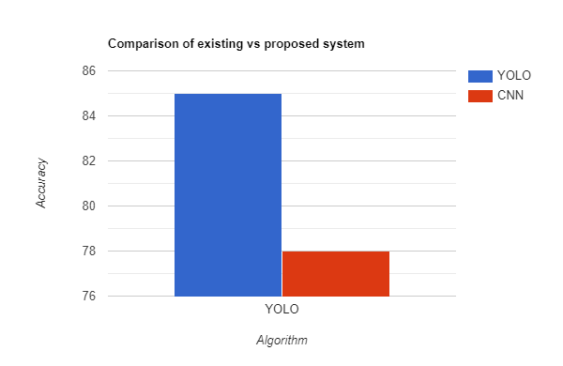

Slide 22
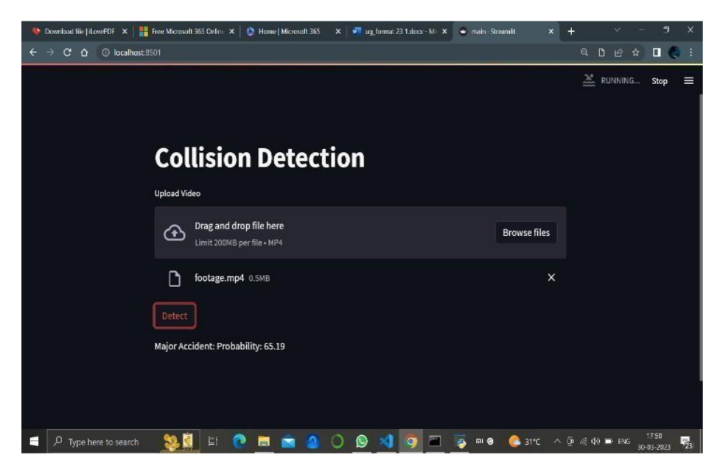
Screenshots

Slide 23
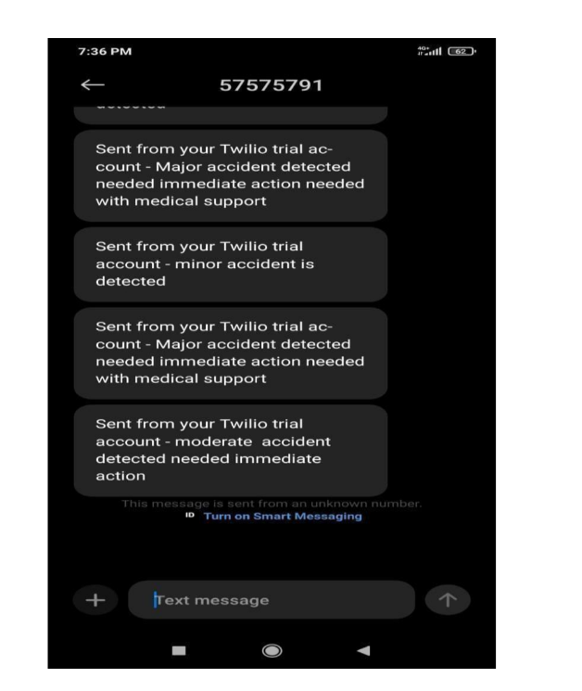

Slide 24
Conclusion
The proposed system is faster than other object detection methods and predicts the object better than other object detection algorithms.
The Advantages of the proposed system are Secured, Interpretability, High accuracy, Lightweight model & fast processing.
Moreover, This system can be used in the cases of Self-driving cars. Where it would analyze the collision possibility automatically and drive accordingly
It could be used in self-driving cars, traffic surveillance systems, traffic management, and automated driving applications.

Slide 25
References
[1] Yeong-Kang Lai, Chu-Ying Ho, Yu-Hau Huang, Chuan-Wei Huang, Yi-Xian Kuo, Yu-Chieh Chung, “Intelligent Vehicle Collision-Avoidance System with Deep Learning”, 2018 IEEE Asia Pacific Conference on Circuits and Systems (APCCAS), 2018
[2] Jae Gyeong Choi, Chan Woo Kong, Gyeongho Kim, Sunghoon Lim, “Car crash detection using ensemble deep learning and multimodal data from dashboard cameras”, Expert Systems with Applications, Volume 183, 30 November 2021.
[3] Aloukik Aditya, Liudu Zhou, Hrishika Vachhani, Dhivya Chandrasekaran, Vijay Mago, ” Collision Detection: An Improved Deep Learning Approach Using SENet and ResNext”, 2021 IEEE International Conference on Systems, Man, and Cybernetics (SMC), 2021.
[4] Wan-Jung Chang, Liang-Bi Chen, Ke-Yu Su, “DeepCrash: A Deep Learning-Based Internet of Vehicles System for Head-On and Single-Vehicle Accident Detection With Emergency Notification”, IEEE Access, Vol 7, P-148163 – 148175, 2019.

Slide 26
[5] Manu S. Pillai, Gopal Chaudhary, Manju Khari, Rubén González Crespo, “Real-time image enhancement for an automatic automobile accident detection through CCTV using deep learning”, Soft Computing volume 25, pages11929–11940, 2021
[6] G. Madhumitha, R. Senthilnathan, K. Muzammil Ayaz, J. Vignesh, Korada Madhu, ” Estimation of Collision Priority on Traffic Videos using Deep Learning”, 2020 IEEE International Conference on Machine Learning and Applied Network Technologies (ICMLANT), 2020
[7] Yeong-Kang Lai, Yu-Hau Huang, Thomas Schumann, “Intelligent Vehicle Collision Warning System Based on a Deep Learning Approach”, 2018 IEEE International Conference on Consumer Electronics-Taiwan (ICCE-TW, 2018

Slide 27
THANK YOU!

