Slide 1
DataStax Enterprise Search
Rob Murphy & Aaron Regis
14th June 2017

Slide 2
Agenda
1 | Introduction DSE Search

Slide 3

DSE Search
Your Application
Live indexing engine with powerful search
Automatic indexing on insert
Higher ingestion throughput
Distributed query optimization
Compared to self-managed:
No separate search cluster to manage
Probably less total hardware required
No “Split Brain” data inconsistencies
No ETL or synch to build and maintain
No app level data management code
CQL
Search
+
Cassandra

Slide 4
The data model is important
Partition Key user_id : ‘1‘
create table users (
user_id int,
name text,
age int,
gender boolean,
PRIMARY KEY(user_id))
Node 1
PK:‘5‘
PK:‘2‘
Node 5
Node 2
SELECT name FROM users WHERE user_id=1
PK:‘4‘
Node 4
Node 3
PK:‘3‘
SELECT * FROM users WHERE name=“Thomas“
SELECT * FROM users WHERE age>45 and name=„Thomas“
Not possible out of the box without secondary Idx or further extra tables
No problem with DSE Search

Slide 5
What is the value of DSE Search?
Multi-criteria WHERE Constraints
WHERE constraints with multiple columns
No extra tables needed
Full Text Search
Wildcards ? *, like or Lemmatisation
Faceting, Slice and Dice
Geospatial queries
Queries with coordinates and distances search
Notes:
lemmatization is to reduce inflectional forms and sometimes derivationally related forms of a word to a common base form. For instance:
am, are, is be car, cars, car's, cars' car
The result of this mapping of text will be something like:
the boy's cars are different colors the boy car be differ color
Lemmatization usually refers to doing things properly with the use of a vocabulary and morphological analysis of words,

Slide 6
Integrated with CQL
Create core, schema.xml and solrconfig.xml.
[optional] customize schema.xml, solrconfig.xml
Start indexing, re-indexing
Wildcard search
cqlsh> select * from sales where solr_cql = ' {`fq`:`name=gre*`} '
Facet query
cqlsh> SELECT * FROM sales WHERE solr_query='{"q":”name:*","facet":{"field":”item"}}';
Range query
Cqlsh> SELECT * FROM sales WHERE solr_query='{"q":"dt:[2017-01-01 TO 2017-01-10]"}';
Geo search
cqlsh> select * from sales where solr_cql = ' {"fq":"name=Hein*"} '
Notes:
Vorteile durch Query Fan optimization
Live Indexing?

Slide 7
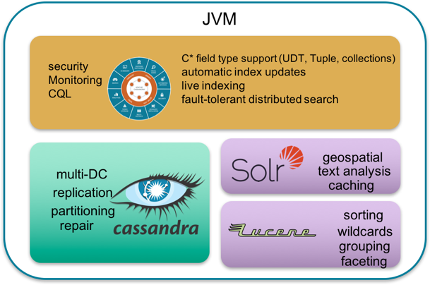
DSE Search Architecture
Integrated in the the same JVM
Data Locality (TokenRanges) and Shared Memory
High Available, no master needed
Index is sharded to all nodes
Transparency
Access via CQL or REST API
Automated indexing with INSERT / UPDATE
No extra ETL Process needed
With all benefits:
Node 1
High Available
Node 2
Node 5
Scalable
Multi Data Center
Node 4
Node 3
Index Security

Slide 8


The Open Source Way
Separated Search Cluster
“Split Brain” risk, data inconsistency
ETL to generate, update and re-create index
Complex application
Two seperated APIs, driver, read paths
Application
DB API
Solr API
Manuel ETL Re-Indexing ...
Apache Solr™
Cluster
Apache Cassandra™
Cluster
https://docs.datastax.com/en/datastax_enterprise/5.0/datastax_enterprise/srch/searchOssSolrDiff.html

Slide 9
Inserting through CQL
Coordinator Node
Replica Node
DSE SEARCH
DSE SEARCH
Update Handler
Update Handler
2
4
DSE C*
SI API
DSE C*
SI API
1
3
CQL INSERT
Notes:
6/12/17
9
9

Slide 10
Querying through CQL
SELECT title FROM solr WHERE solr_query='title:natio*';
title
--------------------------------------------------------------------------
Bolivia national football team 2002
List of French born footballers who have played for other national teams
Lithuania national basketball team at Eurobasket 2009
Bolivia national football team 2000
Kenya national under-20 football team
Bolivia national football team 1999
Israel men's national inline hockey team
Bolivia national football team 2001
How many nodes to contact?
We don't know the primary key
Theory:
contact at least one replica for every token range
Cassandra contacts all nodes
Our custom Solr SearchComponent does intelligent shard selection
Notes:
6/12/17
10
10

Slide 11
Querying through CQL
Coordinator Node
Replica Node
DSE Search
DSE Search
2
4
contacts all nodes
CQL SELECT
DSE C*
SI API
DSE C*
SI API
1
3
6
5
Notes:
6/12/17
11
11

Slide 12
Lab 5 : Hands-on DSE Search
Notes:
So you might be asking how it works, let’s get into it.

Slide 13
Thank You!

