Slide 1
DataStax Hands-On Workshop
Aaron Regis & Richard Henderson
12th Jan 2018

Slide 2
Agenda
1 | Quick intro to DataStax and Team
2 | Key Facts DataStax Enterprise
3 | Hands-On Agenda today

Slide 3
DataStax

Slide 4


















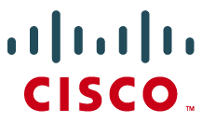





DataStax
400+
Employees
$190M
Funding
500+
Customers
Founded in April 2010
Santa Clara • San Francisco • Austin • London • Paris • Berlin • Tokyo • Sydney
30% +
(Series E – Sept. 2014)
2016 World’s Best
100 Cloud Companies
Ranked #1 in multiple operational database categories
Company Confidential
Notes:
So who is DataStax?
We are a 400 people company with offices around the world.
We have validation from some of the worlds leading venture firms
And we are continuing to drive momentum with customers that are the top brands in the world who believe in us
Even Industry influencers like Gartner consistently rank us at the top in multiple categories.
Last year Forbes listed us in the world’s best 100 cloud companies.

Slide 5



Apps have changed
Client/Server
Web
Cloud
1990s
2000s
Today
Notes:
What we’ve all witnessed is how quickly apps have changed. Even in the past decade we’ve added mobile phones, IoT connected cars, we’ve quickly become always connected and that’s changed a lot of what’s possible in terms of creating data-driven experiences at the heart of apps.

Slide 6





And what powers them
Scale-out App Layer
Scale-out Data Layer

Slide 7
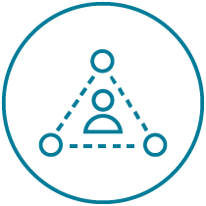
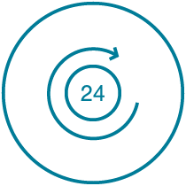
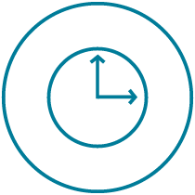


Cloud Application Characteristics
Contextual
Always-On
Real-Time
Distributed
Scalable
Notes:
Now what we mean by cloud applications, is these few characteristics. Apps today have evolved to be contextual, personalized for us, always-on can never go down with real-time responsiveness. We’re serving up a global application that has numerous endpoints or users around the world and it needs to be scalable to support all of this. So where do we begin with that data layer?

Slide 8
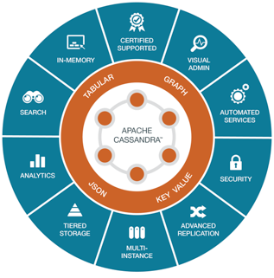
Powering Cloud Applications
Always-on
Designed to handle any failure, no matter how catastrophic.
Effortless scale
Take advantage of every opportunity.
Focus on what matters most to you.
Instant insight
Built into your application to create actionable, modern experiences.
Notes:
Here’s a quick look at our data platform. In short, we are built to be always-on, deliver that effortless scale, and help create the type of real-time, data-driven experiences users love.

Slide 9





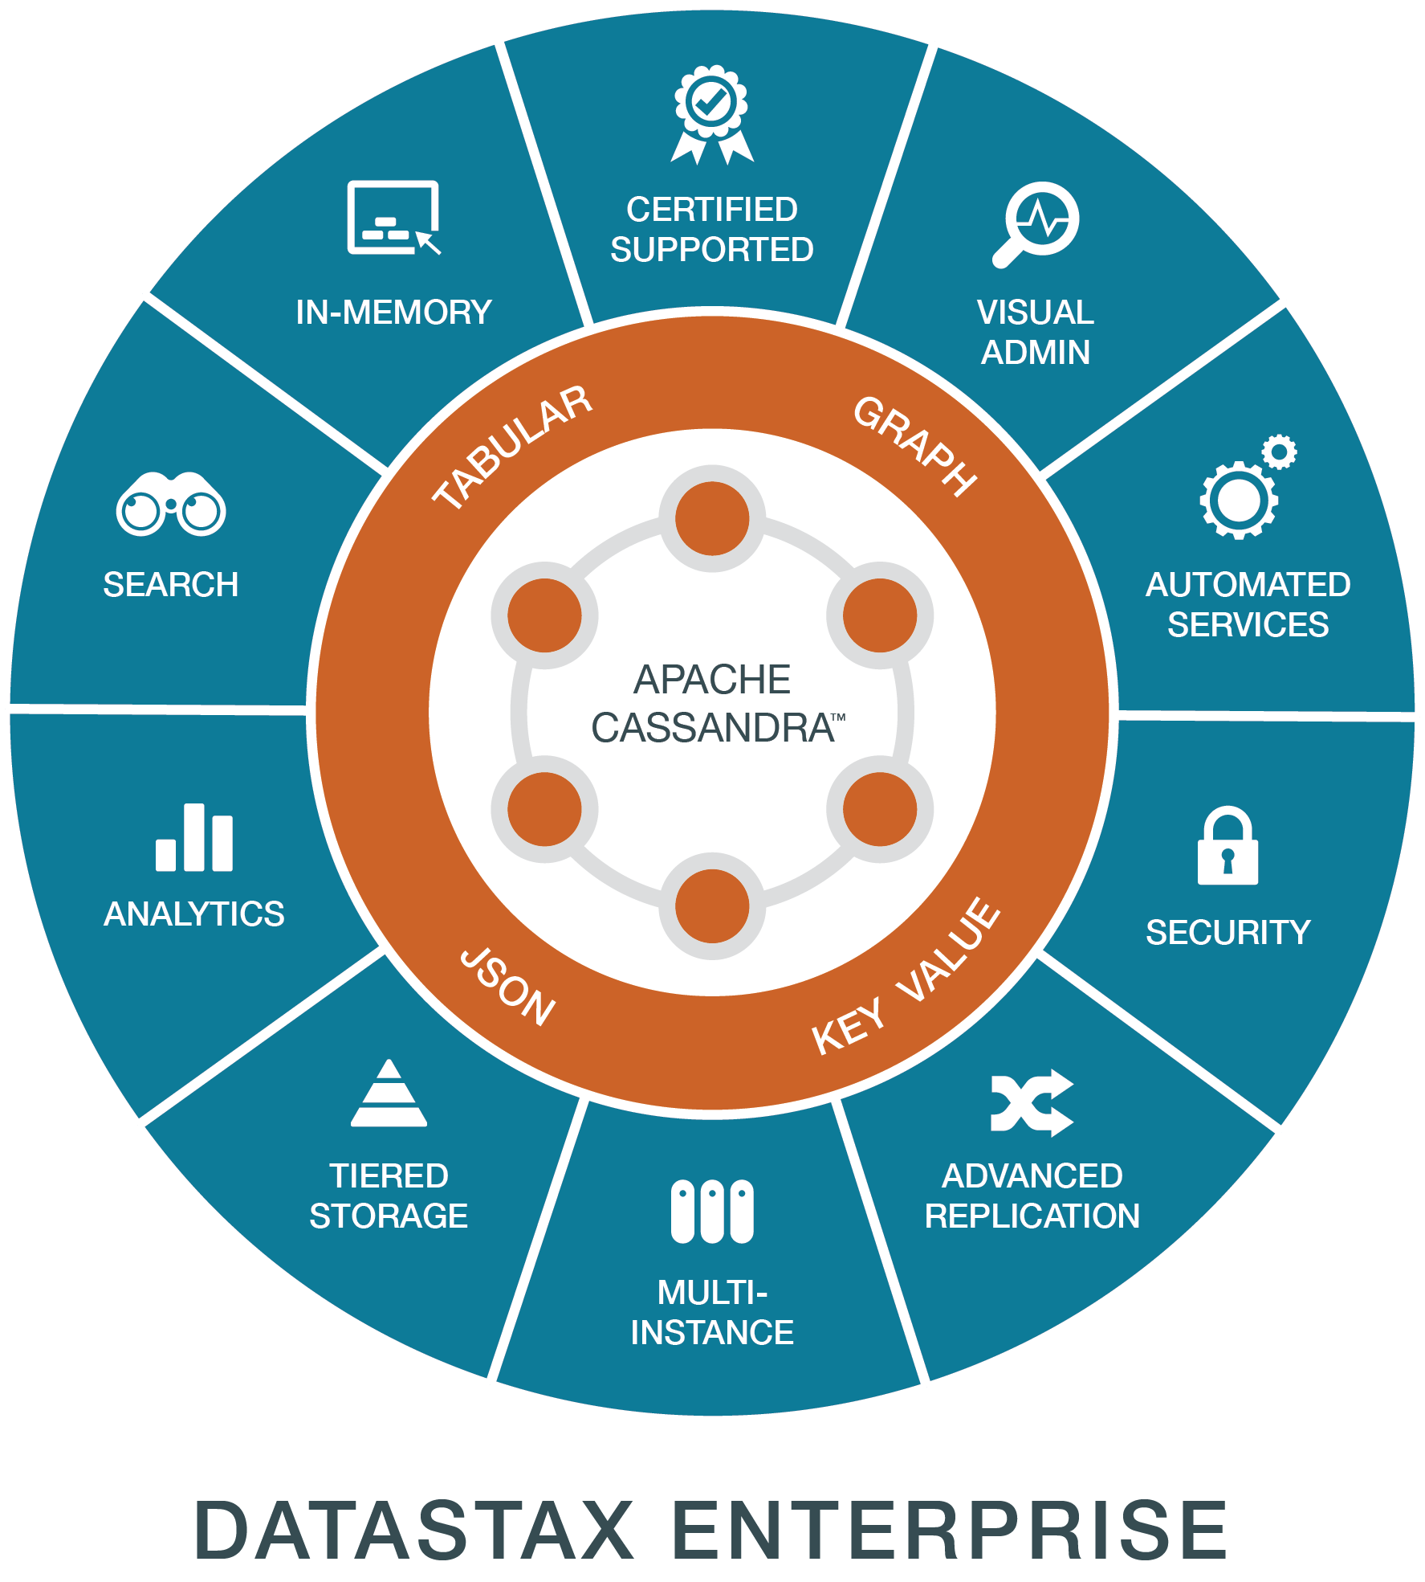






Functional use cases
Collections/ Playlists
Recommendation/ Personalization
Fraud detection
Internet of things/ Sensor data
Messaging
Notes:
DataStax helps companies like Netflix, ING, British Gas, Intuit, and Target power data management for their cloud applications. The customers of these companies have billions of defining moments each second around the globe. The moment they get that personalized online deal, watch a streamed movie, manage their finances with ease, know exactly when a package will arrive, efficiently manage a manufacturing process or visit a new physician who already has all the information she needs about her patient. DataStax is the power behind these moments.

Slide 10
DataStax Enterprise
Key Facts

Slide 11
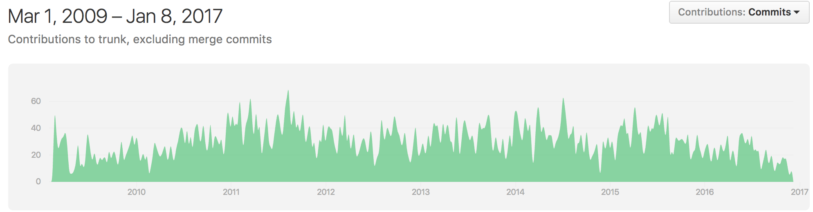
DataStax: The World Leader in Apache Cassandra™ Engineering
Contributors
110 Total
22 DataStax Employees (20%)
Contributions
10,423 Total
8,950 DataStax Employees (86%)
Notes:
20% of the people doing 86% of the work… that’s DataStax
Most contributors are just doing things for themselves
DataStax is the steward of the C* project, developing it for EVERYONE
But we love contributors and have a number of customers who contribute code (but are still customers) you may be one of them
7000 people will attend the 2015 C* summit.

Slide 12
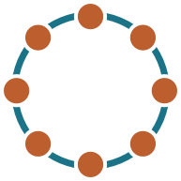
DataStax Enterprise (DSE)
Based on the best distribution of Apache Cassandra™
Continuously Available
Master Less
Fully Distributed
Shared-Nothing Architecture
Build In Replication
Linear Scalability
Scale out
Notes:
Scale Out – Simply add more nodes to get greater storage capacity or performance. As opposed to needing massive cost-prohibitive Disks or Super Servers
Build in Replication – Inherent to the design/architecture of Apache Cassandra, not managed by code or 3rd party bolt on solution.
Masterless – No single point of failure. All nodes contribute to storing data and co-ordinating queries etc.

Slide 13
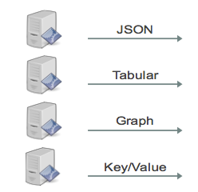




Integrated Multi-Model/Mixed Workload Platform
Indexing
& Search
Batch
Analytics
Streaming
Analytics
Graph
Notes:
Modern cloud applications often have many end points including browser, mobile devices and machines, those apps can also have many modules such as logs, customer profiles, transactions, etc. each of those components may have different data models. As an enterprise –class data management solution for cloud applications, Datastax Enterprise is able to handle different data models and data formats such as JSON, Tabular, Graph and key-value that exist in the cloud applications and persist them in a single datastore. An integrated indexing engine in DSE offers full text search support for both streaming and batch analytics workloads on a same DSE platform, thus delivering lower TCO for hardware expenditure and ease of management for the IT team.

Slide 14
DSE Search
Your Application
Live indexing engine with powerful search
Automatic indexing on insert
Higher ingestion throughput
Distributed query optimization
Compared to self-managed:
No separate search cluster to manage
Probably less total hardware required
No “Split Brain” data inconsistencies
No ETL or synch to build and maintain
No app level data management code
CQL
Search
+
Cassandra
Notes:
Integrated within each node of DSE is an advanced indexing engine with powerful search capabilities based on Solr. The indexing engine allows you to easily find data in real-time using complex queries and includes support for sub-string, fuzzy and full text search. The indexing engine also has full support for real-time aggregations, faceting, and filtering, making it easy to locate data relevant to your applications. When user updates a table via CQL API, the Solr document is updated and re-indexing occurs automatically after the update. The integration of indexing and search makes it simple to target use cases that require indexing transactions, hosting product catalogs, or searching document repositories, it also eliminate complex tasks such as ETL, Sync or application-level data management.

Slide 15
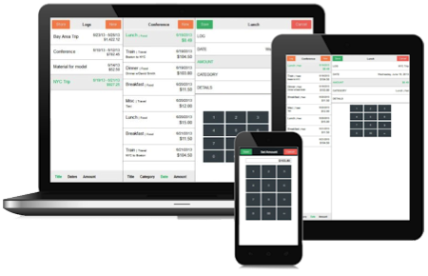
DSE Analytics
Single DSE Custer
Streaming, ad-hoc, and batch
High-performance
Workload management
SQL reporting
Compared to self-managed:
No ETL
True HA without Zookeeper
Your Application
Real Time Operations
Cassandra
Your Analytics
Real Time Replication
Analytics
Queries
Analytics
Notes:
Your customers expect your cloud applications to provide intelligent and personalized behavior. In order to accomplish this goal, developers need powerful streaming and batch analytics tools capable of understanding data as it flows through the application. Integrated into DSE is the industry standard Apache Spark™ large scale data processing engine, which allows you to easily construct data pipelines that interact both streaming and batch workloads. No messy ETL needed. DSE builds upon the functionality found in Apache Spark to eliminate single point of failure, increase performance, and provide full integration with the search and graph capabilities present in DSE. Because DSE Analytics is tightly integrated, it inherits all the enterprise grade functionality in DSE that you expect such as security and simple, unified administration interface.

Slide 16
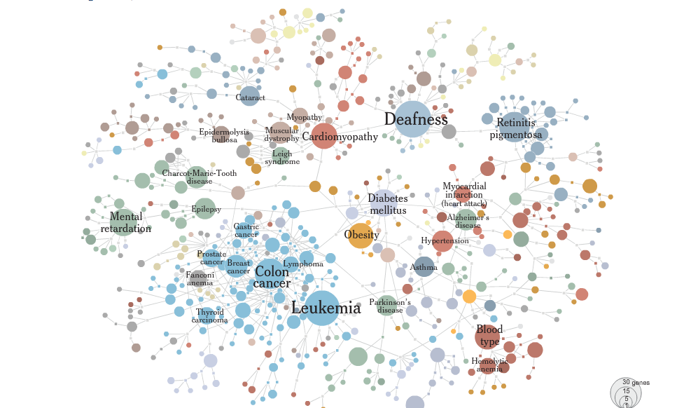
DSE Graph
A scalable, distributed graph database that is optimized for storing, traversing and querying complex graph data in real time
Value data between relationships
DSE Analytics and Search integrated
Perfect for use cases:
Customer360
Recommendations
Fraud Detection
Notes:
Built upon open source Titan graph database, DSE Graph is a distributed, scalable database for storing, managing and querying highly connected and complex data in real-time. DSE Graph is part of DSE multi-model platform offering built-in support for real-time search and analytic graph queries via DSE integration. DSE Graph inherits all the key enterprise benefits from DSE including always-on, multi-datacenter support, massive scalability, and simplified administration. In addition, DSE Graph is highly performant via an adaptive query optimizer, locality-aware data partitioner, distributed query engine and various graph-specific index structure.

Slide 17
Agenda
1 | Workshop: Apache Cassandra™ Data Structures and Replication | 10:15
2 | Workshop: DataModelling with DataStax Enterprise and Apache Cassandra™ | 12:00
 | BREAK | 13:00
3 | Workshop: Live Data Indexing with DataStax Enterprise and Apache Solr | 14:00
4 | Workshop: DataStax Enterprise Analytics with Apache Spark | 15:00
5 | Discussion, Questions and Answers | 16:00
Notes:
10:00 Introduction
10:15 Apache Cassandra™ Data Structures and Replication
12:00 Workshop: DataModelling with DataStax Enterprise and Apache Cassandra™
13:00 LUNCH BREAK
14:00 Workshop: Live Data Indexing with DataStax Enterprise and Apache Solr
15:00 Workshop: DataStax Enterprise Analytics with Apache Spark
16:00 Discussion, Questions and Answers

