Slide 1
DataStax Enterprise Analytics
Aaron Regis & Richard Henderson
14th June 2017

Slide 2
Agenda
1 | Introduction DSE Analytics
2 | Lab 6: Hands-on DSE Analytics

Slide 3
DSE Analytics
Data extraction, transformation and load (ETL)
Cross-table operations, JOIN, UNION
Ad-Hoc queries
Complex analytics e.g. machine learning
Streaming processing
Notes:
Fast, distributed, scalable and fault tolerant cluster compute system

Slide 4
Architecture overview
JVM Spark Master
C* Node
HA for Spark Master
All nodes are worker nodes
No extra software needed e.g. Zookeeper, Yarn
JVM Spark Worker
Node 1
Node 5
Node 2
JVM Spark Worker
JVM Spark Worker
Node 4
Node 3
JVM Spark Worker
JVM Spark Worker
Notes:
Alle Knoten sind Apache Spark™ Workers
Workser sind standardmäßig ausfallsicher
Der erste Apache Spark™ Knoten wird zum Apache Spark™ Master ernannt
Status ist in DSE C* gespeichert, Kein SPOF
Im Fehlerfall wird ein Neuer Spark Master ernannt
Neuer Apache Spark™ Master verbindet sich mit Workers und dem Treiber um weiter zu arbeit
Kein Drittsoftware notwendig

Slide 5
Spark data model RDD
RDD = Resilient Distributed Dataset
A collection with following qualities:
immutable
iterable
serializable
distributed
parallel
lazy
Partitioned RDD
A | B | C | D | E | F | G | H | I | J
map
Z | Y | X | W | V | U
Immutable In and Outputs
Z | Y | X
filter
Z
reduce
Transformations are state less

Slide 6
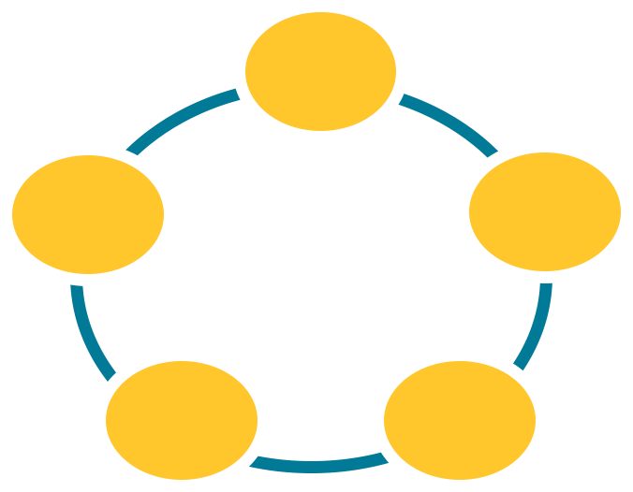
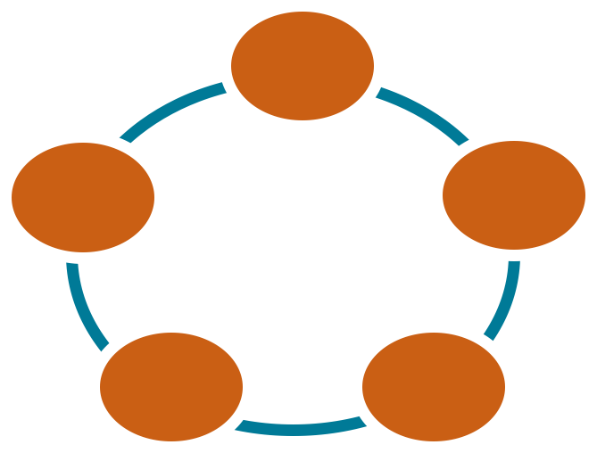
Token Ranges Aware
Simple provisioning and deployment
Data locality: less network hops
Pushdown Predicates
Caching
DSE Analytics
Cluster
DSE C*
Cluster
Notes:
RDD Partitions with Spark PK
Cassandra Partions with C* PK
Spark Loader select data from the C* node based on the TokenRanges
Alle Knoten sind Apache Spark™ Workers
Workser sind standardmäßig ausfallsicher
Der erste Apache Spark™ Knoten wird zum Apache Spark™ Master ernannt
Status ist in DSE C* gespeichert, Kein SPOF
Im Fehlerfall wird ein Neuer Spark Master ernannt
Neuer Apache Spark™ Master verbindet sich mit Workers und dem Treiber um weiter zu arbeit
Kein Drittsoftware notwendig

Slide 7
Submit Spark Jobs to DSE Analytics
JVM Spark Master
C* Node
Spark Master: Allocate resources for app
Spark Worker: Starts and manages the executers
Spark Executor: Covers all main tasks of the Spark App
JVM Spark Worker
Node 1
Node 5
Node 2
JVM Spark Worker
JVM Spark Worker
JAR
dse spark submit
Node 4
Node 3
dse spark-submit --class MainClass MeineJarDatei.jar
JVM Spark Worker
JVM Spark Worker

Slide 8
Features of DSE Analytics
DSE Cassandra tables exposed as
Apache Spark™ RDDs
Apache Spark™ DataFrames
Load data from DSE C* to DSE Analytics
Write data from DSE Analytics to DSE C*
Object mapper : Mapping of C* tables and rows to Scala / Java objects
All DSE C* types supported and converted to Scala / Java types
Server side data selection
Virtual Nodes support
Data Locality awareness
Scala, Python and Java APIs

Slide 9
DSE Analytics - REPL
$ dse spark
scala> val table = sc.cassandraTable[CassandraRow]( retailer‘,'sales‘).select("name",“item").where(“name= ?", “gregg")
table: com.datastax.spark.connector.rdd.CassandraTableScanRDD [com.datastax.spark.connector.CassandraRow] = CassandraTableScanRDD[5] at RDD at CassandraRDD.scala:15
// With collect the data gets read from Cassandra
scala> table.collect()
res1: Array[com.datastax.spark.connector.CassandraRow] = Array(CassandraRow{name: gregg, item: PlayStation 4}, CassandraRow{name: gregg, item: iMac}, CassandraRow{name: gregg, item: Microsoft Xbox})
scala> table.collect().foreach(println);
CassandraRow{name: gregg, item: PlayStation 4}
CassandraRow{name: gregg, item: iMac}
CassandraRow{name: gregg, item: Microsoft Xbox}
Notes:
sc.cassandraTable or sqlContext.load(org.apache.spark.sql.cassandra)
spark.cassandra.input.split.size
The (estimated) number of C* Partitions to be placed in a Spark Partition

Slide 10
DSE Analytics - Spark SQL
Save to DSE
sc.parallelize(Seq(A,B,C)).saveToCassandra(“demo”, “collections")
Spark RDD JOIN with NOSQL!
churnRateRdd.join(custJourney).saveToCassandra(“customerESxty",“churns")
Use Spark SQL to select the database
val track_count_by_year = sqlContext.sql("select 'dummy' as dummy, album_year as year, count(*) as track_count from tmp_tracks_by_album group by album_year")
Notes:
sc.cassandraTable or sqlContext.load(org.apache.spark.sql.cassandra)
spark.cassandra.input.split.size
The (estimated) number of C* Partitions to be placed in a Spark Partition

Slide 11
DSE Analytics Features
Easy setup and config
No need to setup a separate Apache Spark™ cluster
No need to tweak classpaths or config files
High availability of DSE Analytics Master
Enterprise security
Password / Kerberos / LDAP authentication
SSL for all DSE Analytics to DSE C* connections

Slide 12
Lab 6 : Hands-on DSE Analytics
Notes:
So you might be asking how it works, let’s get into it.

Slide 13
Thank You!

