Slide 1

Artificial Intelligence in Business
Boudjaoui Badis
Hamadouche Axcel
Naceri Walid
2CP – Group 8

Slide 2
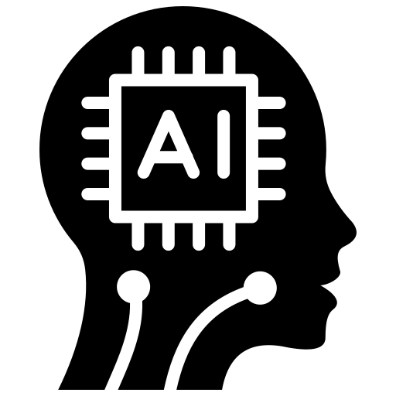
Artificial Intelligence in Business
1 -What is Artificial Intelligence and Its Role in Business Today
2 -Practical Examples of Al in Companies
3 -Advantages, Challenges, and the Future of Al in Business
Boudjaoui Badis
Adjeroud Mohamed Mounib
Sahali Maria
2CP – Group 8

Slide 3




1 -What is Artificial Intelligence and Its Role in Business Today
Artificial Intelligence is a branch of computer science that tries to create machines capable of thinking, learning, and making decisions like humans.
2 -Practical Examples of Al in Companies
3 -Advantages, Challenges, and the Future of Al in Business
Perception
Reasoning
Action

Slide 4



1 -What is Artificial Intelligence and Its Role in Business Today
Artificial Narrow Intelligence (ANI)
Artificial Intelligence is a branch of computer science that tries to create machines capable of thinking, learning, and making decisions like humans.
Artificial General Intelligence (AGI)
Artificial Super Intelligence (ASI)

Slide 5

1 -What is Artificial Intelligence and Its Role in Business Today
Simple Reflex Agents
Artificial Narrow Intelligence (ANI)
Model-Based Reflex Agents
Artificial Intelligence is a branch of computer science that tries to create machines capable of thinking, learning, and making decisions like humans.
ANI
Goal-Based Agents
Artificial General Intelligence (AGI)
AGI
Utility-Based Agents
ASI
Learning Agents
Artificial Super Intelligence (ASI)

Slide 6
1 -What is Artificial Intelligence and Its Role in Business Today
Increase
2 -Practical Examples of Al in Companies
3 -Advantages, Challenges, and the Future of Al in Business
Simple Reflex Agents
AI helps businesses automate tasks, make smarter decisions, and improve efficiency.
Model-Based Reflex Agents
Artificial Intelligence is a branch of computer science that tries to create machines capable of thinking, learning, and making decisions like humans.
ANI
Goal-Based Agents
AGI
Utility-Based Agents
Learning Agents
ASI

Slide 7

Artificial Intelligence in Business
1 -What is Artificial Intelligence and Its Role in Business Today
Many companies use AI chatbots to help customers.
For example, when you open a website and a chat box appears asking, “How can I help you?”, that’s usually an AI program.
It answers simple questions, gives information, and helps customers 24 hours a day.
This saves time and money for companies.
2 -Practical Examples of Al in Companies
3 -Advantages, Challenges, and the Future of Al in Business
AI helps businesses automate tasks, make smarter decisions, and improve efficiency.
1. Customer service

Slide 8




1 -What is Artificial Intelligence and Its Role in Business Today
Artificial Intelligence in Business
2 -Practical Examples of Al in Companies
Many companies use AI chatbots to help customers.
For example, when you open a website and a chat box appears asking, “How can I help you?”, that’s usually an AI program.
It answers simple questions, gives information, and helps customers 24 hours a day.
This saves time and money for companies.
2. Online shopping and recommendations
2. Online shopping and recommendations
1. Customer service
3 -Advantages, Challenges, and the Future of Al in Business
Companies like Amazon or Netflix use AI to recommend products or movies.
AI looks at what you bought or watched before and suggests new things you might like.
This helps companies increase their sales and makes customers happier.
AI helps businesses automate tasks, make smarter decisions, and improve efficiency.

Slide 9




1 - What is Artificial Intelligence and Its Role in Business Today
Artificial Intelligence in Business
2 -Practical Examples of Al in Companies
Companies like Amazon or Netflix use AI to recommend products or movies.
AI looks at what you bought or watched before and suggests new things you might like.
This helps companies increase their sales and makes customers happier.
Many companies use AI chatbots to help customers.
For example, when you open a website and a chat box appears asking, “How can I help you?”, that’s usually an AI program.
It answers simple questions, gives information, and helps customers 24 hours a day.
This saves time and money for companies.
1 – Customer service
2. Online shopping and recommendations
3 -Advantages, Challenges, and the Future of Al in Business
Companies like Tesla use AI for self-driving cars.
AI systems process data from cameras and sensors to decide how to drive safely.
Also, in delivery companies like DHL or FedEx, AI helps find the best route to save time and fuel.
3. Transportation
AI helps businesses automate tasks, make smarter decisions, and improve efficiency.
1. Customer service

Slide 10



1 - What is Artificial Intelligence and Its Role in Business Today
Artificial Intelligence in Business
2 -Practical Examples of Al in Companies
Companies like Tesla use AI for self-driving cars.
AI systems process data from cameras and sensors to decide how to drive safely.
Also, in delivery companies like DHL or FedEx, AI helps find the best route to save time and fuel.
2. Online shopping and recommendations
2. Online shopping and recommendations
4. Healthcare
3 -Advantages, Challenges, and the Future of Al in Business
3. Transportation
In hospitals, AI helps doctors analyze medical images like X-rays or scans.
It can find diseases earlier and faster than humans sometimes.
AI is also used to create personalized treatment plans for patients.
Companies like Amazon or Netflix use AI to recommend products or movies.
AI looks at what you bought or watched before and suggests new things you might like.
This helps companies increase their sales and makes customers happier.
AI helps businesses automate tasks, make smarter decisions, and improve efficiency.

Slide 11
1 -What is Artificial Intelligence and Its Role in Business Today
Artificial Intelligence in Business
1 - What is Artificial Intelligence and Its Role in Business Today
2 -Practical Examples of Al in Companies
3 -Advantages, Challenges, and the Future of Al in Business
In hospitals, AI helps doctors analyze medical images like X-rays or scans.
It can find diseases earlier and faster than humans sometimes.
AI is also used to create personalized treatment plans for patients.
Many companies use AI chatbots to help customers.
For example, when you open a website and a chat box appears asking, “How can I help you?”, that’s usually an AI program.
It answers simple questions, gives information, and helps customers 24 hours a day.
This saves time and money for companies.
1 – Customer service
4. Healthcare
3 -Advantages, Challenges, and the Future of Al in Business
Companies like Tesla use AI for self-driving cars.
AI systems process data from cameras and sensors to decide how to drive safely.
Also, in delivery companies like DHL or FedEx, AI helps find the best route to save time and fuel.
3. Transportation
AI helps businesses automate tasks, make smarter decisions, and improve efficiency.

Slide 12


Artificial Intelligence in Business
1 -What is Artificial Intelligence and Its Role in Business Today
Saves time
Better decisions
Saves money
Improves customer service
2 -Practical Examples of Al in Companies
3 -Advantages, Challenges, and the Future of Al in Business
1. Adventages
4. Healthcare
In hospitals, AI helps doctors analyze medical images like X-rays or scans.
It can find diseases earlier and faster than humans sometimes.
AI is also used to create personalized treatment plans for patients.
AI helps businesses automate tasks, make smarter decisions, and improve efficiency.

Slide 13
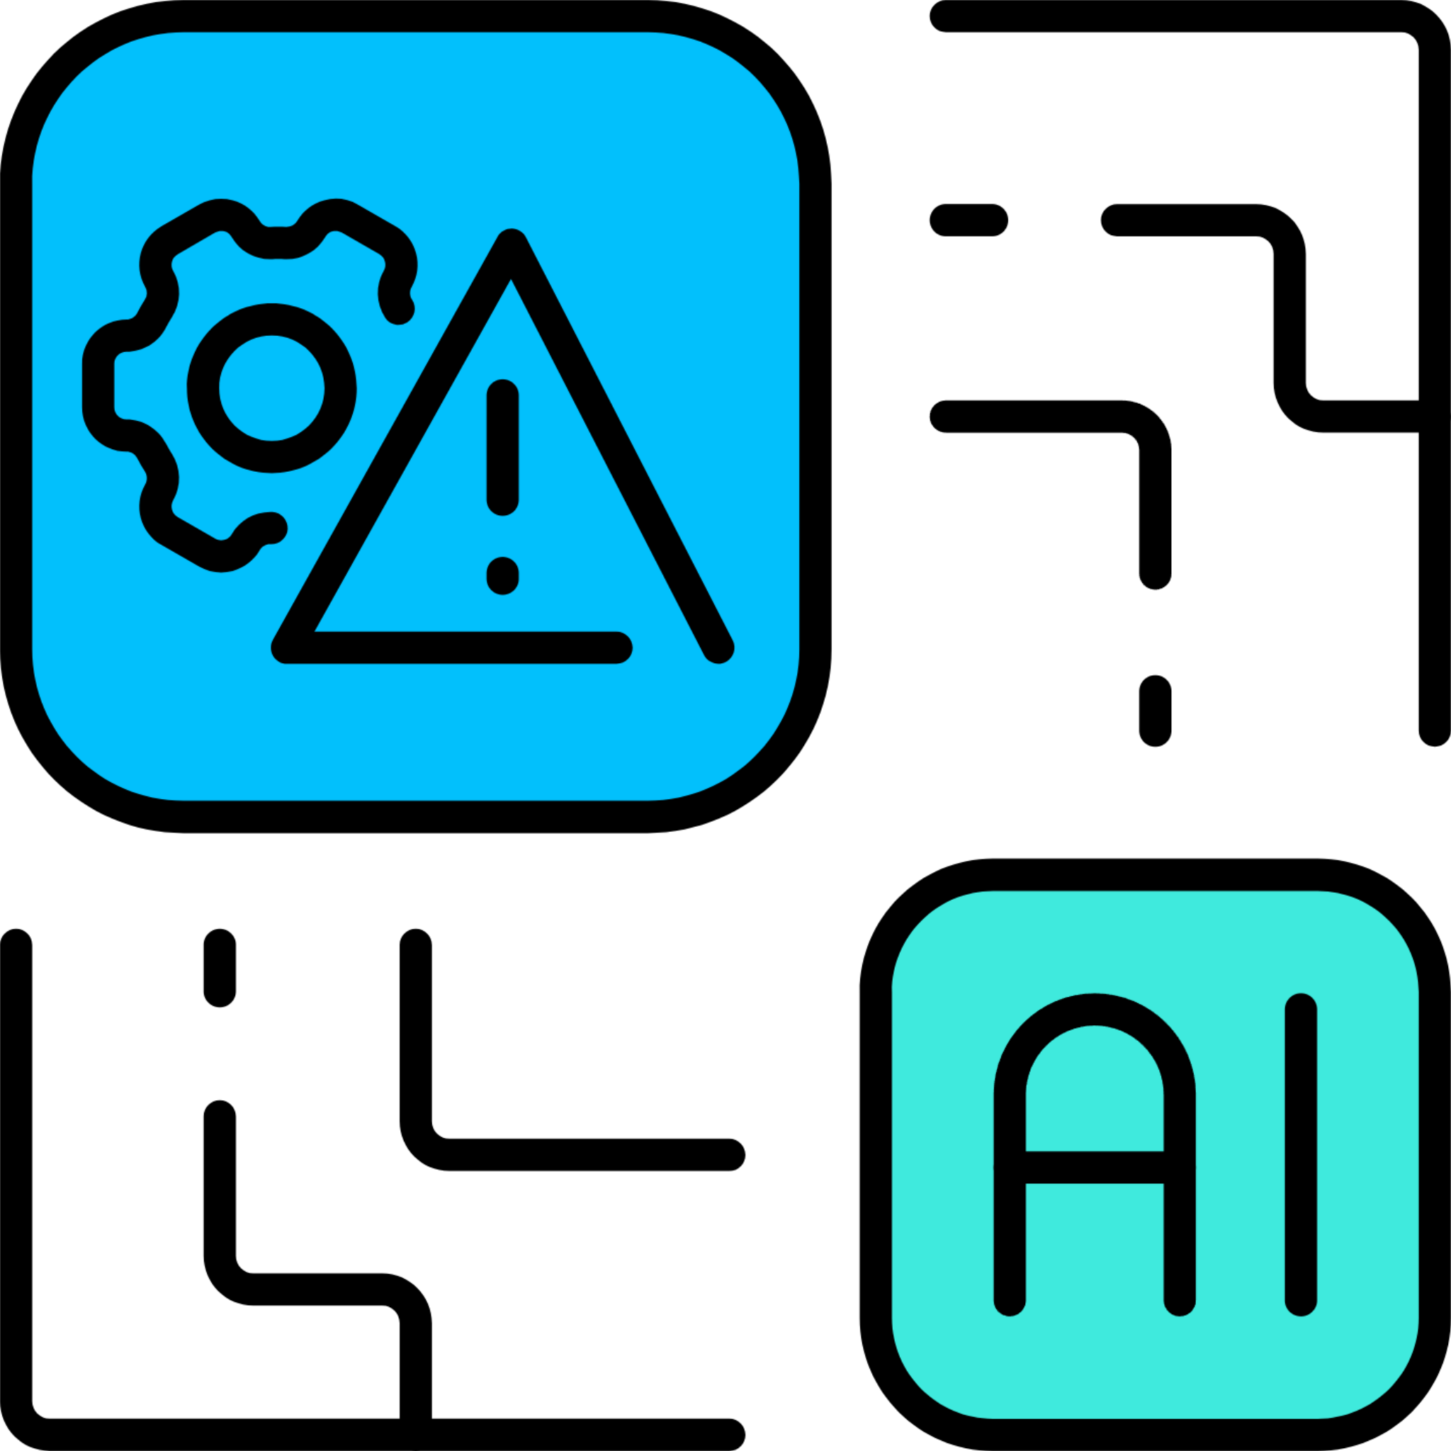

1 -What is Artificial Intelligence and Its Role in Business Today
Artificial Intelligence in Business
3 -Advantages, Challenges, and the Future of Al in Business
2 -Practical Examples of Al in Companies
Saves time
Better decisions
Saves money
Improves customer service
In hospitals, AI helps doctors analyze medical images like X-rays or scans.
It can find diseases earlier and faster than humans sometimes.
AI is also used to create personalized treatment plans for patients.
1. Adventages
2. Challenges
Costs money
Needs data
Can replace jobs
Privacy risks
AI helps businesses automate tasks, make smarter decisions, and improve efficiency.

Slide 14
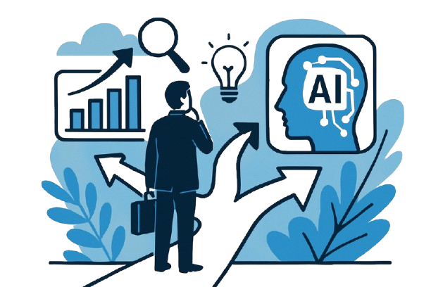

Artificial Intelligence in Business
3 -Advantages, Challenges, and the Future of Al in Business
Saves time
Better decisions
Saves money
Improves customer service
Costs money
Needs data
Can replace jobs
Privacy risks
2. Challenges
3. Future
1. Adventages
More Automation
More personal services
Humans + IA
Faster innovation
4. Healthcare
In hospitals, AI helps doctors analyze medical images like X-rays or scans.
It can find diseases earlier and faster than humans sometimes.
AI is also used to create personalized treatment plans for patients.

Slide 15



1 -What is Artificial Intelligence and Its Role in Business Today
Artificial Intelligence in Business
3 -Advantages, Challenges, and the Future of Al in Business
2 -Practical Examples of Al in Companies
More Automation
More personal services
Humans + IA
Faster innovation
Badis Boudjaoui
Axcel Hamadouche
Walid Naceri
In hospitals, AI helps doctors analyze medical images like X-rays or scans.
It can find diseases earlier and faster than humans sometimes.
AI is also used to create personalized treatment plans for patients.
3. Future
2. Challenges
Costs money
Needs data
Can replace jobs
Privacy risks
AI helps businesses automate tasks, make smarter decisions, and improve efficiency.

Slide 16
Artificial Intelligence in Business
3 -Advantages, Challenges, and the Future of Al in Business
Saves time
Better decisions
Saves money
Improves customer service
Badis Boudjaoui
Axcel Hamadouche
Walid Naceri
3. Future
1. Adventages
More Automation
More personal services
Humans + IA
Faster innovation
4. Healthcare
In hospitals, AI helps doctors analyze medical images like X-rays or scans.
It can find diseases earlier and faster than humans sometimes.
AI is also used to create personalized treatment plans for patients.

