Slide 1
Hybrid IoT and Computer Vision Framework
for Real-Time Industrial Hazard Detection
Worker Safety Compliance | Dissertation Presentation
Sushant Tomar | 1/24/SET/MVLSI/001
Supervisor: Dr. Umesh Dutta | Co-Supervisor: Dr. Abhiruchi Passi
Department of ECE, MRIIRS
AI + IoT
Edge Safety Monitoring

Slide 2
Presentation Roadmap
Overview
Agenda
Problem context and research gap
Proposed hybrid IoT-CV framework
System architecture and workflow
Implementation and model configuration
Fusion engine and alert mechanism
Actual experimental results and charts
Conclusion, limitations, and future scope
Core idea
Combine visible hazards from camera analytics with invisible
environmental hazards from IoT sensors.
Evaluation focus
Runtime performance, latency, resource use, decision
distribution, and model efficacy pathway.
Output
A modular, reproducible prototype for Industry 4.0
safety automation.
2

Slide 3
Industrial Safety Motivation
Problem
Why hybrid safety monitoring is needed
Manual supervision
Fatigue, limited field of view, delayed response,
and missed events in dynamic industrial areas.
CCTV-only monitoring
Passive surveillance cannot automatically
detect PPE violations or risk escalation.
IoT-only sensing
Sensors detect gas, heat, or vibration but cannot
interpret worker behavior or PPE compliance.
Industrial hazards include toxic gases, high temperatures, machine vibration, PPE non-compliance, fall incidents, and restricted-zone violations.
Single-modality systems create blind spots: visible-only systems miss invisible hazards, while sensor-only systems miss behavioral risks.
A fused edge solution can improve responsiveness, privacy, and reliability.
3

Slide 4
Research Aim and Objectives
Objectives
Research aim
Design, develop, and evaluate a Hybrid IoT-Computer Vision framework for real-time industrial hazard
detection and worker safety compliance.
Specific objectives
Integrate IoT environmental sensing with CV-based PPE and hazard detection.
Implement edge-compatible processing with low-latency decision-making.
Fuse sensor and vision evidence using rule-based and confidence-weighted logic.
Generate real-time alerts through MQTT, buzzer, email, and local dashboard modules.
Evaluate using FPS, latency, CPU/memory use, decision distribution, and model efficacy metrics.
4

Slide 5
Proposed System Architecture
Framework
Hybrid IoT + Computer Vision pipeline
IoT Sensors
Gas Temp Vibration
Camera Feed
Video / camera input frames
Edge Processing
YOLO inference Sensor preprocessing
Fusion Engine
Rule-based + weighted scoring
Alerts + Logs
MQTT / email SQLite events
Edge execution avoids constant cloud dependency and reduces response time.
Sensor-vision fusion improves situational awareness by combining physical measurements and visual evidence.
The modular pipeline allows model replacement, sensor expansion, and future dashboard integration.
5

Slide 6
Prototype Implementation
Development
Implemented software modules
Layer | Implemented modules
Core | Configuration loader, logger, utilities
Sensors | Sensor reader, preprocessor, sensor manager
Vision | Camera/video manager, PPE detector, fall detector, zone detector, frame annotator
Fusion | Fusion engine, risk assessor, rule-based logic
Alerts and logs | MQTT publisher, email alert, buzzer placeholder, SQLite event logger
Research metrics | Frame-level metrics collector and graph generator
The implementation is structured as a repeatable frame loop: read sensor data, acquire frame, run detection, fuse evidence, alert
, log, annotate, and display.
6

Slide 7
Computer Vision Model Configuration
Model
YOLO-based visual hazard detection
Primary model path
The system attempts to load a custom PPE model from
models/ppe_model.pt.
Fallback model
If the custom PPE model is unavailable, the system falls back to yolov8n.pt
for generic object/person detection.
The custom model should contain classes such as helmet, no_helmet, vest, no_vest, person, and fall for PPE-specific evaluation.
The fallback YOLOv8n model is useful for general person/object detection but should not be reported as a specialized PPE detector unless PPE classes are trained and validated.
Model efficacy should be reported separately from runtime performance using labeled ground-truth data.
7

Slide 8
Fusion Engine and Decision Logic
Fusion
Decision-level sensor-vision fusion
Condition | System decision
Gas high + no helmet | CRITICAL_ALERT
No helmet detected | HIGH_RISK
Fall detected | EMERGENCY
Gas high + person | HIGH_RISK
Temperature high + person | HIGH_RISK
Vibration high | MEDIUM_RISK
Weighted score >= 0.85 | HIGH_RISK
Weighted score >= 0.60 | MEDIUM_RISK
Fusion score
Final score = 0.6 x sensor score + 0.4 x vision score
Safety value
A hazard is confirmed more strongly when visual and sensor
evidence support each other.
Research measurement
Decisions are logged frame-by-frame for distribution analysis and
future confusion-matrix evaluation.
8

Slide 9
Evaluation Methodology
Evaluation
Runtime and efficacy evaluation plan
Runtime metrics
FPS, frame latency, PPE detection latency,
fusion latency, logging time, display time,
CPU usage, and memory usage.
Decision analysis
Distribution of HIGH_RISK, MEDIUM_RISK,
CRITICAL_ALERT, EMERGENCY, and
SAFE decisions across frames.
Model efficacy
Precision, recall, F1-score, mAP, false alarm rate,
and missed hazard rate require labeled ground
truth.
This presentation uses actual runtime logs from 64 processed frames.
Accuracy metrics are included as a research pathway, not invented values.
For publication, run multiple scenarios and report mean plus standard deviation.
9

Slide 10
Actual Runtime Results
Results
Frame-level system performance summary
64
Frames processed
6.76
Average FPS
160.4 ms
Avg frame latency
80.6 ms
PPE latency
44.8%
Avg CPU
Metric | Value
Min FPS | 0.000
Max FPS | 9.809
Average fusion time | 0.017 ms
Average memory usage | 931.8 MB
HIGH_RISK frames | 48
MEDIUM_RISK frames | 16
The measured run shows the computer vision stage as the main latency contributor.
System decisions were risk-oriented: 75% HIGH_RISK and 25% MEDIUM_RISK.
No SAFE, CRITICAL_ALERT, or EMERGENCY frames occurred in this particular test run.
10

Slide 11
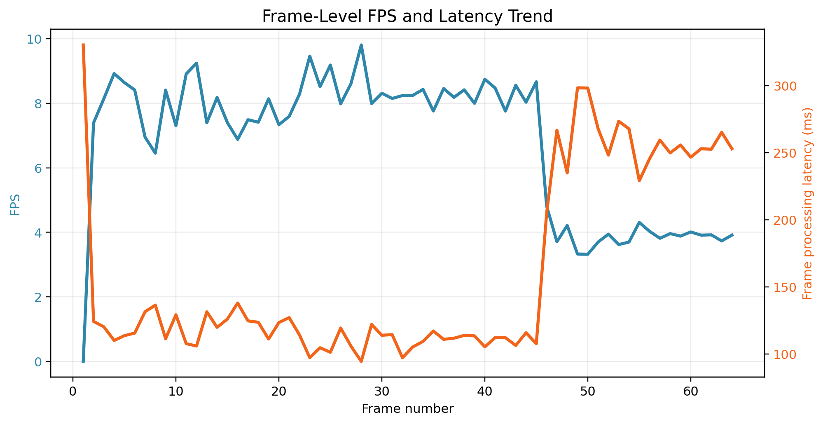
Line Chart: FPS and Latency
Results
Actual frame-level performance trend
Observation: frame latency rises noticeably after approximately frame 45, while FPS drops to around 3-4 FPS for the later segment.
11

Slide 12
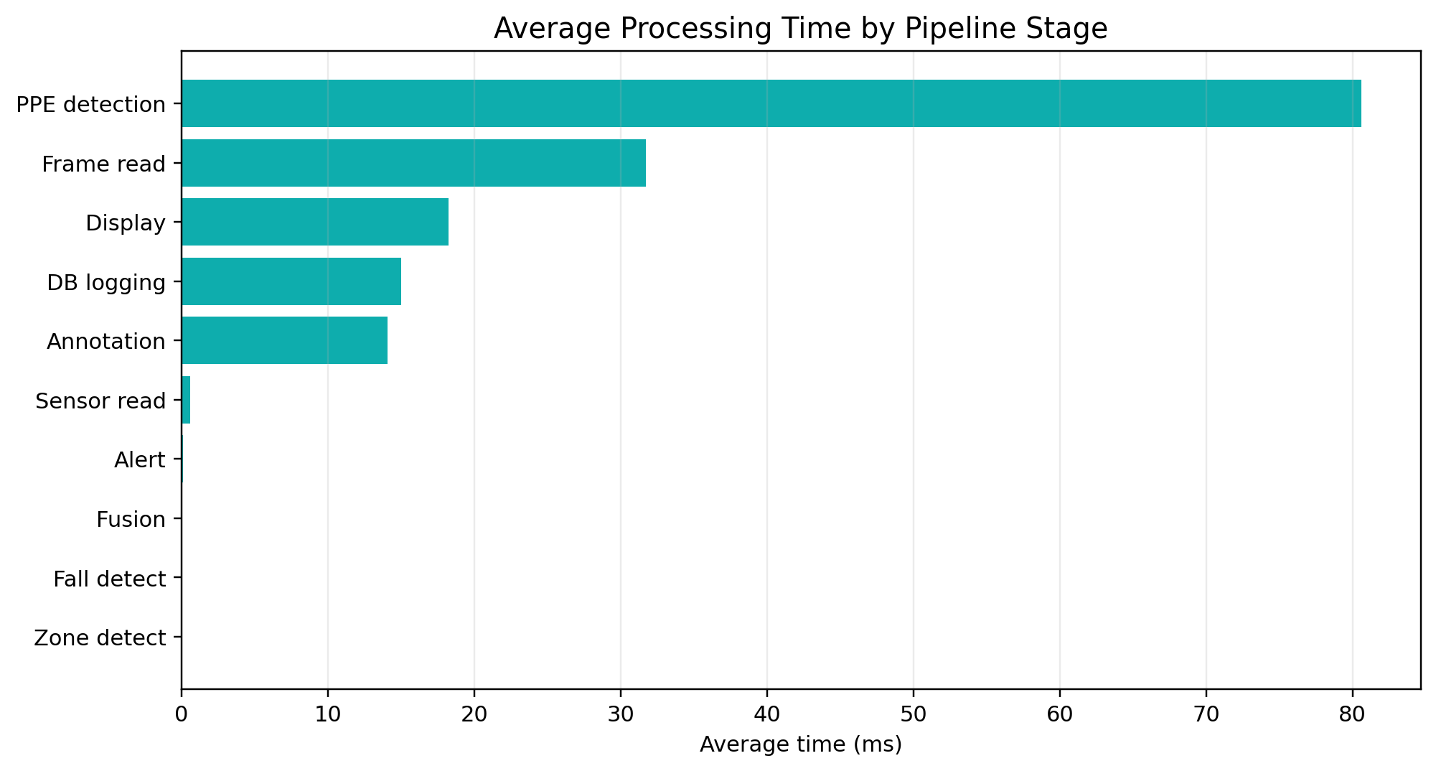
Pipeline Bottleneck Analysis
Results
Average processing time by stage
PPE inference contributed the largest average stage latency, followed by frame acquisition and display/annotation/logging overheads.
12

Slide 13
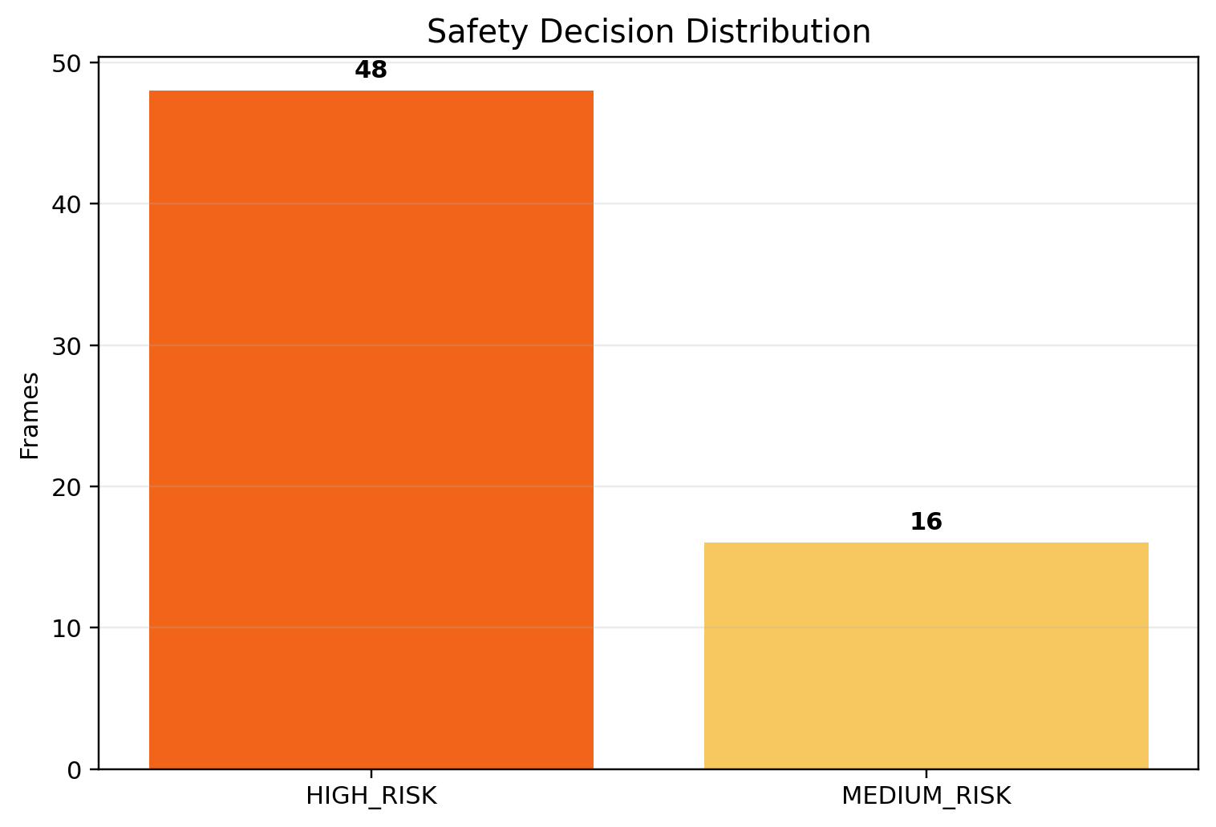
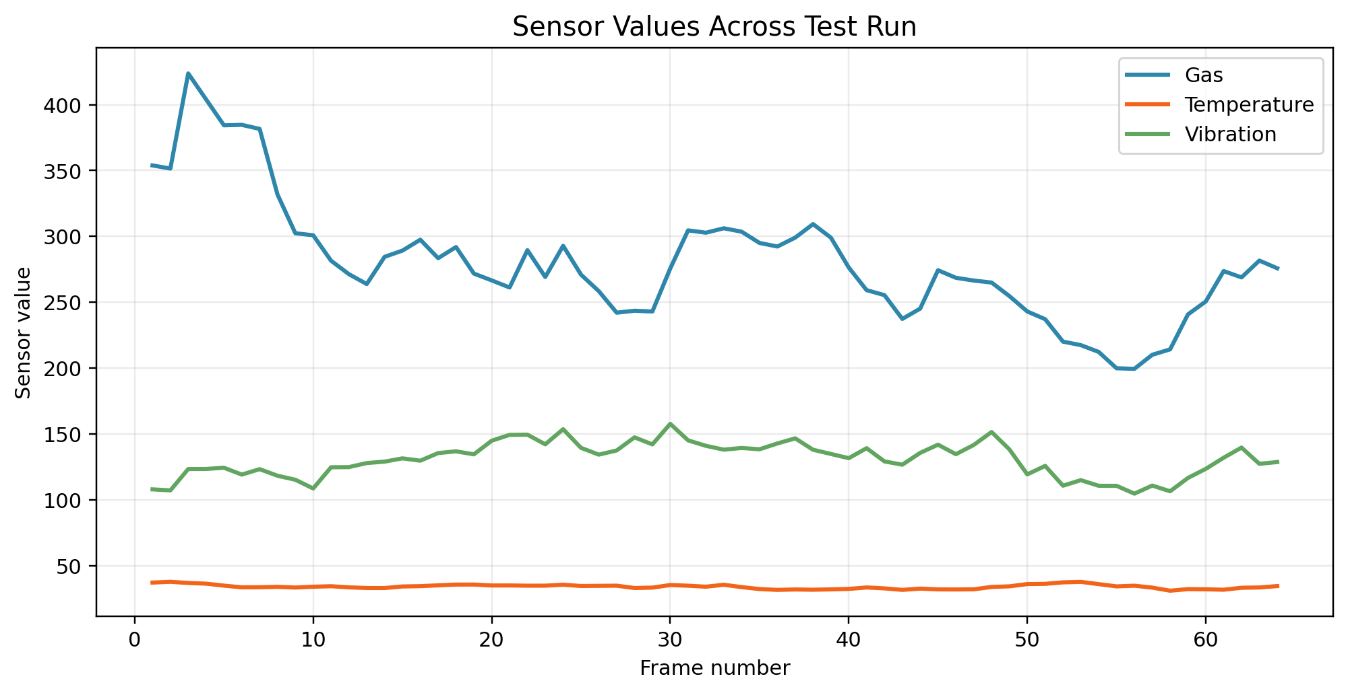
Decision and Sensor Analysis
Results
Risk decisions and sensor trends
HIGH_RISK decisions were mostly linked to missing-helmet/person detections and elevated multimodal anomaly scores.
13

Slide 14
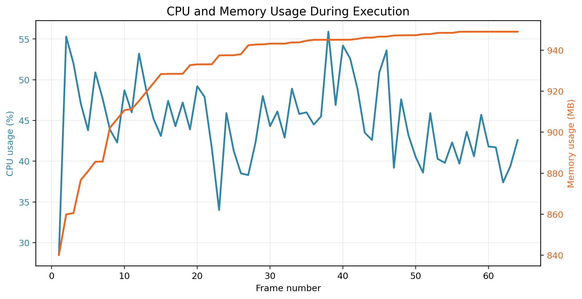
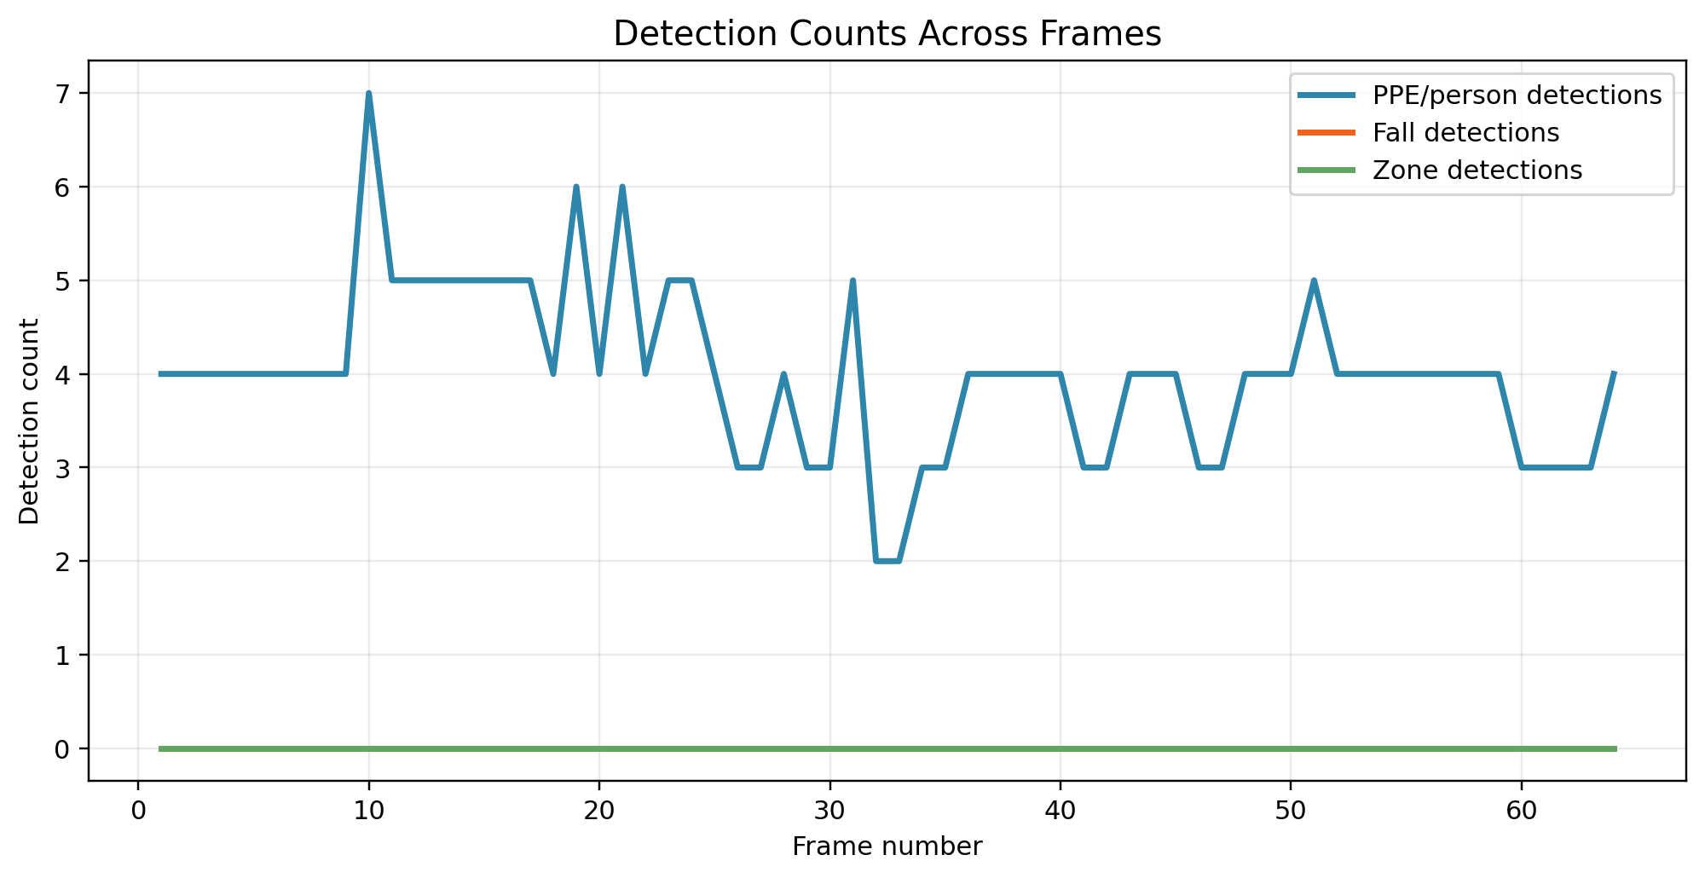
Resource Use and Detection Counts
Results
Runtime resource and detection behavior
Average memory usage was approximately 931.8 MB; PPE/person detections ranged from 2 to 7 objects per frame in the measured run.
14

Slide 15
Discussion of Findings
Discussion
Interpretation of results
Real-time feasibility
Average FPS of 6.76 indicates a working
prototype, but further optimization is needed
for smoother real-time deployment.
Bottleneck
PPE detection latency dominated processing
time, suggesting model optimization or
hardware acceleration as the priority.
Safety behavior
The test generated HIGH_RISK and
MEDIUM_RISK frames, validating that the
fusion logic produced active safety decisions.
Actual accuracy cannot be concluded from runtime logs alone; it requires labeled ground truth.
For research reporting, runtime performance and model efficacy should be presented as separate evaluations.
The current results are suitable for a prototype-level feasibility and performance analysis.
15

Slide 16
How to Report Model Efficacy
Efficacy
Accuracy evaluation requires ground-truth labels
Metric | What is needed | Output
Precision | True vs predicted detections | Correctness of predicted PPE/hazard detections
Recall | All real hazards annotated | Ability to avoid missed hazards
F1-score | Precision + recall | Balanced detection performance
mAP@0.5 / 0.5:0.95 | Bounding-box labels | Object detection benchmark score
False alarm rate | True SAFE scenarios | Incorrect risk alerts
Missed hazard rate | True hazard scenarios | Hazards predicted as SAFE
Recommended next step: validate models on a labeled PPE and hazard dataset, then merge detection metrics with runtime findings.
16

Slide 17
Limitations and Future Scope
Future Work
Limitations and planned improvements
Current runtime sample contains only 64 frames; a larger multi-scenario test set should be used for final publication results.
PPE classification depends on availability of a trained custom model; fallback YOLOv8n should not be treated as a PPE-specific model.
Environmental factors such as lighting, occlusion, dust, and camera position may reduce detection confidence.
Future improvements include TensorRT/ONNX optimization, edge accelerators, multi-camera fusion, adaptive thresholds, and explainable AI visualizations.
Final efficacy reporting should include confusion matrices and precision-recall curves from labeled test data.
17

Slide 18
Conclusion
Closing
Key takeaway
The proposed framework demonstrates a practical hybrid IoT-computer vision safety monitoring pipeline.
Actual runtime logging produced measurable evidence for FPS, latency, resource usage, and decision distribution.
The system is modular, reproducible, and suitable for further optimization and labeled-data validation.
Hybrid sensor-vision fusion offers stronger situational awareness than isolated IoT-only or CV-only approaches.
6.76
Avg FPS
160 ms
Avg latency
48/64
HIGH_RISK frames
931.8 MB
Avg memory
18

