Slide 1

Hybrid IoT and Computer Vision Framework for Real-Time Industrial Hazard Detection and Worker Safety Compliance
Author: Sushant Tomar Roll Number: 1/24/SET/MVLSI/001 Department of ECE, MRIIRS
Supervisor: Prof. (Dr.) Umesh Dutta

Slide 2
Agenda
Introduction
Problem Statement
Research Objectives
Significance of the Study
Scope of the Study
Limitations of the Study
Literature Review
Research Methodology
Expected Outcomes
Discussion
Conclusion & Future Work

Slide 3
Introduction
Industrial automation has increased efficiency, but hazards remain (machinery, toxic gases, heat).
Traditional monitoring: manual supervision, CCTV → limited, delayed, error-prone.
IoT sensors: detect invisible hazards (gas, vibration, temperature).
Computer Vision: detect PPE violations, unsafe postures, proximity breaches.
Proposed hybrid framework: sensor + vision fusion at the edge for real-time, privacy-preserving safety monitoring.

Slide 4
Problem Statement
Workplace accidents persist despite automation and safety protocols.
Existing systems are fragmented:
IoT-only → environmental hazards, threshold alerts.
Vision-only → PPE/behavior detection, but blind to invisible hazards.
Lack of integration → blind spots, false positives, missed detections.
Cloud-based systems → latency + privacy concerns.
Gap: No unified, intelligent, low-latency framework fusing IoT + CV at the edge.

Slide 5
Research Objectives
Design modular architecture (sensors + vision + edge + alerts).
Develop lightweight, edge-optimized CV models for PPE/behavior detection.
Implement sensor–vision fusion logic for improved reliability.
Deploy prototype with MQTT alerts + dashboard visualization.
Evaluate performance (precision, recall, latency, false alarm rate, resource use).

Slide 6
Significance of Study
Industry: Proactive hazard detection → fewer accidents, downtime, compliance with OSHA/ISO 45001.
Academia: Novel IoT–CV integration, reproducible framework, datasets, metrics.
Policy: Evidence-based insights for next-gen safety standards, smart industrial infrastructure.

Slide 7
Scope
Industrial settings: manufacturing, warehouses, construction.
IoT sensors: gas, temperature, vibration.
CV module: PPE detection, unsafe proximity, fall/slip incidents.
Edge deployment: Jetson Nano, Coral TPU.
Alerts: MQTT + dashboard.
Metrics: precision, recall, latency, false alarm rate, uptime.

Slide 8
Limitations
Dataset dependency → generalization issues.
Environmental sensitivity (lighting, occlusion, dust).
Connectivity requirements (MQTT).
Sensor calibration/maintenance.
Edge resource constraints.
Privacy/ethical considerations.

Slide 9
Literature Review
IoT for industrial safety: gas, temperature, vibration sensors; anomaly detection.
CV for PPE/behavior detection: CNNs, object detection, pose estimation.
Sensor–vision fusion: early, late, hybrid fusion; reduces false positives.
Edge deployment: quantization, pruning, distillation for lightweight models.
Evaluation metrics: precision, recall, latency, false alarm rate.
Ethical concerns: privacy, anonymization, compliance with regulations.

Slide 10
Research Methodology
System Architecture:
Sensing layer (IoT sensors).
Vision analysis layer (CV models).
Edge processing unit (Jetson/ESP32).
Fusion engine (sensor + vision).
Communication & alerting (MQTT + dashboard).

Slide 11
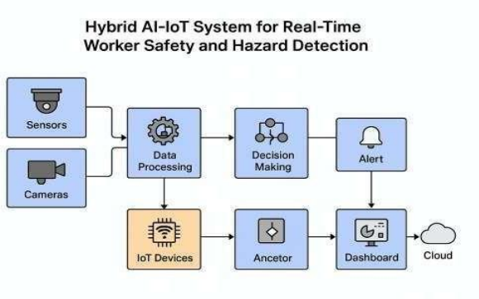
Architecture Continued - Flow
Video → AI inference → PPE/hazard classification → sensors → threshold analysis → Fusion → hazard identified? → Alert + log

Slide 12
Project Outcomes
Real-time safety monitoring with video and sensor fusion
Helmet/no-helmet detection with fallback logic
IoT dashboard for live status and event history
Roboflow support for hosted/custom PPE models
SQLite event logging for audit and alerts
Dynamic vehicle-zone visualization for moving objects
Configurable camera/video input and display mode
Alert propagation via MQTT/email integration

Slide 13
Discussion
Fusion improves reliability (sensor corroborates vision, vision mitigates sensor drift).
Trade-offs: accuracy vs latency, privacy vs observability.
Deployment challenges: calibration, network outages, worker acceptance.
Ethical/regulatory: anonymization, non-punitive monitoring, compliance with safety/data laws.

Slide 14
Conclusion & Future Work
Contributions: hybrid IoT–CV framework, edge optimization, empirical evaluation.
Future work:
Larger datasets, diverse industrial scenarios.
Integration with predictive analytics.
Deployment on FPGA/ASIC for scalability.
Policy alignment with evolving safety standards.

