Slide 1

0xAA Command

Slide 2
Operating Steps
①
②
③
File Starting Location
File to VP
VP to Flash

Slide 3
1. File Starting Location
16MB Flash

Slide 4
Mode 1
256KB storage block
13, 14, 22,32 files are stored in 256KB
64 pcs

Slide 5
Mode 2
32KB
data block
0xAA command is based on 32KB data block
512 pcs

Slide 6

File Starting Location
Based on 32KB data block
13.bin=13*256/32=104=0x0068
14.bin=14*256/32=112=0x0070
22.bin=22*256/32=176=0x00B0
32.icl=32*256/32=256=0x0100

Slide 7
2. File to VP
Frame header
0xF3=
243
Command
length
Write
command
VP
address
240 bytes data/command
5AA5 F3 82 8000 14 44 47 55 53 5F 04 00 00...
Next command:
VP+0x78
1*VP address=2 bytes
240 bytes/2=120=0x78(VP address)
5AA5 F3 82 8078 00 00 ...

Slide 8

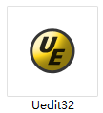
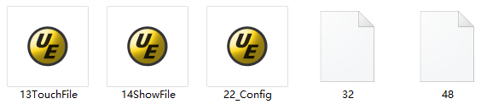
240 bytes data
Use Uedit32 to open the file

Slide 9
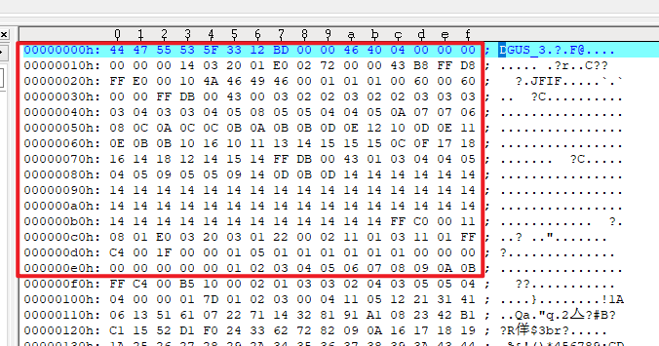
240 bytes data
16 bytes*15 =240bytes

Slide 10
3. VP to Flash
Frame header
0x0F=15
Command
length
Write
command
System VP
address
D11
Enable
flag
D10
Operation mode
D9:D8
file
starting location
D7:D6
VP
address
D5:D0
Undefine,write 00
5AA5 0F 82 00AA 5A 02 0100 8000 00*6
Reset command:
5AA5 07 82 0004 55AA 5AA5
15 bytes

Slide 11
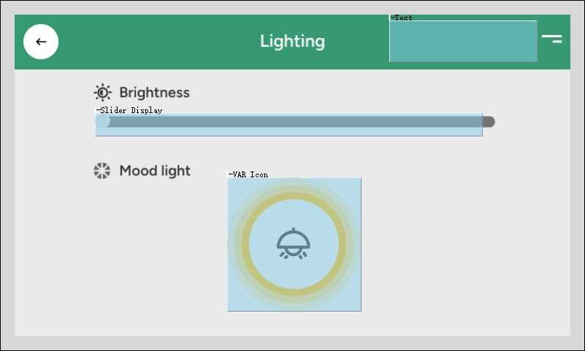
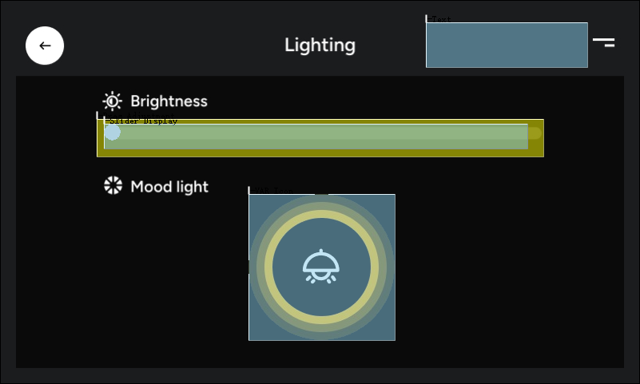
Project File
22.bin
32.icl
21:00pm
14:00pm
13.bin
14.bin
Project 1
Project 2

