Slide 1
MASSIVELY SCALABLE APPS LAB
Lab 2: Git Version Control
Fundamentals to Advanced Commands
PREPARED BY: MOHAMED AYMAN

Slide 2
Part A: Git Fundamentals

Slide 3
Version Control
Version Control System (VCS) = Software that tracks and manages changes to files over time
Key capabilities:
• Track complete history of every change
• Revert to any previous version
• Enable team collaboration
• See who changed what and when
• Protect against data loss
Think of it as: A time machine for your code that lets you travel back to any point in your project's history!
3

Slide 4
GIT'S Three-State Architecture
Git organizes work in three distinct areas:
Working Directory
Staging Area
Repository
git add
git commit
📁 Where you edit files
Regular files on disk
📦 Preparation zone
What goes in next commit
💾 Permanent snapshots
Complete project history
Key Insight: The staging area gives you precise control over commits. You can choose exactly what changes to include!
4

Slide 5
Basic Git Workflow
Essential Commands
1
Initialize repository: git init
2
Check status: git status
3
Stage files: git add <filename> or git add .
4
Commit changes: git commit -m "Your message"
This three-step process (edit → stage → commit) is fundamental to Git!
5

Slide 6
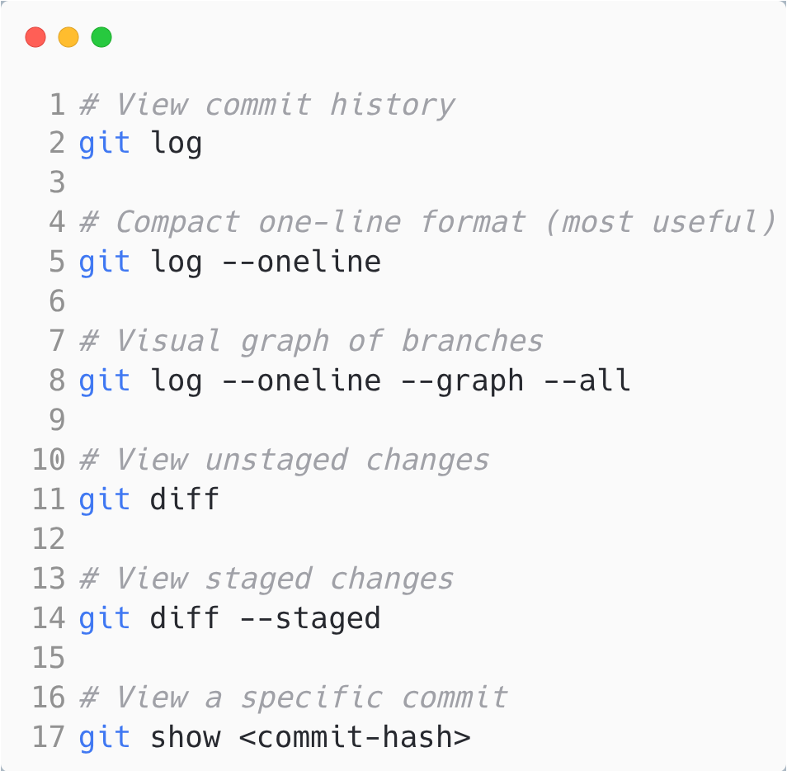
Viewing History
Tip: You only need the first 7 characters of a commit hash!
6

Slide 7
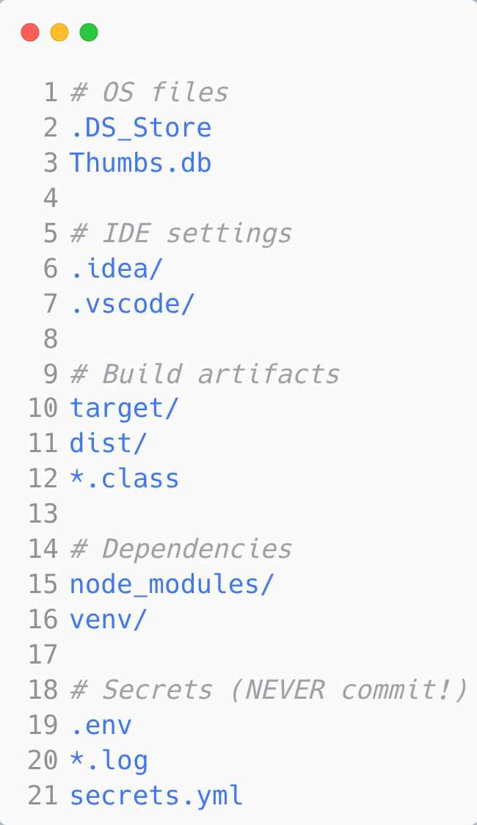
Using .gitignore
Prevent files from being tracked:
Never commit: Passwords, API keys, tokens, large files, build artifacts, or IDE settings!
7

Slide 8
Part B: Branching & Merging
8

Slide 9
WHAT IS A BRANCH?
A branch = A pointer to a specific commit + a way to work on multiple versions simultaneously
Why branches matter:
🔄 Work on features without affecting main code
🔧 Fix bugs while feature development continues
👥 Multiple developers working independently
🧪 Experiment safely
Branches are lightweight! Creating a branch is just creating a 41-byte pointer—not copying your entire codebase.
9

Slide 10
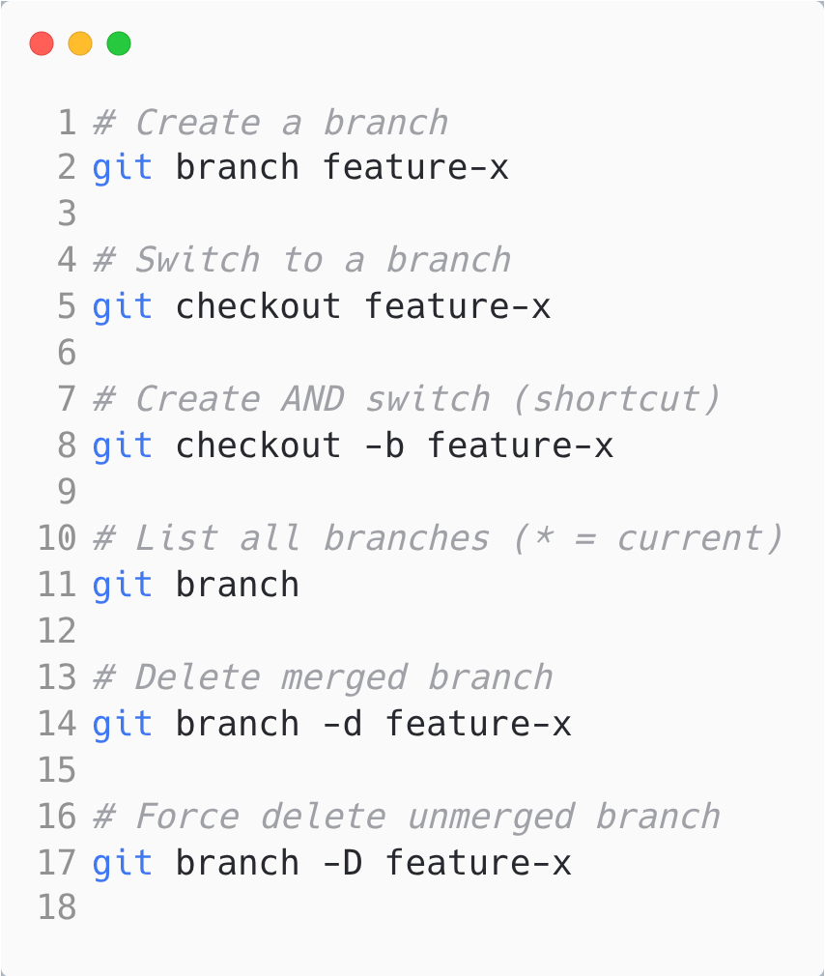
ESSENTIAL BRANCH COMMANDS
Best Practice: Use descriptive names like feat/user-auth or fix/login-error, in general <type>/<ticket# and/or desc>
10

Slide 11
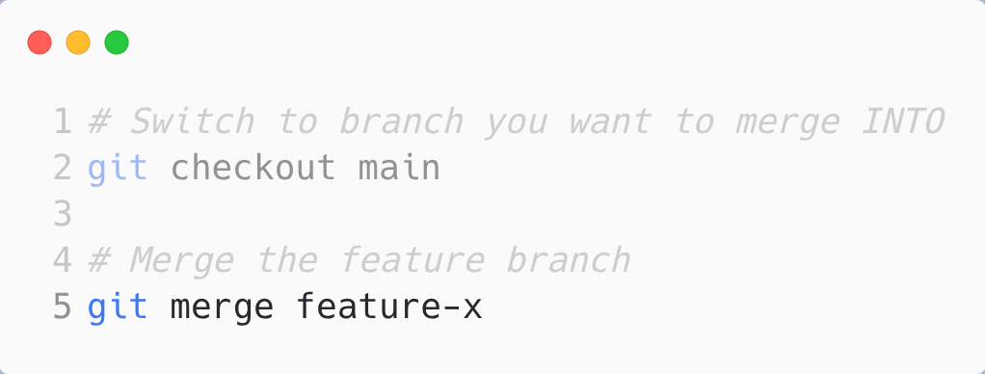
MERGING BRANCHES
Basic merge workflow:
Two types of merges:
• Fast-Forward: Main hasn't changed—just moves pointer forward
• Three-Way: Both branches have commits—creates merge commit
Merge Conflicts: When same lines/files edited in both branches. Git marks conflicts—you resolve manually, then git add and git commit.
11

Slide 12
Part C: Remote Repositories
12

Slide 13
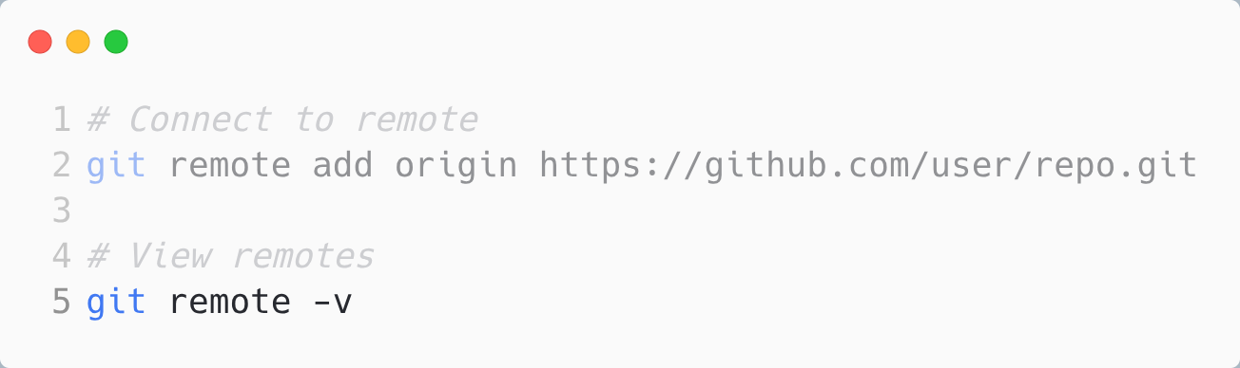
REMOTE REPOSITORY BASICS
Remote = Copy of your repository on a server (GitHub, GitLab, BitBucket, etc.)
Why use remotes:
💾 Backup: Code survives laptop failure
👥 Collaboration: Team members share code
🌐 Portfolio: Showcase your work
🚀 Deployment: Production servers pull from remote
13

Slide 14
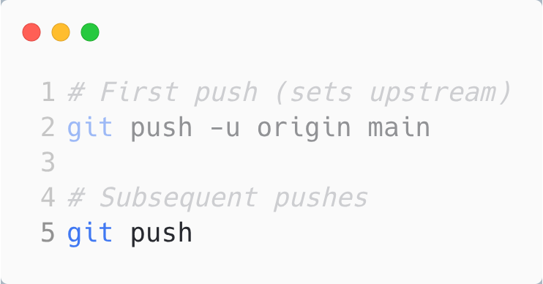
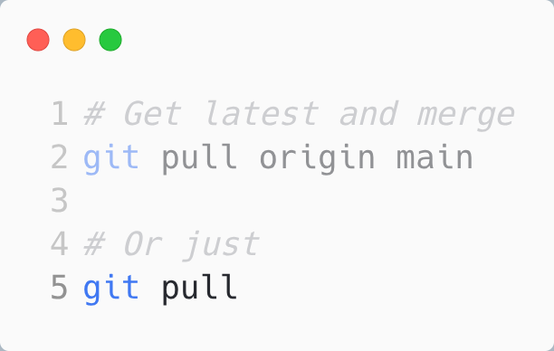
PUSH AND PULL
Push = Send local commits to remote
Pull = Fetch remote commits + merge
Best Practice: Always git pull before starting new work and before pushing!
14

Slide 15
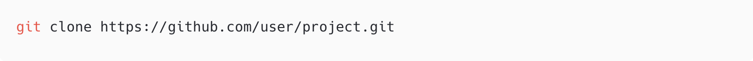
CLONE AND FORK
Clone = Copy entire repository
Fork (GitHub feature):
• Create your own copy on GitHub
• Make changes in your fork
• Create Pull Request to propose changes back
Pull Request workflow:
1. Push your branch to remote
2. Create PR on GitHub
3. Code review
4. Merge after approval
15

Slide 16
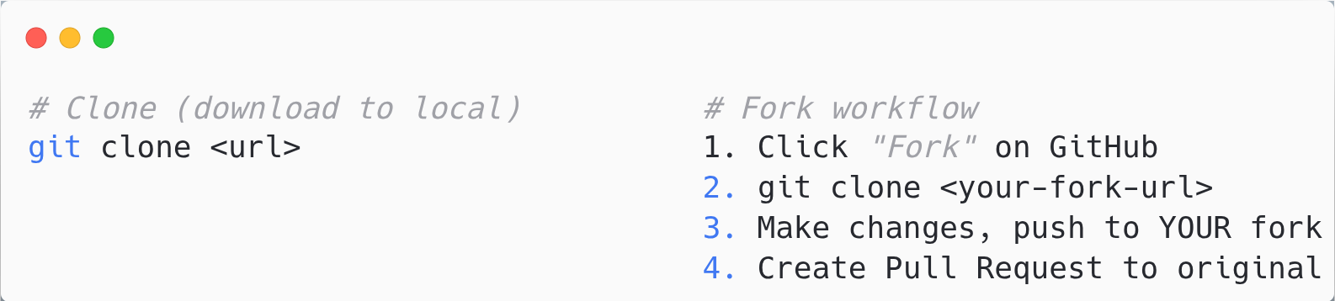
FORK VS CLONE
 | Clone | Fork
What is it? | Copy repo to your local machine | Copy repo to your GitHub account
Where? | Local (your computer) | Remote (GitHub server)
Push access? | Only if you have permissions | Yes — it's YOUR copy
Connected to original? | Yes — same remote origin | No — separate repo (can add upstream)
Use case | Work on repos you own/have access | Contribute to others' projects
Use CLONE when:
Use FORK when:
• It's your own repository
• You're a collaborator with push access
• You're just downloading to work locally
• Contributing to open-source projects
• You don't have push access
• You want your own independent copy

Slide 17
Part D: Advanced Git Commands

Slide 18
WHY LEARN ADVANCED COMMANDS?
Real-world scenarios require more than basics:
🔧 Need to undo commits but keep changes?
🍒 Want to copy ONE commit to another branch?
📏 Need cleaner, linear history?
💾 Want to save work temporarily?
🔄 Need to recover deleted work?
Advanced commands give you surgical precision over your Git history and workflow!

Slide 19
git stash

Slide 20
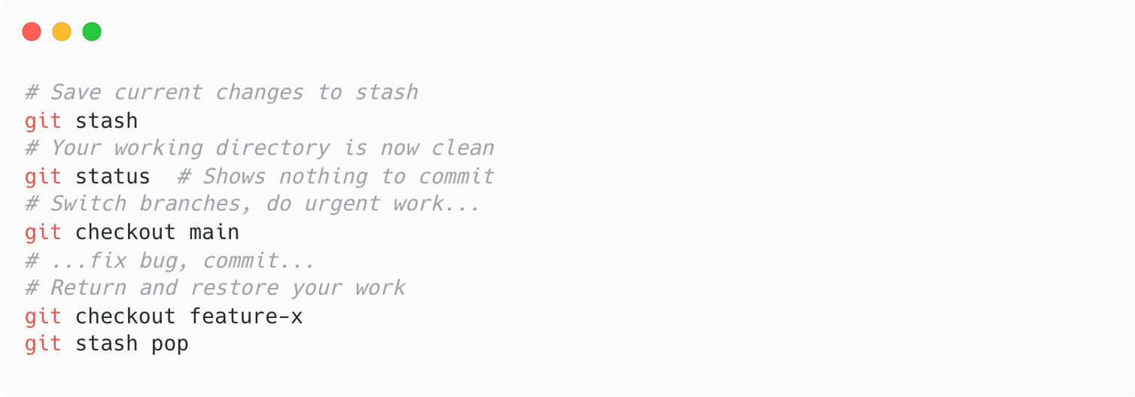
GIT STASH - SAVE WORK TEMPORARILY
The Problem:
You're working on a feature, but need to switch branches urgently. Your changes aren't ready to commit.
The Solution:
Stash = A hidden stack where you can temporarily store uncommitted changes

Slide 21
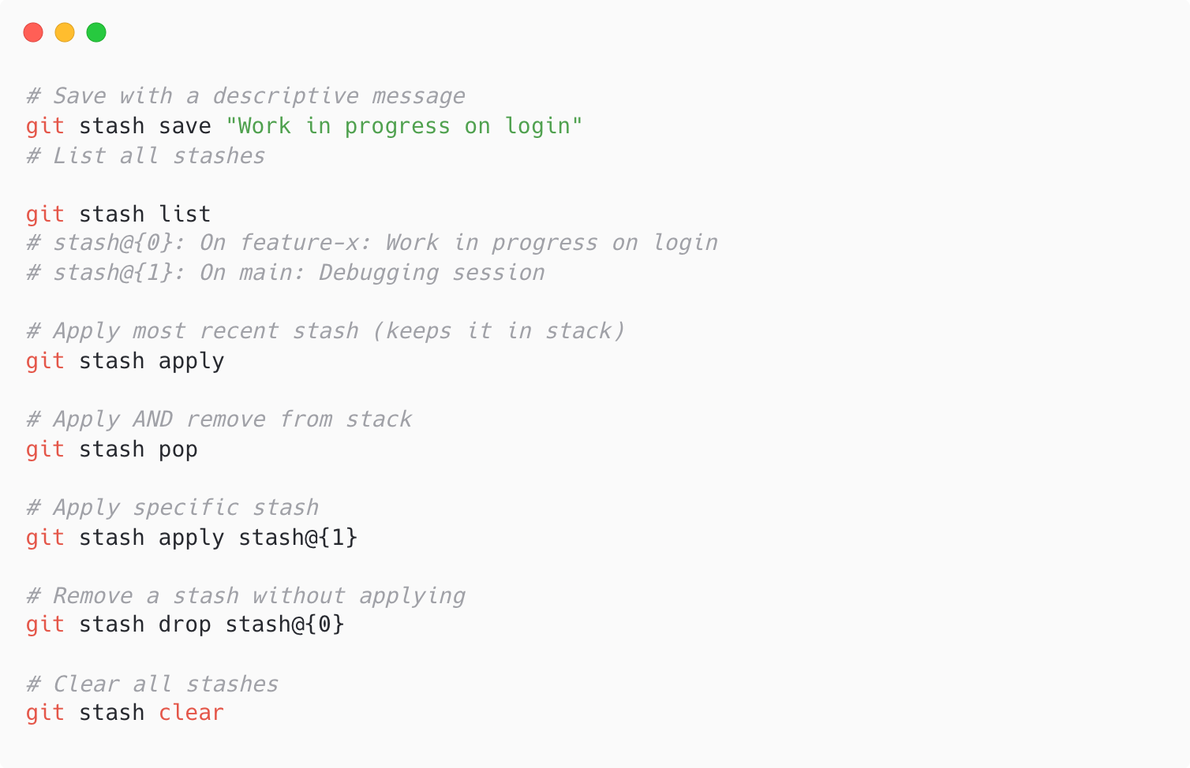
STASH COMMANDS

Slide 22
WHEN TO USE STASH
✅ Perfect for:
• Switching branches with uncommitted work
• Pulling updates when you have local changes
• Temporarily shelving experiments
• Quick context switches
❌ Not recommended for:
• Long-term storage (use branches instead)
• Sharing with others (stash is local only)
Tip: Use git stash save "message" to remember what each stash contains!

Slide 23
git reset

Slide 24
GIT RESET - UNDO COMMITS
Reset = Move HEAD (and optionally staging/working directory) to a different commit
Three modes:
Mode
HEAD
Staging
Working Dir
--soft
✓ Moves
✗ Unchanged
✗ Unchanged
--mixed
✓ Moves
✓ Reset
✗ Unchanged
--hard
✓ Moves
✓ Reset
✓ Reset
Warning: --hard is destructive! It permanently discards uncommitted changes.

Slide 25
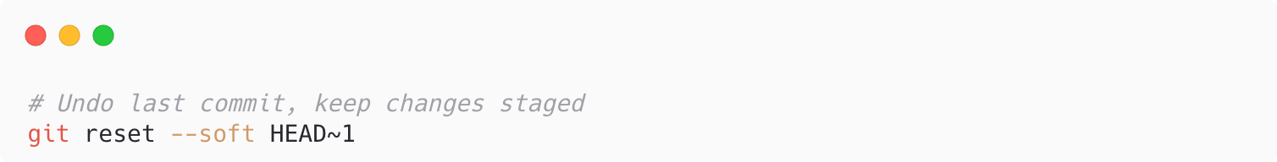
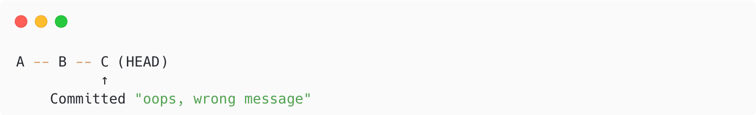
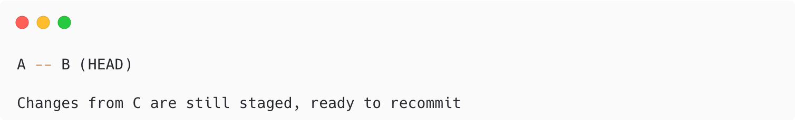
GIT RESET --SOFT
Use case: Undo commit but keep all changes staged
Before:
After:
Perfect for: Fixing commit messages, combining multiple commits into one

Slide 26
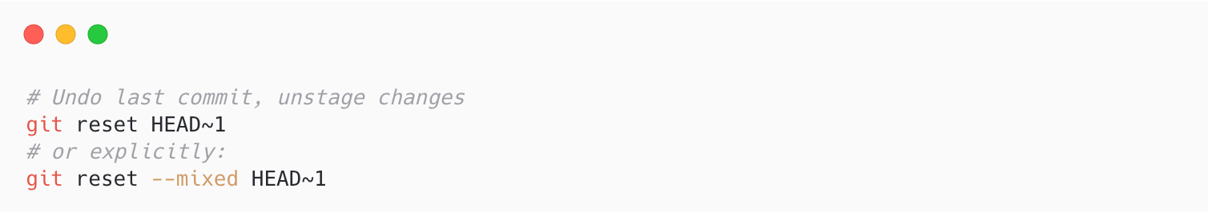
GIT RESET --MIXED (DEFAULT)
Use case: Undo commit AND unstage changes (keep in working directory)
Result:
• Commit is undone
• Changes are in working directory (modified files)
• Nothing is staged
• You can re-stage selectively
Perfect for: Breaking a commit into smaller commits, reviewing changes before re-committing

Slide 27
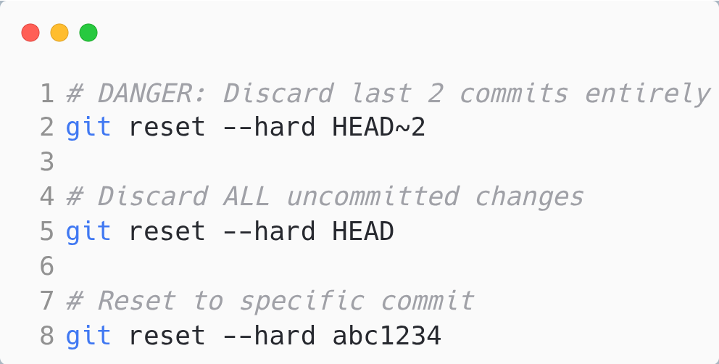
GIT RESET --HARD
Use case: Completely discard commits and all changes
⚠️ DANGEROUS: This permanently deletes uncommitted work!
Always double-check before using --hard
When to use:
• Abandoning a failed experiment
• Clearing messed up working directory
• Reverting to known good state

Slide 28
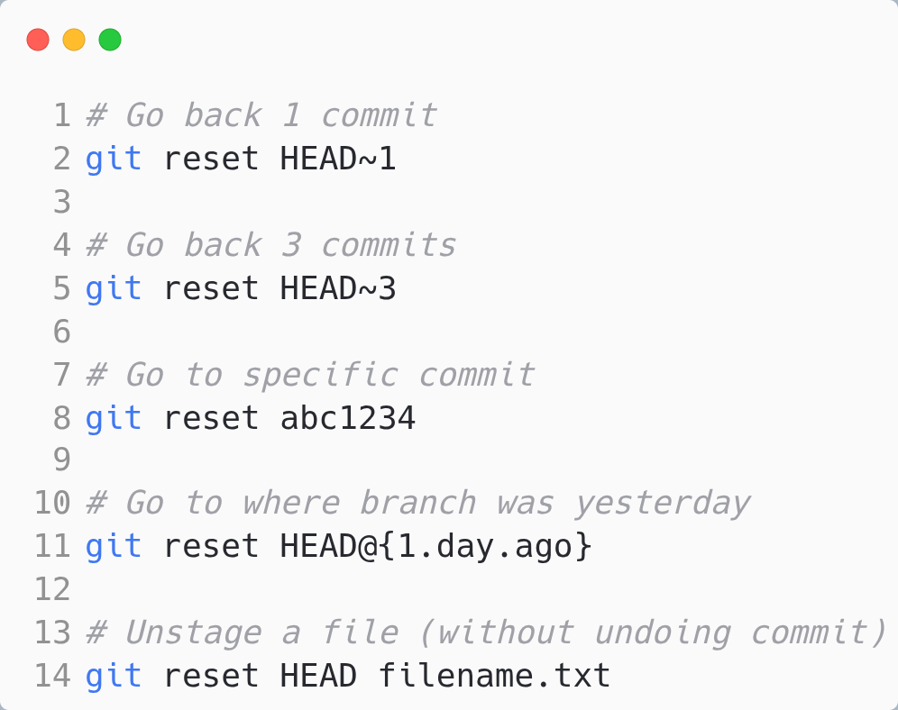
RESET REFERENCE SYNTAX
HEAD~n = n commits before HEAD
HEAD^ = parent of HEAD (same as HEAD~1)

Slide 29
git revert

Slide 30
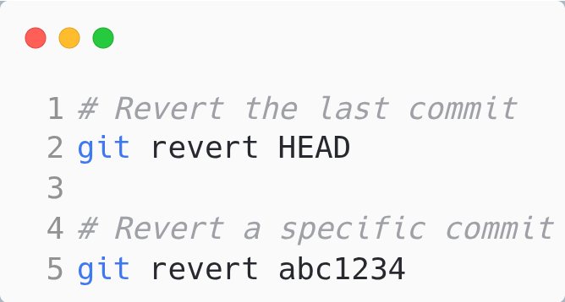
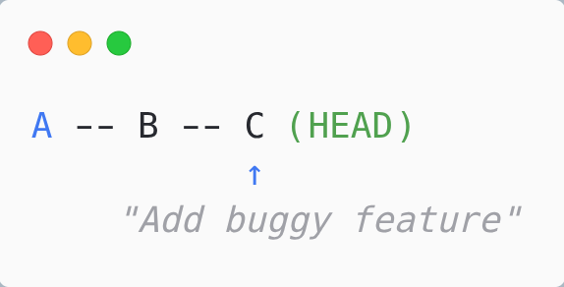
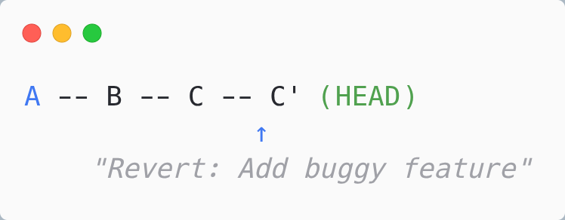
GIT REVERT - SAFE UNDO
Revert = Create a NEW commit to undo changes from a previous commit.
Before:
After revert:
Key point: History is preserved! The original commit still exists.

Slide 31
RESET VS REVERT - CRITICAL DIFFERENCE!
Aspect
git reset
git revert
History
Rewrites/erases
Preserves (adds new)
Safety
Destructive
Safe
Shared branches
❌ Never use
✅ Safe to use
Local branches
✅ OK to use
✅ OK to use
Golden Rule: Never reset commits that have been pushed! Use revert instead.

Slide 32
WHEN TO USE RESET VS REVERT
Use git reset when:
• Working locally (not pushed yet)
• You want to "erase" commits from history
• Cleaning up before pushing
Use git revert when:
• Commits are already pushed/shared
• You need to maintain history for audit
• Others might have pulled your commits
• Working on main/production branches
When in doubt, use revert! It's always safer.

Slide 33
git cherry-pick

Slide 34
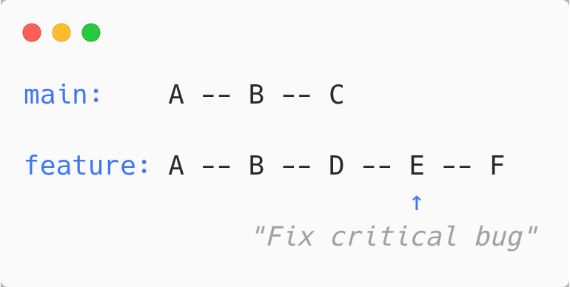
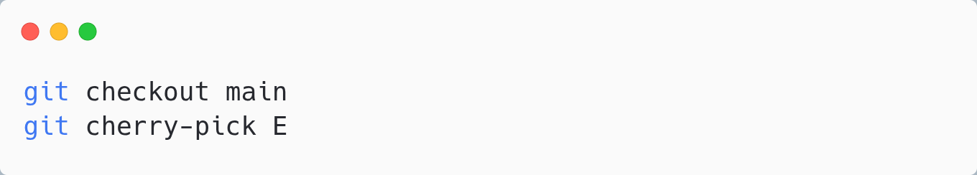
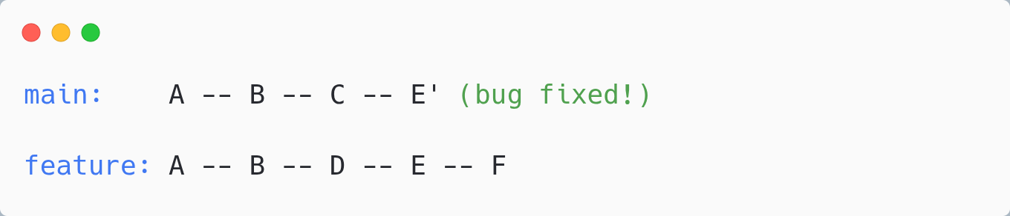
GIT CHERRY-PICK - COPY SPECIFIC COMMITS
Cherry-pick = Apply changes from specific commit(s) to current branch
Scenario:
You made a bugfix on feature branch, but main needs it NOW (before feature is ready)
Solution:

Slide 35
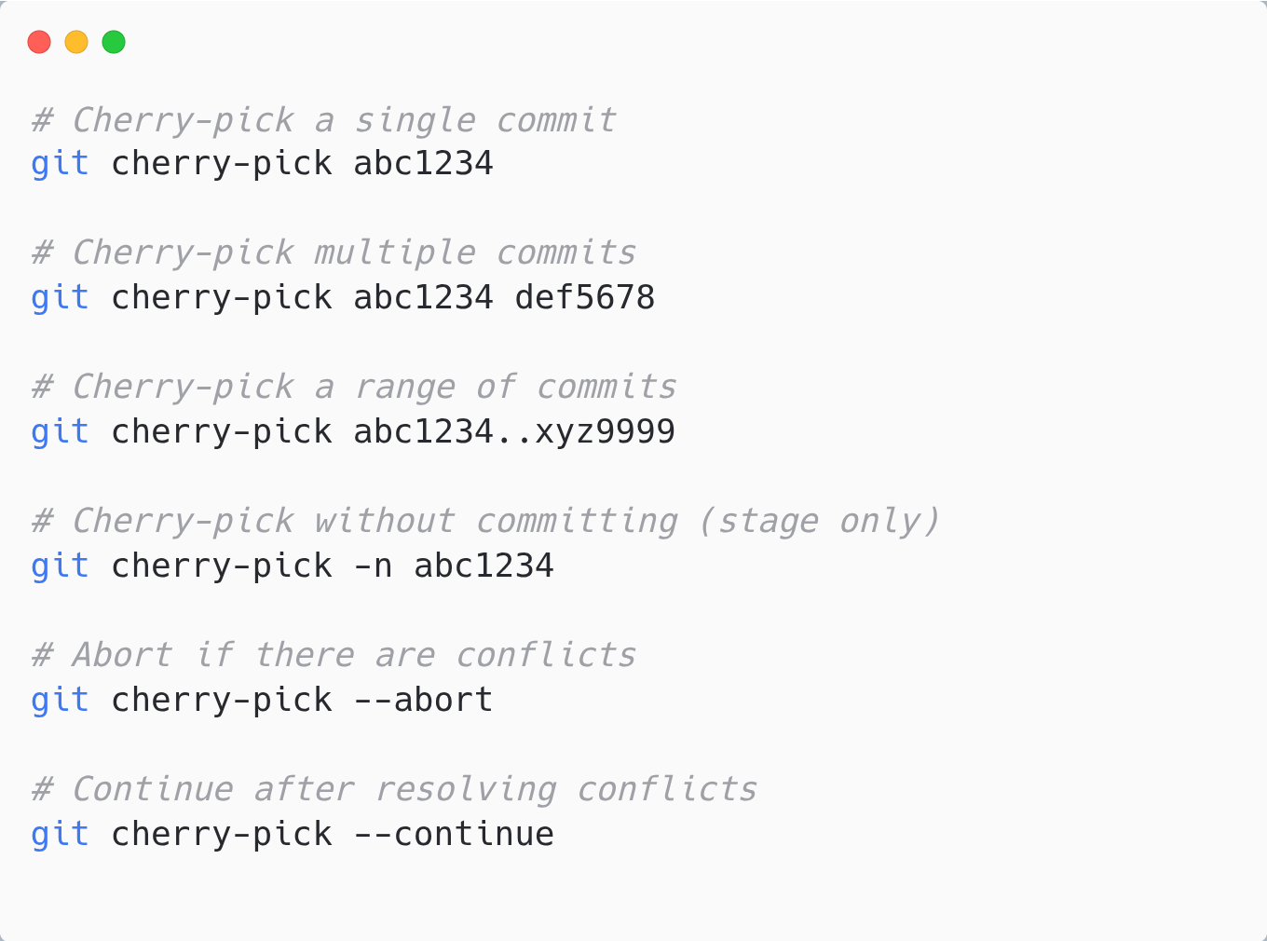
CHERRY-PICK COMMANDS

Slide 36
WHEN TO USE CHERRY-PICK
✅ Perfect for:
• Applying hotfixes to multiple branches
• Backporting features to older releases
• Recovering specific commits from abandoned branches
• Pulling specific changes without full merge
❌ Avoid when:
• You need ALL changes from a branch (use merge)
• The commit depends on previous commits
• You're cherry-picking frequently (consider better branching)
Note: Cherry-picked commits get NEW hashes! They're copies, not moves.

Slide 37
git rebase

Slide 38
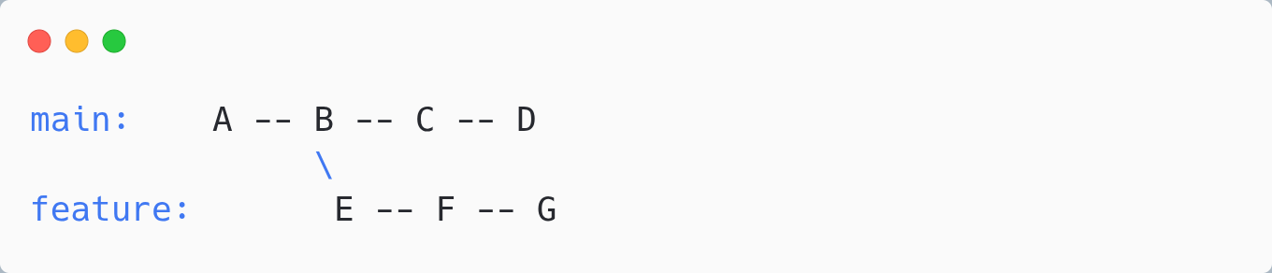
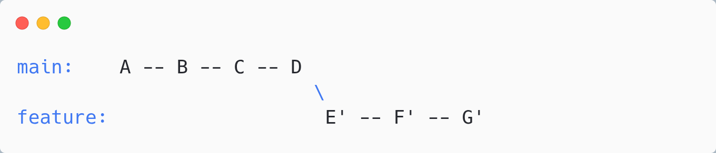
GIT REBASE - REWRITE HISTORY
Rebase = Move your branch's commits to start from a different point
Before rebase:
After git checkout feature && git rebase main:
Result: Feature branch now starts from latest main. Linear history!

Slide 39
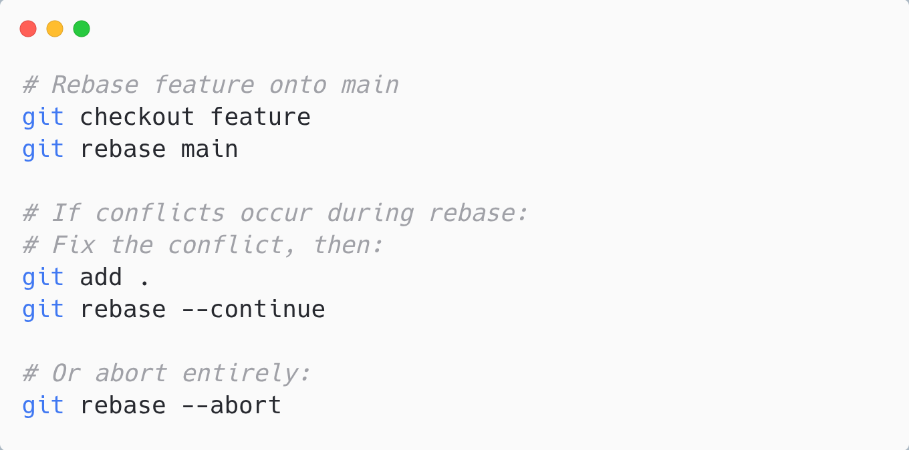
HOW REBASE WORKS
Step by step:
1. Git finds common ancestor of branches
2. Git "removes" your commits temporarily
3. Git fast-forwards to target branch
4. Git replays your commits one by one
5. Commits get NEW hashes (they're recreated)

Slide 40
MERGE VS REBASE - THE GREAT DEBATE
Aspect
git merge
git rebase
History
Preserves (shows merge)
Linear (rewrites)
Commits
Original hashes kept
New hashes created
Conflicts
Resolve once
May resolve multiple times
Shared branches
✅ Safe
❌ Dangerous

Slide 41
WHEN TO USE MERGE VS REBASE
Use merge when:
• Combining feature into main/production
• Working with shared branches
• You want to preserve the exact history
• You're uncertain which to use
Use rebase when:
• Updating YOUR feature branch with latest main
• Cleaning up local commits before pushing
• You want linear, clean history
• Working on YOUR branch only
Golden Rule: Never rebase commits that have been pushed to shared branches!

Slide 42
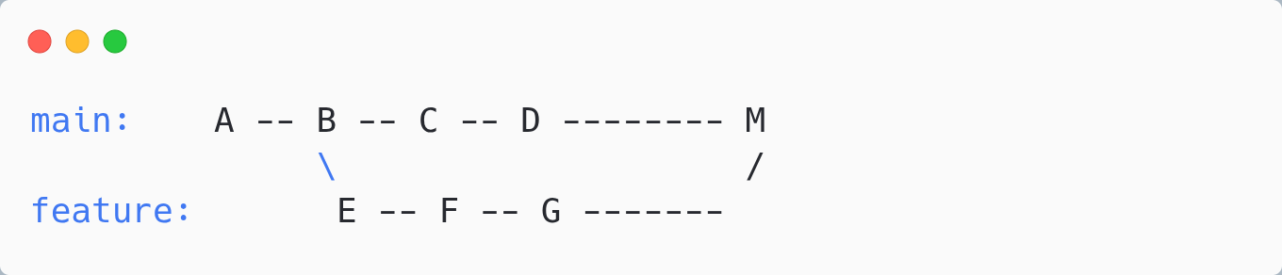
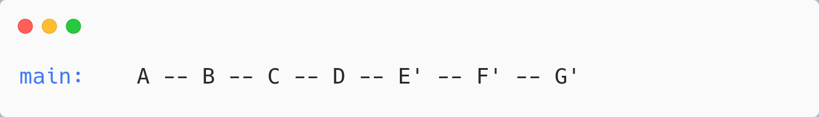
MERGE VS REBASE - VISUAL COMPARISON
With Merge:
Shows when feature was merged (preserves context)
With Rebase:
Clean, linear history (looks like sequential work)
Neither is "better" — they serve different purposes!

Slide 43
Interactive Rebase

Slide 44
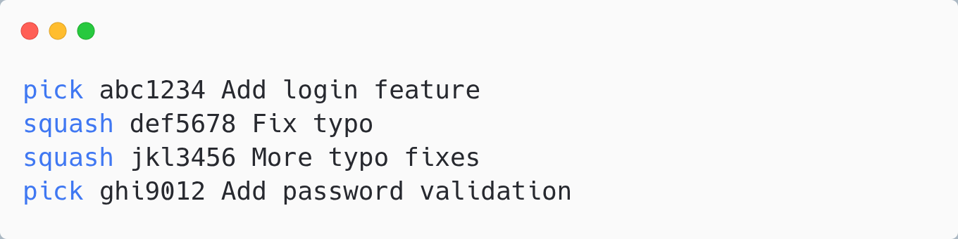
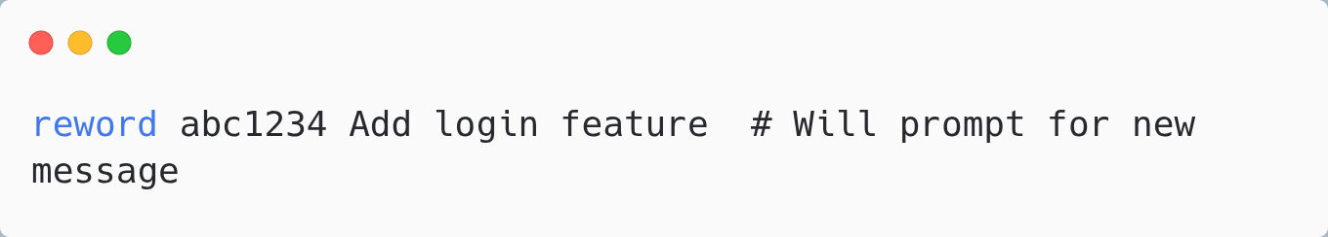
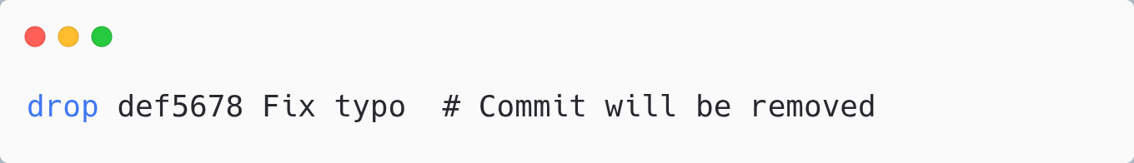
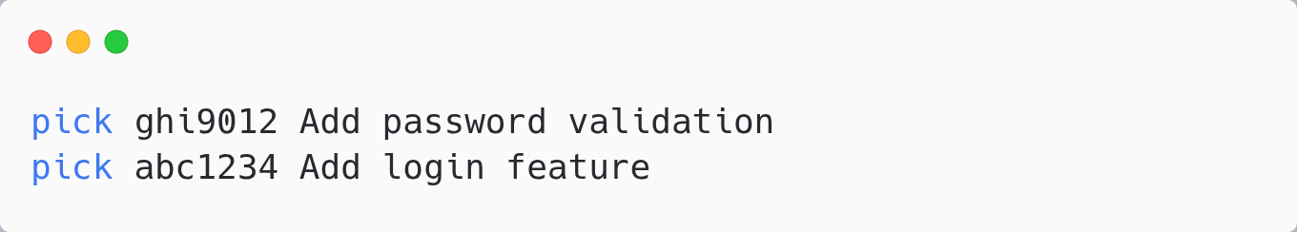
INTERACTIVE REBASE ACTIONS
Squash commits (combine multiple into one):
Reword (change commit message):
Result: 3 commits become 1 + password validation = 2 commits
Drop (remove a commit):
Reorder (just change the order):

Slide 45
WHEN TO USE INTERACTIVE REBASE
✅ Perfect for:
• Squashing: Combine "WIP", "fix typo", "oops" commits
• Cleaning up: Before creating a Pull Request
• Reordering: Group related changes together
• Editing: Split one commit into multiple
• Fixing: Change old commit messages
Pro tip: Clean up your commits with interactive rebase BEFORE pushing to make history easier to review!

Slide 46
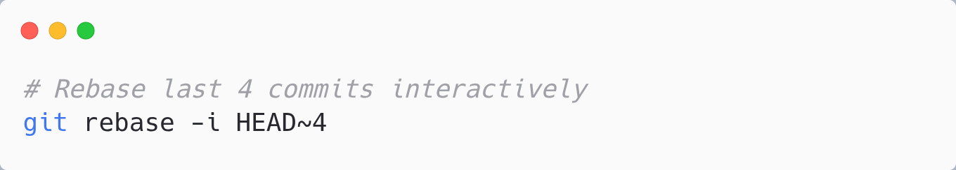
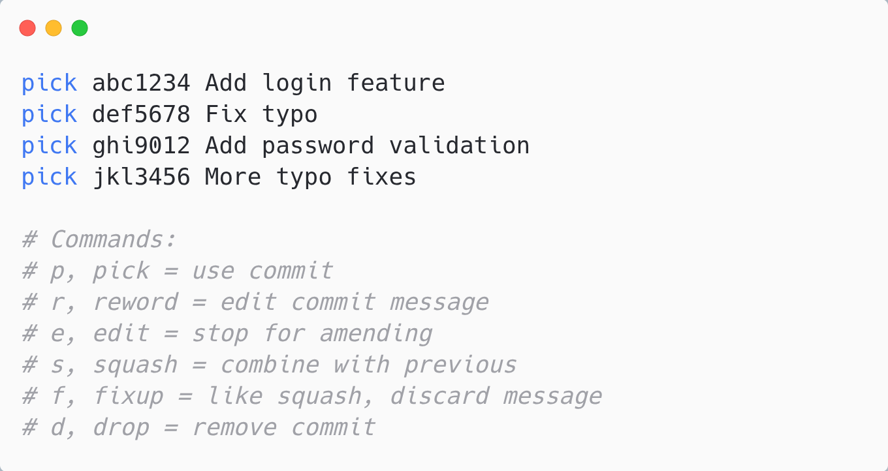
GIT REBASE -I (INTERACTIVE)
Interactive rebase = Edit, reorder, squash, or drop commits
Opens editor with:

Slide 47
git squash

Slide 48
WHAT IS GIT SQUASH?
Squash = Combine multiple commits into a single, cleaner commit
Before Squash:
WIP
→
Fix typo
→
Oops
→
Done!
→
Actually done
⬇ squash
After Squash:
✓ Implement user authentication
Result: Clean, professional commit history that tells a clear story!

Slide 49
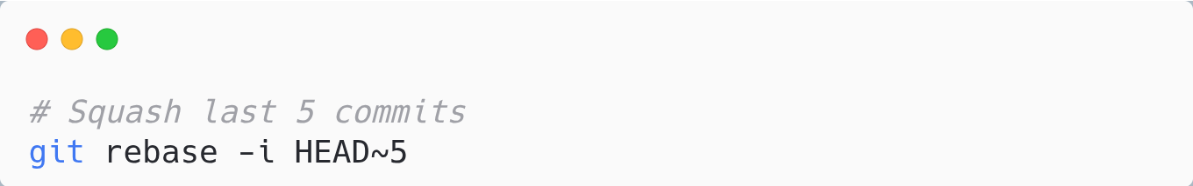
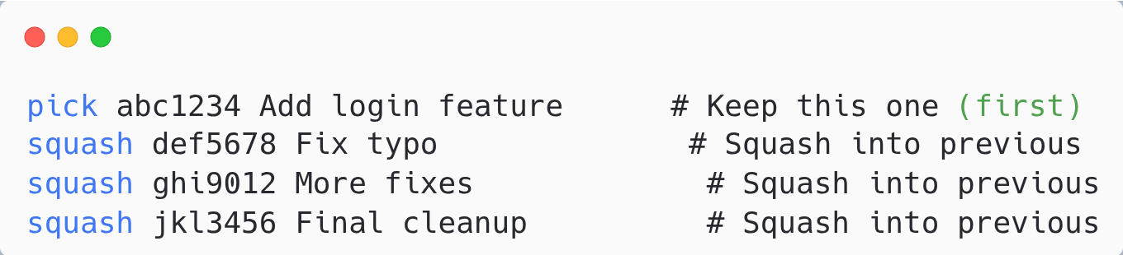
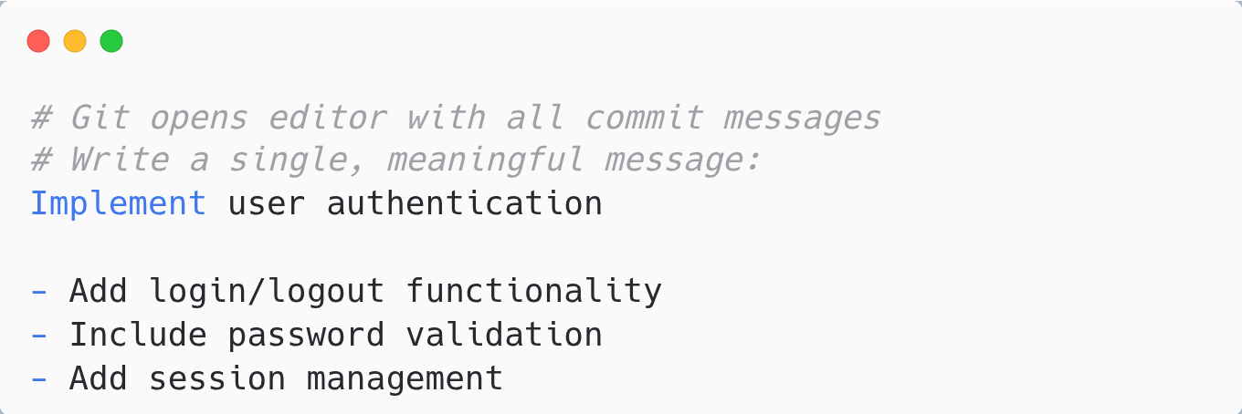
HOW TO SQUASH COMMITS
Step 1: Start interactive rebase
Step 2: Mark commits to squash
Step 3: Edit the combined commit message

Slide 50
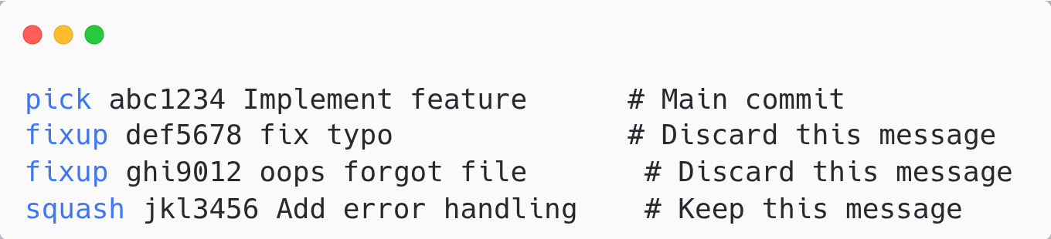
SQUASH VS FIXUP
Two ways to combine commits — choose based on what you want to keep:
Command | Keeps Message? | Use When
squash (s) | ✓ Yes - combines all messages | You want to edit/combine messages
fixup (f) | ✗ No - discards message | Quick fixes, typos (message not needed)
Example:
Pro tip: Use fixup for quick fixes, squash when the commit message adds context!

Slide 51
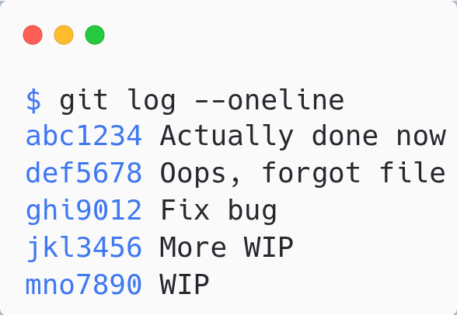
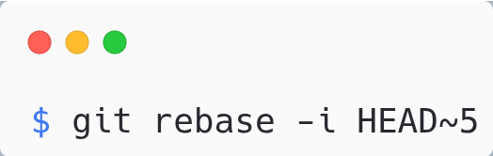
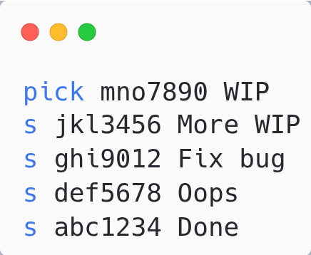
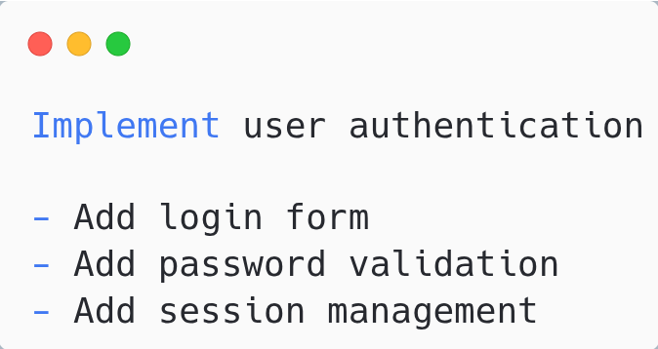
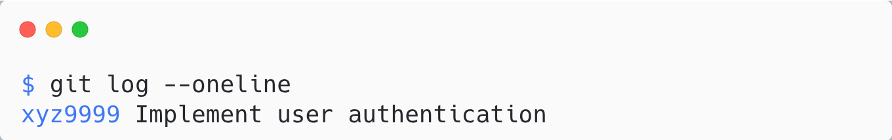
SQUASH EXAMPLE - COMPLETE WORKFLOW
1. Your messy commit history:
2. Run interactive rebase:
3. Change pick to squash:
4. Write new commit message & save:
5. Result - Clean history!
5 messy commits → 1 clean, professional commit!

Slide 52
WHEN TO USE SQUASH
✓ PERFECT FOR:
✗ AVOID WHEN:
Before creating a Pull Request
Combining "WIP" and "fix typo" commits
Cleaning up feature branch history
After code review changes
Organizing commits by logical changes
Commits already pushed to shared branch
Others have based work on your commits
On main/master branch
You need to preserve detailed history
Golden Rule: Only squash commits that have NOT been pushed to a shared branch!
BEST PRACTICE WORKFLOW:
Develop with many commits
→
Squash before PR
→
Push clean history

Slide 53
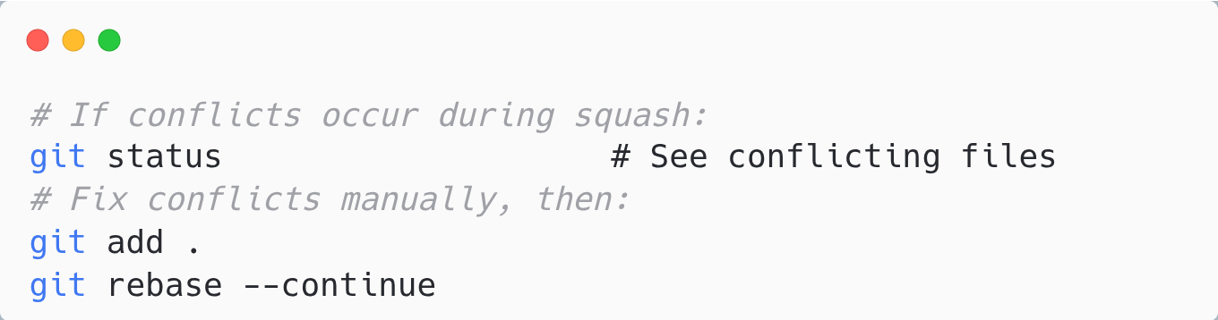
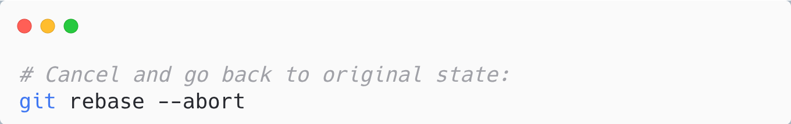
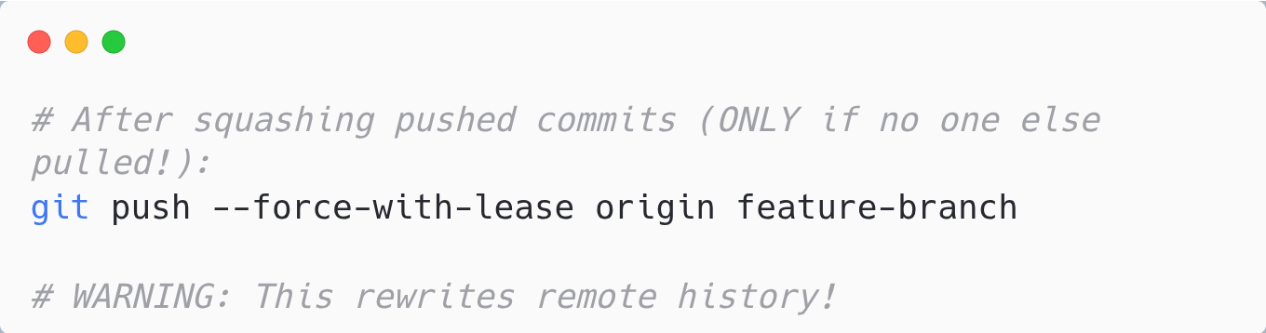
TROUBLESHOOTING SQUASH
Problem 1: Squash conflicts
Problem 2: Want to abort squash
Problem 3: Already pushed commits
Always use --force-with-lease instead of --force. It prevents overwriting others' work!

Slide 54
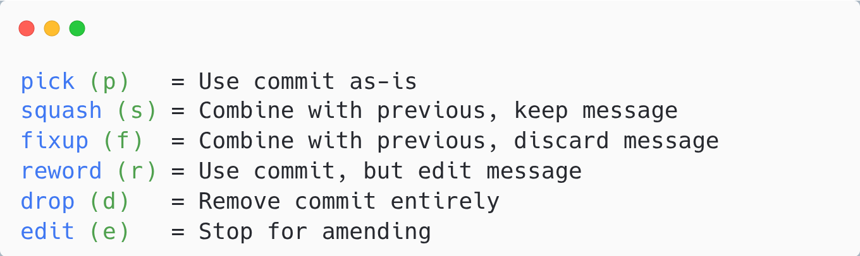
GIT SQUASH - QUICK REFERENCE
Action | Command
Squash last N commits | git rebase -i HEAD~N
Squash down to specific commit | git rebase -i <commit-hash>
Abort rebase | git rebase --abort
Continue after fixing conflicts | git rebase --continue
Force push after squash | git push --force-with-lease
INTERACTIVE REBASE KEYWORDS:

Slide 55
git reflog

Slide 56
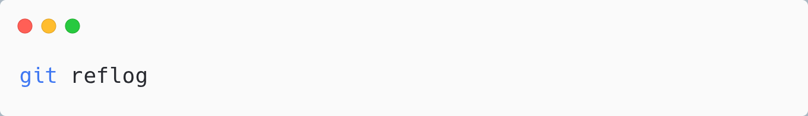
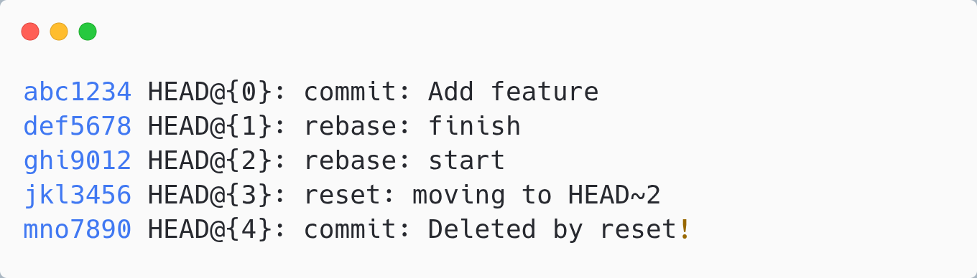
GIT REFLOG - YOUR SAFETY NET
Reflog = Log of everywhere HEAD has pointed
(local only)
Output:
Amazing fact: Reflog tracks everything—even commits "deleted" by reset! It's your time machine.

Slide 57


RECOVERING "LOST" COMMITS WITH REFLOG
Disaster scenario:
Recovery:
Note: Reflog entries expire (default 90 days). Don't wait too long to recover!

Slide 58



REFLOG RECOVERY SCENARIOS
Scenario 1: Recover from bad reset
Scenario 2: Recover from bad rebase
Scenario 3: Find deleted branch's commits
Remember: git reflog is your "undo" for almost any Git operation!

Slide 59
Command Comparison Summary

Slide 60
UNDO COMMANDS COMPARISON
Command
What It Does
Modifies History?
reset --soft
Undo commit, keep staged
Yes
reset --mixed
Undo commit, unstage
Yes
reset --hard
Undo commit, discard all
Yes ⚠️
revert
Create undo commit
No ✅

Slide 61
INTEGRATION COMMANDS COMPARISON
Command
Use Case
History Impact
merge
Combine branches
Creates merge commit
rebase
Move branch base
Rewrites history
cherry-pick
Copy specific commits
Creates new commits
rebase -i
Edit commit history
Rewrites history
Rule of thumb: Anything that "rewrites history" should only be used on unpushed commits!

Slide 62
WHICH COMMAND SHOULD I USE?
Need to undo commits?
• Pushed? → git revert
• Not pushed, keep changes? → git reset --soft
• Not pushed, discard changes? → git reset --hard
Need to integrate branches?
• Combining feature into main? → git merge
• Updating YOUR branch with main? → git rebase
• Need just ONE commit? → git cherry-pick
Need to clean up commits?
• Before pushing? → git rebase -i
Made a mistake?
• Check git reflog for recovery options

Slide 63
Summary & Best Practices

Slide 64

ADVANCED COMMANDS SUMMARY

Slide 65
GOLDEN RULES FOR ADVANCED GIT
🔑 Safety Rules:
• Never rebase or reset pushed commits
• Always use revert for shared branches
• Always check reflog before panicking
✨ Best Practices:
• Clean up commits with rebase -i BEFORE pushing
• Use descriptive stash messages
• Prefer merge for integrating features into main
• Prefer rebase for updating YOUR feature branch
Master these commands and you'll handle ANY Git situation!

Slide 66

COMPLETE COMMANDS REFERENCE

Slide 67

REMOVING ALREADY TRACKED FILES
The Problem:
You committed .env file early in the project. Now you add it to .gitignore... but Git keeps tracking it!
⚠ Why? .gitignore only prevents untracked files from being added. Files already tracked are NOT affected.
The Solution:
Use git rm --cached to remove the file from Git's index (staging area) while keeping it on disk.
What happens:
BEFORE:
.env is tracked by Git
(changes show in git status)
↓ git rm --cached
AFTER:
.env still exists locally
but Git ignores it ✓
⚠ Warning: The file remains in Git history! To fully remove secrets, you need git filter-branch or BFG Repo-Cleaner.

Slide 68
Extra: Pull Requests

Slide 69
WHAT IS A PULL REQUEST?
Pull Request (PR) = A request to merge your changes into another branch
Also called "Merge Request" (MR) in GitLab
The PR Workflow:
Create
Branch
→
Make
Changes
→
Push to
Remote
→
Open
PR
→
Code
Review
→
Merge
Why Pull Requests Matter:
✓ Code Review — Catch bugs before they reach main
✓ Discussion — Collaborate and improve code quality
✓ Documentation — Track why changes were made
✓ CI/CD Integration — Run tests automatically before merge

Slide 70



CREATING A PULL REQUEST
Step 1: Create and switch to a new branch
Step 2: Make changes and commit
Step 3: Push branch to remote
Step 4: Open Pull Request on GitHub
• Go to your repository on GitHub
• Click "Compare & pull request" button (appears after push)
• Or: Click "Pull requests" tab → "New pull request"
• Select base branch (main) and compare branch (your feature)
• Fill in title and description → Click "Create pull request"

Slide 71

PR TITLE & DESCRIPTION
❌ Bad PR:
✓ Good PR:
Title: "Fixed stuff"
Description: (empty)
Title: "Add JWT authentication"
Description: Implements user
authentication using JWT tokens...
PR Description Template:

Slide 72
CODE REVIEW BEST PRACTICES
FOR PR AUTHORS:
FOR REVIEWERS:
Keep PRs small (< 400 lines ideal)
Self-review before requesting
Write clear commit messages
Respond to feedback promptly
Don't take criticism personally
Squash commits before merge
Be constructive, not critical
Explain WHY, not just what
Suggest improvements with examples
Approve when "good enough"
Review within 24 hours
Review Comment Examples:
❌ "This is wrong."
✓ "Consider using StringBuilder here
for better performance in loops."
Goal: Improve code quality while maintaining team morale. Be kind!

Slide 73
BRANCH PROTECTION RULES
Branch Protection = Rules that prevent direct pushes and enforce code review
❌ WITHOUT Protection:
✓ WITH Protection:
• Anyone can push directly to main
• No code review required
• Bugs go straight to production
• No audit trail
• Accidents happen easily
• All changes go through PRs
• Required code reviews
• CI tests must pass
• Complete audit trail
• Mistakes caught early
Protected Branch Workflow:
Developer
Pushes
→
Create
PR
→
CI Tests
Run
→
Code
Review
→
Approved
& Merged
Branch protection ensures code quality and prevents accidents on critical branches.

Slide 74
SETTING UP BRANCH PROTECTION
GitHub Settings Path:
Repository → Settings → Branches → Add branch protection rule
Step-by-Step:
1
Go to your repository on GitHub
2
Click "Settings" tab (need admin access)
3
Click "Branches" in left sidebar
4
Under "Branch protection rules", click "Add rule"
5
Enter branch name pattern: main (or master)
6
Configure protection options (see next slide)
7
Click "Create" to save the rule
Tip: Use "main" or "master" to protect the default branch. Use "*" patterns for multiple branches.

Slide 75
PROTECTION OPTIONS EXPLAINED
Option | What It Does | Recommended
Require pull request before merging | No direct pushes allowed | ✓ Yes
Require approvals | Set minimum reviewers (1-6) | ✓ Yes (1-2)
Dismiss stale reviews | New commits invalidate old approvals | ✓ Yes
Require status checks | CI tests must pass before merge | ✓ Yes
Require branches up to date | Must merge/rebase main first | ✓ Yes
Require signed commits | GPG signature verification | Optional
Include administrators | Rules apply to admins too | ✓ Yes
Start with basic protection (require PR + 1 approval + CI checks), then add more as needed.

Slide 76
RECOMMENDED CONFIGURATION
Small Teams (2-5 developers):
Large Teams (10+ developers):
☑ Require pull request
☑ Require 1 approval
☑ Dismiss stale reviews
☑ Require status checks
☐ Require linear history
☑ Include administrators
☑ Require pull request
☑ Require 2 approvals
☑ Dismiss stale reviews
☑ Require status checks
☑ Require branch up to date
☑ Require code owners review
☑ Include administrators

Slide 77

PR MERGE STRATEGIES
GitHub offers three merge options (configurable in Settings → General):
Strategy | Result | Best For
Create merge commit | Preserves all commits + adds merge commit | Full history tracking
Squash and merge | Combines all PR commits into one | Clean history (recommended)
Rebase and merge | Replays commits on top of base | Linear history, no merge commits
Visual Comparison:
Recommendation: Use "Squash and merge" for clean main branch history with meaningful commits.

Slide 78
PR BEST PRACTICES SUMMARY
CREATING PRs:
REVIEWING PRs:
Keep PRs small and focused
Write descriptive titles
Use PR templates
Link related issues
Self-review before requesting
Add screenshots for UI changes
Review within 24 hours
Be constructive and kind
Test the changes locally
Check for edge cases
Approve when good enough
Use suggestions feature
REPOSITORY SETTINGS:
☑ Enable branch protection on main/master
☑ Require PR reviews (1-2 approvals)
☑ Require status checks (CI/CD must pass)
☑ Dismiss stale reviews on new commits
☑ Use "Squash and merge" as default
☑ Set up CODEOWNERS for automatic review requests
PRs are not bureaucracy — they're a tool for collaboration, learning, and catching bugs early!

Slide 79

PULL REQUESTS - QUICK REFERENCE
GIT COMMANDS:
GITHUB SETTINGS:
Branch Protection:
Settings → Branches
→ Add rule
Merge Options:
Settings → General
→ Pull Requests
PR CHECKLIST:
□ Descriptive title □ Linked issue □ Tests pass □ Self-reviewed □ Updated docs □ Ready for review

Slide 80
ADDITIONAL RESOURCES
Interactive Learning:
🎮 Learn Git Branching: learngitbranching.js.org
🔀 Git Immersion: gitimmersion.com
Documentation:
📖 Git Book: git-scm.com/book
📚 GitHub Docs: docs.github.com
Cheat Sheets:
GitHub Git Cheat Sheet
Atlassian Git Tutorials
Best Practices:
Conventional Commits
Conventional Commit Messages Semantic Versioning
Practice makes perfect! Create a test repository and experiment with these commands.

Slide 81
Thank You!
Questions?

