Slide 1

Final Milestone : Completed app with all intended features and designs.
Team members:
Badr Elsayed - 22010664
Adham Anas- 22010601
Mohamed Mostafa Sayed - 22011170
Nour Khaled Mohamed - 22011319
Ali El-Deen Maher - 22010934
Yousef Awad – 22011390

Slide 2
GOAL OF THE MILESTONE
Completed app with all intended features and designs (Calendar, Study Techniques and Task Progress Tabs).

Slide 3
List of accomplished tasks:
Created the Calendar, Study Techniques and Task Progress Tabs
Created the Calendar Tab: tasks appear in the calendar with the same color as their priority. Events appear as “cyan” color. Clicking on a day, opens a dialog window that lists all tasks and events on that day.
Created the Study Techniques Tab: A dropdown box to choose a Study Technique. A “Start” Button to start the session, a “Reset” button to reset the session and a “Pause” button to pause the timer.
Created the Task Progress Tab: Weekly graph, shows progress of tasks over the week (Completed Tasks) Monthly graph, shows progress of tasks over the month (Completed Tasks)
More in depth in the upcoming screenshots of the app.

Slide 4
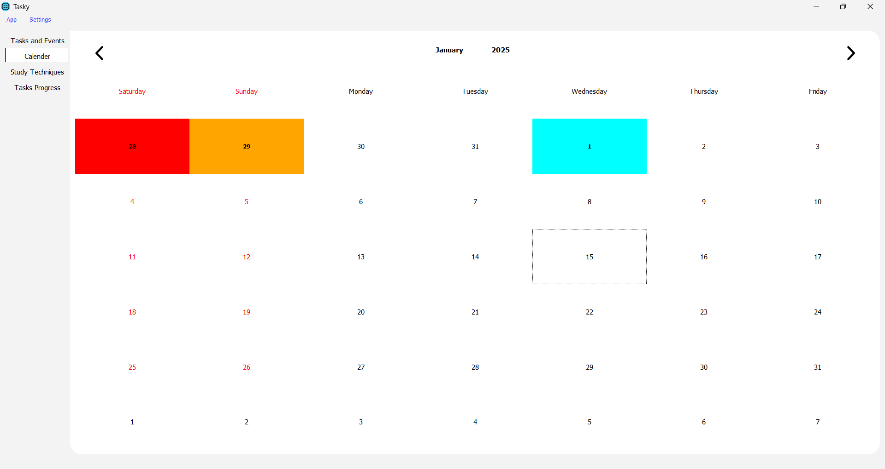
Overview of the Calendar Tab :

Slide 5
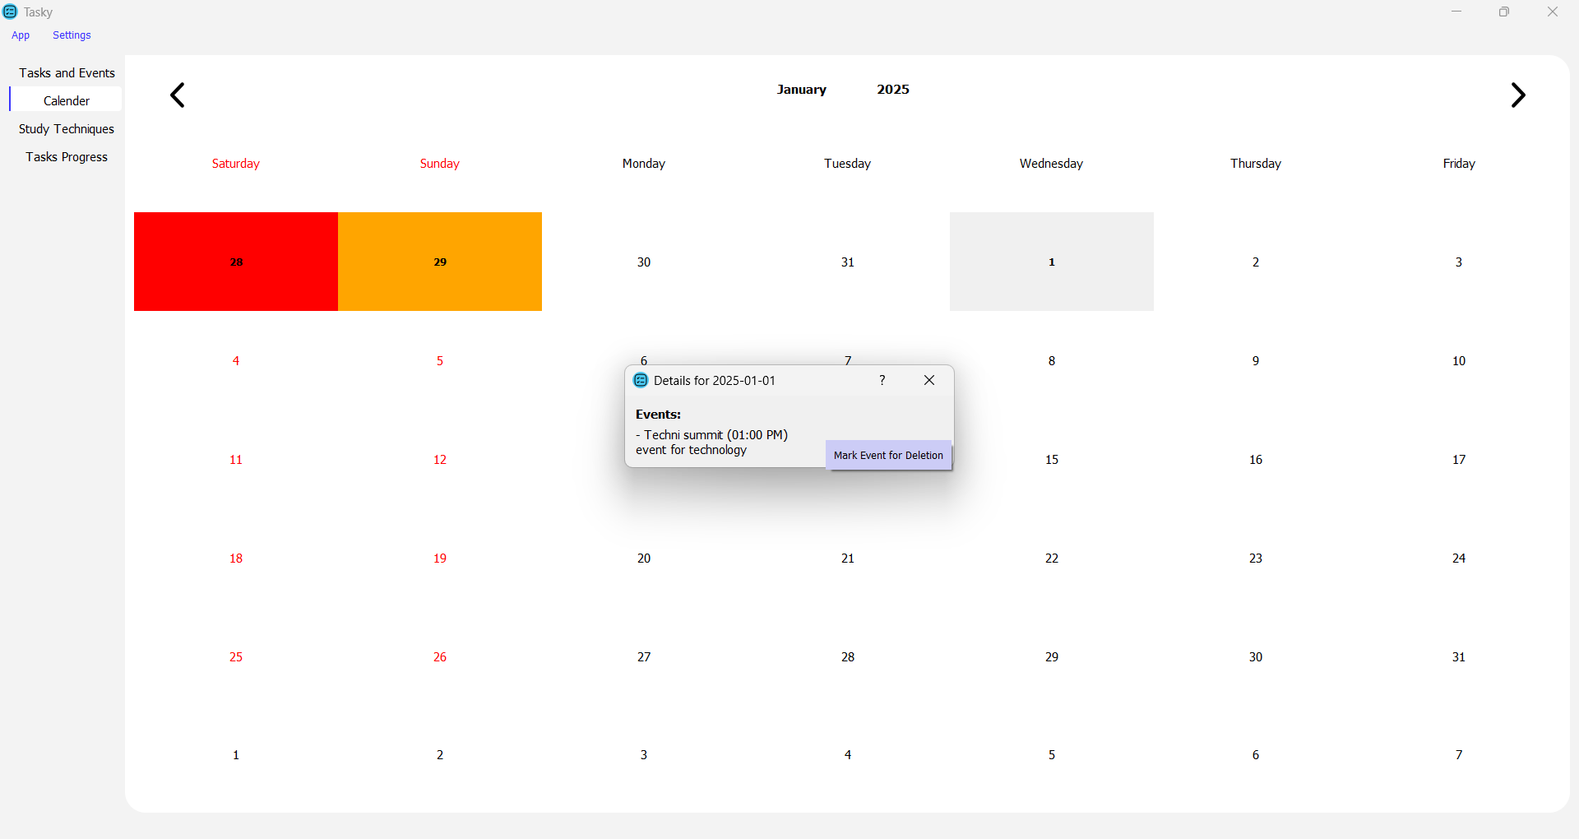
Clicking on day 1 reveal a list of Events on that day, we can “right click” to delete it.

Slide 6
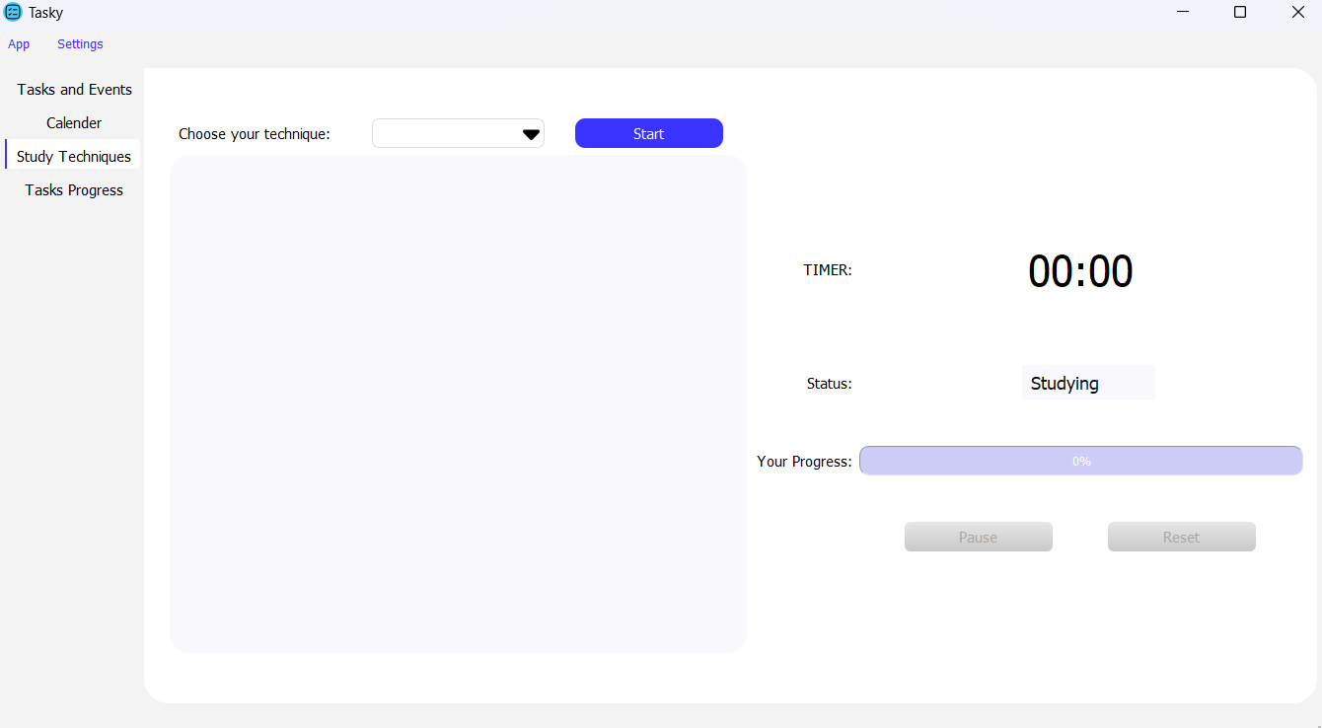
Overview of the Study Techniques Tab :

Slide 7
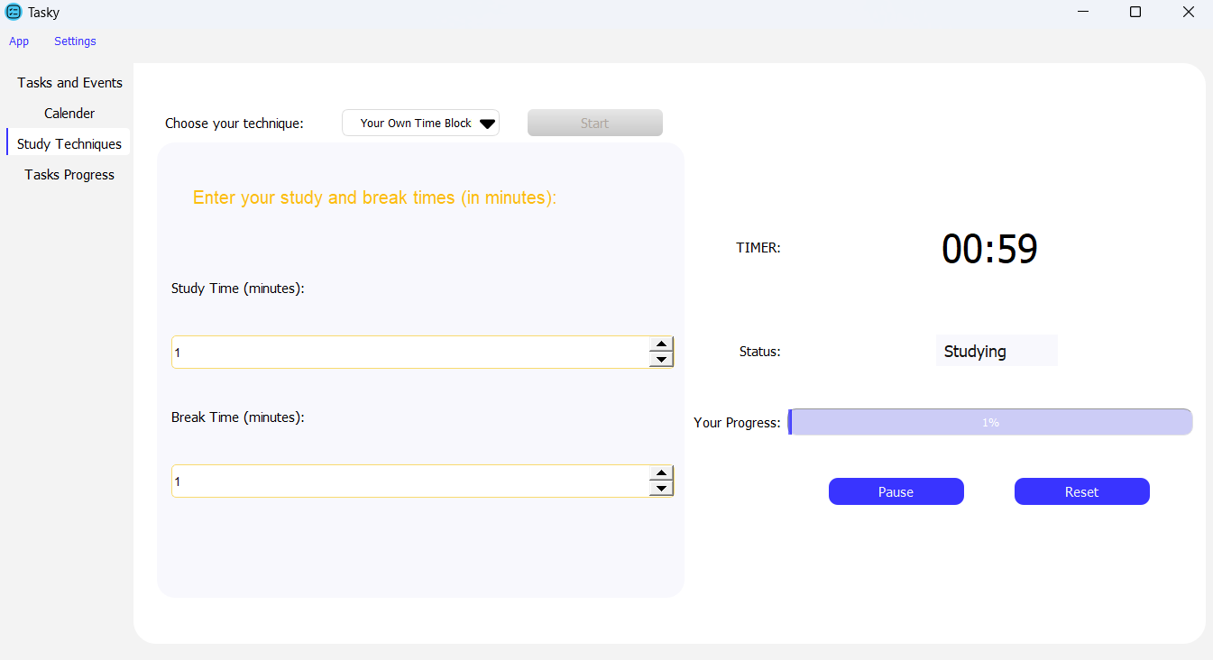
Here we chose the “Your Own Time Block” option and clicked start.

Slide 8
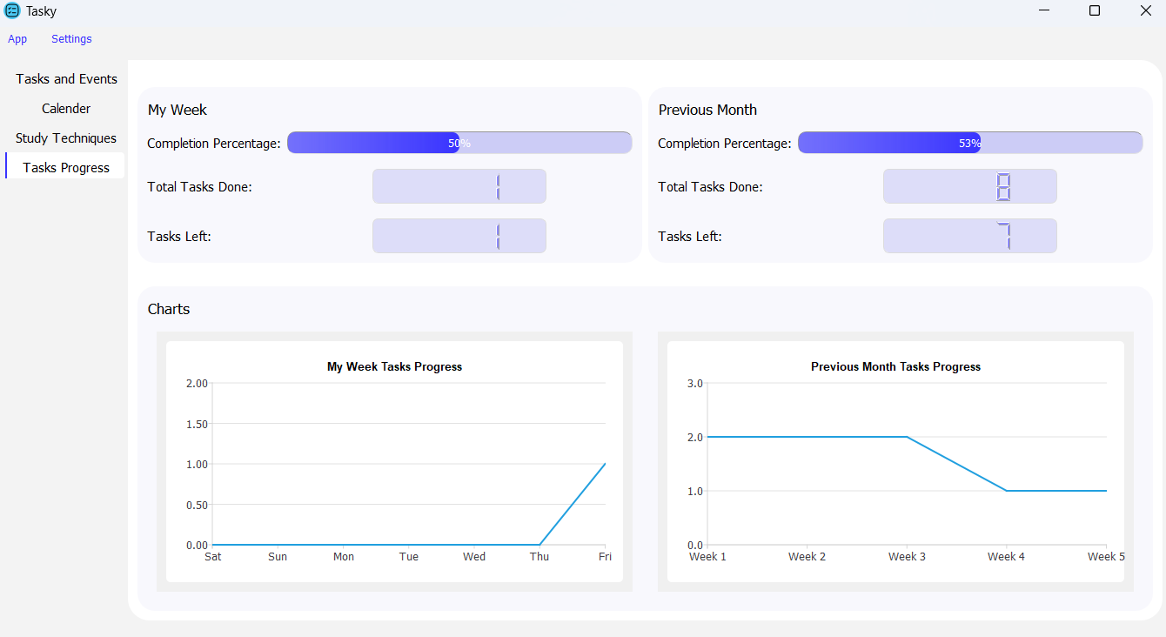
Overview of the Tasks Progress Tab :

Slide 9
External links to code:
Currently our Github repo is private, so I’m providing a mediafire link of the compiled/built app.
Link:
https://www.mediafire.com/file/gpu3w84916gn4dr/Tasky.rar/file

