Slide 1

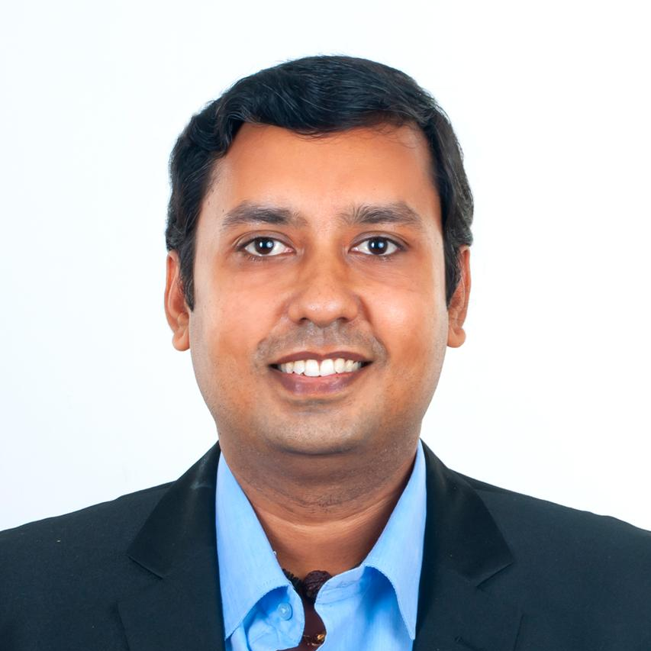

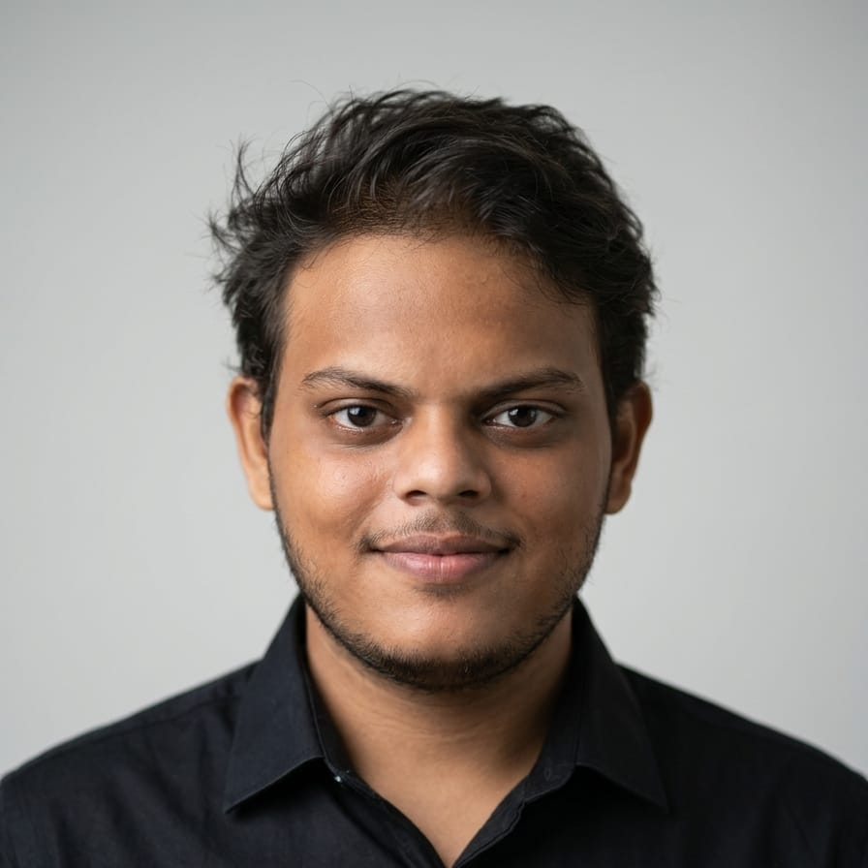
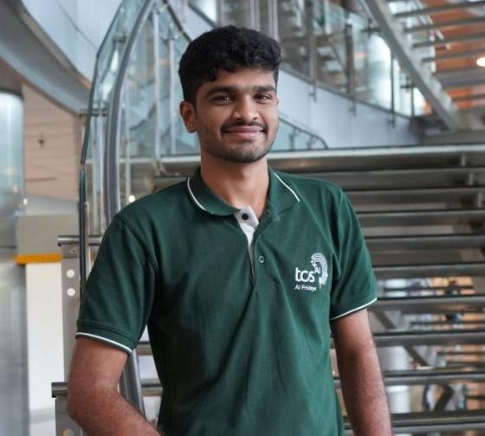
NVIDIA GSI OPEN HACKATHON
TEAM COGNITIVE CORE
LifeShield AI
An NVIDIA-Native Disaster Intelligence & Decision Command System
Evidence-to-decision pipeline for flood disasters — fusing live hazard data, NVIDIA NIM reasoning and vision, and governed guardrails into one auditable pipeline serving four real stakeholders.
TEAM MEMBERS Ramakrishnan Vedanarayanan, Srinivasan D, Kishoor, Badrinath – Tata Consultancy Services
MENTORS Mr.Swaminathan, NVIDIA
1

Slide 2







AGENDA
What we'll cover
01
01
02
02
03
03
04
04
The problem
Industry gaps
Market
Our solution
Why flood disaster response is one of the world's largest, least-served AI problems
What exists today (Google Flood Hub, One Concern, ICEYE...) and what's still missing
Stakeholders and Total Addressable Market — sized with citations
The architecture, live and running, with every NVIDIA service labeled
05
05
06
06
07
07
Trust & proof
Why NVIDIA
Business & scale
Guardrails, traceability, token/cost tracking, and measured evaluation metrics
Head-to-head vs. alternatives — with numbers
Differentiators, business value, patent strategy, roadmap
LIFESHIELD AI · NVIDIA GSI OPEN HACKATHON
2

Slide 3







THE BUSINESS PROBLEM · PART 1
Flooding is the most frequent, and one of the costliest, disasters on Earth
$320B
49M
+134%
$424B
Global disaster economic losses, 2024
People affected by floods in 2024 alone — more than any other disaster type
Rise in recorded flood-related disasters since 2000 vs. the prior two decades
Global natural-catastrophe insurance protection gap
Why this keeps getting worse, not better:
Climate volatility. Warmer air holds more moisture — extreme rainfall events are becoming both more frequent and more intense across every region this app targets (US Gulf Coast, South India tech corridors).
FLOOD EXPOSURE, GLOBAL POPULATION
Urbanization outpaces infrastructure. Flood exposure has climbed from 28.1M people (1970) to 35.1M (2020) — a +24.9% rise — as cities grow into floodplains faster than drainage/response systems scale.
Decisions still take too long. Life-safety and evacuation calls today depend on a human manually reading five disconnected data feeds under time pressure — the actual bottleneck this project targets.
The protection gap is a trust/latency gap, not a capital gap. Insurers and governments have the money to act — they don't have a fast, trustworthy way to fuse evidence into a decision in minutes, not hours.
It hits the most vulnerable hardest. In emerging markets, 80–90% of catastrophe losses are uninsured; in Asia specifically, only ~7% of flood economic losses are covered — vs. 34% in advanced economies.
+24.9% since 1970
Sources: Aon 2024 Global Catastrophe Recap · Munich Re 2024 disaster loss estimate ($320B) · EM-DAT/CRED 2024 Report (49M people, +134% events) · Swiss Re Institute sigma research (protection gap, regional coverage) · World Bank "People in Harm's Way: Flood Exposure and Poverty in 189 Countries"
THE BUSINESS PROBLEM
3

Slide 4

THE BUSINESS PROBLEM · PART 2
The human and economic cost compounds every year it isn't solved
INSURED LOSSES FROM FLOODS & STORMS ($B)
83%
of global flood losses over the last decade were uninsured — the single largest line item in the world's insurance protection gap.
~$85B
2023 economic losses from floods alone — third only to convective storms and earthquakes among all disaster types.
38.9%
CAGR for flood-detection software — flood insurance (20.7%) and flood-warning systems (12%) are also growing double digits; the market is voting with capital that this is unsolved.
Per Swiss Re's own long-term trend — every year without faster, more trustworthy decision-support compounds this curve, for governments issuing warnings AND insurers pricing/paying claims.
400M
people affected by disasters worldwide in extreme years (100M+ in an average year), per EM-DAT — this is not a niche problem.
It is disproportionately a Global South problem. The regions this project explicitly targets (Chennai, Bengaluru) alongside the US (Houston) sit at the center of the world's flood-insurance coverage gap, not its edge.
Sources: Swiss Re Institute, sigma research (2025–2026 insured-loss projections, protection gap) · Statista (2023 flood economic losses) · Verified Market Research / Market Research Future / Grand View Insights (flood insurance, warning, detection market CAGRs) · EM-DAT 2024 Report
THE BUSINESS PROBLEM
4

Slide 5
INDUSTRY LANDSCAPE
What exists today — and the gap each one leaves open
SOLUTION
WHAT IT DOES WELL
THE GAP IT LEAVES OPEN
Google Flood Hub
Free AI river/flash-flood forecasts, 2B people across 150+ countries
Forecast only — no exposure math, no evacuation routing, no insurer workflow, no human-approval audit trail
One Concern
AI "digital twin" disaster simulation, $150M+ raised
Pre-event risk scoring — not a live, evidence-fused, in-the-moment decision pipeline with guardrails
Floodbase (fka Cloud to Street)
Satellite flood detection for parametric insurance triggers
Narrow: payout triggers only — no life-safety guidance, no multi-persona command interface
ICEYE
SAR satellite constellation, real-time flood imagery
A data provider, not a decision layer — still requires a human to fuse it with everything else
Traditional cat-modeling software
Mature actuarial loss modeling ($1.82B market)
Post-event / pricing-cycle tool — not built for real-time, in-event life-safety decisions
Sources: Google (blog.google flood forecasting posts, cities.google/flood-hub) · Netzero Insights & Mercy Corps (One Concern, Floodbase funding) · ICEYE newsroom (Series E, $65M, Dec 2024) · GrowthMarketReports (catastrophe modeling software, $1.82B 2024)
INDUSTRY LANDSCAPE
5

Slide 6


MARKET
Stakeholders and Total Addressable Market
Government / NDMA
Insurance
Field Response
Executive / Leadership
Duty officers, emergency management agencies — public-safety liability, evacuation authority
Underwriters, portfolio & claims teams — loss-ratio, exposure triage, faster claims
First responders, dispatchers — one instruction, one route, in real time
City/agency leadership, boards — a decision in four sentences, not a dashboard
Total Addressable Market — layered, and every layer is real spend today
TAM BY SEGMENT — 2024 SIZE VS. FORECAST ($B)
SEGMENT
2024
FORECAST
CAGR
Incident & Emergency Mgmt
$137.5B
$196.2B by 2030
6.1%
Flood Insurance
$17.5B (2026)
$37.1B by 2030
20.7%
AI in Insurance
$8.99–11.3B
$93.9B by 2035
23.8%
Cat. Modeling Software
$1.82B
$3.85B by 2033
8.6%
Flood Warning Systems
$3.5B
$9.0B by 2032
12.0%
Sources: MarketsandMarkets / GlobeNewswire (Incident & Emergency Mgmt) · ResearchAndMarkets/GMInsights (Flood Insurance) · MarketResearchFuture (AI Insurtech) · GrowthMarketReports (Catastrophe Modeling) · MarketResearchFuture (Flood Warning Systems)
MARKET
6

Slide 7






OUR SOLUTION
LifeShield AI: one pipeline, four real front doors
A live evidence layer feeds a governed NVIDIA reasoning pipeline that produces life-safety guidance, insurer exposure, an evacuation plan, and a forward risk forecast — every model call checked, traced, and benchmarked.
Fuse
Decide
Trust
Prove
7 live evidence adapters (weather, gauges, road incidents, federal declarations, population risk, shelters) into one auditable bundle
4 decision gates + 5 parallel outputs — AI narrates, deterministic math computes every number that matters
NeMo Guardrails checks every generated claim against source evidence; NeMo Relay traces every call
NVIDIA NeMo Evaluator benchmarks retrieval + narrative quality against a hand-labeled golden set — a measured answer, not a claim
VERIFIED LIVE, TONIGHT, NOT CLAIMED:
Full Houston run completed end-to-end in 152s against the real NVIDIA API evidence, gates, life-safety, exposure ($996K / 5 policies), a 3-route evacuation plan, and a forward-risk forecast, all populated correctly.
The grounding guardrail caught and demoted an actually-unsupported claim in a live narrative — not a scripted failure.
A measured retrieval-quality fix NeMo Evaluator's benchmark went from 0.32 to 0.71 precision after a root-caused, code-level fix.
OUR SOLUTION
7

Slide 8














DETAILED ARCHITECTURE
Σ
deterministic math — never an LLM
The pipeline — every box is real, running code
NVIDIA-hosted model call, guardrail-checked
AI
1
NWS / IMD
Σ
USGS / CWC
Σ
HCFCD
Σ
TranStar
Σ
FEMA
Σ
Pop / SVI
Σ
OSM Shelters
Σ
EVIDENCE LAYER
2
Deep Agent Orchestrator
NeMo Switchyard + NIM
NeMo Relay
NVIDIA RUNTIME
3
Evidence Verifier
Σ
Confidence Gate
Σ
OpenShell Sandbox
AI
Policy Verifier
Σ
DECISION GATES
4
Life-Safety
AI
Insurer Exposure
Σ
Evacuation Plan
Σ
Forward Forecast
AI
Counterfactual
AI
DECISION OUTPUTS
5
Decision Brief
Σ
Approve / Reject
AI
HUMAN APPROVAL
CROSS-CUTTING · WRAPS EVERY STAGE ABOVE
NeMo Guardrails
AI
NeMo Retriever
Σ
Proactive Monitor
AI
Circuit Breaker
Σ
NeMo Evaluator
AI
DETAILED ARCHITECTURE
8
Notes:
Architecture update:
• Deep Agent Orchestrator represents the long-running planning and tool-execution layer used by LifeShield. NVIDIA describes deep agents as combining planning, persistent memory, tool execution, reusable skills and delegation. Source: https://www.nvidia.com/en-eu/glossary/deep-agents/
• OpenShell provides the sandbox and policy boundary for autonomous agents, including filesystem, network, process and inference controls. Source: https://docs.nvidia.com/openshell/about/overview

Slide 9
LIVE NVIDIA SERVICES
Six NVIDIA services in the live inference path
NVIDIA NIM
NeMo Switchyard
NeMo Relay
Every reasoning + vision model call, OpenAI-compatible dispatch to build.nvidia.com / self-hosted
Chooses dev vs. self-hosted target AND effort tier (small model on clean evidence, large model when ambiguous)
Governs every call: real token counts, real measured latency, labeled cost, full exported audit trace
nim_client.py
switchyard_router.py
relay_governance.py
NeMo Guardrails
NeMo Retriever
NVIDIA NeMo Evaluator
Grounding self-check on narratives, input moderation on SMS/Assistant, bias/fairness proxy in eval
Embeds a 34-doc knowledge corpus; adaptive-cutoff similarity ranking for the RAG Assistant
Two real BYOB benchmarks: retrieval P/R/F1 + life-safety faithfulness/completeness/bias vs. golden data
guardrails/*_rails.py
retriever_client.py
nemo_evaluator_suite.py
NVIDIA SERVICES IN USE
9

Slide 10
TRUST, TRACEABILITY & EVALUATION
"Is this trustworthy" has a measured answer here
Guardrails — caught live
Traceability & cost
Evaluation metrics (real)
Grounding self-check re-verifies every life-safety narrative against source evidence
NeMo Relay scopes every LLM/tool/gate call: real token counts, real measured wall-clock latency, labeled cost estimate
NVIDIA NeMo Evaluator, 2 registered benchmarks: retrieval P/R/F1/accuracy + life-safety faithfulness/completeness/bias
Verified live: caught an unsupported claim mid-run, demoted to a raw evidence summary automatically
Full chronological trace exported to an on-disk audit file — visible live in the Observability screen
Root-caused a 0.32 precision score to a fixed-K cutoff bug; fixed; re-measured at 0.71 precision / 0.80 recall / 0.73 F1
Input moderation on SMS + Assistant chat; fails OPEN on infra failure (never silently blocks a real emergency message)
Circuit breaker: 3 failures → 300s cooldown. Measured 418s → 95.3s, a 4.4× speedup, observed not estimated
Golden-dataset assertions run through the REAL pipeline — not an LLM grading its own homework
MEASURED, NOT ESTIMATED
Retrieval precision
Circuit-breaker recovery (s)
4.4×
circuit-breaker speedup
0.73
retrieval F1 score
TRUST, TRACEABILITY & EVALUATION
10

Slide 11

LLM STRATEGY
One routing layer with a LifeShield fine-tuned model
Switchyard routes live requests. Data Designer and AutoModel build the specialist model offline.
Environment axis
LifeShield fine-tuning
dev (hosted build.nvidia.com) vs. prod (self-hosted NIM on a GPU cluster) — one settings flag, zero code change at any call site.
Data Designer generated 100 synthetic examples. AutoModel and LoRA adapted Nemotron 3.5 Lightning 30B on 1× B300 and produced a ~14 MB adapter.
MODELS IN THE LIVE ROTATION TODAY
TASK
MODEL
EFFORT TIER
Life-safety synthesis (clean evidence)
Nemotron 3.5 Lightning 30B + LifeShield LoRA
Fine-tuned
Life-safety synthesis (ambiguous evidence)
nvidia/nemotron-3-super-120b-a12b
High
Vision damage read
meta/llama-3.2-11b-vision-instruct
Vision
Forecast / briefs / narratives / SMS drafting
nvidia/nemotron-3.5-lightning-30b-a3b
Low
Why this matters: Switchyard controls live cost and latency, while the LifeShield LoRA adds disaster-response behavior without retraining the full model.
LLM STRATEGY
11
Notes:
LifeShield fine-tuning evidence:
• User-supplied walkthrough: C:/Users/srini/Downloads/lifeshield_finetuning_step_by_step.html
• LifeShield used NeMo Data Designer with Nemotron 3 Super 120B to generate 100 synthetic disaster-response examples.
• NeMo AutoModel applied LoRA supervised fine-tuning to Nemotron 3.5 Lightning 30B on one NVIDIA B300 for 100 steps. The resulting LifeShield adapter is approximately 14 MB, with 7,072,256 trainable parameters, about 0.02% of the loaded model.
• NVIDIA describes Data Designer as a framework for orchestrating high-quality synthetic data generation. Source: https://docs.nvidia.com/nemo/datadesigner/getting-started/welcome
• NVIDIA documents NeMo AutoModel support for LLM fine-tuning and parameter-efficient LoRA adaptation. Source: https://docs.nvidia.com/nemo/automodel/latest/model-coverage/large-language-models/overview

Slide 12





DIFFERENTIATORS
What makes this different from a chatbot bolted onto a dashboard
Digital Twin "What-If" Simulator
Domain-grounded RAG, not open-domain chat
AI narrates, math decides — enforced structurally
A slider-driven, real-time scenario model for 3 historical events (Harvey, Cyclone Vardah, 2022 Bengaluru floods) — the same exposure math as the live pipeline, instantly interactive, zero model latency.
The Assistant answers ONLY from a 34-document, hand-written corpus + live event state — it says "I don't know" rather than guessing, and now includes persona-specific domain reference (NFIP, ICS/NIMS, swift-water safety).
No model call anywhere in this app can produce a dollar figure, a route, or a distance — the single sentence that separates a demo from something a risk desk could actually use.
Resilience as a measured feature
One adapter, three countries, zero core-logic changes
Proactive, not just reactive
A real CLOSED/OPEN/HALF_OPEN circuit breaker with a documented 4.4× measured speedup — most hackathon AI apps have zero fallback tier, this one has three.
NWS/USGS/HCFCD → IMD/CWC/GCC Stormwater → IMD/KSNDMC/BBMP — the same EvidenceAdapter interface, just relabeled. This IS the internationalization strategy.
A background monitor that decides, on its own, to raise an alert on a rising trend — the one surface that doesn't wait for a human to click "Check Now."
DIFFERENTIATORS
12

Slide 13
WHY NVIDIA
Why NVIDIA: capacity, control and deployment speed
ADVANTAGE
CONFIGURATION / NVIDIA EVIDENCE
LIFESHIELD VALUE
Installed GPUs
4× NVIDIA B300 GPUs in the LifeShield environment
Parallel capacity for model serving and concurrent agents
Usable GPU memory
275 GB per GPU, 1.1 TB aggregate
Keeps larger models and long context workloads resident
Blackwell inference
B300 supports FP4 Tensor Core inference
Lower precision reduces model memory pressure
Portable inference
NIM: containerized microservices with industry-standard APIs
Self-host across cloud, data center or workstation
Safety coverage
5 guardrail stages: input, retrieval, dialog, execution, output
Controls RAG context, tool calls and final answers
Built-in policy library
33 built-in rails exposing 78 configurable surfaces
Broader policy coverage with less custom middleware
LIFESHIELD MEASURED
152s live run
0.71 retrieval precision
LIFESHIELD HARDWARE
4× B300 GPUs
1.1 TB aggregate memory
LifeShield hardware figures reflect the deployed four-GPU environment and are separate from the published eight-GPU DGX B300 system specification.
WHY NVIDIA
13
Notes:
Slide 13 evidence notes (accessed 16 September 2026):
• LifeShield deployed configuration supplied by the team: 4 NVIDIA B300 GPUs with 275 GB usable GPU memory each, totaling 1.1 TB aggregate usable GPU memory.
• NVIDIA documents B300 Blackwell Ultra support for FP4 inference. The published DGX B300 system specification uses eight GPUs and is not presented here as the LifeShield configuration. Source: https://docs.nvidia.com/dgx/dgxb300-user-guide/dgxb300-user-guide.pdf
• NeMo Guardrails has five control stages: input, retrieval, dialog, execution and output. Source: https://docs.nvidia.com/nemo/guardrails/about-nemo-guardrails-library/rail-types
• NeMo Guardrails library support summary: 33 built-in rails and 78 exposed surfaces. Source: https://docs.nvidia.com/nemo/guardrails/reference/rail-engine-support
• NVIDIA NIM microservices are containerized, portable and expose industry-standard APIs for self-hosting in cloud, data center or workstation environments. Source: https://docs.api.nvidia.com/nim/docs/introduction
• LifeShield figures (152-second live run; 0.71 retrieval precision) are internal baseline measurements carried forward from the prior slide 13 and are not comparative B300 gains.

Slide 14


WHY NVIDIA · ECOSYSTEM
One integrated standard vs. a patchwork of point solutions
Switchyard, Guardrails, Retriever, and the NeMo toolkit aren't four separate products bolted together — they share one schema, one trace format, one vendor to call when something breaks.
CAPABILITY
NVIDIA ECOSYSTEM — ONE STANDARD
FRAGMENTED ALTERNATIVE — MANY STANDARDS
Model routing
NeMo Switchyard
One router decides target (dev/self-hosted) AND effort tier, per call — a single config flag, zero call-site changes.
Hand-rolled if/else, LangChain routers, LiteLLM gateways
Every team reinvents routing logic; no shared config format between projects.
Guardrails
NeMo Guardrails
Canonical Colang rail definitions for grounding, topical, and moderation checks — reusable across every model call in the pipeline.
Guardrails-AI, Llama Guard, ad-hoc regex/prompt filters
Different schema per tool; rails written for one project rarely port to the next.
Retrieval
NeMo Retriever
Standardized, GPU-accelerated embedding + reranking microservices with adaptive-cutoff ranking.
DIY FAISS/Pinecone/Weaviate + a bolted-on reranker
Each vector store has its own API, its own tuning knobs, its own failure modes.
Governance & eval
NeMo Relay + Evaluator (toolkit)
One audit-trace format covering cost, latency, and quality for every call in the pipeline.
LangSmith, Helicone, custom logging + spreadsheets
Cost tracking, tracing, and evaluation live in three different tools that don't talk to each other.
One vendor, one schema, one audit trail. The fragmented stack needs 4+ vendors' worth of glue code before it can even be compared apples-to-apples — this build gets that integration for free.
WHY NVIDIA · ECOSYSTEM
14

Slide 15


WHY NVIDIA · RETRIEVAL
NeMo Retriever vs. plain-vanilla and hybrid retrieval
Same 34-document corpus, same golden evaluation set — the retrieval method is the only variable.
Semantic (vanilla)
Hybrid (BM25 + dense)
NeMo Retriever
Cutoff strategy
Fixed top-K — same K for every query, regardless of how well evidence agrees
Fixed weighted blend of sparse + dense scores, hand-tuned per corpus
Adaptive-cutoff: a relative-score gap sets K per query, dynamically
Reranking
None — raw cosine order returned as-is
Optional, usually a separately bolted-on reranker model
Built-in GPU-accelerated reranking microservice (NIM), same pipeline
Acceleration
CPU-bound, framework-dependent
CPU-bound sparse+dense fusion, slower at corpus scale
GPU-accelerated embedding + rerank, production-scale throughput
Measured precision (our golden set)
0.32 precision — this project's own fixed-K baseline, measured
Not evaluated in this build — would need separate tuning + re-benchmarking
0.71 precision / 0.80 recall / 0.73 F1 — measured after the fix
Standardized evaluation
Custom scoring code, one-off per project
Custom fusion logic, no shared benchmark harness
Paired with NVIDIA NeMo Evaluator for a repeatable P/R/F1 benchmark
Same corpus, same golden set — only the retrieval method changed. The precision jump (0.32 → 0.71) is attributable to the adaptive-cutoff method itself, not a bigger model or more data.
WHY NVIDIA · RETRIEVAL
15

Slide 16
WHY NVIDIA · IMPACT
What the NVIDIA ecosystem actually bought LifeShield AI
Not hypothetical benefits — every row below is a capability this build could not have measured, or would have had to build from scratch, without it.
NVIDIA COMPONENT
WHAT IT GAVE LIFESHIELD AI
MEASURED OUTCOME
NVIDIA NIM
One OpenAI-compatible endpoint for every reasoning + vision call, dev or self-hosted
Full Houston run, 152s end-to-end, against the real API
NeMo Switchyard
Per-call routing between small/large models by evidence ambiguity, not hardcoded
Cost and latency scale with need — not every call defaulting to the biggest model
NeMo Relay
Governed call tracing: tokens, latency, cost, and a circuit breaker, all in one format
418s → 95.3s recovery — a measured 4.4× speedup, observed not estimated
NeMo Guardrails
A grounding self-check that re-verifies narratives against source evidence
Caught and demoted an unsupported claim live, mid-run — not a scripted failure
NeMo Retriever
Adaptive-cutoff retrieval in place of a fixed top-K similarity search
Retrieval precision measured at 0.32 → 0.71 after the fix
NeMo Evaluator
A standardized benchmark harness run through the real pipeline
A measured answer to "is this trustworthy" — not a claim
4.4×
0.71
152s
6
circuit-breaker speedup
retrieval precision
full live run, real API
NVIDIA services, wired live
WHY NVIDIA · IMPACT
16

Slide 17
BUSINESS VALUE
What this is worth to each buyer, in their own currency
For Government / NDMA agencies
For Insurers
Minutes, not hours, from evidence to a defensible public warning — with a full audit trail attached automatically
Portfolio-level exposure triage the moment an event starts — before individual claims exist
Liability reduction: every decision is a human's, but every input to that decision is traceable and reproducible
Directly attacks the stat that matters to them: a $424B global protection gap is un-priced opportunity, not just risk
One system across 3 countries today (Houston, Chennai, Bengaluru) via the adapter pattern — not a bespoke build per city
No model ever touches a dollar figure — the one sentence that gets this into an actuarial review, not rejected by one
THE PITCH IN ONE SENTENCE FOR EITHER BUYER
“We turn five disconnected data feeds into one auditable, guardrail-checked decision in minutes — priced on decisions supported, not seats.” The NeMo Relay trace file is the literal artifact that pricing would meter.
BUSINESS VALUE
17

Slide 18
SCALING THIS AS A PRODUCT
From hackathon build to a licensable, patentable platform
Technical scaling
IP / patent angle
Self-hosted NIM behind NVIDIA Dynamo for disaggregated, KV-cache-aware serving at real load — Switchyard's prod path already exists for this
The evidence-agreement confidence gate (deterministic 0.4/0.3/0.3 weighted source-agreement scoring feeding a model-routing decision) is a concrete, novel decision-gating method
Replace the in-memory run store with Postgres + an event-sourced audit log — the one flagged blocker before multi-instance deployment
The adaptive-cutoff retrieval method (replacing fixed top-K with a relative-score gap) is a measurable, defensible improvement over standard RAG retrieval — patentable as a retrieval-quality method
Turn the Proactive Monitor into a real event-bus consumer instead of a 45s poll
The circuit-breaker-gated agentic-fallback architecture (measured 4.4× speedup) is a reusable resilience pattern for any agentic pipeline, not just this one
Multi-tenant evidence adapters — config per customer, not code per city
SCALING THIS AS A PRODUCT
18

Slide 19

ROADMAP
Ordered by what unlocks the next thing
NOW
NEXT
LATER
Hardening
Scale the same design
New capabilities
Real datastore for runs/approvals (Postgres)
Self-hosted NIM + Dynamo for the prod runtime target
Cross-event memory, trend reasoning and country adapters
NVIDIA Omniverse digital-twin flood simulation
Real authentication (today's login is disclosed as mock)
Business-interruption exposure modeling
NVIDIA Metropolis vision AI for traffic, damage and public safety
Fix the Twilio trial-template send path
Event-bus-driven Proactive Monitor
Human-reviewed damage-ratio calibration from real claims data
Per-customer evidence-source configuration
ROADMAP
19
Notes:
Future roadmap sources:
• NVIDIA Omniverse provides accelerated libraries and microservices for physical AI simulation, digital twins and agentic workflows. LifeShield roadmap use: flood digital-twin scenario simulation. Source: https://docs.nvidia.com/omniverse/index.html
• NVIDIA Metropolis is a vision AI platform for building and scaling video analytics agents from edge to cloud, including smart-city and transportation use cases. LifeShield roadmap use: traffic, damage and public-safety video intelligence. Source: https://www.nvidia.com/en-us/autonomous-machines/intelligent-video-analytics-platform/
• Both items are future roadmap capabilities, not current production claims.

Slide 20
CLOSING
Built on NVIDIA, verified live, ready to scale
6 NVIDIA services wired live NIM, Switchyard, Relay, Guardrails, Retriever, NeMo Evaluator — not a wrapper around one API call.
A $320B/year problem, a $424B protection gap and a market voting with double-digit CAGRs across every flood-tech category we checked.
Measured, not claimed 0.32→0.71 retrieval precision, 418s→95.3s circuit-breaker speedup, a live-caught hallucination — every number in this deck traces to real code.
Two buyers, one engine, three countries already proven the adapter pattern is the actual go-to-market moat.
THE ASK
Design-partner access to a real gauge network / policy book to move from replay fixtures to a live pilot, and NVIDIA Inception / DGX Cloud credits to move the prod runtime target from code-complete to load-tested.
CLOSING
20

Slide 21
APPENDIX
Full source list
Aon, "Global Catastrophe Recap" (2024) — aon.com/reinsurance
GrowthMarketReports, Catastrophe Modeling Software Market — growthmarketreports.com
Munich Re, 2024 global natural disaster loss estimate ($320B) — via Yahoo Finance / Munich Re press materials
Google, Flood Hub / AI flood forecasting announcements — blog.google, cities.google/flood-hub
Swiss Re Institute, sigma research — natural catastrophe protection gap, insured-loss projections to 2030 — swissre.com/institute
Mercy Corps / NetZero Insights, Cloud to Street / Floodbase funding coverage
EM-DAT / CRED, "2024 Report" and "2023 Report" — Centre for Research on the Epidemiology of Disasters — files.emdat.be
ICEYE newsroom, Series E funding announcement (Dec 2024) — iceye.com/newsroom
World Bank Policy Research Working Paper 9447, "People in Harm's Way: Flood Exposure and Poverty in 189 Countries" — documents1.worldbank.org
Silicon Analysts / IDC-based estimates, AI accelerator market share 2025-2026 — siliconanalysts.com
Statista, U.S. and global flood economic damage statistics — statista.com/topics/11261/floods
NVIDIA Q1 FY2026 and AMD Q1 2026 earnings releases — data-center revenue figures
MarketsandMarkets / GlobeNewswire, Incident & Emergency Management Market report — marketsandmarkets.com
NVIDIA Developer Blog, NIM performance benchmark posts — developer.nvidia.com/blog
ResearchAndMarkets / GMInsights, Flood Insurance Market — researchandmarkets.com, gminsights.com
CUDA ecosystem analyses (developer counts, gross-margin comparison) — multiple 2025 industry analyses
MarketResearchFuture, Flood Warning System Market; AI Insurtech Market — marketresearchfuture.com
APPENDIX
21

Slide 22
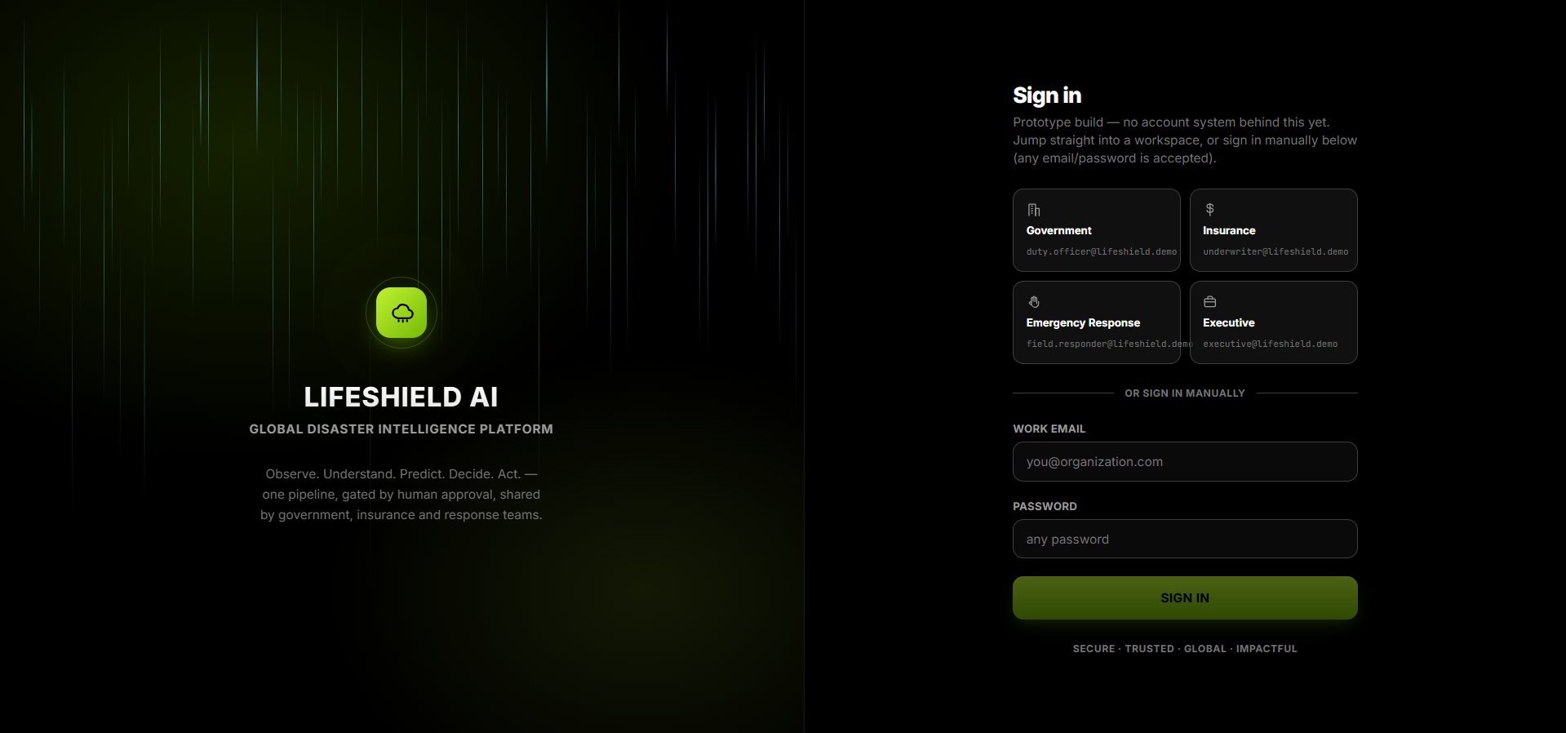
APPENDIX
Sign in
Prototype sign-in with 4 role-based personas — Government, Insurance, Emergency Response, and Executive.
APPENDIX
22

Slide 23
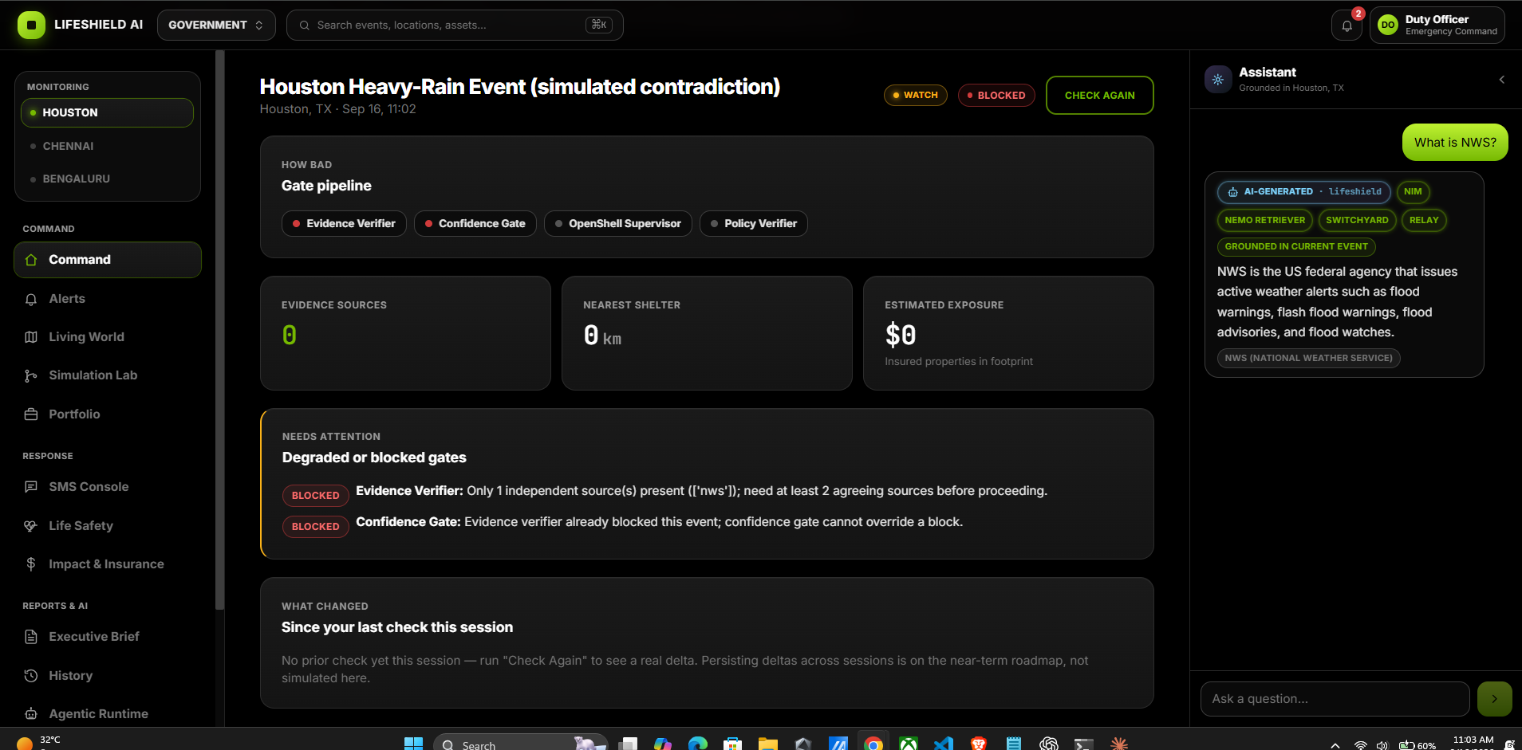
APPENDIX
Command
Live event overview for Houston, TX — gate-pipeline status, evidence sources, nearest shelter, and estimated exposure.
APPENDIX
23

Slide 24
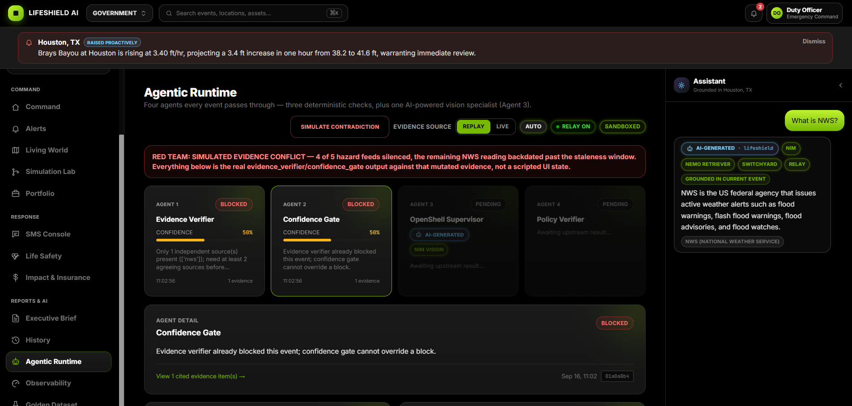
APPENDIX
Agentic Runtime
The four-agent evidence pipeline, shown here holding under a red-team simulated evidence conflict.
APPENDIX
24

Slide 25
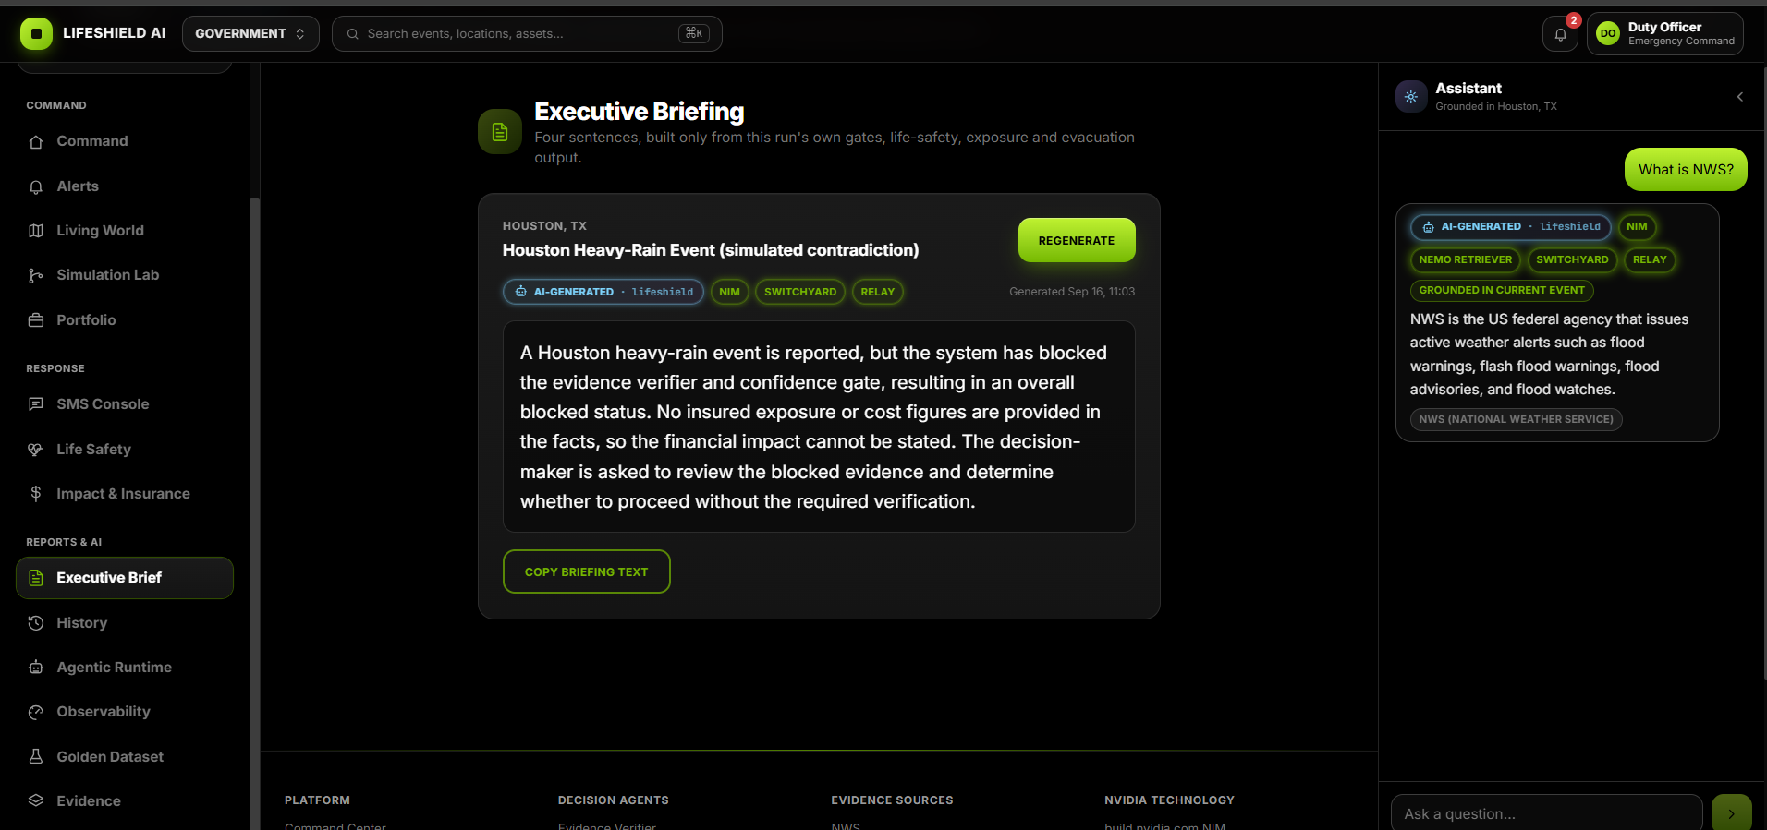
APPENDIX
Executive Briefing
An AI-generated summary built only from this run's own gates, life-safety, exposure, and evacuation output.
APPENDIX
25

Slide 26
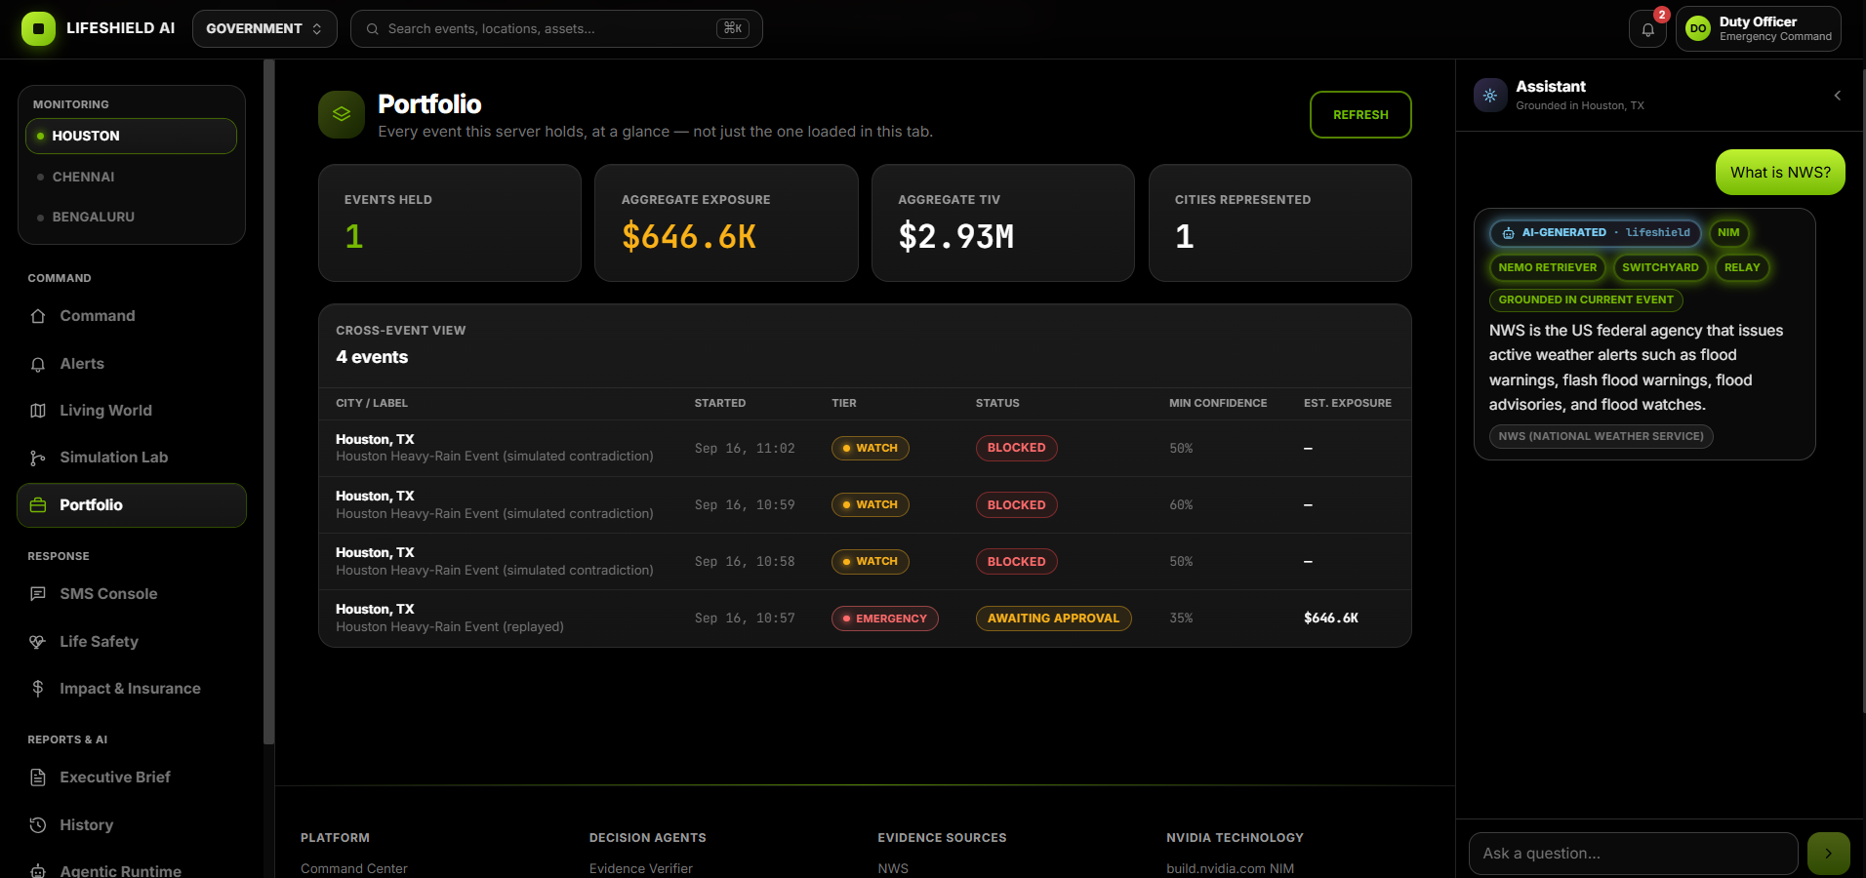
APPENDIX
Portfolio
Cross-event view of aggregate exposure, total insured value, and status across every monitored event.
APPENDIX
26

Slide 27
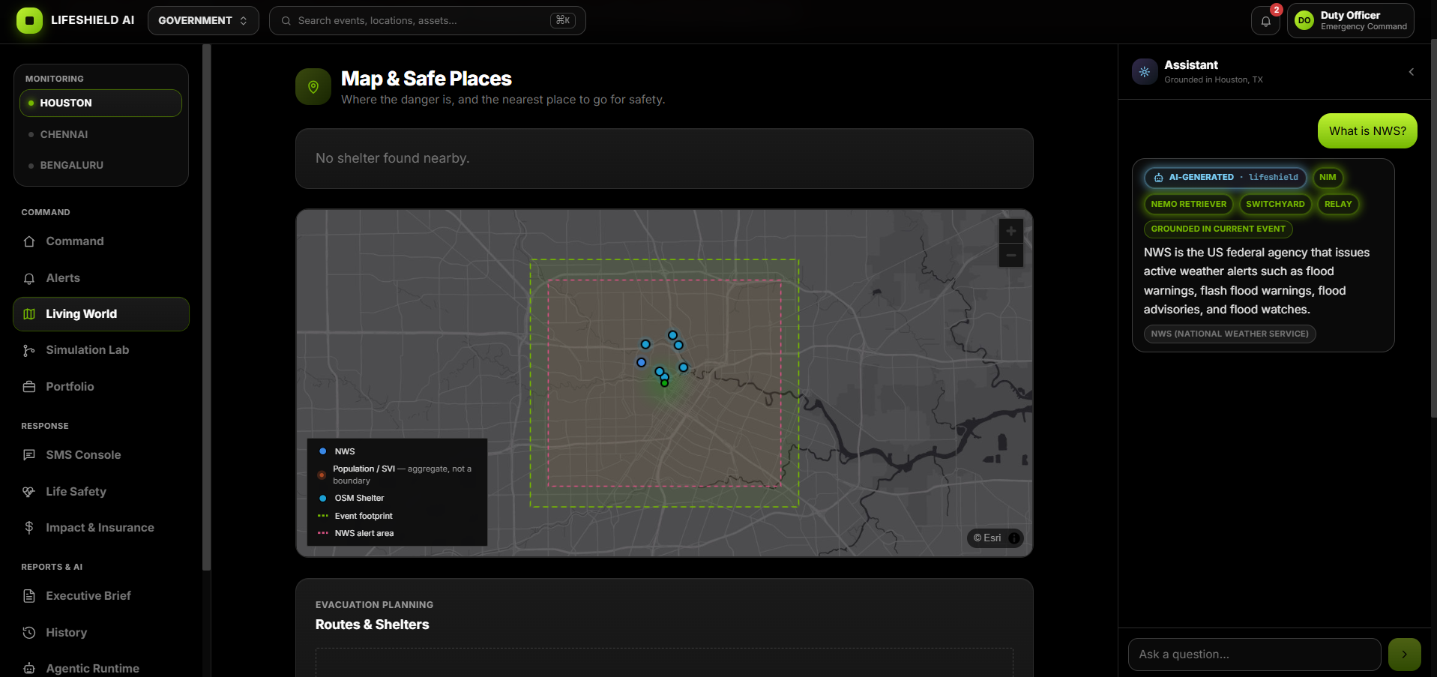
APPENDIX
Map & Safe Places
Hazard footprint, NWS alert area, and nearby shelters plotted for evacuation planning.
APPENDIX
27

