Slide 1

Episode 1 – Hot Trends of 2017

Slide 2



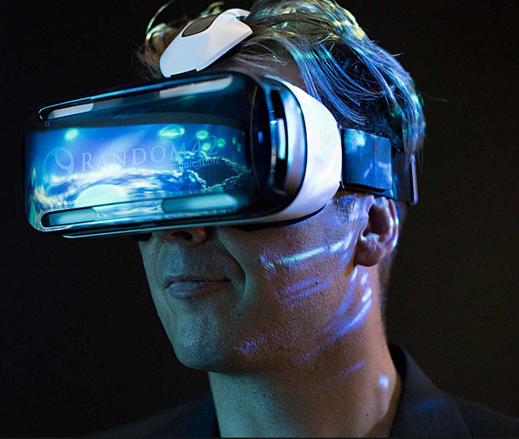
Episode 1 – Hot Trends of 2017

Slide 3
#5 Blockchain

Slide 4
#4 IOT

Slide 5
#3 Virtual Reality

Slide 6
#2 Assistive Intelligence

Slide 7
#1 Cloud

Slide 8
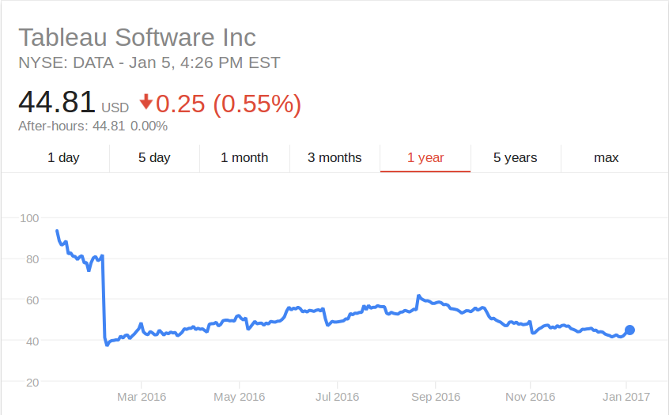

Slide 9
Sources
http://www.gartner.com/smarterwithgartner/gartners-top-10-technology-trends-2017/
http://www.forbes.com/sites/danielnewman/2017/01/03/17-top-enterprise-tech-trends-for-2017-and-this-years-ces/#1375949c1f10
http://www.recode.net/2017/1/3/14154874/2017-predictions-top-10-technology-mobile-ai-smart-home

Slide 10
http://

