Slide 1

Project TITLE : Stock Return Analysis using Kolmogorov–Smirnov Test
Course Title : Simulation and Modeling Lab Project
Course Code : CSE-416
Presented to
Saima Siddique Tashfia
Lecturer
Department of CSE , UITS
Presented By
Yeasmin Akter -2215151112
Rudra DAS -2215151117
Abdul badsha -2215151137
Bulbul bhuiya -2215151163

Slide 2
Objective
- Analyze daily return behavior of AAPL stock for the year 2023
- Use the Kolmogorov–Smirnov (K–S) Test to determine if the returns follow a normal distribution
- Understand the statistical nature of financial returns and the applicability of standard models

Slide 3
Dataset Description
- Data Source: Yahoo Finance
- Stock: Apple Inc. (AAPL)
- Period: January 1, 2023 to December 31, 2023
- Fields used: Date, Close, Adjusted Close
- Daily returns calculated using percentage change in adjusted close prices

Slide 4
Working Procedure
1. Download historical AAPL stock data in CSV format
2. Load the dataset in Google Colab using pandas
3. Compute daily returns using adjusted close prices
4. Perform Kolmogorov–Smirnov test comparing returns to normal distribution
5. Visualize returns using a histogram for better understanding
6. Interpret the test result using p-value and KS statistic.

Slide 5
Technology and Tools Used
- Google Colab (Python Jupyter Environment)
- Python Libraries:
- pandas (Data loading & processing)
- matplotlib (Visualization)
- scipy.stats (Kolmogorov–Smirnov Test)
- Yahoo Finance (data source)

Slide 6
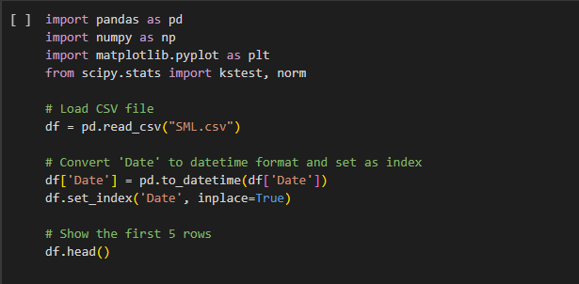
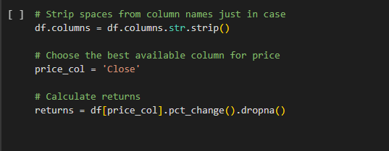
Project Demostration:

Slide 7
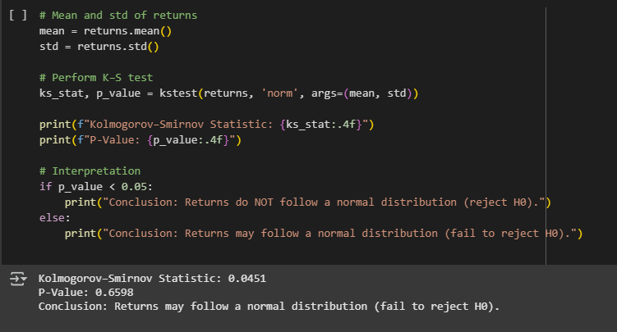
Project Demostration:

Slide 8
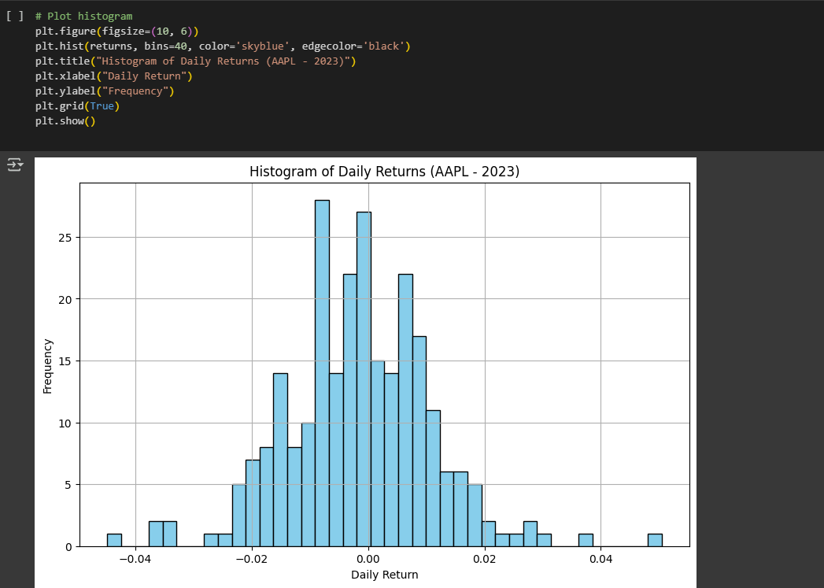
Project Demostration:

Slide 9
Result & Interpretation
- K–S Statistic: 0.0454
- P-Value: 0.6529
Interpretation:
✔ Since p-value > 0.05, we fail to reject the null hypothesis.
✔ Daily returns of AAPL stock for 2023 may follow a normal distribution.
✔ Normal distribution-based financial models are likely applicable.

Slide 10
Histogram of Daily Returns
Histogram was plotted using matplotlib
It showed a symmetric bell-shaped curve, supporting the normality assumption.

Slide 11
Conclusion
- The Kolmogorov–Smirnov test shows that the daily returns of AAPL in 2023 are consistent with a normal distribution.
- The project demonstrates how statistical tests can validate assumptions in financial modeling.
- Future work could include testing other stocks or comparing multiple years.

Slide 12
References
- Yahoo Finance: https://finance.yahoo.com
- scipy.stats.kstest documentation
- matplotlib and pandas documentation
- Google Colab (for implementation)

Slide 13
THANK YOU

