Slide 1
Probability

Slide 2
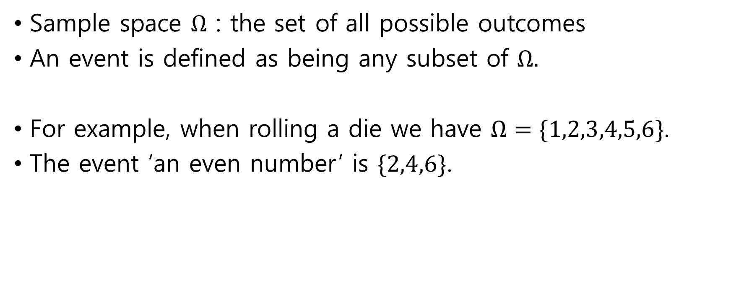
Sample space
Sample space $Ω$ : the set of all possible outcomes
An event is defined as being any subset of $Ω.$
For example, when rolling a die we have $Ω=\{1,2,3,4,5,6\}$.
The event ‘an even number’ is $\{2,4,6\}$.

Slide 3
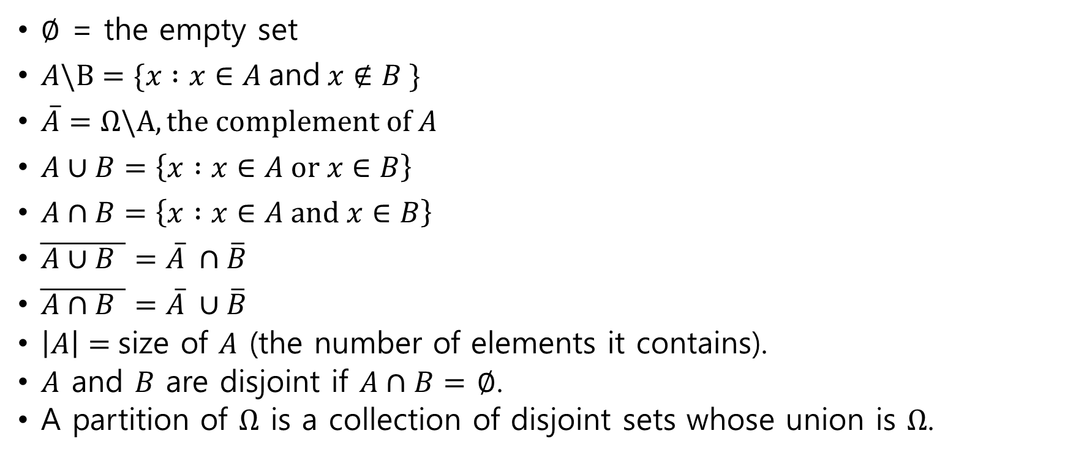
Notations and useful results
$∅$ = the empty set
$A\backslash B=\{x :x∈A \text{and} x∉B \}$
$\overline{A}=Ω\backslash A, \text{the} \text{complement} \text{of} A$
$A∪B=\left\{x :x∈A \text{or} x∈B\right\}$
$A∩B=\left\{x :x∈A \text{and} x∈B\right\}$
$\overline{A∪B }=\overline{A} ∩\overline{B}$
$\overline{A∩B }=\overline{A} ∪\overline{B}$
$\left|A\right|=$size of $A$ (the number of elements it contains).
$A$ and $B$ are disjoint if $A∩B=$ $∅$.
A partition of $Ω$ is a collection of disjoint sets whose union is $Ω$.

Slide 4
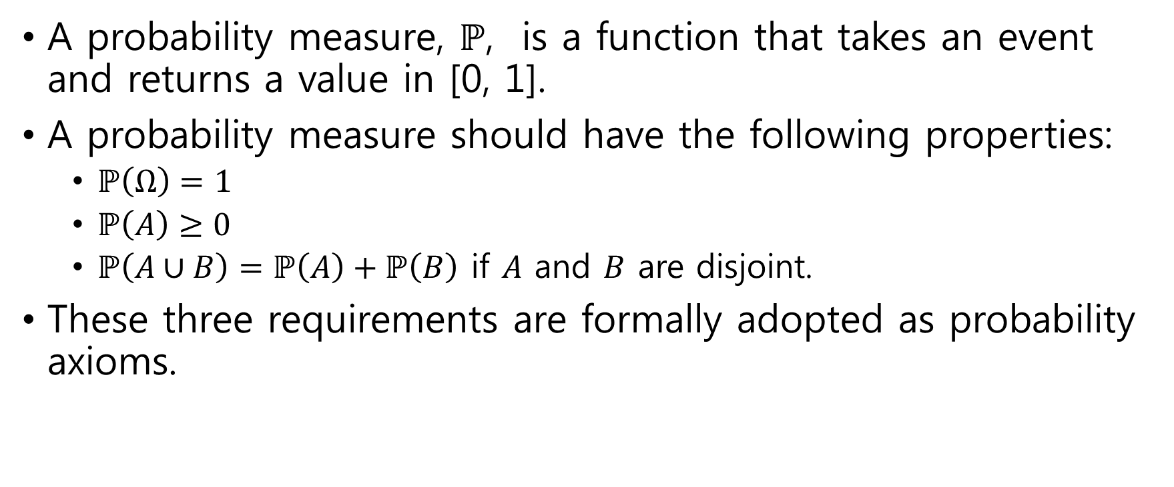
Probability measure and axioms
A probability measure, $ℙ$, is a function that takes an event and returns a value in [0, 1].
A probability measure should have the following properties:
$ℙ\left(Ω\right)=1$
$ℙ\left(A\right)≥0$
$ℙ\left(A∪B\right)=ℙ\left(A\right)+ℙ\left(B\right)$ if $A$ and $B$ are disjoint.
These three requirements are formally adopted as probability axioms.

Slide 5
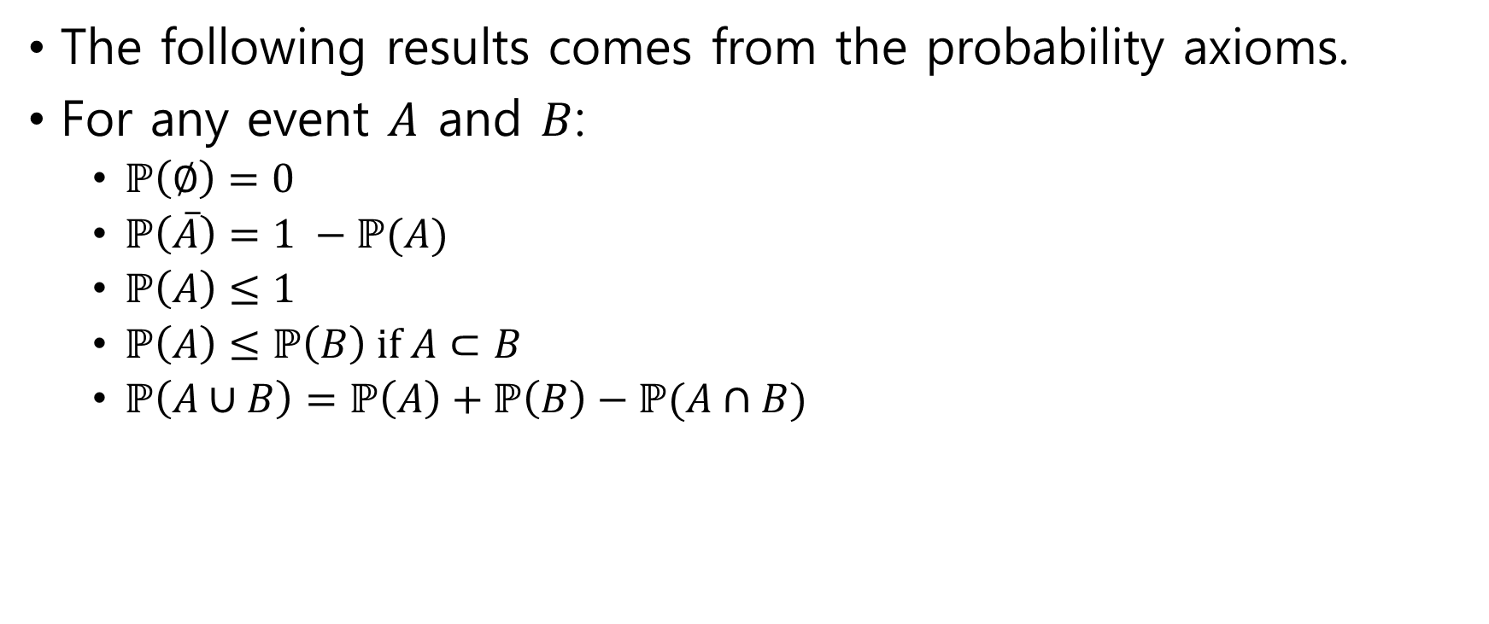
Basic property
The following results comes from the probability axioms.
For any event $A$ and $B$:
$ℙ\left(∅\right)=0$
$ℙ\left(\overline{A}\right)=1 −ℙ(A)$
$ℙ\left(A\right)≤1$
$ℙ\left(A\right)≤ℙ\left(B\right) \text{if} A⊂B$
$ℙ\left(A∪B\right)=ℙ\left(A\right)+ℙ\left(B\right)−ℙ(A∩B)$

Slide 6
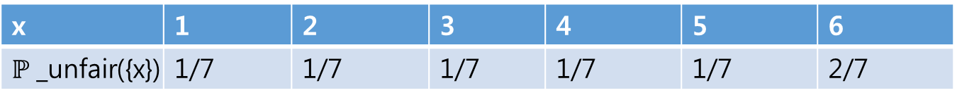
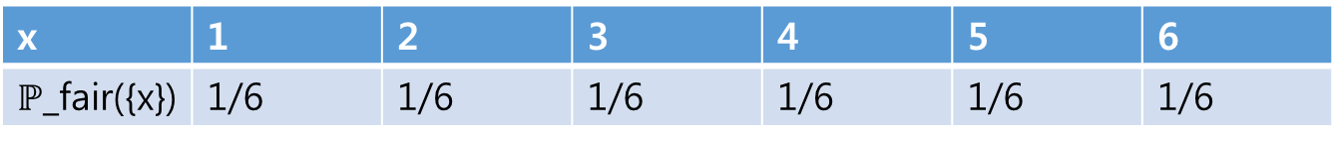
Probability measures on a sample sapce
A given sample space can have more than one probability measure defined on it.
For example, consider an experiment where we roll a die.
If the die is fair, then we would use the following probability:
If the die is unfair so that the number six was twice as likely to appear, then:
x | 1 | 2 | 3 | 4 | 5 | 6
$ℙ$_fair({x}) | 1/6 | 1/6 | 1/6 | 1/6 | 1/6 | 1/6
x | 1 | 2 | 3 | 4 | 5 | 6
$ℙ$_unfair({x}) | 1/7 | 1/7 | 1/7 | 1/7 | 1/7 | 2/7

Slide 7

Counting probability
If $Ω$ is finite, $\left|Ω\right|=n$, and every element of $Ω$ is equally likely, then for all outcomes $x$ and events $A$ $ℙ\left(\left\{x\right\}\right)=\frac{1}{n} \text{and} ℙ\left(A\right)= \frac{|A|}{n}\text{.}$

Slide 8
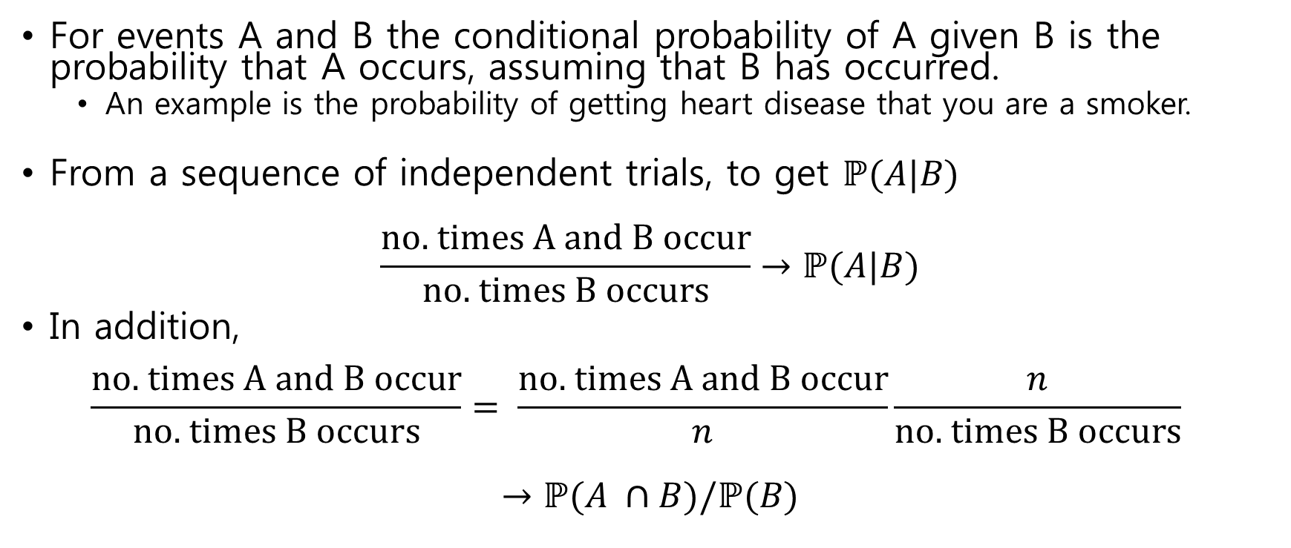
Conditional probability
For events A and B the conditional probability of A given B is the probability that A occurs, assuming that B has occurred.
An example is the probability of getting heart disease that you are a smoker.
From a sequence of independent trials, to get $ℙ(A|B)$
$$\frac{\text{no}\text{. }\text{times} \text{A} \text{and} \text{B} \text{occur}}{\text{no}\text{. }\text{times} \text{B} \text{occurs}}→ℙ(A|B)$$
In addition, $\frac{\text{no}\text{. }\text{times} \text{A} \text{and} \text{B} \text{occur}}{\text{no}\text{. }\text{times} \text{B} \text{occurs}}= \frac{\text{no}\text{. }\text{times} \text{A} \text{and} \text{B} \text{occur}}{n}\frac{n}{\text{no}\text{. }\text{times} \text{B} \text{occurs}}$
$$→ℙ(A ∩B)/ℙ(B)$$

Slide 9
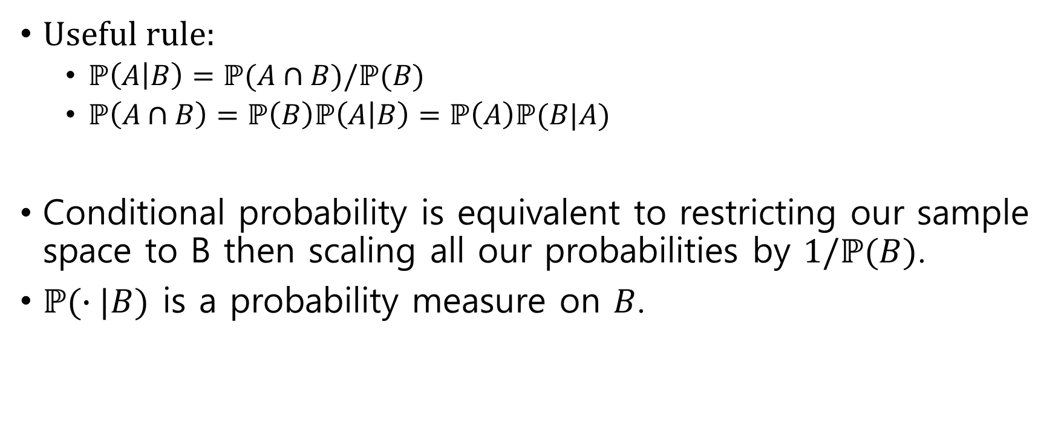
Conditional probability (2)
Useful rule:
$ℙ\left(A | B\right)=ℙ(A∩B)/ℙ(B)$
$ℙ\left(A∩B\right)=ℙ\left(B\right)ℙ\left(A | B\right)=ℙ\left(A\right)ℙ(B|A)$
Conditional probability is equivalent to restricting our sample space to B then scaling all our probabilities by $1/ℙ(B)$.
$ℙ(∙|B)$ is a probability measure on $B$.

Slide 10
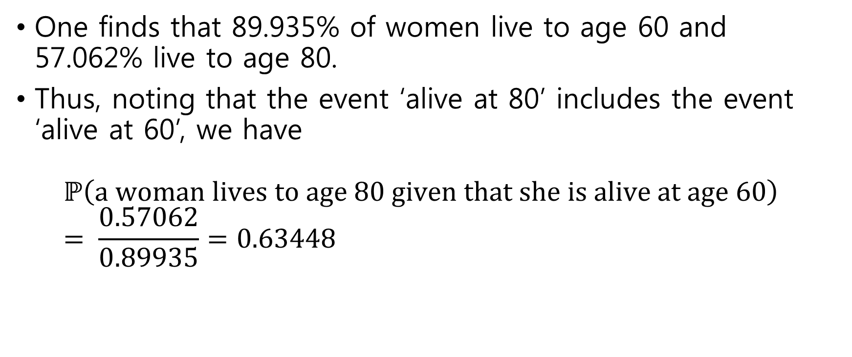
Example : life table
One finds that 89.935% of women live to age 60 and 57.062% live to age 80.
Thus, noting that the event ‘alive at 80’ includes the event ‘alive at 60’, we have $ℙ\left(\text{a} \text{woman} \text{lives} \text{to} \text{age}\text{ 80 }\text{given} \text{that} \text{she} \text{is} \text{alive} \text{at} \text{age}\text{ 60}\right)$ $= \frac{0.57062}{0.89935}=0.63448$

Slide 11
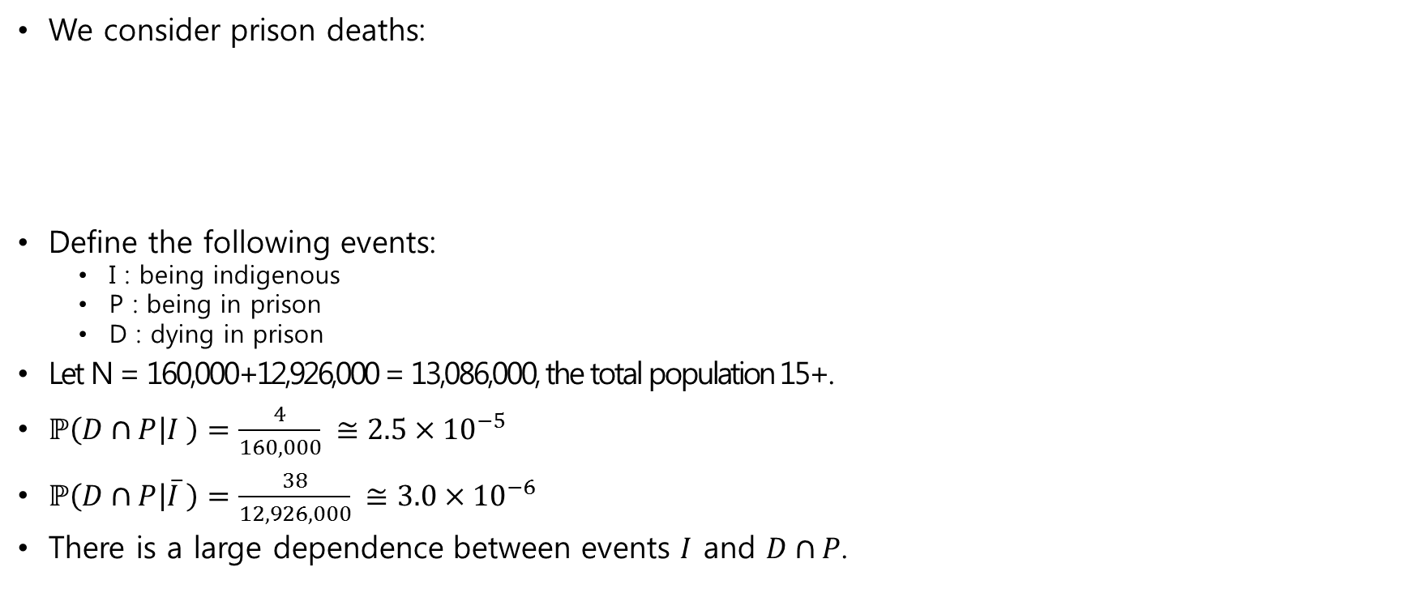
Example : indigenous deaths in custody
We consider prison deaths:
Define the following events:
I : being indigenous
P : being in prison
D : dying in prison
Let N = 160,000+12,926,000 = 13,086,000, the total population 15+.
$ℙ\left(D∩P | I \right)=\frac{4}{160,000} ≅2.5×{10}^{−5}$
$ℙ\left(D∩P | \overline{I} \right)=\frac{38}{12,926,000} ≅3.0×{10}^{−6}$
There is a large dependence between events $I$ and $D∩P$.
 | Indigenous | Non-indigenous
Death in prison | 4 | 38
Population 15+ | 160,000 | 12,926,000
Prison population | 2,198 | 13,361

Slide 12
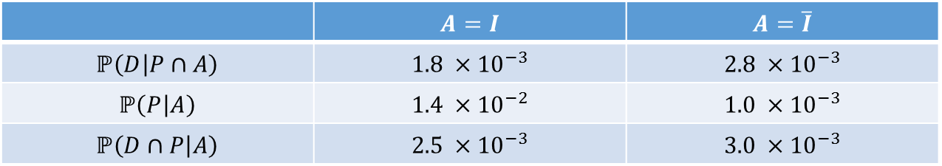
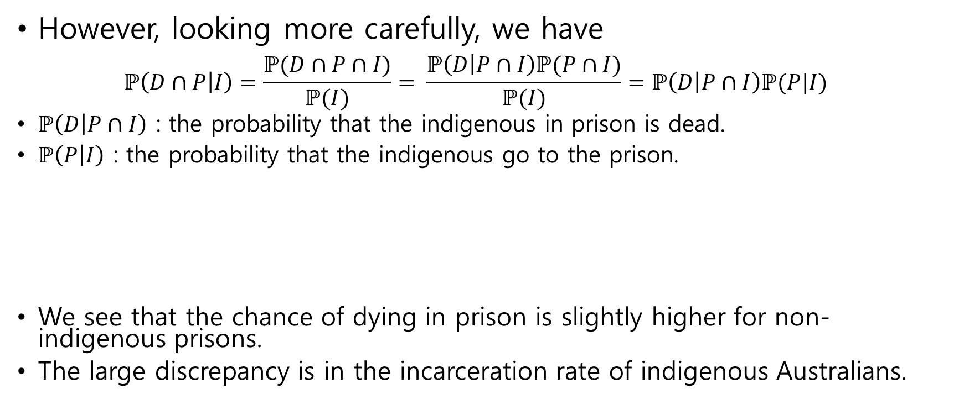
Example : indigenous deaths in custody(2)
However, looking more carefully, we have $ℙ\left(D∩P | I\right)=\frac{ℙ(D∩P∩I)}{ℙ(I)}= \frac{ℙ\left(D | P∩I\right)ℙ(P∩I)}{ℙ(I)}=ℙ\left(D | P∩I\right)ℙ(P|I)$
$ℙ\left(D | P∩I\right)$ : the probability that the indigenous in prison is dead.
$ℙ\left(P | I\right)$ : the probability that the indigenous go to the prison.
We see that the chance of dying in prison is slightly higher for non-indigenous prisons.
The large discrepancy is in the incarceration rate of indigenous Australians.
 | $$A=I$$ | $$A=\overline{I}$$
$$ℙ\left(D | P∩A\right)$$ | $$1.8 ×{10}^{−3}$$ | $$2.8 ×{10}^{−3}$$
$$ℙ\left(P | A\right)$$ | $$1.4 ×{10}^{−2}$$ | $$1.0 ×{10}^{−3}$$
$$ℙ\left(D∩P | A\right)$$ | $$2.5 ×{10}^{−3}$$ | $$3.0 ×{10}^{−3}$$

Slide 13
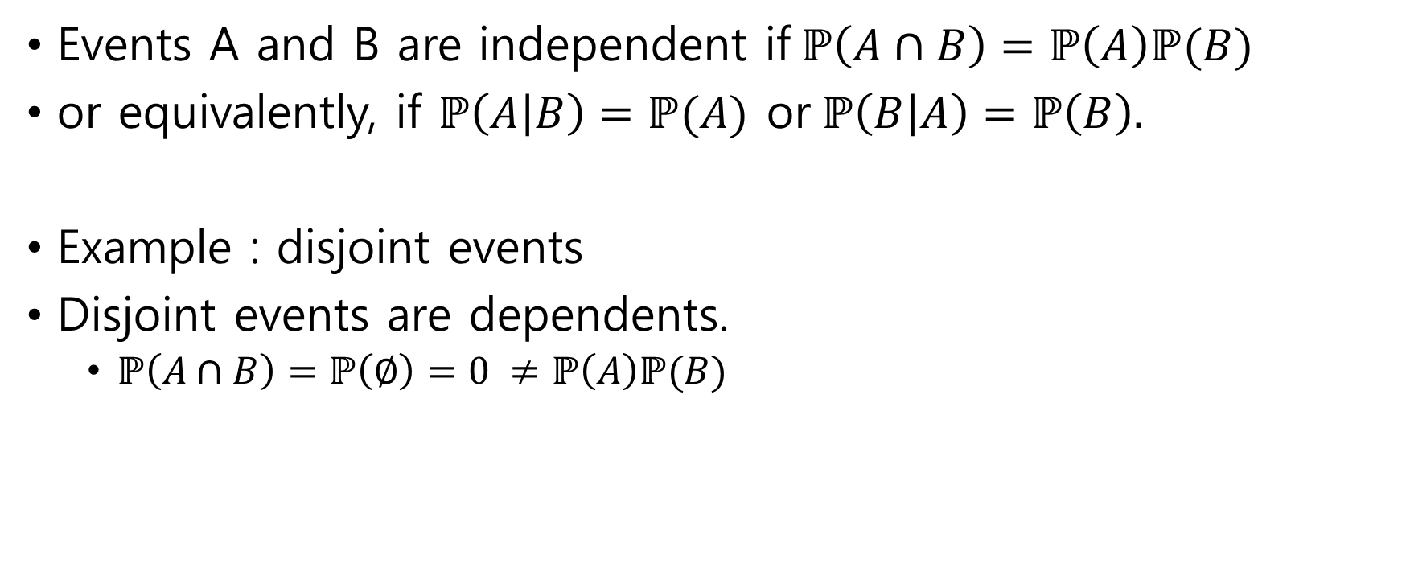
Independence
Events A and B are independent if$ℙ\left(A∩B\right)=ℙ\left(A\right)ℙ(B)$
or equivalently, if $ℙ\left(A | B\right)=ℙ(A)$ or$ℙ\left(B | A\right)=ℙ\left(B\right).$
Example : disjoint events
Disjoint events are dependents.
$ℙ\left(A∩B\right)=ℙ\left(∅\right)=0 ≠ℙ\left(A\right)ℙ(B)$

Slide 14
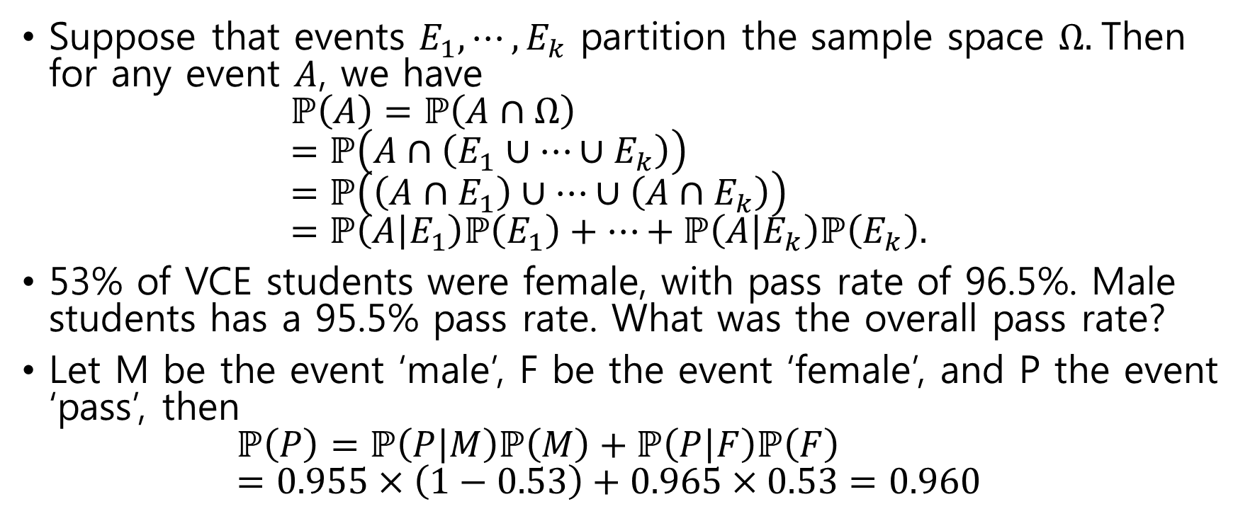
The law of total probability
Suppose that events $E_{1}, ⋯,E_{k}$ partition the sample space $Ω.$Then for any event $A$, we have $ℙ\left(A\right)=ℙ\left(A∩Ω\right)$ $=ℙ\left(A∩\left(E_{1}∪⋯∪E_{k}\right)\right)$ $=ℙ\left(\left(A∩E_{1}\right)∪⋯∪\left(A∩E_{k}\right)\right)$ $=ℙ\left(A | E_{1}\right)ℙ\left(E_{1}\right)+⋯+ℙ\left(A | E_{k}\right)ℙ\left(E_{k}\right).$
53% of VCE students were female, with pass rate of 96.5%. Male students has a 95.5% pass rate. What was the overall pass rate?
Let M be the event ‘male’, F be the event ‘female’, and P the event ‘pass’, then $ℙ\left(P\right)=ℙ\left(P | M\right)ℙ\left(M\right)+ℙ\left(P | F\right)ℙ\left(F\right)$ $=0.955×\left(1−0.53\right)+0.965×0.53=0.960$

Slide 15
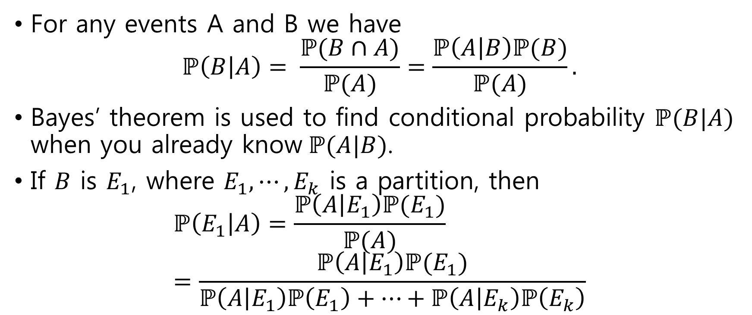
Bayes’ theorem
For any events A and B we have $ℙ\left(B | A\right)= \frac{ℙ(B∩A)}{ℙ(A)}=\frac{ℙ\left(A | B\right)ℙ(B)}{ℙ(A)}.$
Bayes’ theorem is used to find conditional probability $ℙ(B|A)$ when you already know$ℙ(A|B)$.
If $B$ is $E_{1}$, where $E_{1}, ⋯,E_{k}$ is a partition, then
$$ℙ\left(E_{1} | A\right)=\frac{ℙ\left(A | E_{1}\right)ℙ(E_{1})}{ℙ(A)} \\ =\frac{ℙ\left(A | E_{1}\right)ℙ(E_{1})}{ℙ\left(A | E_{1}\right)ℙ\left(E_{1}\right)+⋯+ℙ\left(A | E_{k}\right)ℙ\left(E_{k}\right)}$$

Slide 16
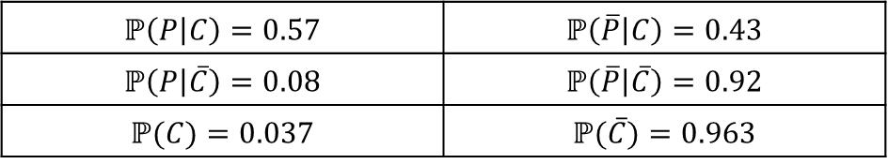
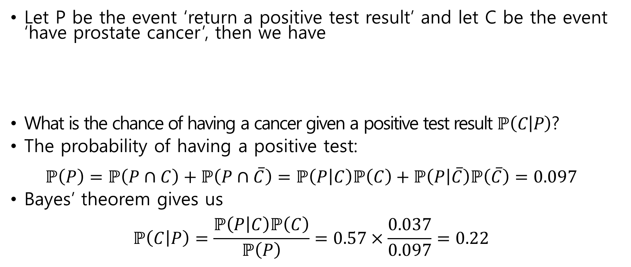
Example : Prostate cancer screening
Let P be the event ‘return a positive test result’ and let C be the event ‘have prostate cancer’, then we have
What is the chance of having a cancer given a positive test result $ℙ\left(C | P\right)$?
The probability of having a positive test: $ℙ\left(P\right)=ℙ\left(P∩C\right)+ℙ\left(P∩\overline{C}\right)=ℙ\left(P | C\right)ℙ\left(C\right)+ℙ\left(P | \overline{C}\right)ℙ\left(\overline{C}\right)=0.097$
Bayes’ theorem gives us $ℙ\left(C | P\right)=\frac{ℙ\left(P | C\right)ℙ\left(C\right)}{ℙ\left(P\right)}=0.57×\frac{0.037}{0.097}=0.22$
$$ℙ\left(P | C\right)=0.57$$ | $$ℙ\left(\overline{P} | C\right)=0.43$$
$$ℙ\left(P | \overline{C}\right)=0.08$$ | $$ℙ\left(\overline{P} | \overline{C}\right)=0.92$$
$$ℙ(C)=0.037$$ | $$ℙ(\overline{C})=0.963$$

