Slide 1
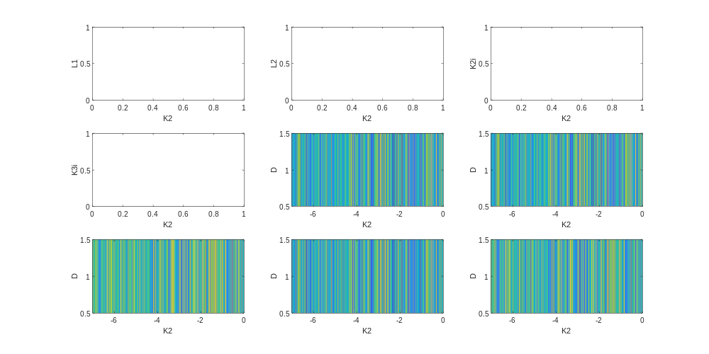
S1LR_Fan_73867370395.mat
6/1/2022 5:22 PM
S1:
Source 10MOhm
Left Dev: Source 11
L1: I(15-11) 0.05V/10MOH = 5nA, voltage drop across 10MOh
L2: 13-12
L3: 14-13
L4 : x
L5: 7-8
K3: TG-9
Right Dev: Source 1
L8: I(6-1) 0.05V/10MOh, voltage drop across 10MOh
L6: 4-3
L7: vxy 16-3
K2:TG-2

