Slide 1
Simple Kaggle data analysis
Lee Jeong Hoon

Slide 2
데이터 전처리 (type 등)
데이터 EDA (Exploratory Data Analysis)
데이터 시각화
데이터 모델링
-> 팀원들의 능력 파악 및 소통
(모든 지식은 구글에 있음)
위에서 제작한 모델을 Python – FLASK를 활용하여
웹 서비스를 제공하는 것이 목표
(모델이 아닌, 시각화 기능을 제공하는 웹사이트도 좋음)

Slide 3
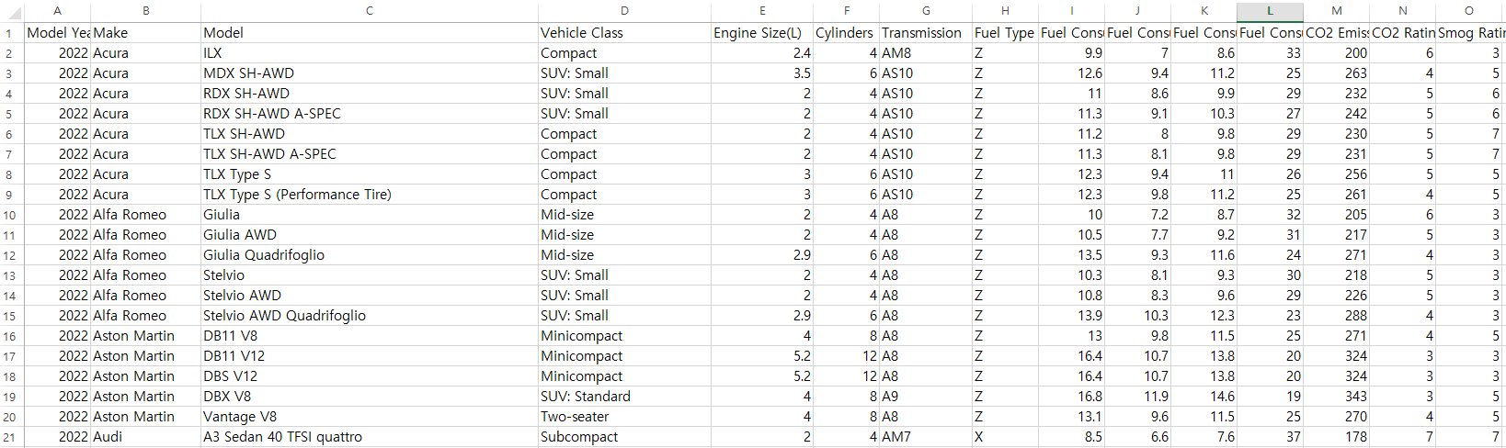
Recurrent Neural Network
https://www.kaggle.com/datasets/rinichristy/2022-fuel-consumption-ratings

Slide 4
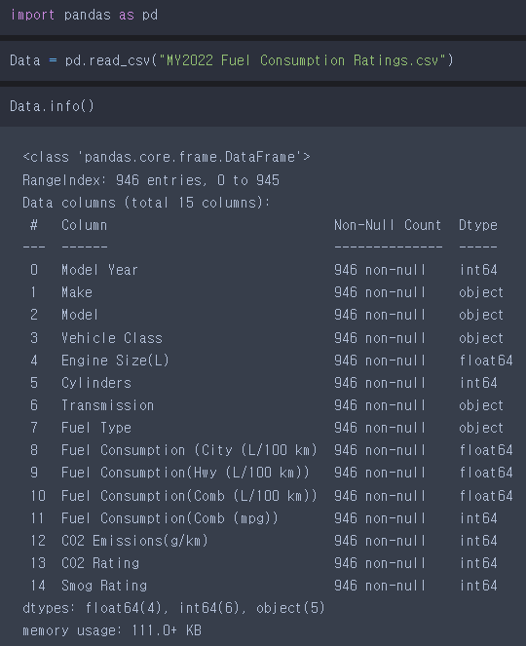
City / Highway
Comb: combined
mpg: Mile per gallon

Slide 5
EDA
ModelYear | Make | Model | VehicleClass | EngineSize | Cylinders | Transmission | FuelType | FuelCS_City | FuelCS_Hwy | FuelCS_Comb | FuelCS_MPG | CO2Emissions | CO2Rating | SmogRating
2022 | Acura | ILX | Compact | 2.4 | 4 | AM8 | Z | 9.9 | 7 | 8.6 | 33 | 200 | 6 | 3
2022 | Acura | MDX SH-AWD | SUV: Small | 3.5 | 6 | AS10 | Z | 12.6 | 9.4 | 11.2 | 25 | 263 | 4 | 5
2022 | Acura | RDX SH-AWD | SUV: Small | 2 | 4 | AS10 | Z | 11 | 8.6 | 9.9 | 29 | 232 | 5 | 6
2022 | Acura | RDX SH-AWD A-SPEC | SUV: Small | 2 | 4 | AS10 | Z | 11.3 | 9.1 | 10.3 | 27 | 242 | 5 | 6
2022 | Acura | TLX SH-AWD | Compact | 2 | 4 | AS10 | Z | 11.2 | 8 | 9.8 | 29 | 230 | 5 | 7
2022 | Acura | TLX SH-AWD A-SPEC | Compact | 2 | 4 | AS10 | Z | 11.3 | 8.1 | 9.8 | 29 | 231 | 5 | 7

Slide 6
ColumnName | UniqueCount | Type
ModelYear | 1 | int
Make | 39 | chr
Model | 715 | chr
VehicleClass | 14 | Compact
EngineSize | 36 | num
Cylinders | 8 | int
Transmission | 23 | chr
FuelType | 4 | chr
FuelCS_City | 149 | num
FuelCS_Hwy | 107 | num
FuelCS_Comb | 131 | num
FuelCS_MPG | 49 | int
CO2Emissions | 242 | int
CO2Rating | 10 | int
SmogRating | 5 | int

Slide 7
데이터 수: 946개
ColumnName | UniqueCount | Type
ModelYear | 1 | int
Make | 39 | chr
Model | 715 | chr
VehicleClass | 14 | Compact
EngineSize | 36 | num
Cylinders | 8 | int
Transmission | 23 | chr
FuelType | 4 | chr
FuelCS_City | 149 | num
FuelCS_Hwy | 107 | num
FuelCS_Comb | 131 | num
FuelCS_MPG | 49 | int
CO2Emissions | 242 | int
CO2Rating | 10 | int
SmogRating | 5 | int
필요없음: 모두 똑같은 column

Slide 8
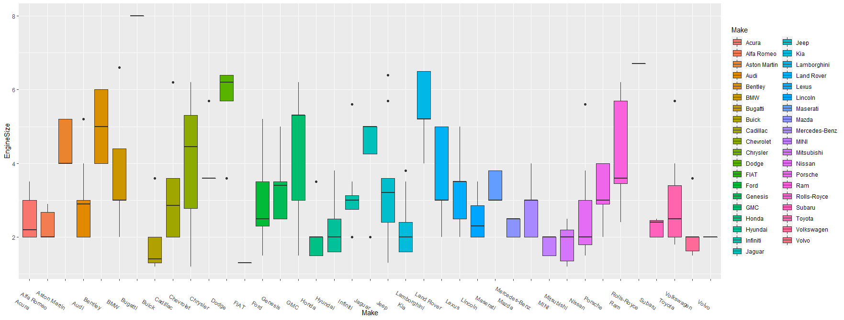
데이터 수: 946개
ColumnName | UniqueCount | Type
ModelYear | 1 | int
Make | 39 | chr
Model | 715 | chr
VehicleClass | 14 | chr
EngineSize | 36 | num
Cylinders | 8 | int
Transmission | 23 | chr
FuelType | 4 | chr
FuelCS_City | 149 | num
FuelCS_Hwy | 107 | num
FuelCS_Comb | 131 | num
FuelCS_MPG | 49 | int
CO2Emissions | 242 | int
CO2Rating | 10 | int
SmogRating | 5 | int
필요없음: 모두 똑같은 column
메이커: 39개
메이커도 결국 vehicle class, engine 등의 feature에
따라 너무 다를 것 같으므로..

Slide 9
데이터 수: 946개
ColumnName | UniqueCount | Type
ModelYear | 1 | int
Make | 39 | chr
Model | 715 | chr
VehicleClass | 14 | chr
EngineSize | 36 | num
Cylinders | 8 | int
Transmission | 23 | chr
FuelType | 4 | chr
FuelCS_City | 149 | num
FuelCS_Hwy | 107 | num
FuelCS_Comb | 131 | num
FuelCS_MPG | 49 | int
CO2Emissions | 242 | int
CO2Rating | 10 | int
SmogRating | 5 | int
필요없음: 모두 똑같은 column
메이커: 39개
필요없음: 너무 많은 model

Slide 10
데이터 수: 946개
ColumnName | UniqueCount | Type
ModelYear | 1 | int
Make | 39 | chr
Model | 715 | chr
VehicleClass | 14 | chr
EngineSize | 36 | num
Cylinders | 8 | int
Transmission | 23 | chr
FuelType | 4 | chr
FuelCS_City | 149 | num
FuelCS_Hwy | 107 | num
FuelCS_Comb | 131 | num
FuelCS_MPG | 49 | int
CO2Emissions | 242 | int
CO2Rating | 10 | int
SmogRating | 5 | int
필요없음: 모두 똑같은 column
메이커: 39개
필요없음: 너무 많은 model
매우중요해보임

Slide 11
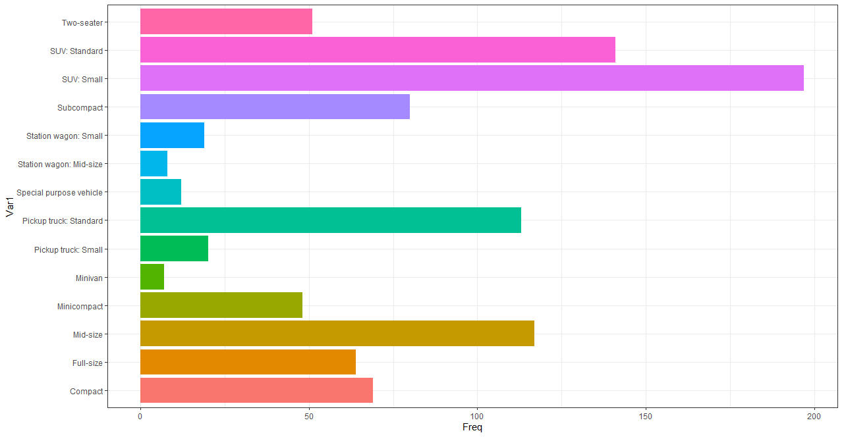
데이터 수: 946개
ColumnName | UniqueCount | Type
ModelYear | 1 | int
Make | 39 | chr
Model | 715 | chr
VehicleClass | 14 | chr
EngineSize | 36 | num
Cylinders | 8 | int
Transmission | 23 | chr
FuelType | 4 | chr
FuelCS_City | 149 | num
FuelCS_Hwy | 107 | num
FuelCS_Comb | 131 | num
FuelCS_MPG | 49 | int
CO2Emissions | 242 | int
CO2Rating | 10 | int
SmogRating | 5 | int
필요없음: 모두 똑같은 column
메이커: 39개
필요없음: 너무 많은 model
매우중요해보임

Slide 12
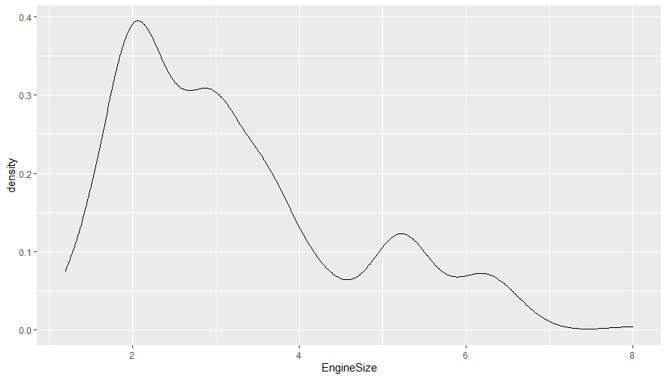
매우중요해보임
데이터 수: 946개
ColumnName | UniqueCount | Type
ModelYear | 1 | int
Make | 39 | chr
Model | 715 | chr
VehicleClass | 14 | chr
EngineSize | 36 | num
Cylinders | 8 | int
Transmission | 23 | chr
FuelType | 4 | chr
FuelCS_City | 149 | num
FuelCS_Hwy | 107 | num
FuelCS_Comb | 131 | num
FuelCS_MPG | 49 | int
CO2Emissions | 242 | int
CO2Rating | 10 | int
SmogRating | 5 | int

Slide 13
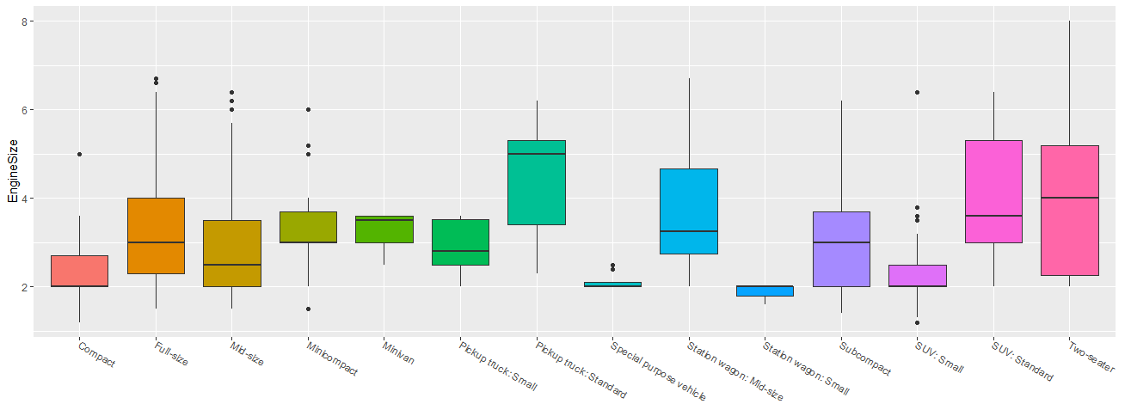
매우중요해보임
데이터 수: 946개
ColumnName | UniqueCount | Type
ModelYear | 1 | int
Make | 39 | chr
Model | 715 | chr
VehicleClass | 14 | chr
EngineSize | 36 | num
Cylinders | 8 | int
Transmission | 23 | chr
FuelType | 4 | chr
FuelCS_City | 149 | num
FuelCS_Hwy | 107 | num
FuelCS_Comb | 131 | num
FuelCS_MPG | 49 | int
CO2Emissions | 242 | int
CO2Rating | 10 | int
SmogRating | 5 | int

Slide 14
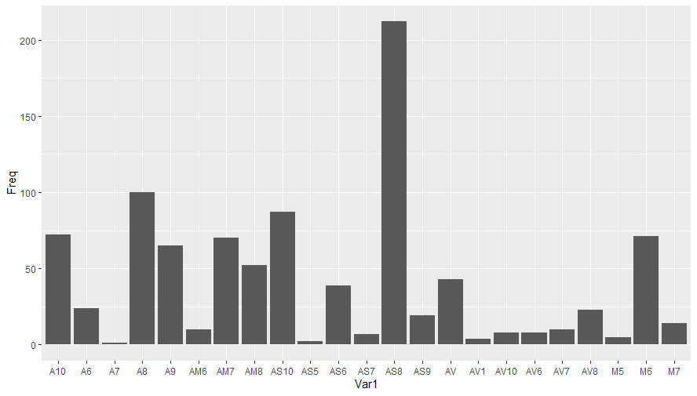
데이터 수: 946개
ColumnName | UniqueCount | Type
ModelYear | 1 | int
Make | 39 | chr
Model | 715 | chr
VehicleClass | 14 | chr
EngineSize | 36 | num
Cylinders | 8 | int
Transmission | 23 | chr
FuelType | 4 | chr
FuelCS_City | 149 | num
FuelCS_Hwy | 107 | num
FuelCS_Comb | 131 | num
FuelCS_MPG | 49 | int
CO2Emissions | 242 | int
CO2Rating | 10 | int
SmogRating | 5 | int
변속기

Slide 15
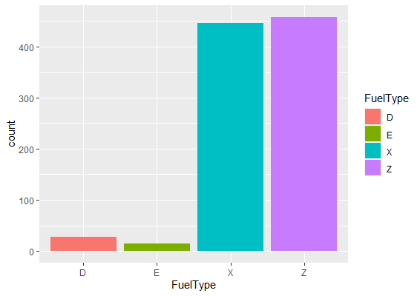
데이터 수: 946개
ColumnName | UniqueCount | Type
ModelYear | 1 | int
Make | 39 | chr
Model | 715 | chr
VehicleClass | 14 | chr
EngineSize | 36 | num
Cylinders | 8 | int
Transmission | 23 | chr
FuelType | 4 | chr
FuelCS_City | 149 | num
FuelCS_Hwy | 107 | num
FuelCS_Comb | 131 | num
FuelCS_MPG | 49 | int
CO2Emissions | 242 | int
CO2Rating | 10 | int
SmogRating | 5 | int

Slide 16
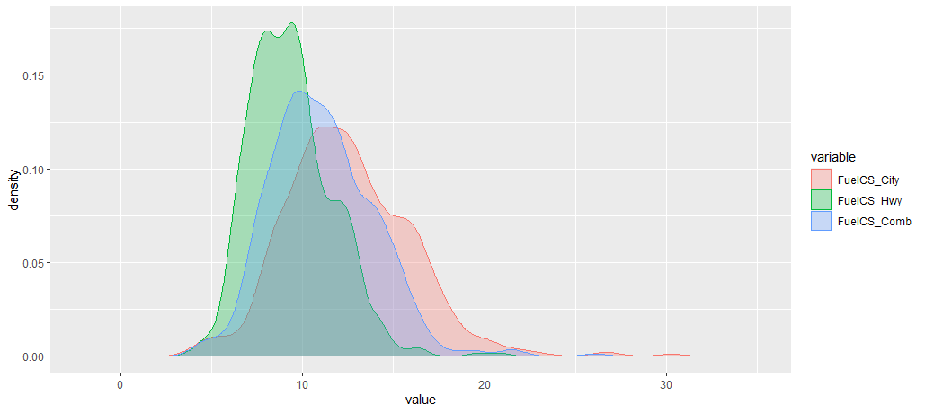
데이터 수: 946개
ColumnName | UniqueCount | Type
ModelYear | 1 | int
Make | 39 | chr
Model | 715 | chr
VehicleClass | 14 | chr
EngineSize | 36 | num
Cylinders | 8 | int
Transmission | 23 | chr
FuelType | 4 | chr
FuelCS_City | 149 | num
FuelCS_Hwy | 107 | num
FuelCS_Comb | 131 | num
FuelCS_MPG | 49 | int
CO2Emissions | 242 | int
CO2Rating | 10 | int
SmogRating | 5 | int

Slide 17
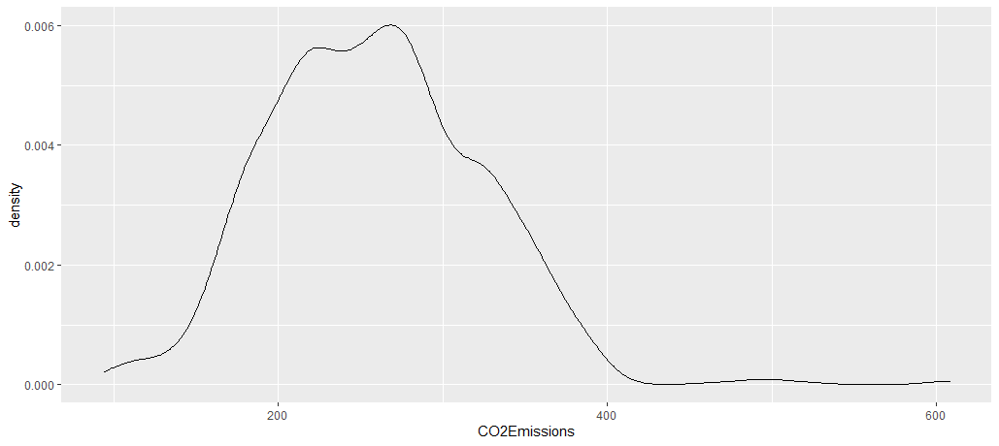
데이터 수: 946개
ColumnName | UniqueCount | Type
ModelYear | 1 | int
Make | 39 | chr
Model | 715 | chr
VehicleClass | 14 | chr
EngineSize | 36 | num
Cylinders | 8 | int
Transmission | 23 | chr
FuelType | 4 | chr
FuelCS_City | 149 | num
FuelCS_Hwy | 107 | num
FuelCS_Comb | 131 | num
FuelCS_MPG | 49 | int
CO2Emissions | 242 | int
CO2Rating | 10 | int
SmogRating | 5 | int

Slide 18
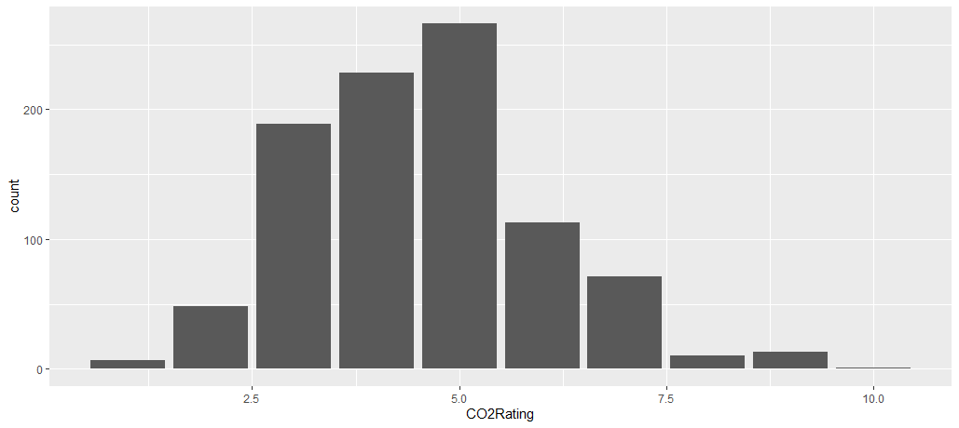
데이터 수: 946개
ColumnName | UniqueCount | Type
ModelYear | 1 | int
Make | 39 | chr
Model | 715 | chr
VehicleClass | 14 | chr
EngineSize | 36 | num
Cylinders | 8 | int
Transmission | 23 | chr
FuelType | 4 | chr
FuelCS_City | 149 | num
FuelCS_Hwy | 107 | num
FuelCS_Comb | 131 | num
FuelCS_MPG | 49 | int
CO2Emissions | 242 | int
CO2Rating | 10 | int
SmogRating | 5 | int

Slide 19
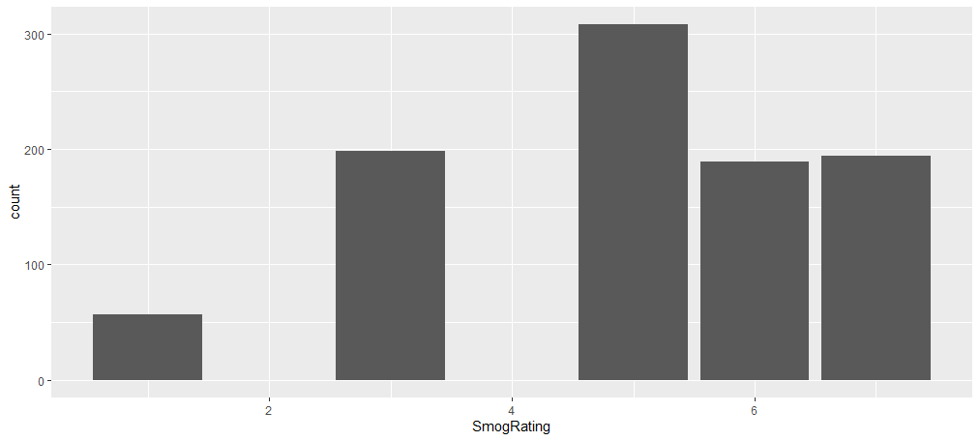
데이터 수: 946개
ColumnName | UniqueCount | Type
ModelYear | 1 | int
Make | 39 | chr
Model | 715 | chr
VehicleClass | 14 | chr
EngineSize | 36 | num
Cylinders | 8 | int
Transmission | 23 | chr
FuelType | 4 | chr
FuelCS_City | 149 | num
FuelCS_Hwy | 107 | num
FuelCS_Comb | 131 | num
FuelCS_MPG | 49 | int
CO2Emissions | 242 | int
CO2Rating | 10 | int
SmogRating | 5 | int

Slide 20
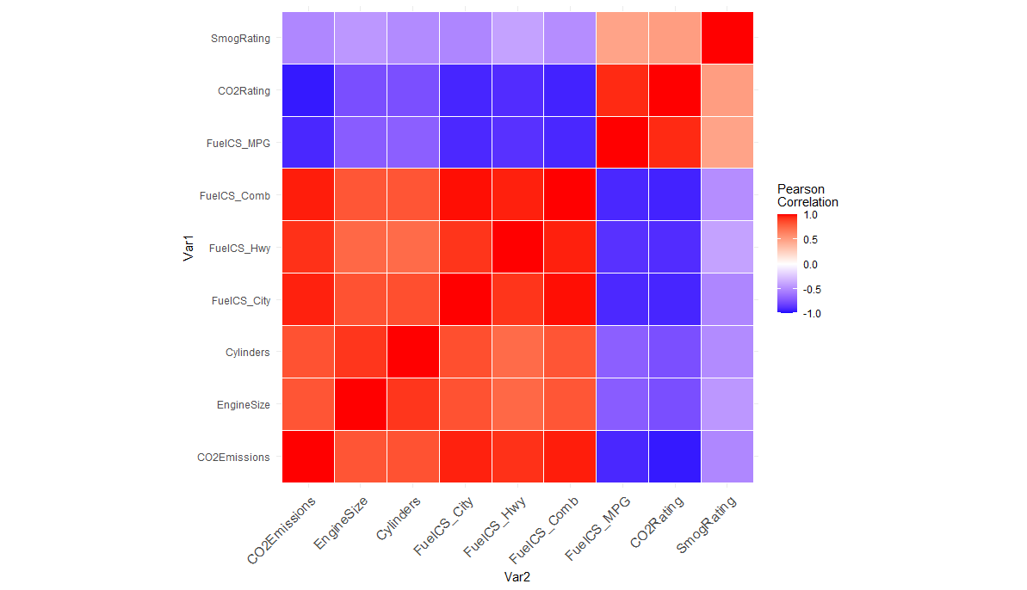

Slide 21
데이터 수: 946개
Random split (80% train, 20% valid) – 751 vs 195
ColumnName | UniqueCount | Type
ModelYear | 1 | int
Make | 39 | chr
Model | 715 | chr
VehicleClass | 14 | chr
EngineSize | 36 | num
Cylinders | 8 | int
Transmission | 23 | chr
FuelType | 4 | chr
FuelCS_City | 149 | num
FuelCS_Hwy | 107 | num
FuelCS_Comb | 131 | num
FuelCS_MPG | 49 | int
CO2Emissions | 242 | int
CO2Rating | 10 | int
SmogRating | 5 | int
모델 사용 - Random Forest
CO2Emissions ~ VehicleClass + EngineSize + Cylinders + Transmission + FuelType + FuelCS_City + FuelCS_Hwy + FuelCS_Comb + FuelCS_MPG + CO2Rating + SmogRating

Slide 22
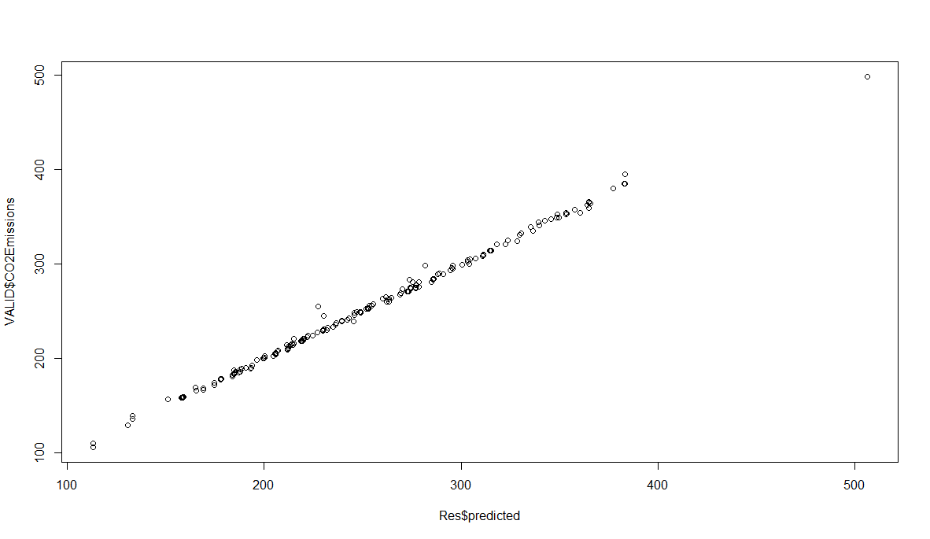
Mean of (predicted - CO2Emissions)^2
10.99231

Slide 23
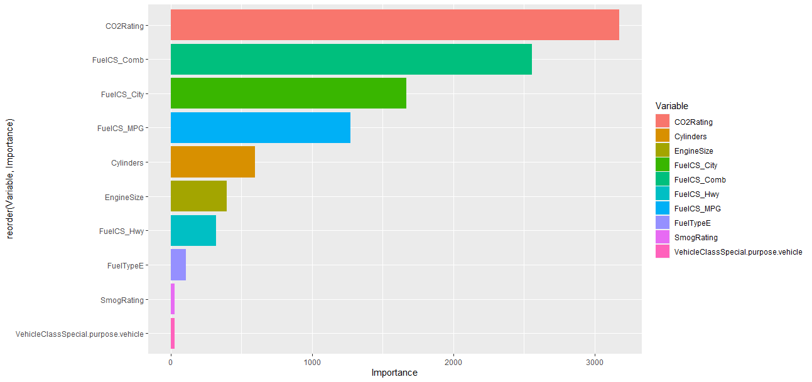
모델 결과 분석 (Random Forest Importance)
CO2Emissions ~ VehicleClass + EngineSize + Cylinders + FuelType + FuelCS_City + FuelCS_Hwy + FuelCS_Comb + FuelCS_MPG + CO2Rating + SmogRating

Slide 24
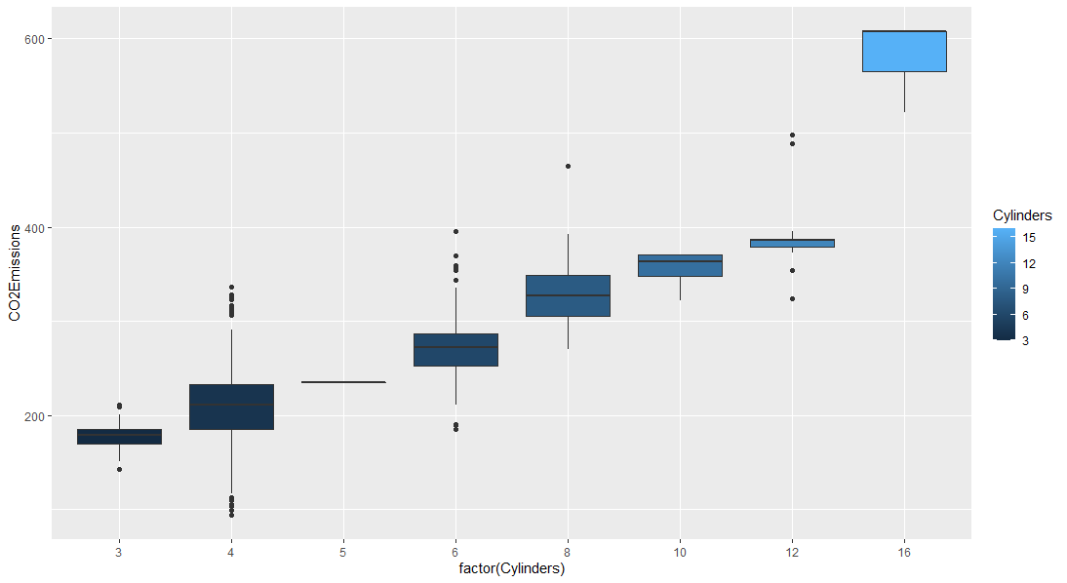
Cylinders & CO2 Emission
Pearson Correlation – 0.833
P-value < 0.001

Slide 25
