Slide 1
FLASK – Web Application of Python
Lee Jeong Hoon

Slide 2
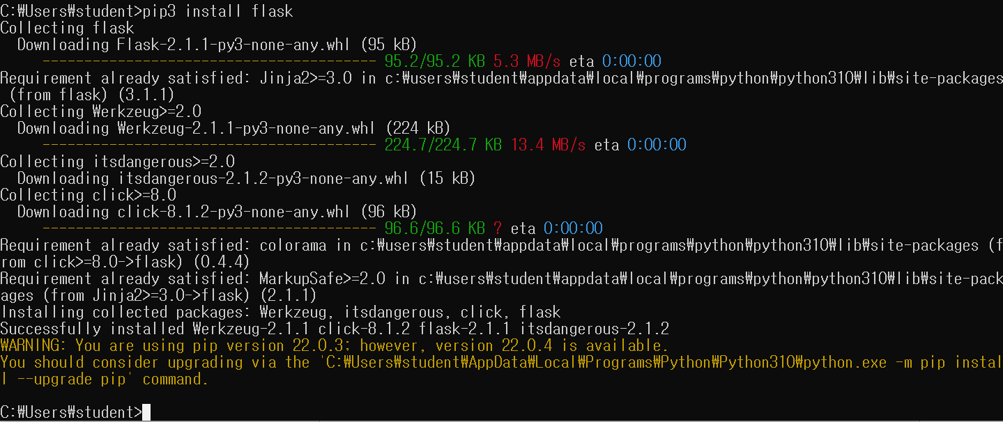
FLASK install

Slide 3
from flask import Flask
app = Flask(__name__)
@app.route("/")
def hello_world():
return "<p>Hello, World!</p>"

Slide 4
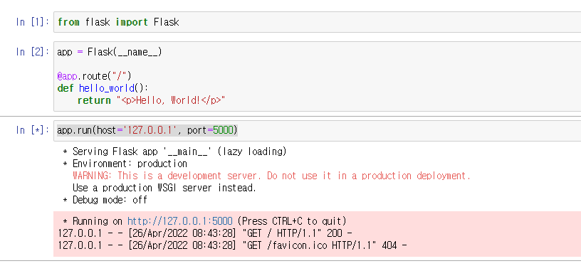
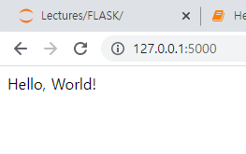

Slide 5
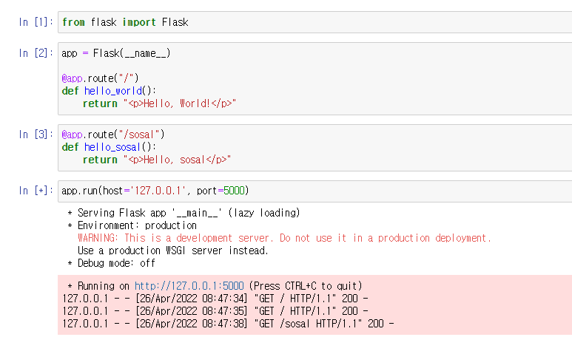
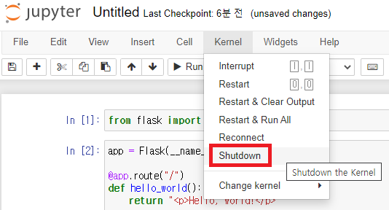
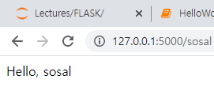

Slide 6
from flask import Flask
app = Flask(__name__)
@app.route("/", methods=['GET','POST'])
def hello_world():
name = request.form.get('name')
return "<p>Hello, " + name + "</p>"

Slide 7
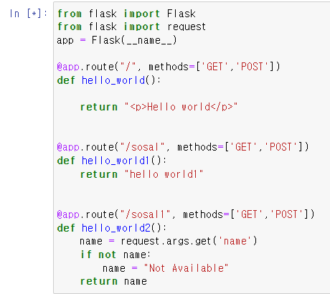
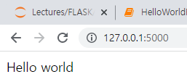
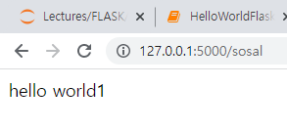
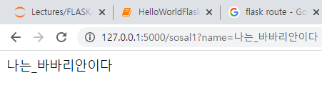
http://127.0.0.1:5000/sosal1?name=나는_바바리안이다

