Slide 1
(ﾉ›_‹)ﾉMy-ticon
Special character emoticon recommendation
based on text emotion
Group 8
강현서(2020314978)
김성민(2018311561)
배정우(2018310164)
이금진(2018311696)
정윤수(2018314089)
Notes:
1.
Hello, I’m Yunsu Jeong from group 8 and our topic is a special character emoticon recommendation based on text emotion.

Slide 2
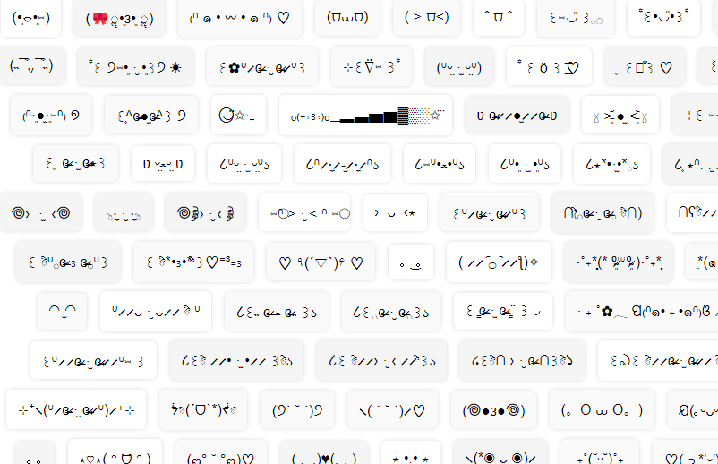
Table of Contents
1
Introduction
2
Model outline & Datasets
3
Model Specification
4
Conclusion
Notes:
I will proceed my presentation with these contents. After the introduction, I will outline our model and datasets, and then explain our model in detail. Lastly, I will discuss the novelty and limitation of our project and conclude.

Slide 3
1
Introduction

Slide 4

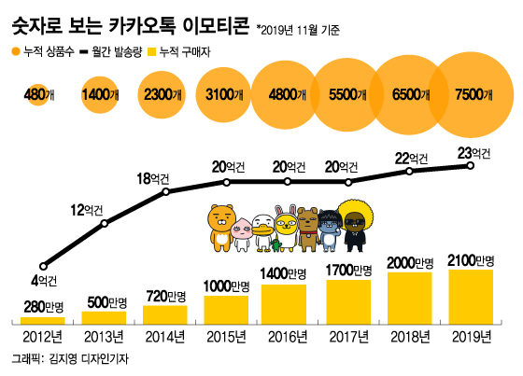
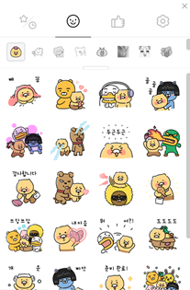

Project Background
Notes:
Many people use emoticons to convey their feelings on messengers. But purchased emoticons are divided by series, as you can see on the middle. So it is inconvenient to find and use emoticons that fit the situation every time.
To resolve this problem, we want to develop a special character emoticon recommendation system based on entered sentences. There are programs that recommend emoticons in the form of images, but in this project, we will create a program that recommends emoticons consisting of special characters rather than image types. With the recent retro craze, things that were popular in the past have begun to trend again. Therefore, this program will increase the use of special character emoticons. In addition, the use of special text emoticons will help elderly users who are not familiar with messenger use, and this will facilitate communication between generations.

Slide 5
Part 1
Goals
Input User Sentence
Model → Emotion + Sentence content
Special Character Emoticon Recommendation
Notes:
So, First, a sentence is given from the user to do sentiment analysis. This sentence is analyzed and classified by sentiment. Also, the content of the sentence is considered here. Finally, the model will print out the top 5 recommended special-character-emoticons.

Slide 6
2
Model Outline & Datasets

Slide 7
Model
ELECTRA
Classifier
Emotion
Score
Input
Sentence
Similarity
Based
Recommendation
Sentence
BERT
Sentence
Embedding
Notes:
As input sentence is provided by the user, two parts analyzes this sentence.
Emotional classifier, which is KcELECTRA classifier, predicts sentences’ emotions.
KR-Sbert analyzes sentence content and generates sentence embedding vector to compare similarities between sentences. The most appropriate emoticons from the two results above will be recommended.

Slide 8
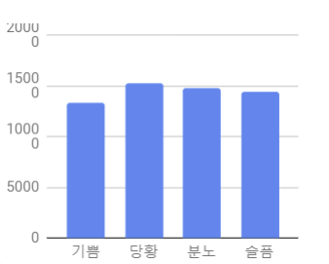
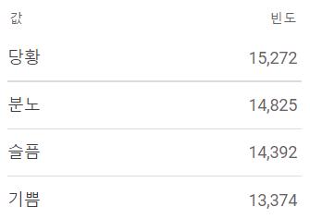
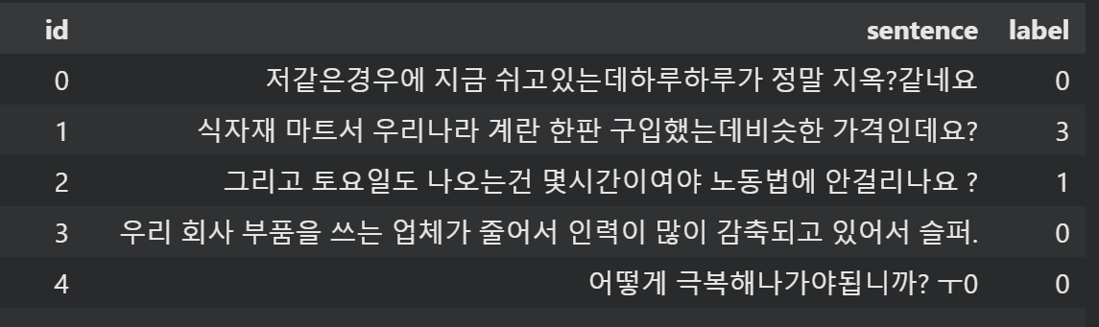
Part 2
Datasets
AI-Hub One-Time Conversation Dataset with Korean Emotion Information
AI-Hub Emotional Conversation Corpus
Interactive Input
Interactive Dataset
내일은 빨간날이야!
Notes:
These are the two datasets we used: AI-Hub One-Time Conversation Dataset with Korean Emotion Information, AI-Hub Emotional Conversation Corpus. Total number of the data is 57863 and it has four emotions: happy, sad, surprise, and anger. It is quite evenly distributed among the four emotions.
And since the input sentence we are going to get from the user is interactive, the dataset we chose is also interactive sentences.

Slide 9
3
Model Specification

Slide 10
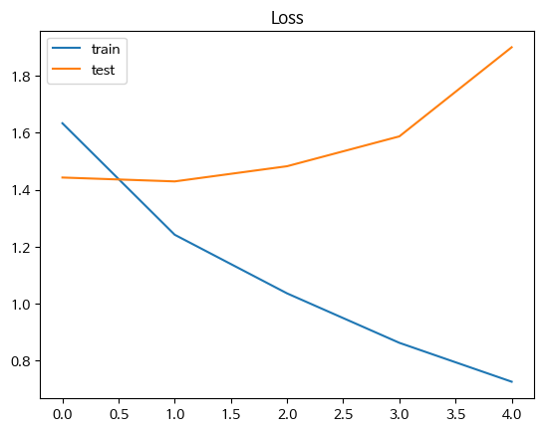
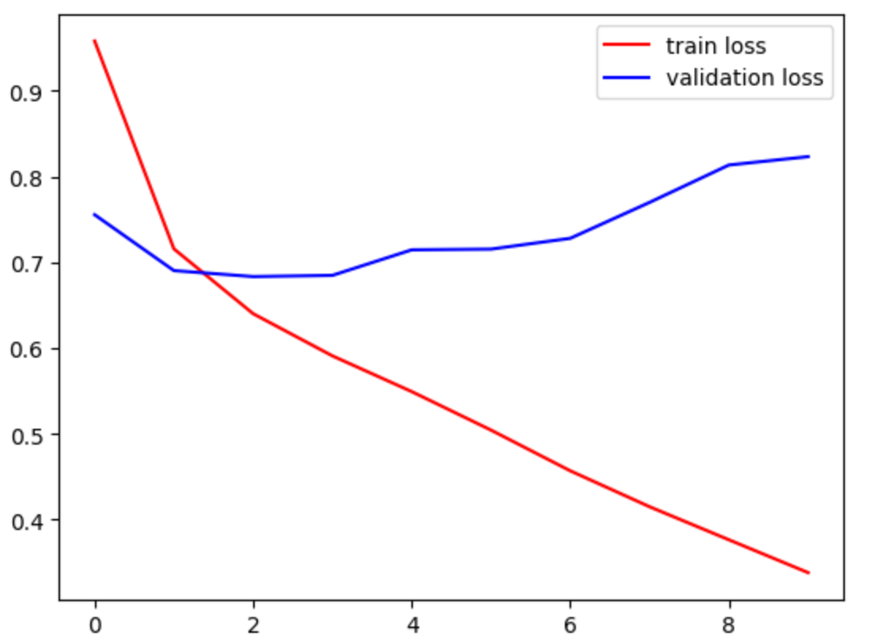
Part 3
Emoticon Classifier – Early Models
Accuracy : 0.4631
Accuracy : 0.6675
1 Dataset
2 Datasets
7 Emotions
4 Emotions
LSTM
LSTM
Notes:
This emotion classifier is a part where we proceeded model learning.
We first started with LSTM with only one dataset among two data which I said before that we used finally. And we had 7 emotion categories to classify. Since the accuracy was 46 and not that good, to improve the accuracy, we increased the dataset size and reduced the number of emotion categories to 4, which are anger, happy, sad, and surprise. As a result, we were able to achieve an accuracy of up to 66%. However, we deemed this accuracy insufficient, so tried another method.

Slide 11
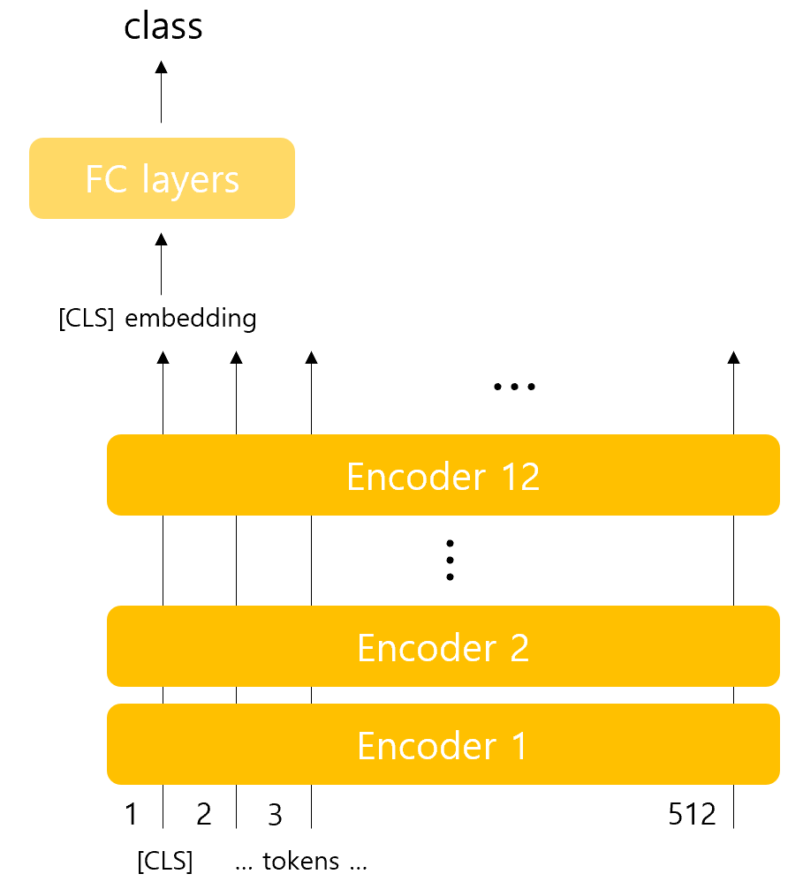
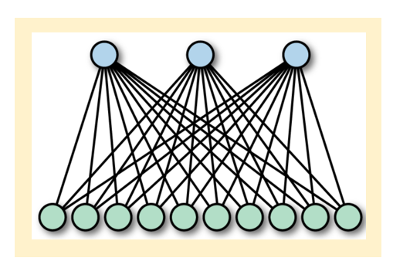
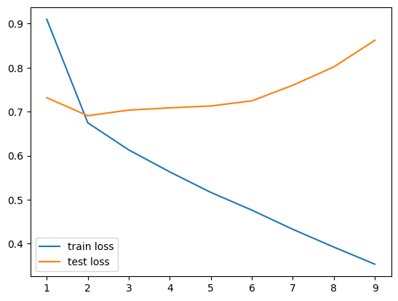
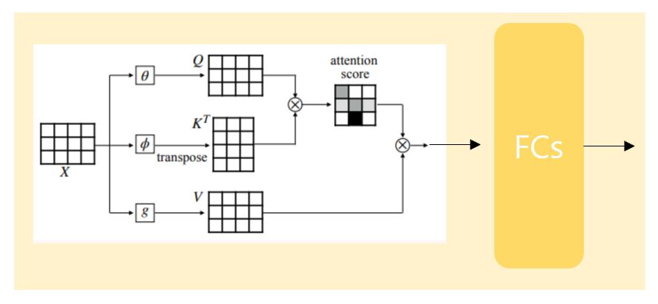
Part 3
Emoticon Classifier – Final Model
Hyper parameter
Accuracy : 0.6938
learning rate
5e-6
2 Datasets
epoch
10
4 Emotions
gamma
0.5
Electra Classifier
max length
25
Notes:
So finally we trained a KcElectra model and finally achieved an accuracy of around 69%. These are the Hyper parameter we used.

Slide 12
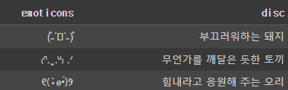
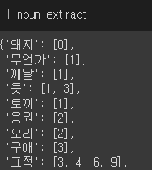
Part 3
Sentence Bert
Word based emoticon recommendation
Noun Extraction
Vocabulary is limited
KR-SBERT
Doesn’t identify and use adjectives well
Notes:
Now I will talk about the sentence bert part. At first, we tried to use keywords for recommendation, but it was expected low performance since we need to manually register the keywords, it had low scalability and the model cannot identify and use adjectives for the recommendation.
So Instead, we decided to use KR-SBERT.

Slide 13
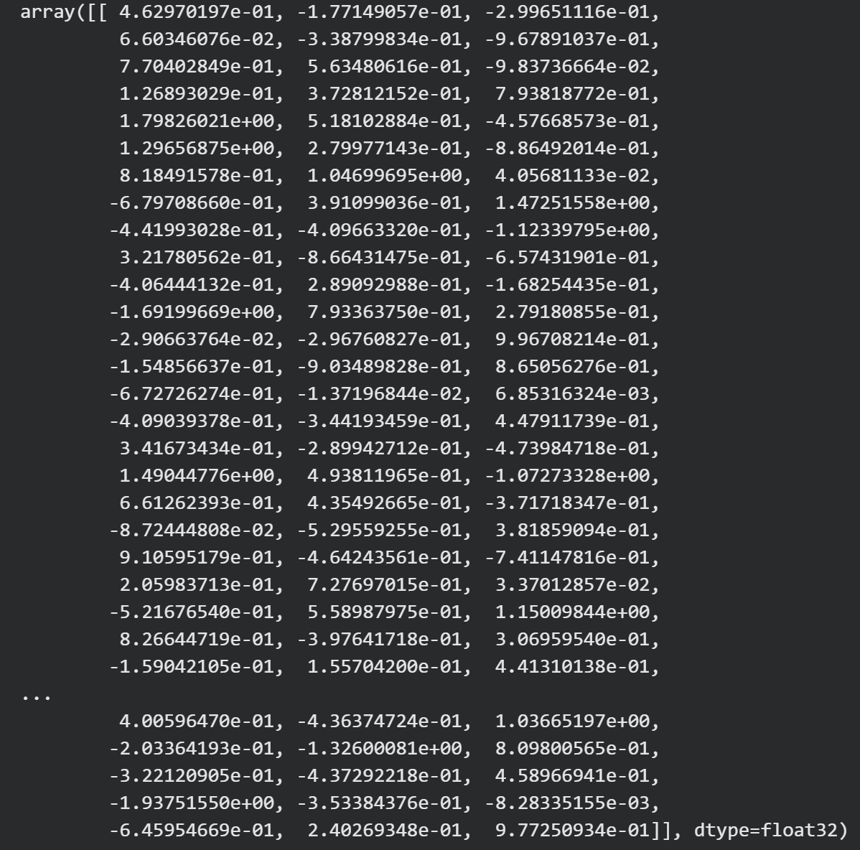
Part 3
Sentence Bert
KR-SBERT
No fine-tuning
sentence
embedding vector
Cosine Similarity
infer meaning of sentence
Notes:
We didn’t go through fine tuning for generalized performance, and when the input sentence from the user is provided, it is converted to an embedding vector. By using the cosine similarity of these vectors, the content of the sentence is inferred.

Slide 14
Part 3
Emoticon Datasets
Happy
Surprise
⸜(*ˊᗜˋ*)⸝
( ⁎ ᵕᴗᵕ ⁎ )
✧*.◟(ˊᗨˋ)◞.*✧
♪ ( ᷇࿀ ᷆ و(و "
✺◟(＾∇＾)◞✺
오늘 아침 너무 상쾌하다
기분이 참 좋네
내가 제일 빛나
둠칫둠칫 신난다
오늘도 좋은 하루 보내
Σ(； ･`д･´)
Σ(●ꉺ▱ꉺ●)
∑(O_O；)
(‘◇’)?
(」゜ロ゜)」
띠용 이게 뭐지?
그게 무슨 소리야?
누구세요?
새가 당황스러워한다.
이거 완전 놀라운 사실인데?
Sad
Anger
( ᴗ_ᴗ̩̩ )
(☍﹏⁰)
(oT-T)尸
༼ ༎ຶ ෴ ༎ຶ༽
.•°(° ＞⌓＜°)°•.
나는 가끔씩 눈물을 흘린다…
눈물이 찔끔 나네
항복이야 내가 잘못했어
광광 울었다
어린애가 엉엉 울고 있다.
ᕕ(ꐦ°᷄д°᷅)ᕗ
(*｀□)<炎炎炎炎
ヾ( ·`⌓´·)ﾉﾞ
༼ง ͠ຈ ͟ل͜ ͠ຈ༽o:[]:::::::>
ʰᵘʰ (ꐦ○_○）✧
나랑 지금 싸우자는거야?
잔소리를 하고 있다.
아니 이건 아니지
법보다 칼이 빠르다네 친구
하 어이가 없네
Notes:
This is the special character emoticons dataset we used.
We collected 30 pieces for each four emotion on the internet and manually made five sentences per one emoticon that represent the characteristics of the emoticon or an appropriate situation it might be used.

Slide 15
Part 3
Similarity Based Recommendation
input vector
cosine similarity rank
Recommended
Emotion Score
sentence 1
emoticon a
emoticon a
sentence 2
emoticon b
emoticon c
weight
sentence 3
emoticon c
sentence 4
emoticon a
Sentence
Embedding
sentence 5
emoticon d
sentence 6
emoticon c
Concated vector
Notes:
So this is our whole similarity based recommendation procedure.
First we concate the emotion score made by emotion classifier and sentence embedding vector made by SBERT.
It recommends the emoticons by cosine similarity calculation. Emoticons which appear more then twice from the closest will be recommended.

Slide 16
4
Conclusion

Slide 17
Part 4
Evaluation Metric - Hit Ratio, Sentence Similarity
emoticon 1
Hit!
emoticon 2
emoticon 3
Hit!
Hit Ratio
emoticon 4
Hit!
emoticon 5
input sentence
vector
Sentence Similarity
Notes:
X emotion weight 정우 y sentence similarity

Slide 18
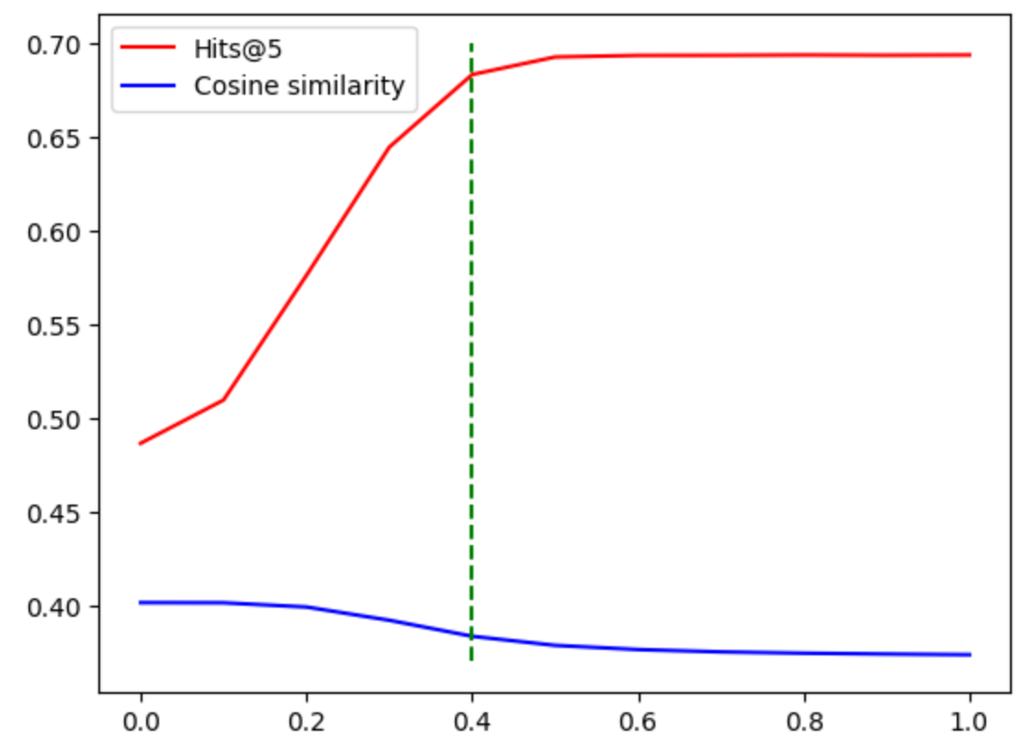
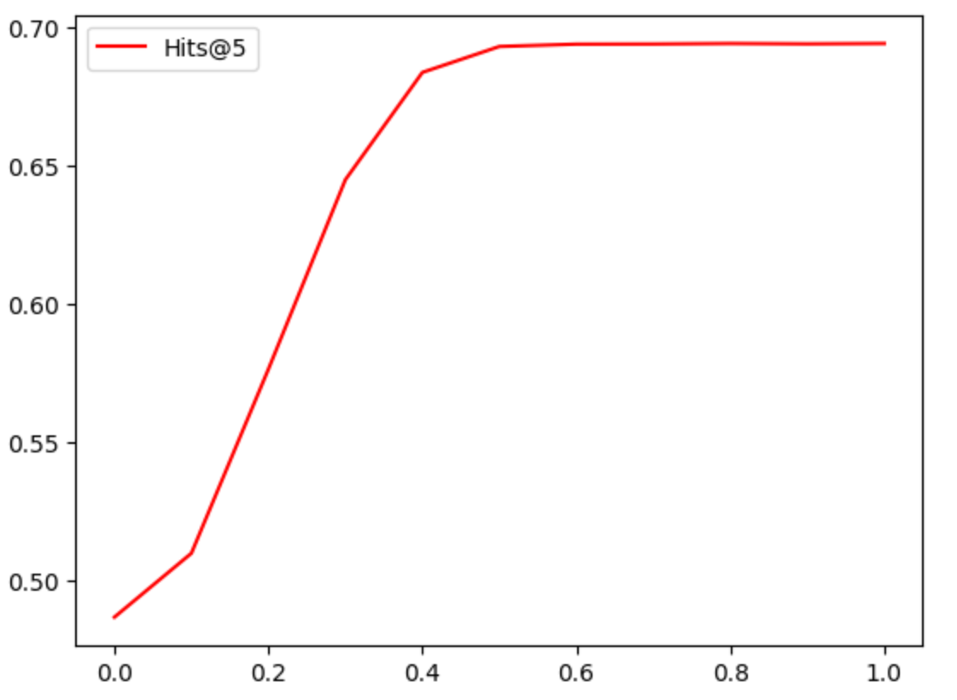
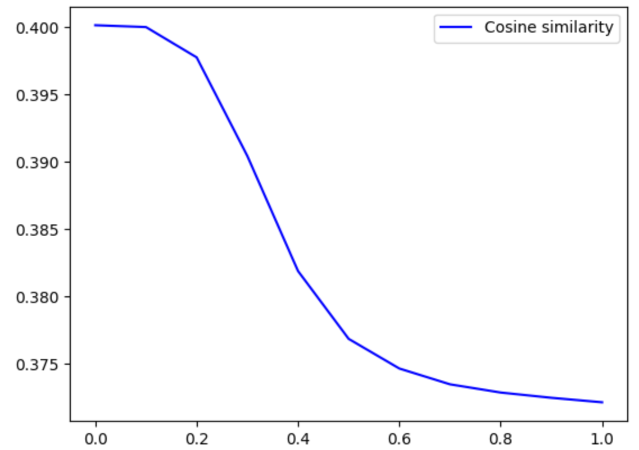
Part 4
Evaluation Metric – Emotion Weight Decision
Emotion Weight:
0.4

Slide 19
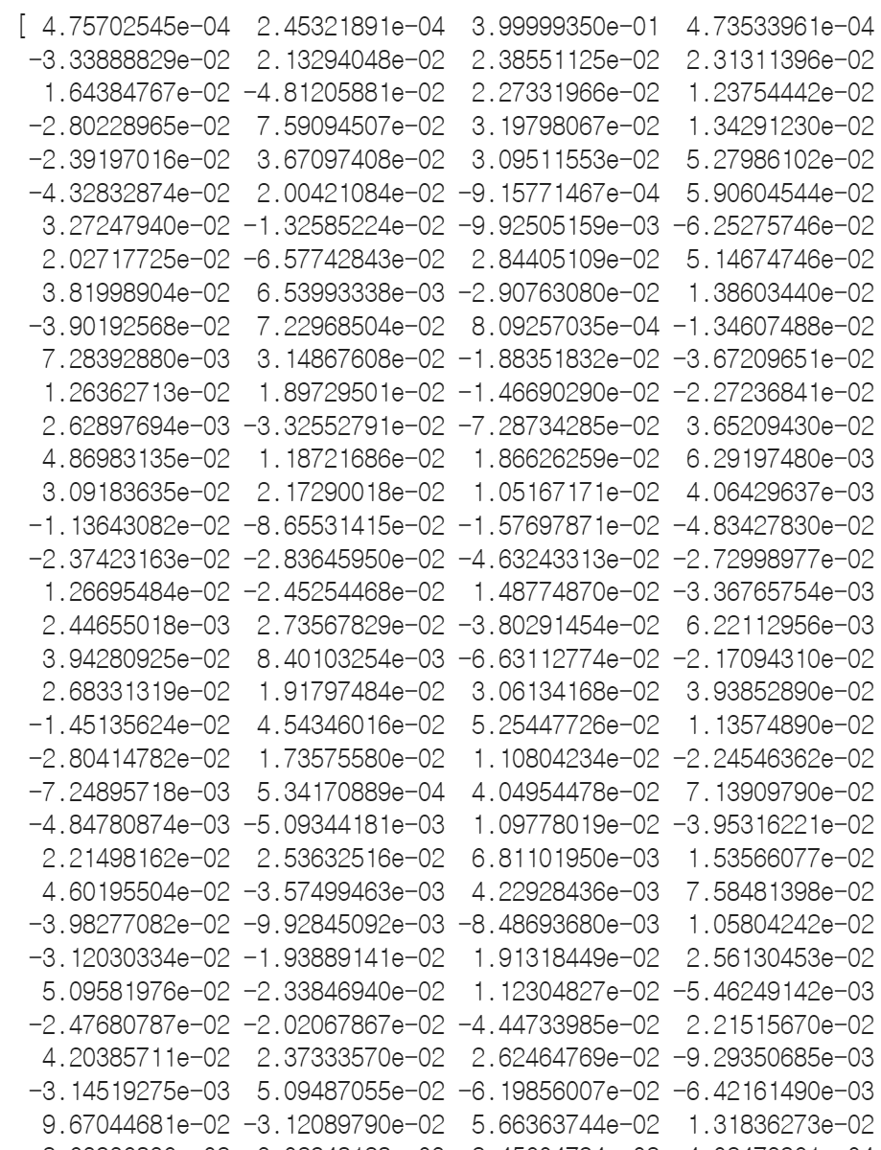
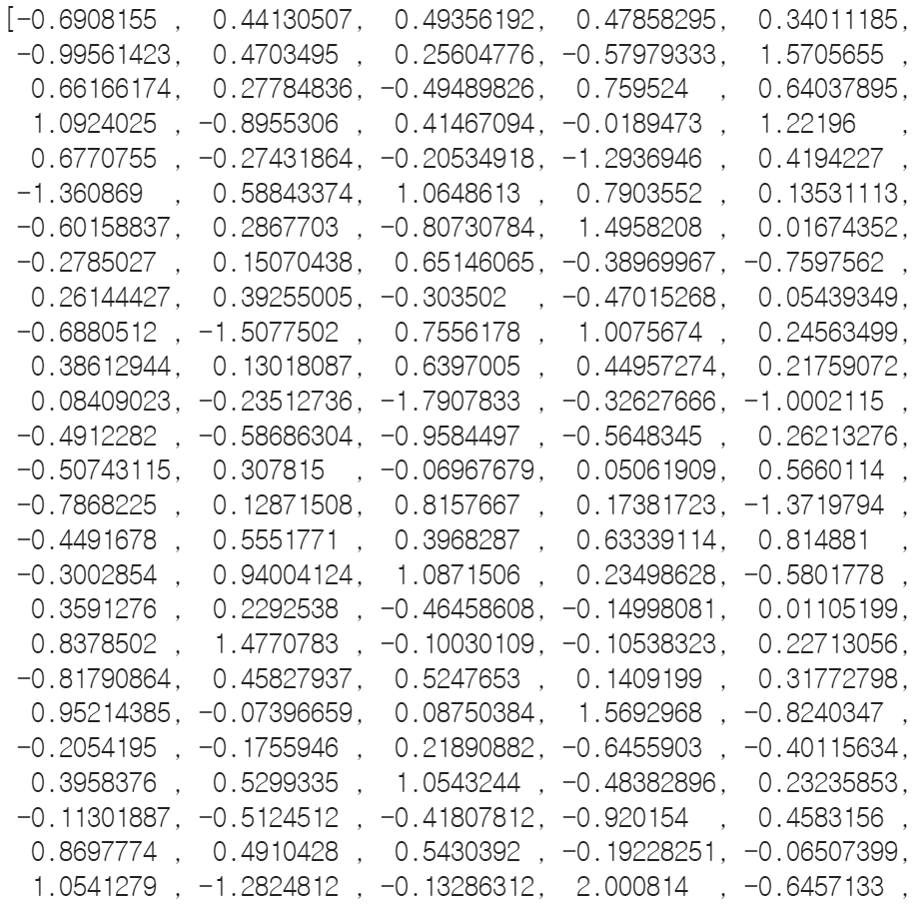
Part 4
Result
Emotion Score
Normalize, Weight, Concate
input sentence
(4, )
“강아지랑 고양이 너무 귀여워서 키우고 싶어"
Sentence Embedding
(768, )
(772, )

Slide 20
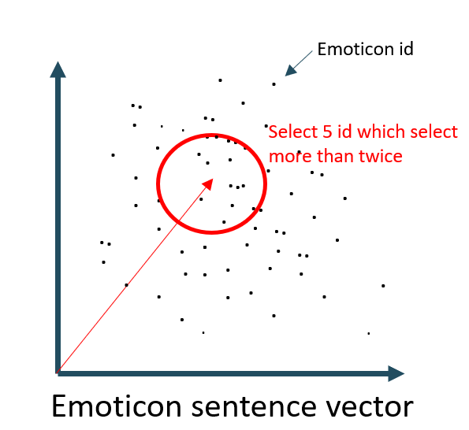
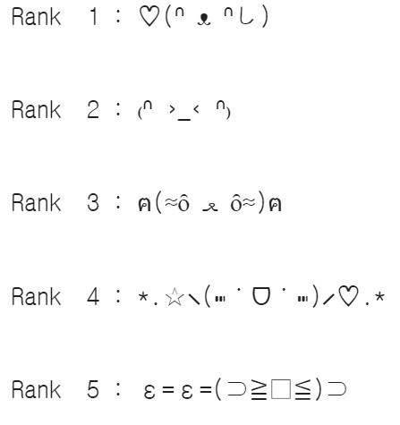
Part 4
Result
Compare vector with
Emoticon sentence vector space
Recommended Result
(772, )

Slide 21
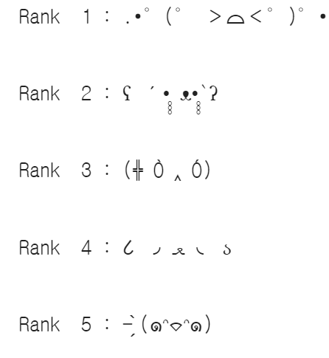
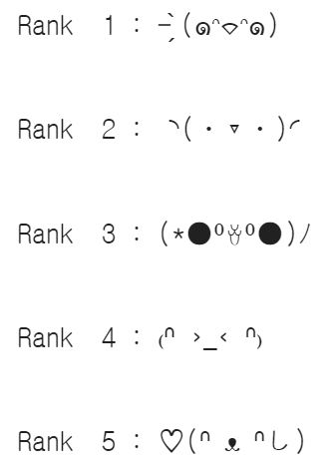
Part 4
Novelty
Random Recommendations within Emotional Labels
Only Emotion
Only
Sentence Embedding
Emotion + Sentence Embedding
Sentence Vector = [Emotion Vector] * Weight + [Sentence Embedding Vector]
Notes:
Beside the topic’s novelty, I will talk about some technical novelty in our model perspective. We considered not only emotions but also the content of the sentence.
If only emotions are considered, emoticons are randomly matched among the same emotion category of the sentence, so it is not that personalized.
On the other side, if only sentence contents similarity is considered, there is a possibility that the model recommends wrong emoticons since it doesn’t consider the implied meaning of the sentence.
So finally, by combining the two factors: emotion and content of the sentence we were able to see significant performance of the model.

Slide 22
Thank you

