Slide 1
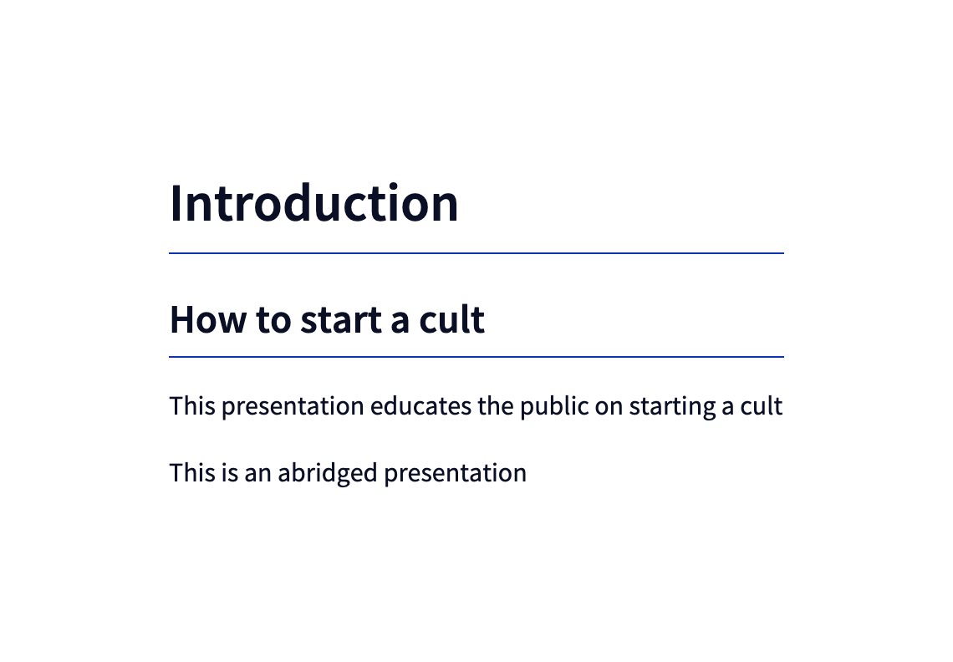
root

Slide 2
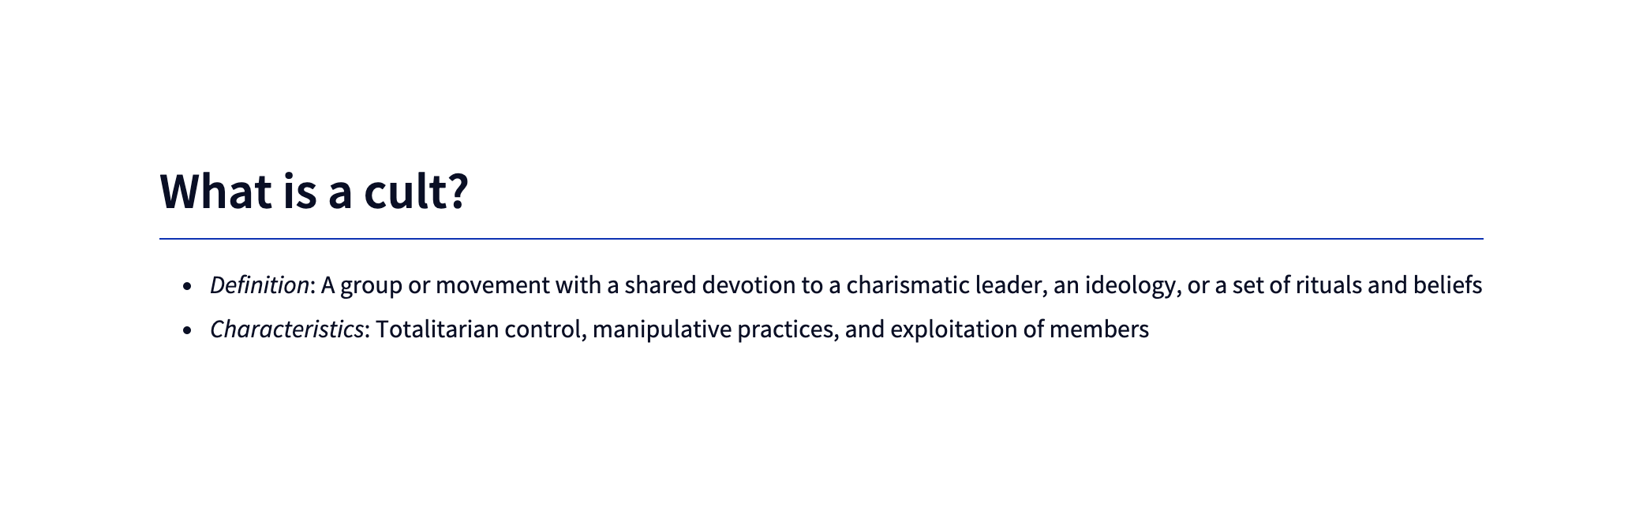
root / 1

Slide 3
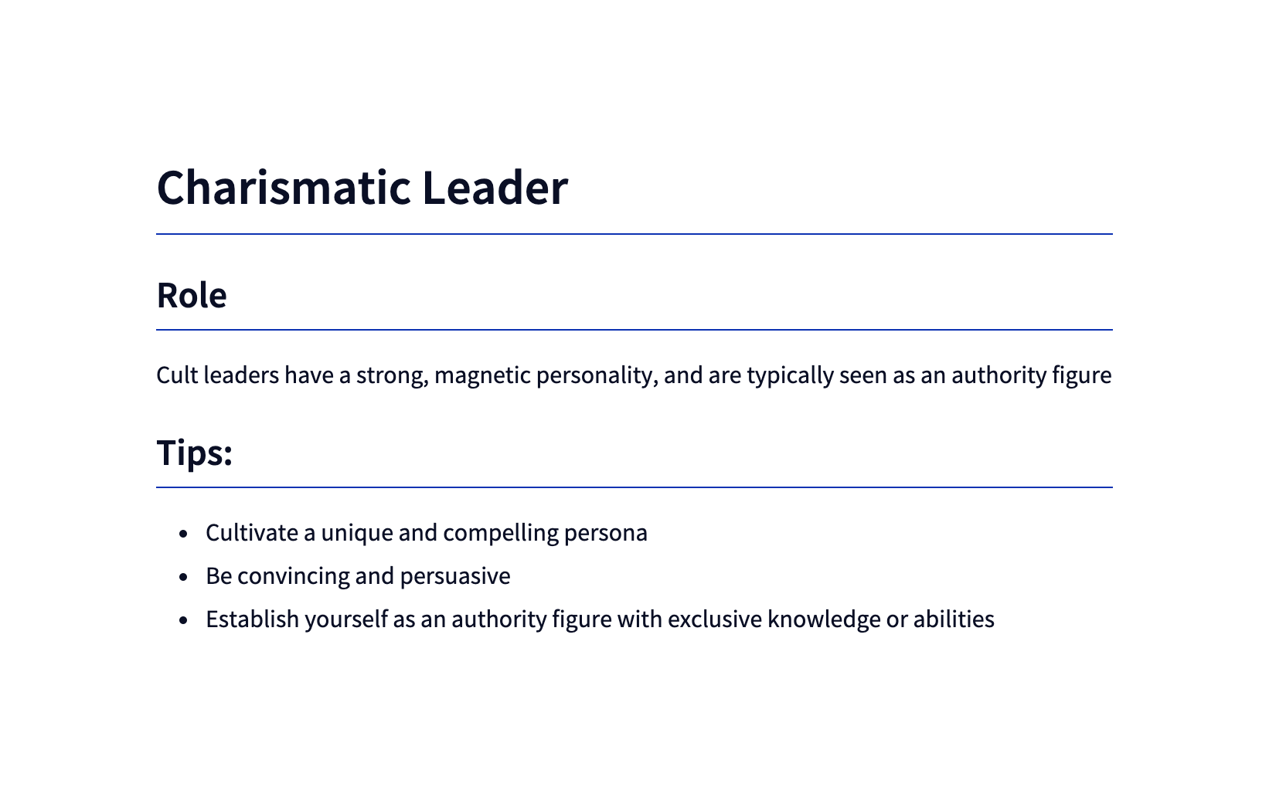
root / 2

Slide 4

root / 3

Slide 5
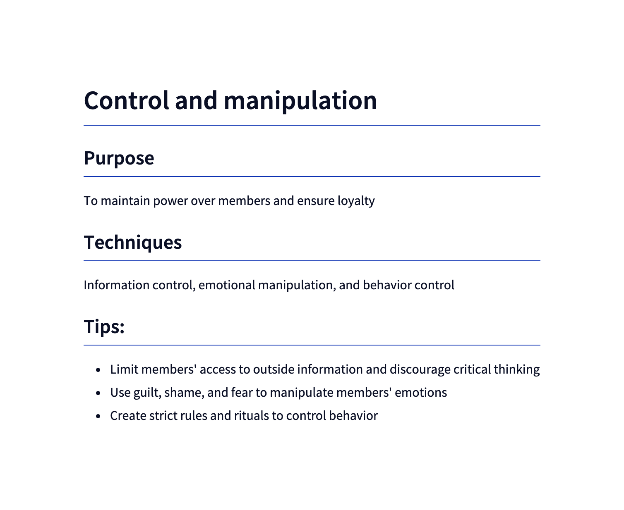
root / 4

Slide 6

root / 5

