Slide 1
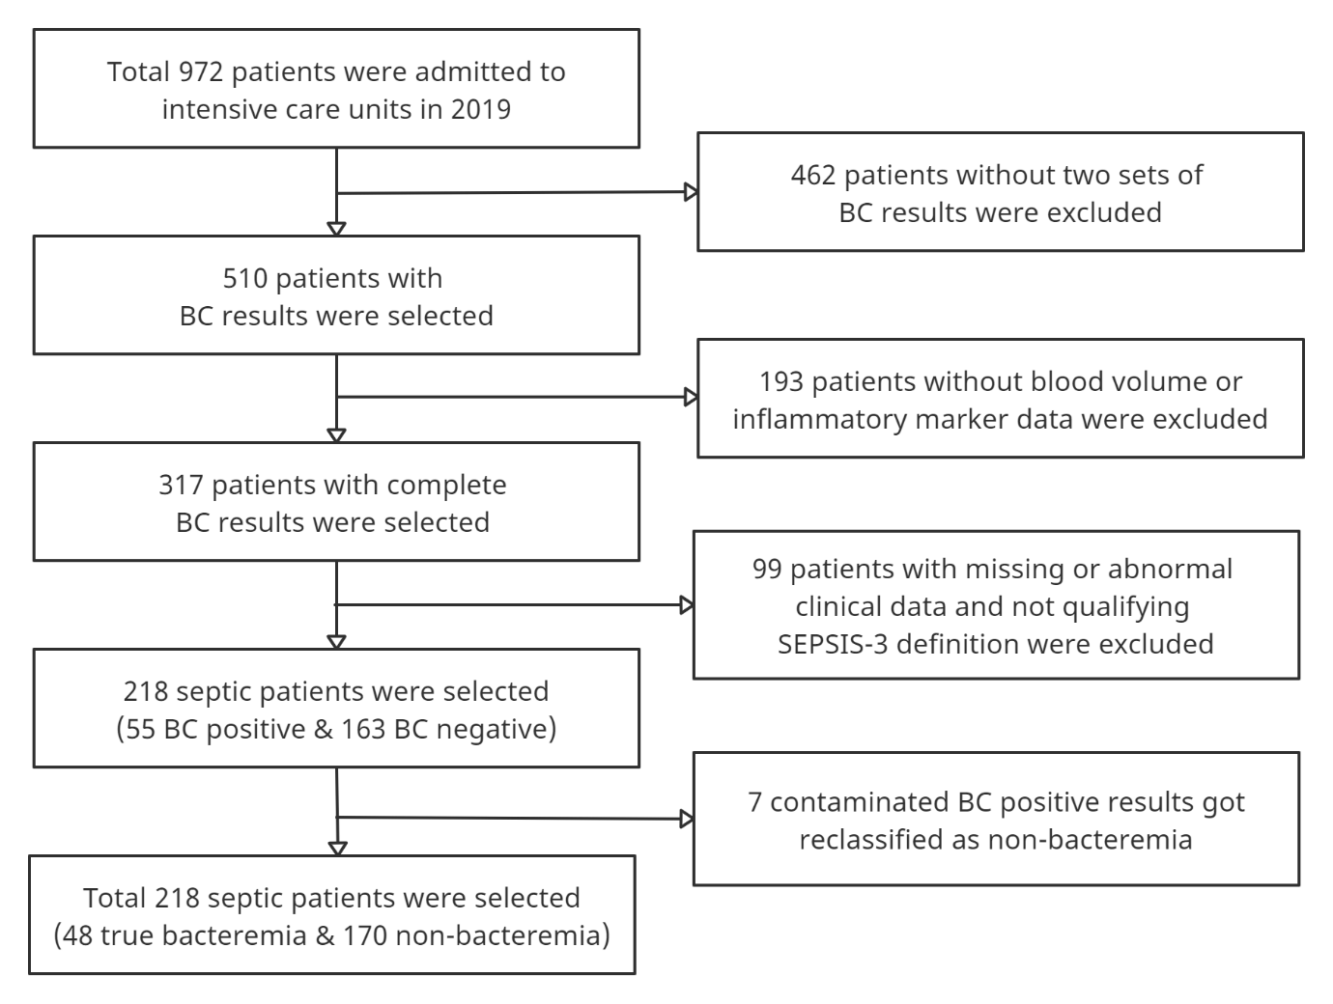
Clinical Characteristics and Laboratory Biomarkers in ICU-admitted Septic Patients
with and without Bacteremia: A Predictive Analysis
Sangwon Baek^{1,2}, Seungjun Lee¹
¹ Department of Laboratory Medicine, Gyeongsang National University Changwon Hospital – Changwon (Korea, Republic of),
² Center for Data Science, New York University (United States)
Presentation Number: Control Number 1515
Presentation Date:
June 10th, 10am-5pm
Institution: New York University
US Phone #: +1-347-819-3350
Korea Phone #: +82-10-8805-3873
Email: baeksw98@gmail.com
Introduction
Sepsis is a life-threatening disease that impairs the body’s organs and tissues
Annual mortality rate of sepsis is 15% to 30% globally
Mortality rate of septic patients particularly rises with the onset of bacteremia
Early and customized therapy can substantially reduce mortality of bacteremic sepsis patients
Diagnosis through laboratory biomarkers can significantly save time
Evaluated diverse biomarkers to optimize the prediction power of the multivariable logistic regression model
Methods
A retrospective cross-sectional study
All hospitalized septic patients admitted to intensive care units in 2019 were included
Of 218 patients, 48 were true bacteremia and 170 were non-bacteremia
Blood culture testing was the gold standard for determining bacteremic/non-bacteremic patients
False-positive results of blood culture were reclassified by the evaluation of a medical doctor
SEPSIS-3 criteria (sequential organ failure assessment score ≥ 2) was the standard for defining septic patients
Selected worst condition of the patient within 12 hours from the time of blood culture.
Results
.
References
.
Conclusions
Table 1. Baseline characteristics of patients
 | Total patients (N=218) | True bacteremia (N=48) | Non-bacteremia (N=170) | P
Patient Characteristics
Age (years) | 68 [56–77] | 65 [55–76] | 68 [57–78] | 0.529
Male sex, n (%) | 140 [64.2%] | 33 [68.8%] | 107 [62.9%] | 0.568
Body temperature (°C) | 36.6 [36.3–37.1] | 37.0 [36.2–37.4] | 36.6 [36.3–37.0] | 0.066
28-day mortality (%) | 67 [30.7%] | 21 [43.8%] | 46 [27.1%] | 0.042
Prior antibiotics (%) | 78 [35.8%] | 14 [29.2%] | 64 [37.6%] | 0.362
Laboratory Findings
Blood culture bottle volume (ml) | 5.9 [4.8–7.6] | 5.8 [5.1–7.6] | 5.9 [4.6–7.6] | 0.455
PaO₂/FiO₂ (mmHg) | 210 [135–334] | 229 [134–353] | 208 [135–317] | 0.670
Mean arterial pressure (mmHg) | 68 [60–79] | 62 [57–71] | 70 [62–79] | 0.001
Serum sodium (mmol/L) | 136.4 [133.2–139.8] | 133.8 [129.0–137.3] | 137.0 [134.2–140.3] | 0.001
GCS score (3-15) | 6 [3–13] | 4 [3–9] | 7 [3–14] | 0.016
Neutrophil-lymphocyte ratio | 10.0 [4.7–17.8] | 18.2 [8.3–36.6] | 8.7 [4.3–14.8] | <0.001
Creatinine (mg/L) | 1.04 [0.68–1.89] | 1.94 [1.02–3.06] | 0.96 [0.67–1.57] | <0.001
Lactic acid (mmol/L) | 2.2 [1.1–5.6] | 3.2 [1.9–9.4] | 1.9 [1.1–3.9] | 0.001
Bilirubin (mg/dL) | 0.86 [0.56–1.42] | 1.40 [0.85–2.10] | 0.77 [0.50–1.18] | <0.001
Aspartic aminotransferase (U/L) | 48.0 [31.5–110.0] | 85.0 [39.5–206.0] | 44.0 [28.5–87.0] | 0.001
Platelets (10³/ml) | 183 [103–265] | 111 [69–171] | 203 [127–276] | <0.001
Blood urea nitrogen (mg/dL) | 22.9 [16.5–37.4] | 35.0 [23.4–56.0] | 19.9 [14.8–33.3] | <0.001
White blood cell (cells/mm³) | 12.5 [7.8–18.1] | 13.4 [6.3–20.8] | 12.5 [8.0–18.1] | 0.865
Hematocrit (%) | 33 [29–38] | 34 [29–36] | 33 [29–38] | 0.453
Erythrocyte sedimentation rate (mm/hr) | 27 [9–53] | 43 [18–59] | 26 [7–51] | 0.039
C-reactive protein (mg/L) | 86.8 [17.0–170.6] | 192.1 [90.4–259.5] | 67.9 [14.4–139.9] | <0.001
Procalcitonin (ng/ml) | 0.37 [0.08–3.68] | 14.31 [3.00–45.51] | 0.22 [0.04–1.09] | <0.001
Pitt bacteremia score (0-14) | 4 [2–6] | 6 [3–6] | 4 [2–6] | 0.165
APACHE II score (0-71) | 20 [15–25] | 25 [18–30] | 19 [15–24] | <0.001
SOFA score (0-24) | 10 [7–12] | 12 [9–16] | 9 [6–11] | <0.001
Medical History
Diabetes mellintus (%) | 71 [32.6%] | 17 [35.4%] | 54 [31.8%] | 0.762
Hypertension (%) | 107 [49.1%] | 22 [45.8%] | 85 [50.0%] | 0.729
Heart failure (%) | 29 [13.3%] | 3 [6.2%] | 26 [15.3%] | 0.165
Cerebrovascular disease (%) | 34 [15.6%] | 7 [14.6%] | 27 [15.9%] | 0.995
Renal disease (%) | 27 [12.4%] | 5 [10.4%] | 22 [12.9%] | 0.825
Liver disease (%) | 14 [6.4%] | 6 [12.5%] | 8 [4.7%] | 0.107
Chronic obstructive pulmonary disease (%) | 16 [7.3%] | 2 [4.2%] | 14 [8.2%] | 0.521
Known neoplasm (%) | 24 [11.0%] | 8 [16.7%] | 16 [9.4%] | 0.247
Suspected Source of Infection
Catheter-related bloodstream infection (%) | 4 [1.8%] | 1 [2.1%] | 3 [1.8%] | >0.999
Intra-abdominal infection (%) | 17 [7.8%] | 9 [18.8%] | 8 [4.7%] | 0.004
Respiratory tract infection (%) | 155 [71.1%] | 21 [43.8%] | 134 [78.8%] | 0.003
Skin and soft tissue infection (%) | 8 [3.7%] | 2 [4.2%] | 6 [3.5%] | >0.999
Urinary tract infection (%) | 33 [15.1%] | 17 [35.4%] | 16 [9.4%] | <0.001
Others (%) | 9 [4.1%] | 6 [12.5%] | 3 [1.8%] | 0.004
Fever of unknown origin (%) | 6 [2.8%] | 1 [2.1%] | 5 [2.9%] | >0.999
Fig 1. Patient enrollment flowchart
 | Cut-off | AUC | Sensitivity | Specificity | PPV | NPV | LR + | LR - | DOR | P
MLR model* |  | 0.907 [0.843–0.956] | 87.9% [74.5–96.6] | 86.6% [78.8–96.0] | 59.7% | 96.6% | 5.25 | 0.13 | 41.81 | <0.001
PCT (ng/ml) | 3.18 | 0.845 [0.771–0.907] | 77.3% [64.4–88.9] | 87.2% [79.1–92.5] | 63.2% | 92.5% | 6.07 | 0.29 | 21.29 | <0.001
CRP (mg/L) | 164.3 | 0.757 [0.670–0.833] | 63.8% [48.8–84.2] | 84.2% [59.5–90.9] | 51.7% | 88.8% | 3.79 | 0.45 | 8.45 | <0.001
SOFA score (0-24) | 13 | 0.734 [0.650–0.814] | 60.8% [38.5–92.2] | 80.4% [41.3–93.2] | 50.0% | 85.5% | 3.54 | 0.6 | 5.88 | <0.001
Bilirubin (mg/dL) | 0.97 | 0.733 [0.647–0.809] | 70.9% [42.1–91.1] | 69.1% [45.3–93.2] | 37.2% | 89.5% | 2.1 | 0.41 | 5.07 | <0.001
BUN (mg/dL) | 19.2 | 0.712 [0.624–0.791] | 82.7% [47.3–96.0] | 57.4% [41.5–89.9] | 31.9% | 94.0% | 1.66 | 0.23 | 7.29 | <0.001
NLR | 14.26 | 0.709 [0.612–0.798] | 65.9% [46.7–80.4] | 76.6% [66.1–88.4] | 41.0% | 88.6% | 2.46 | 0.46 | 5.39 | <0.001
Platelets (10³/ml) | 168 | 0.707 [0.616–0.793] | 77.8% [56.2–91.3] | 63.5% [50.3–80.1] | 36.4% | 89.9% | 2.02 | 0.4 | 5.1 | <0.001
Creatinine (mg/L) | 1.86 | 0.702 [0.619–0.780] | 61.0% [46.2–88.5] | 81.8% [50.9–88.3] | 48.2% | 87.0% | 3.3 | 0.53 | 6.25 | 0.005
APACHE II score (0-71) | 24 | 0.673 [0.573–0.766] | 56.2% [34.0–79.5] | 78.6% [51.7–93.1] | 37.8% | 86.1% | 2.16 | 0.57 | 3.77 | <0.001
Na (mmol/L) | 133.4 | 0.662 [0.568–0.750] | 54.8% [32.6–87.0] | 79.2% [42.4–93.3] | 40.7% | 84.9% | 2.43 | 0.63 | 3.86 | 0.004
Lactic acid (mmol/L) | 6.1 | 0.657 [0.564–0.741] | 64.6% [34.6–91.8] | 64.3% [33.7–90.0] | 41.7% | 83.5% | 2.53 | 0.7 | 3.62 | 0.008
AST (U/L) | 62 | 0.655 [0.562–0.742] | 65.0% [41.7–89.8] | 67.2% [36.0–84.8] | 34.1% | 86.6% | 1.83 | 0.55 | 3.34 | 0.015
MAP (mmHg) | 67.3 | 0.653 [0.562–0.742] | 68.4% [42.4–87.3] | 63.1% [41.1–83.0] | 32.4% | 87.1% | 1.69 | 0.53 | 3.22 | 0.003
GCS score (3-15) | 10 | 0.611 [0.526–0.694] | 79.6% [50.0–93.8] | 43.8% [25.4–70.6] | 27.5% | 88.2% | 1.34 | 0.48 | 2.82 | 0.017
ESR (mm/hr) | 41 | 0.597 [0.503–0.690] | 59.6% [29.4–89.2] | 67.4% [31.8–90.3] | 32.9% | 84.6% | 1.74 | 0.65 | 2.69 | 0.029
Abbreviations: BC, blood culture; SOFA, sequential organ failure

