Slide 1


Early Triaging Support System for Hospitalized COVID-19 Patients: a Machine-Learning based Severity Prediction Model using Nationwide Multi-Center Real World Data
S.W. Baek*, Y.J. Jeong, Y.H. Kim, Y.S. Kwon, J.H. Kim, Y.J. Kim, J.K. Lim, J.O. Kim, M.J. Chung**, K. Kim**
June 13th. 2023
Medical AI Research Center
MARS Team #1
SMC Medical AI Research Center
1
Notes:
안녕하세요, AI 연구 센터 백상원 입니다. 저는 국내 20개 기관으로부터 수집한 multi-center real world data를 활용하여 코로나 바이러스 중증도 예후예측 모델을 개발하였습니다. 이 연구의 주요 목적은 코로나 환자 입원 시 중증도 기반의 조기 분류를 통해 효율적인 의료 자원 배분과 치료를 지원하는것입니다. 본 발표를 통해서, 저희 모델에 대해 임상 전문가 관점에서의 임상 활용 가능성과 유효성에 대한 다양한 피드백을 받아보고자 준비하였습니다. 특히, 저희의 예후예측 모델이 이 실제 의료현장에서 어떠한 가치를 창출할 수 있는지에 대해 의견 있으시다면 공유해주시면 감사하겠습니다.

Slide 2
Research Strengths
Engineering Strength
1. Robust Prediction Power
IV AUROC scores: 0.891 [0.889-0.892]
EV AUROC scores : 0.937 [0.935-0.938]
2. High Model Calibration
Integrated Calibration Index score: 0.004
3. Model Stability
Maintained high performance without implementing data-level nor algorithmic-level interventions
3. Model Generalizability
Geographically distributed hospital sites and its sizes covering most areas and types (general & tertiary care) in South Korea
Wide temporal distributions in cases spanning three-year pandemic period
4. Prompt and Easy Feature Accessibility
Used 11 clinical and laboratory features obtainable within few hours upon hospitalization
6. Model Transportability
EV AUROC scores on Omicron cases : 0.903 [0.897-0.910]
*Applied ensemble learning (AlphaOmicron + DeltaOmicron + Omicron)
Clinical Strength
1. Visualization of Patient Clusters
Graphically visualized the patient clusters according to the presentations of clinical and laboratory features using DDR Tree plot
On top of computing risk score, such cluster analysis allow the clinicians to incorporate more comprehensive aspects during decision-making process
2. Feature Importance Ranking
Numerically presented the marginal feature contribution to severity prediction using SHAP summary plot
3. Decision Curve Analysis
Evaluated the net benefit of incorporating our model into clinical decision-making practice in comparison to two reference strategies: ‘intervention for all’ and ‘intervention for non’
MARS Team #1
SMC AI Research Center
2
Notes:
이 slide를 잘 꾸며서 처음 어떤 강점들이 있는지 얘기하고 넘어갈것.
Patient Flow Chart 생성해야하고

Slide 3
Main Figures & Tables
MARS Team #1
SMC Medical AI Research Center
3
Notes:
Q&A

Slide 4
Figure 1. Development and validation cohort generation and partitioning
Adult patients confirmed with COVID-19 by RT-PCR
who were hospitalized at 19 institutions during 2020-2022
(n = 9,199)
3,254 Patients excluded:
1) 406 Patients diagnosed either more than 15 days before or more than 1 day after hospitalization date
2) 2848 Patients with missing data in any variable of interest
Complete-case patients used for prediction modeling
(n = 5,945)
Development and validation cohort construction by stratified random cluster sampling
from four strata divided according to hospital type and geographical location
3 General hospitals in metropolitan area
(n = 747)
3 General hospitals in non-metropolitan area
(n = 260)
6 Tertiary hospitals in metropolitan area
(n = 1,385)
7 Tertiary hospitals in none-metropolitan area
(n = 3,553)
Development hospitals
D1, D2 (n = 593)
9 Severe Patients
584 Non-Severe Patients
Validation hospital
V1 (n = 154)
47 Severe Patients
107 Non-Severe Patients
Development hospitals
D3, D4 (n = 218)
34 Severe Patients
184 Non-Severe Patients
Validation hospital
V2 (n = 42)
14 Severe Patients
28 Non-Severe Patients
Development hospitals
D5, D6, D7, D8, D9 (n = 1,081)
332 Severe Patients
749 Non-Severe Patients
Validation hospital
V3 (n = 304)
89 Severe Patients
215 Non-Severe Patients
Development hospitals
D10, D11, …, D15 (n = 2,127)
230 Severe Patients
1,897 Non-Severe Patients
Validation hospital
V4 (n = 1,426)
84 Severe Patients
1,342 Non-Severe Patients
Development Cohort (n = 4,019)
D1, D2, …, D15
605 Severe Patients
3,414 Non-Severe Patients
Validation Cohort (n = 1,926)
V1, V2, V3, V4
234 Severe Patients
1,692 Non-Severe Patients
RT-PCR=real-time polymerase chain reaction.
4
Notes:
Development – Validation
Patient Flow Chart 생성 (논문 참고)

Slide 5

Figure 2. Machine learning-based Pipeline for COVID prognosis prediction
A) Candidate Feature Subsets Identification
Feature Importance Evaluation Generate importance rankings for all readily-available features via each of six ML-based feature engineering methods (FEMs)
RF-MDIFI
RF-PFI
RF-Shapley
XGB-MDIFI
XGB-PFI
XGB-Shapley
Candidate Feature-Subset Identification Iterate the following steps (K = 5, 6, …, 15):
Step 1) Select top K high-ranked features by each of all FEMs
Step 2) Identify all subsets of robust features that are stably-selected as top K rankers by at least 50% of all FEMs (i.e., selection probability ≥ 50%)
B) Model Development and Evaluation with Feature Selection
DNN
Hyperparameter Tuning
Internal Validation
External Validation
Final Model Selection
MLR
Use a Bayesian optimization technique
to optimize the hyperparameters of each ML-based algorithm
Perform 5 iterations of stratified 5-fold cross-validation on the development cohort
Explore the validity of development processes using AUROC score & other performance metrics
Conduct 100 iterations of stratified random bootstrapped sampling on the external validation cohort
Compare the performance of models using AUROC score & other metrics
Determine 3 best models with optimal feature subsets based on their performances in both internal & external validations
Choose the final model based on clinical experts’ opinion on clinical usefulness
RF
Candidate Feature Subsets
XGB
GBM
RF-MDIFI=random forest based mean decrease in Gini Impurity feature importance method. RF-PFI=random forest based permutation feature importance method. RF-Shapley=random forest based Shapley method. XGB-BFI=eXtreme gradient Boosting based built-in feature importance method. XGB-PFI=eXtreme gradient Boosting based permutation feature importance method. XGB-Shapley=eXtreme gradient Boosting based Shapley method. RF=random forest. MLR=multivariable logistic regression. DNN=deep neural network. XGB=eXtreme gradient Boosting. GBM=gradient boosting machine. SVM=support vector machine. AUROC=area under receiver operating characteristic curve. ROC=receiver operating characteristic curve. NRI=net-reclassification improvement. DCA=decision curve analysis. SHAP=Shapley Additive exPlanations.
SVM
C) Model Performance Visualization and Feature Interpretation
ROC Curves
Calibration Plots
DCA Plots
Reclassification Plots
SHAP Summary Plots
Evaluate and compare the discriminative performances of prediction models
Examine the reliability of risk prediction by assessing agreement between predictions & observations
Analyze the clinical utility of final model
in promoting better decision-making
Display the NRI of final prediction model contrasted with other comparable models
Interpret the individual feature’ contribution to prediction when incorporated into our model
D) Possible Model Application in Clinical Setting
Collect clinical and laboratory data upon admission to hospital
Compute risk scores using COVID prognosis prediction model
Support clinical decisions of the physicians in patient triaging task
Provide appropriate medical treatment to patients in urgent need
5
Notes:
B를 Step 1 Step 2 로 나눌것

Slide 6
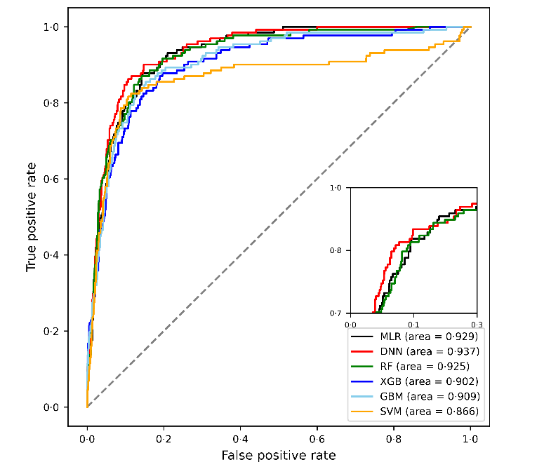
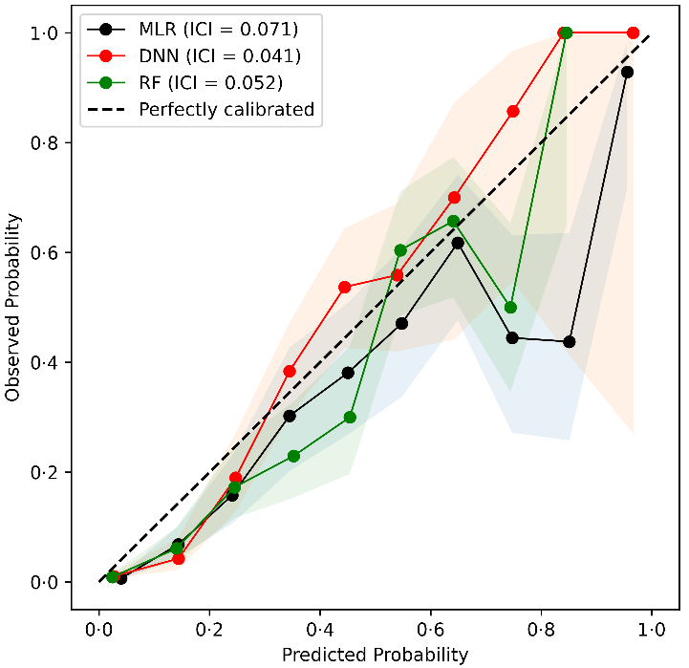
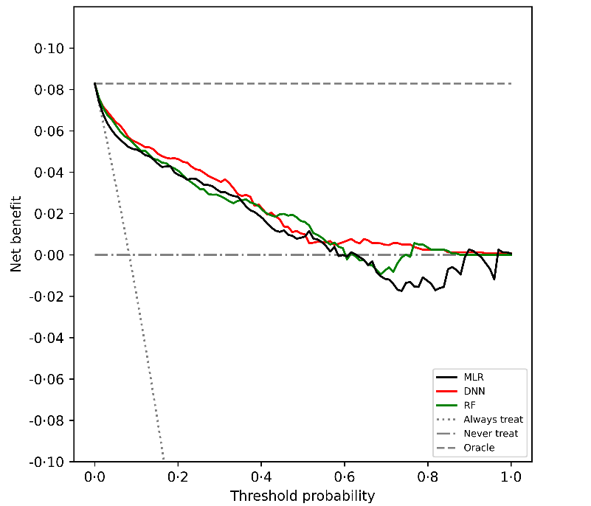
Figure 3. Performance comparisons of prediction models during external validation
(A) Receiver operating characteristic curve showing the performance of the prediction models. (B) Calibration plot displaying the correlation between predicted and observed risks of the prediction models by segmenting the cohort into 10 bins. (C) Decision curve analysis plot demonstrating the potential net benefit of applying the prediction models in clinical applications. AUROC=area under receiver operating characteristic curve. MLR=multivariable logistic regression. DNN=deep neural network. RF=random forest. XGB=eXtreme gradient boosting. GBM=gradient boosting machine. SVM=support vector machine.
A
B
C
MARS Team #1
SMC AI Research Center
6

Slide 7
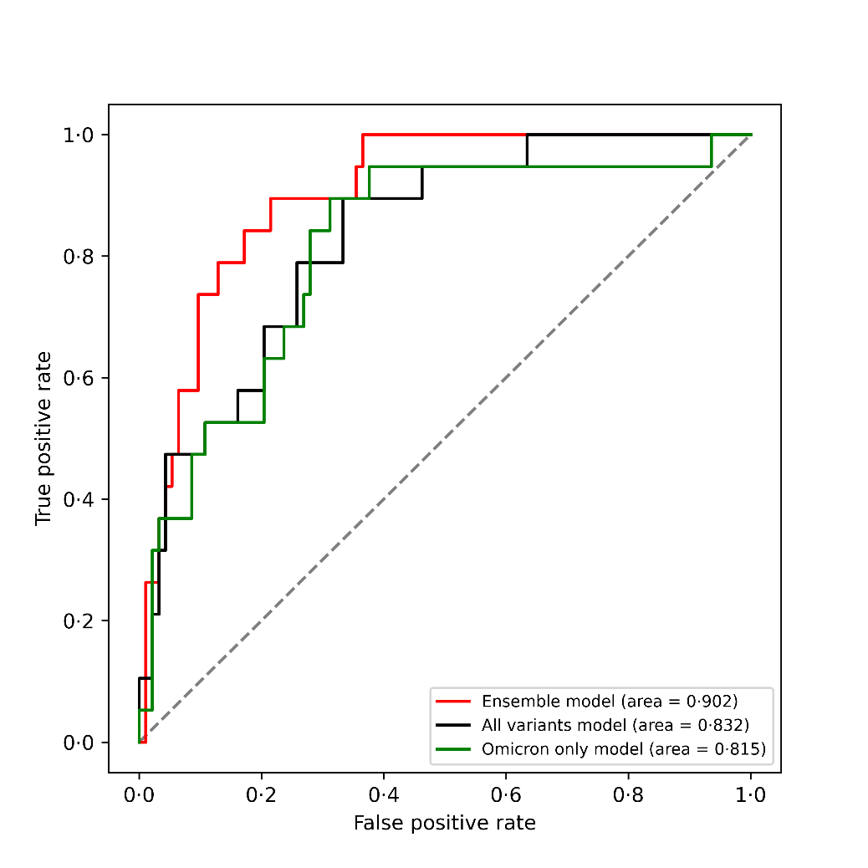
Figure 4. Performance of prediction models on omicron-variant cases
Used final prediction model (Deep neural network-based model with 11 selected features) to develop each model. Ensemble model was developed by combining the prediction probabilities of the three models trained using Alpha&Omicron, Delta&Omicron, and Omicron development cohorts; All variants model was developed by using whole development cohort; Omicron only model was developed by using only Omicron development cohort. Patient size (N): whole development cohort, 4,365 (Alpha development cohort, 2,622; Delta development cohort, 1,406; Omicron development cohort, 337); whole validation cohort, 1580 (Alpha validation cohort, 840; Delta validation cohort, 628; Omicron validation cohort, 112).
MARS Team #1
SMC AI Research Center
7

Slide 8
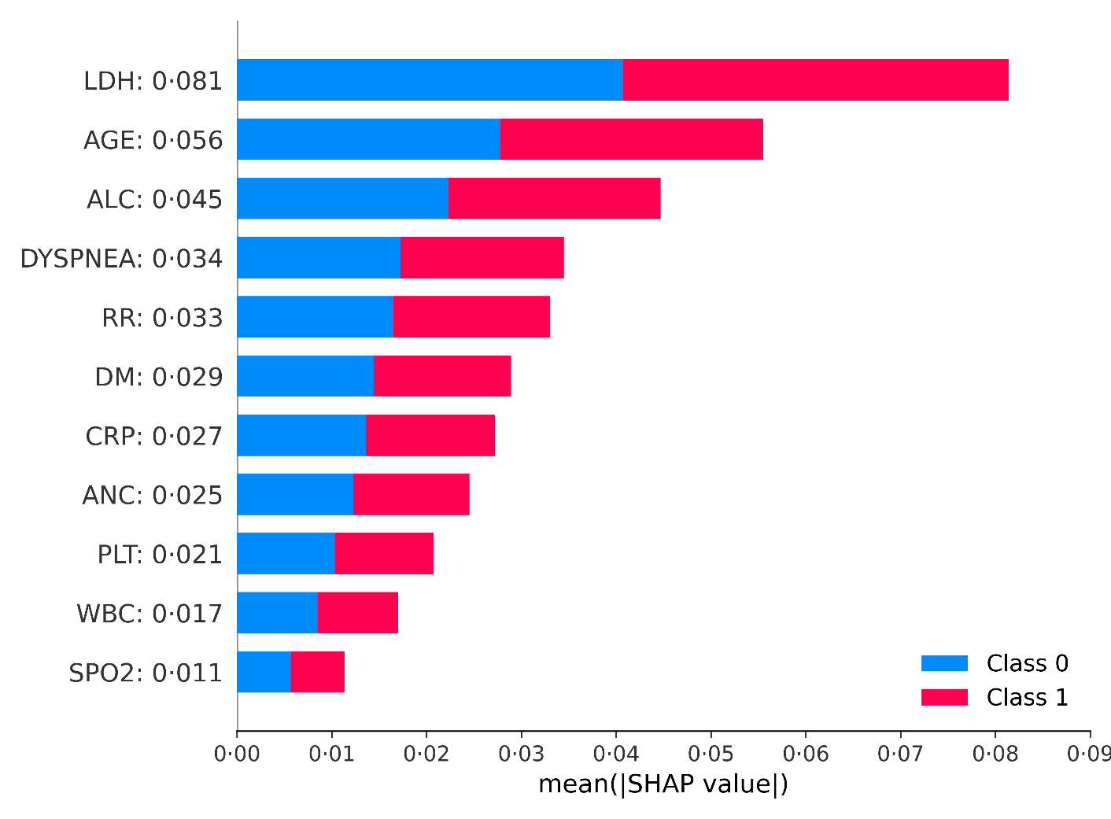
Figure 5. Average impact of selected features on severity prediction
Used final prediction model (Deep neural network-based model with 11 selected features) to construct the summary plot above. To apply DNN model when computing Shapley Additive exPlanations (SHAP) values, we properly modified KernelExplainer. LDH=lactate dehydrogenase. ALC=absolute lymphocyte count. RR=respiratory rate. DM=diabetes mellitus. CRP=c-reactive protein. ANC=absolute neutrophil count. PLT=platelet counts. WBC=white blood cell. SPO2=saturation of peripheral oxygen. *Specific SHAP values are shown on the right of each feature names in the y-label.
MARS Team #1
SMC AI Research Center
8

Slide 9
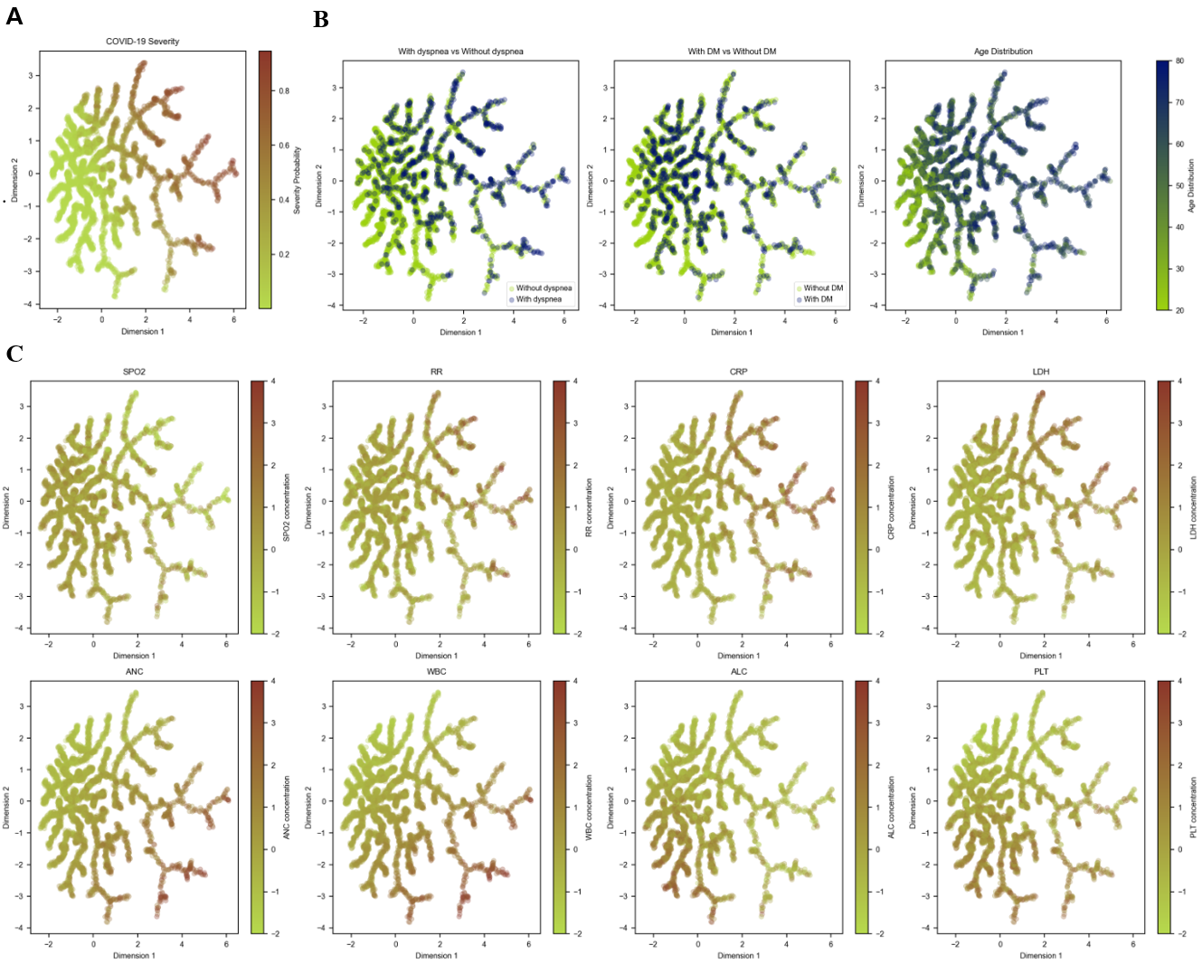
Figure 6. DDR Tree
S.W. Baek
MARS Team #1
SMC AI Research Center
9
Notes:
Identify where the segmentation between the patients occur, the clinical features associated with those segmentation reveal high correlation with their short-term outcomes (severe or non-severe)
Cluster analysis and association rule to make inference on the MDS plot

Slide 10
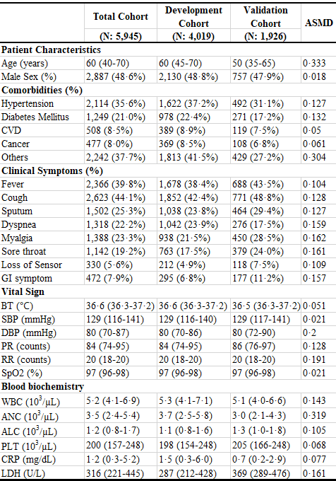
Table 1. Characteristics of patients in development and validation cohorts
Data are median (IQR) or n (%). Cohen's D was used for computing ASMD for continuous variables and Cohen's H was used for computing ASMD for categorical variables.
ASMD=absolute standardized mean difference. CVD=cardio-vascular disease. GI= gastrointestinal. BT=body temperature. SBP=systolic blood pressure. DBP=diastolic blood pressure. PR=pulse rate. RR=respiratory rate. SpO2=saturation of peripheral oxygen. WBC= white blood cell. ANC=absolute neutrophil count. ALC=absolute lymphocyte count. PLT= platelet counts. CRP=c-reactive protein. LDH=lactate dehydrogenase.
MARS Team #1
SMC AI Research Center
10

Slide 11
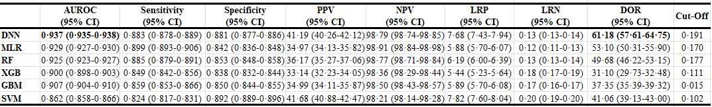
Table 2. Performance of the six prediction models during external validation
All results, 95% CIs in parentheses, were computed from bootstrapping external validation cohorts 100 times with replacements. Youden’s Index was used to determine optimal cut-off point. DNN=deep neural network. MLR=multivariable logistic regression. RF=random forest. XGB=eXtreme gradient boosting. GBM=gradient boosting machine. SVM=support vector machine. AUROC=area under receiver operating characteristic curve. PPV=positive predictive value. NPV=negative predictive value. LRP=likelihood ratio positive. LRN=likelihood ratio negative. DOR=diagnostic odds ratio.
MARS Team #1
SMC AI Research Center
11

Slide 12
Thank you for your time
Medical AI Research Center
MARS Team #1
SMC Medical AI Research Center
12
Notes:
Q&A

Slide 13
Supplementary Figures
MARS Team #1
SMC Medical AI Research Center
13
Notes:
Q&A

Slide 14
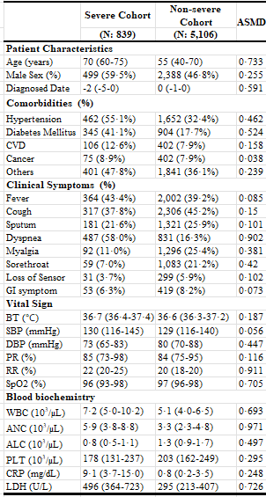
S. Table 1. Characteristics of patients in severe and non-severe cohorts
Data are median (IQR) or n (%). Cohen's D was used for computing ASMD for continuous variables and Cohen's H was used for computing ASMD for categorical variables.
ASMD=absolute standardized mean difference. CVD=cardio-vascular disease. GI= gastrointestinal. BT=body temperature. SBP=systolic blood pressure. DBP=diastolic blood pressure. PR=pulse rate. RR=respiratory rate. SpO2=saturation of peripheral oxygen. WBC= white blood cell. ANC=absolute neutrophil count. ALC=absolute lymphocyte count. PLT= platelet counts. CRP=c-reactive protein. LDH=lactate dehydrogenase.
MARS Team #1
SMC AI Research Center
14

Slide 15
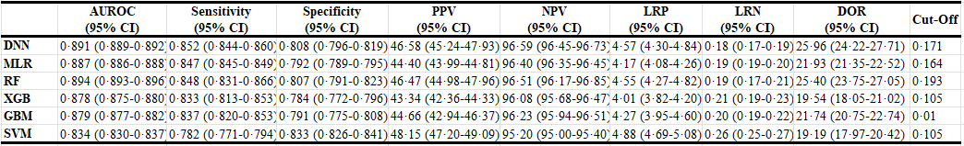
S. Table 2. Performance of the six prediction models during internal validation
All results, 95% CIs in parentheses, were computed from bootstrapping external validation cohorts 100 times with replacements. Youden’s Index was used to determine optimal cut-off point. DNN=deep neural network. MLR=multivariable logistic regression. RF=random forests. XGB=eXtreme gradient boosting. GBM=gradient boosting machine. SVM=support vector machine. AUROC=area under receiver operating characteristic curve. PPV=positive predictive value. NPV=negative predictive value. LRP=likelihood ratio positive. LRN=likelihood ratio negative. DOR=diagnostic odds ratio.
MARS Team #1
SMC AI Research Center
15

Slide 16
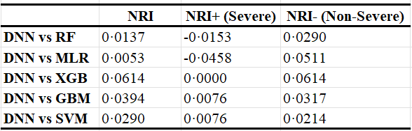
S. Table 3 Comparison in Net Reclassification Improvements among prediction models
DNN=deep neural network. MLR=multivariable logistic regression. RF=random forests. XGB=eXtreme gradient boosting. GBM=gradient boosting machine. SVM=support vector machine. NRI=net reclassification improvements.
MARS Team #1
SMC AI Research Center
16

Slide 17
S. Table 4. Performance of prediction models on omicron-variant cases during external validation
Final model is Deep Neural Network (DNN) model with 11 important variables. All results, 95% CIs in parentheses, were computed from bootstrapping external validation cohorts 100 times with replacements. Youden’s Index was used to determine optimal cut-off point. AUROC=area under receiver operating characteristic curve. PPV=positive predictive value. NPV=negative predictive value. LRP=likelihood ratio positive. LRN=likelihood ratio negative. DOR=diagnostic odds ratio.
MARS Team #1
SMC AI Research Center
17
Notes:
Table 4a (trained with all), 4b (trained independent), 4c (ensemble), 4f (transfer)만 포함시킬것
Test dataset was obtained from Samsung Medical Center (SMC), Chonnam National University Hospital (JNU), Chungnam National University Sejong Hospital (SCN), Soonchunhyang University Hospital (SCH). Abbreviations: AUROC, area under the receiver operating curve; AUPRC, area under the precision-recall curve; PPV, positive predictive value; NPV, negative predictive value; LR+, likelihood ratio positive; LR-, likelihood ratio negative; DOR, diagnostic odds ratio

Slide 18
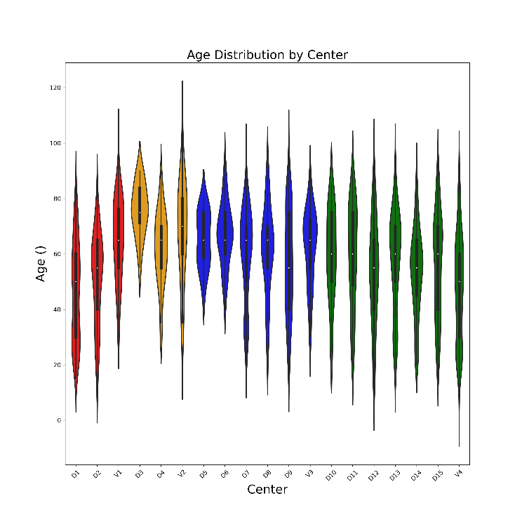
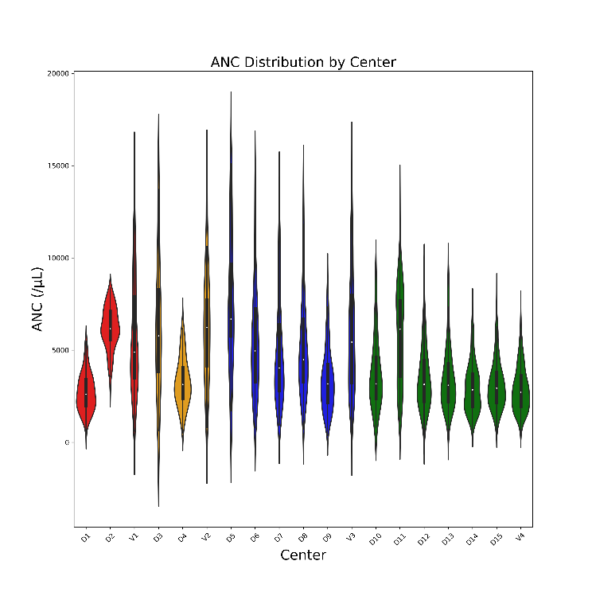
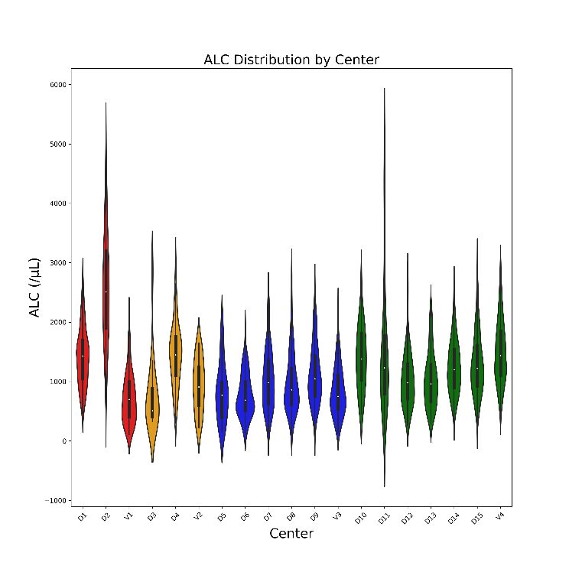
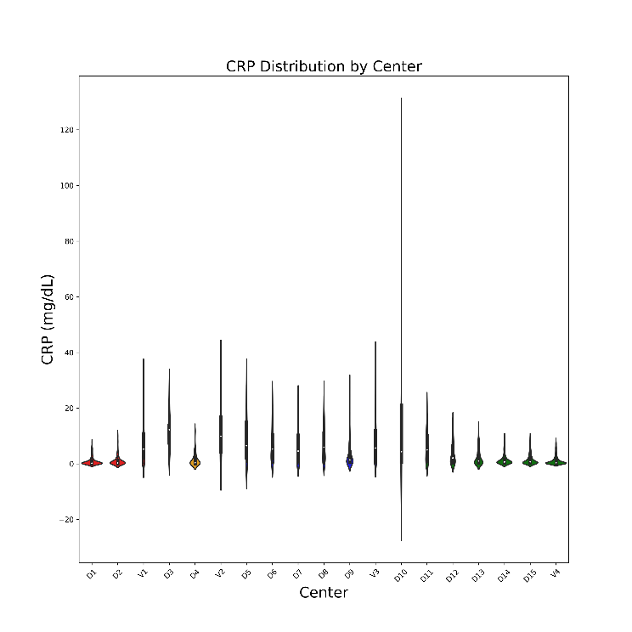
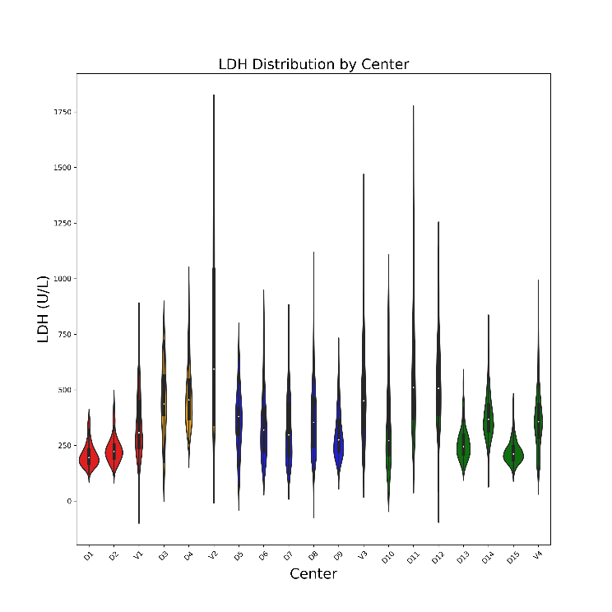
S. Figures 1. Distribution of each feature across centers
*Outliers were removed (Z-score <=3)
MARS Team #1
SMC AI Research Center
18

Slide 19
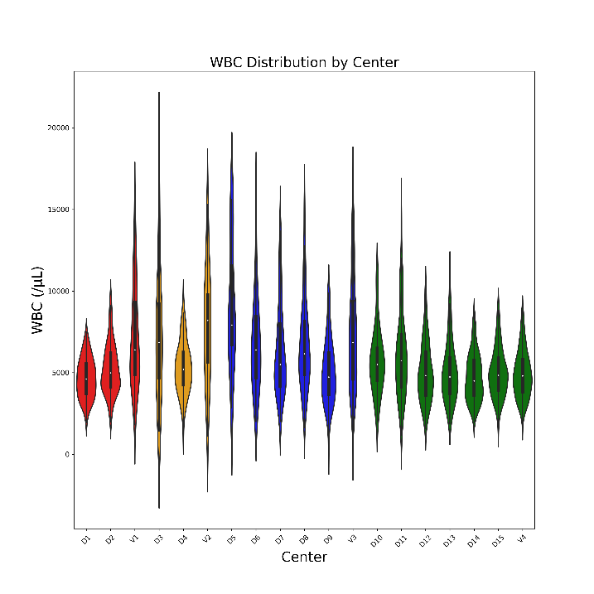
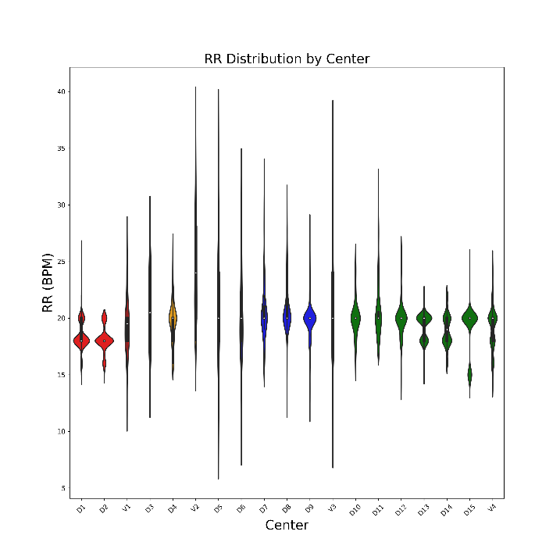
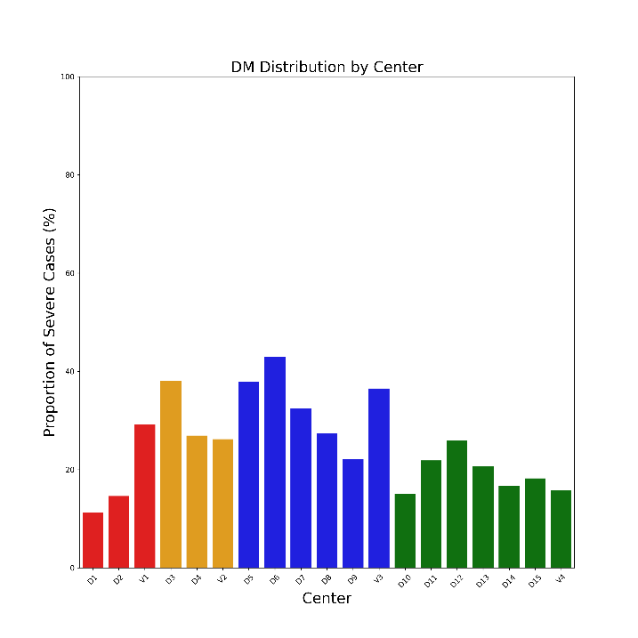
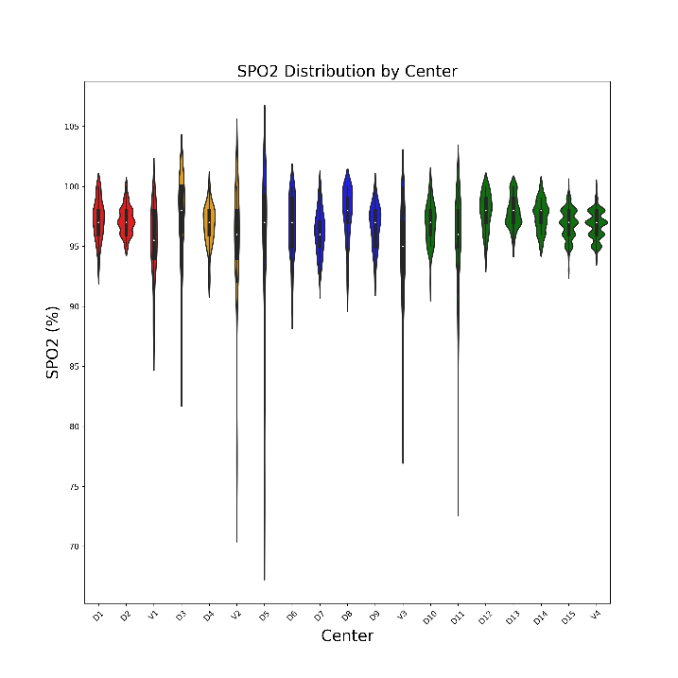
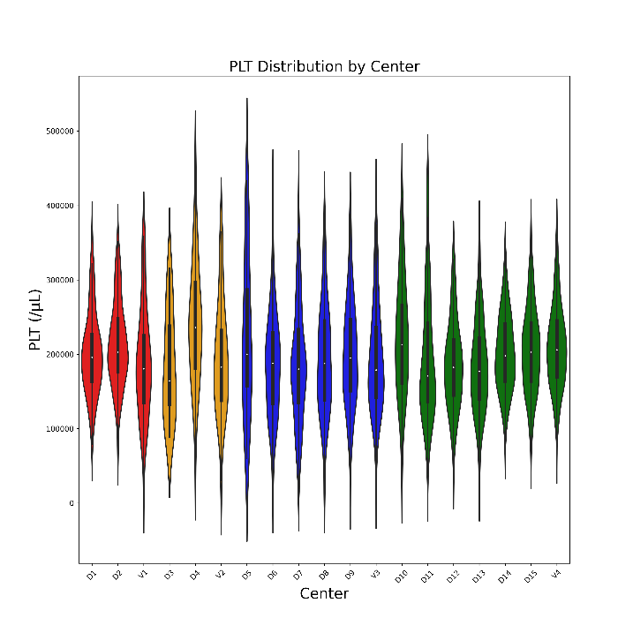
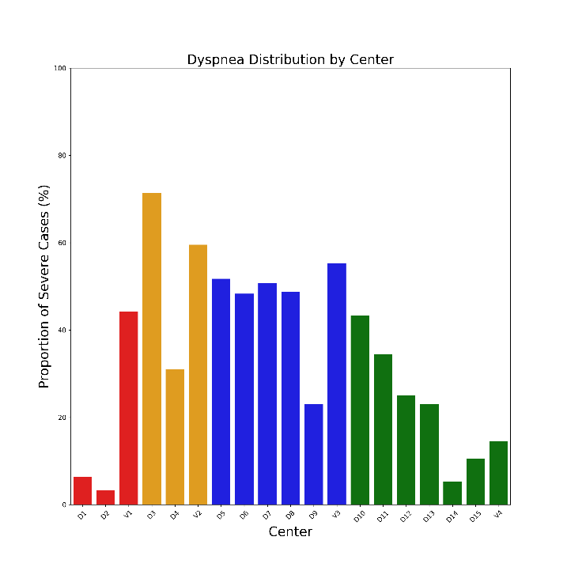
S. Figures 1. Distribution of each feature across centers (continued)
MARS Team #1
SMC AI Research Center
19

Slide 20
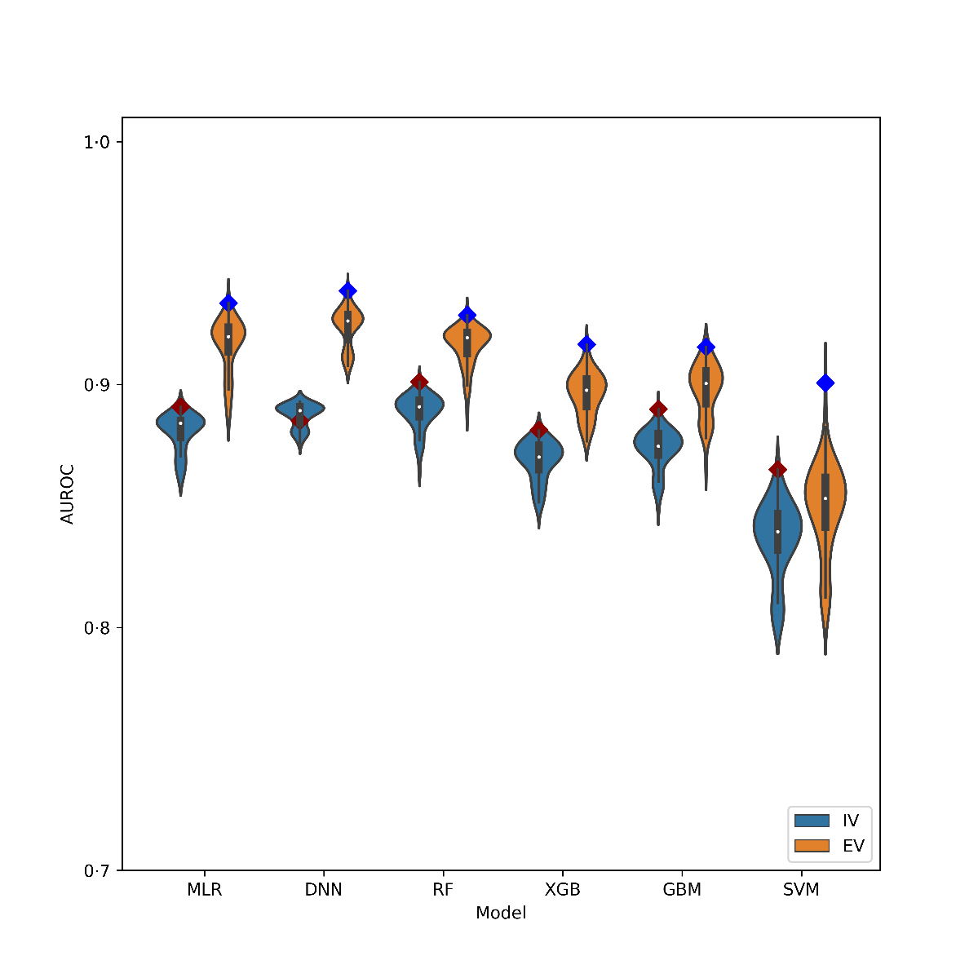
S. Figures 2. Distribution of predictive performance during internal and external validations
Distributions of mean area under receiver operating characteristic curve (AUROC) scores among prediction models for all 60 possible feature sets
MLR=multivariable logistic regression. DNN=deep neural network. RF=random forests. XGB=eXtreme gradient boosting. GBM=gradient boosting machine. SVM=support vector machine.
MARS Team #1
SMC AI Research Center
20
Notes:
0.4, 0.5도 만들어놓음

Slide 21
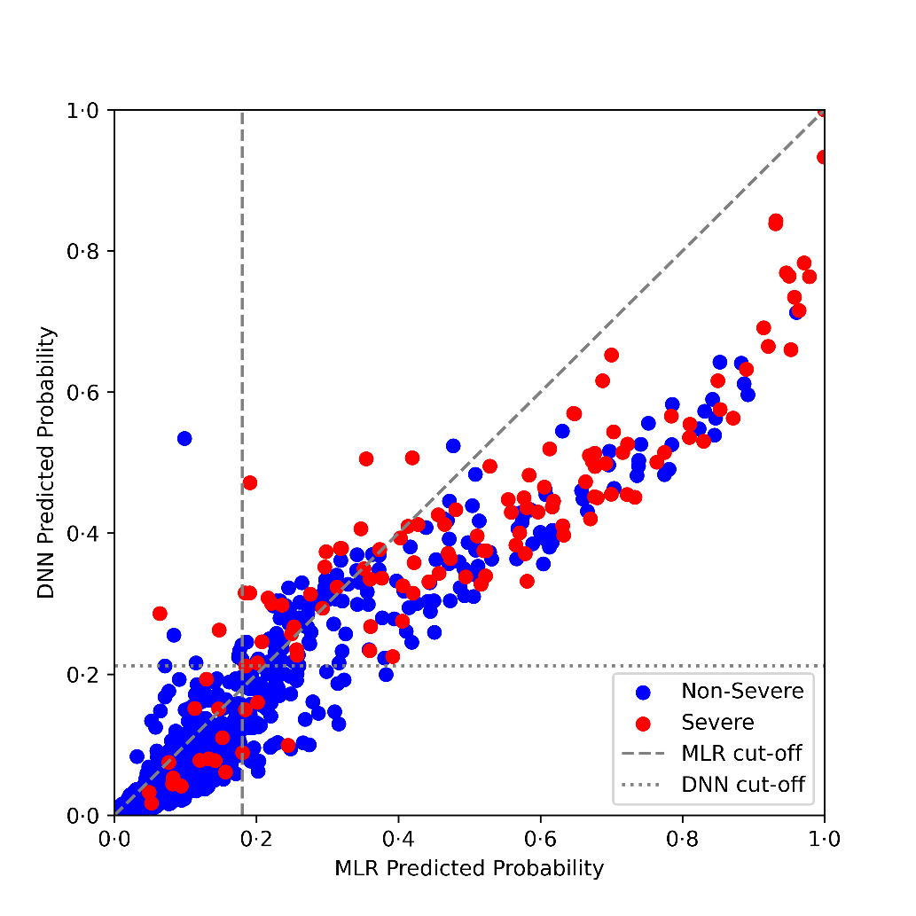
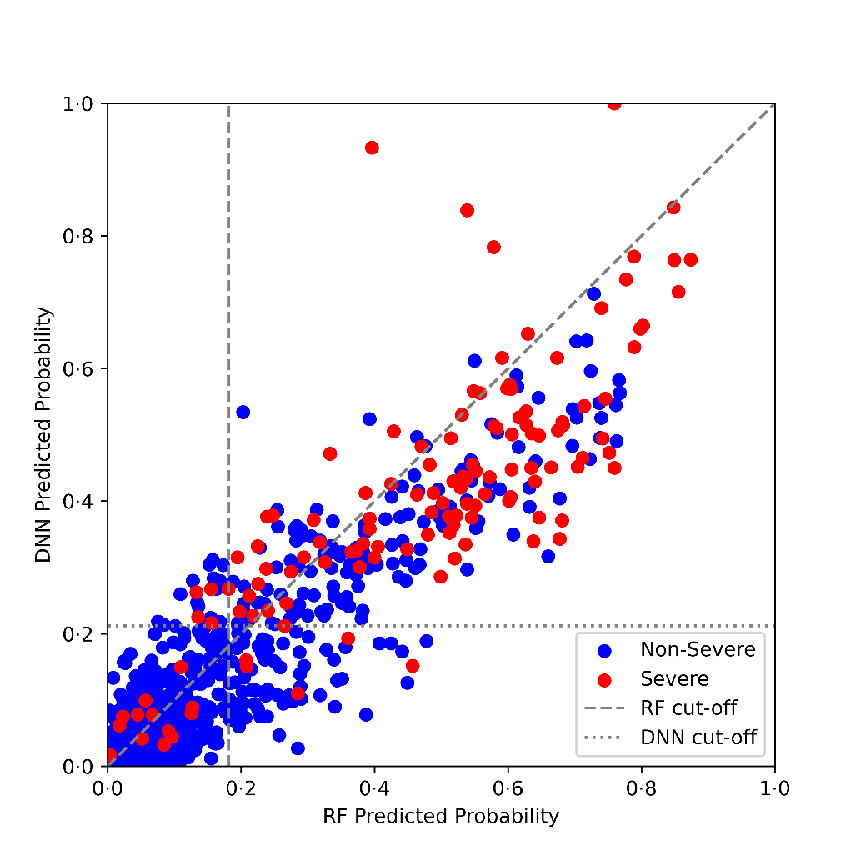
S. Figures 3. Reclassification Plots
(A) comparing the predictive performances between DNN and MLR models. (B) comparing the predictive performances between DNN and RF models. DNN=deep neural network. MLR=multivariable logistic regression. RF=random forests.
A
B
MARS Team #1
SMC AI Research Center
21
Notes:
1,4 분단에서의 해석이 필요 (Discussion Section)

Slide 22
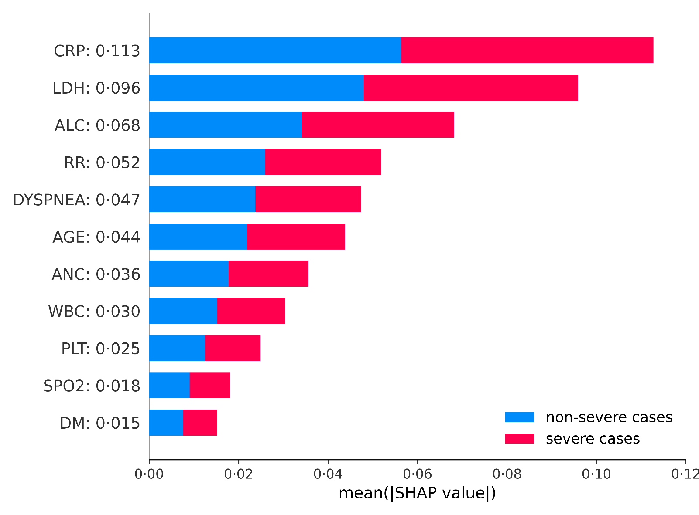
S. Figure 4. Average impact of selected features on severity prediction
Used random forest-based model with 11 selected features to construct the summary plot above. Used TreeExplainer to compute Shapley Additive exPlanations (SHAP) values. CRP=c-reactive protein. LDH=lactate dehydrogenase. ALC=absolute lymphocyte count. RR=respiratory rate. ANC=absolute neutrophil count. WBC=white blood cell. PLT=platelet counts. SPO2=saturation of peripheral oxygen. DM=diabetes mellitus. *Specific SHAP values are shown on the right of each feature names in the y-label.
MARS Team #1
SMC AI Research Center
22

Slide 23
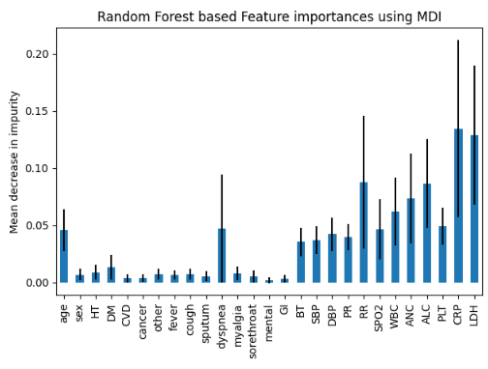
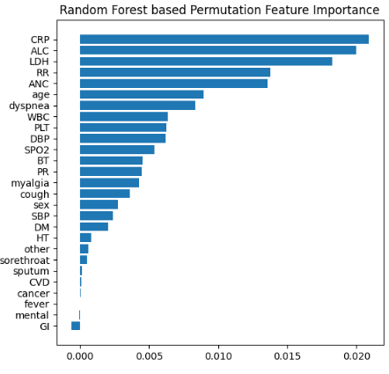
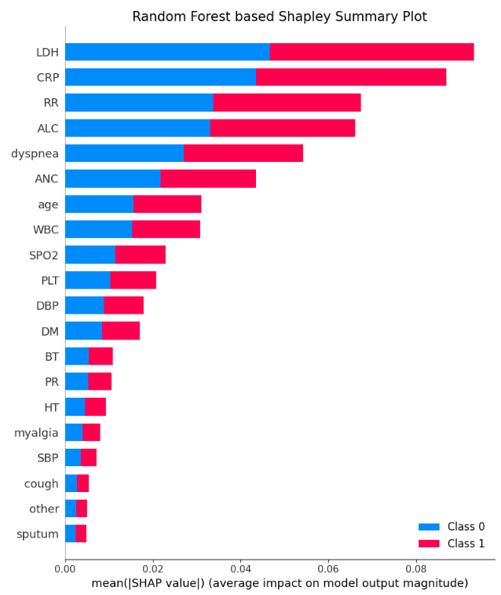
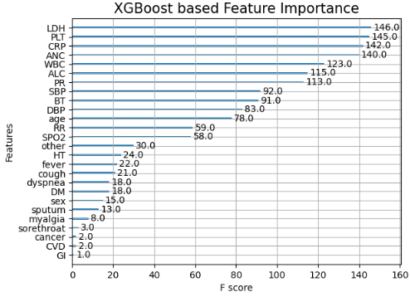
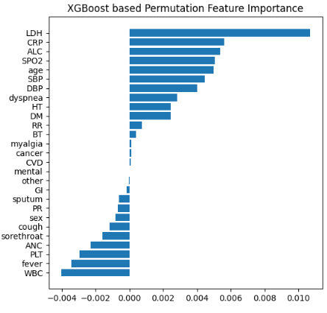
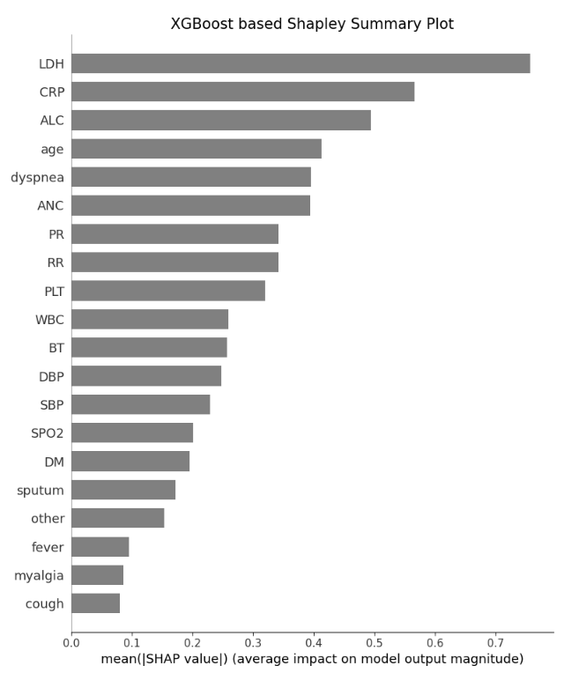
S. Figure 5. Feature engineering methods
S.W. Baek
MARS Team #1
SMC AI Research Center
23

Slide 24
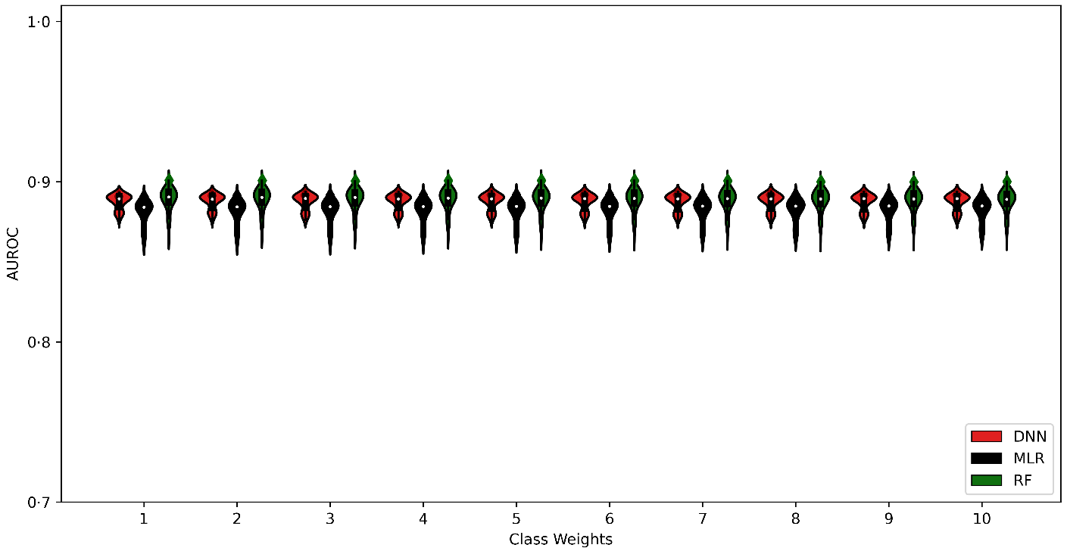
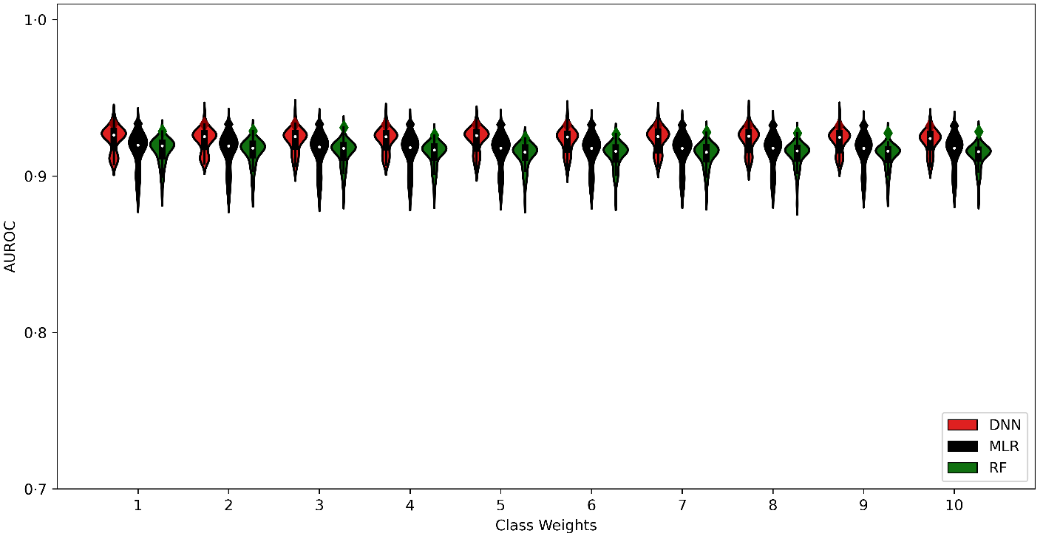
S. Figure 6. Cost sensitivity learning
S.W. Baek
A
B
MARS Team #1
SMC AI Research Center
24

Slide 25
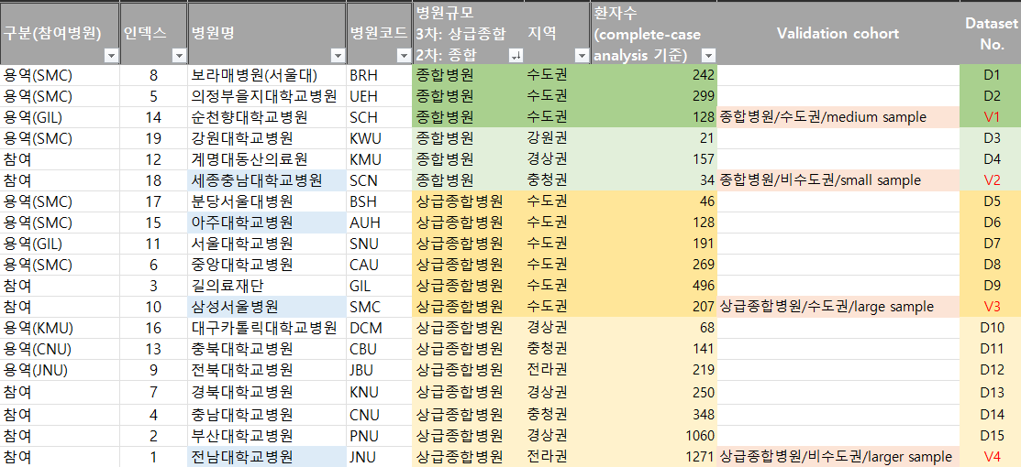
Hospital Index Code
S.W. Baek
MARS Team #1
SMC AI Research Center
25

